Slide 1




Discussion The Hawks and The Doves
What is meant by these terms?
How might we apply them to the Cold War period?

Slide 2
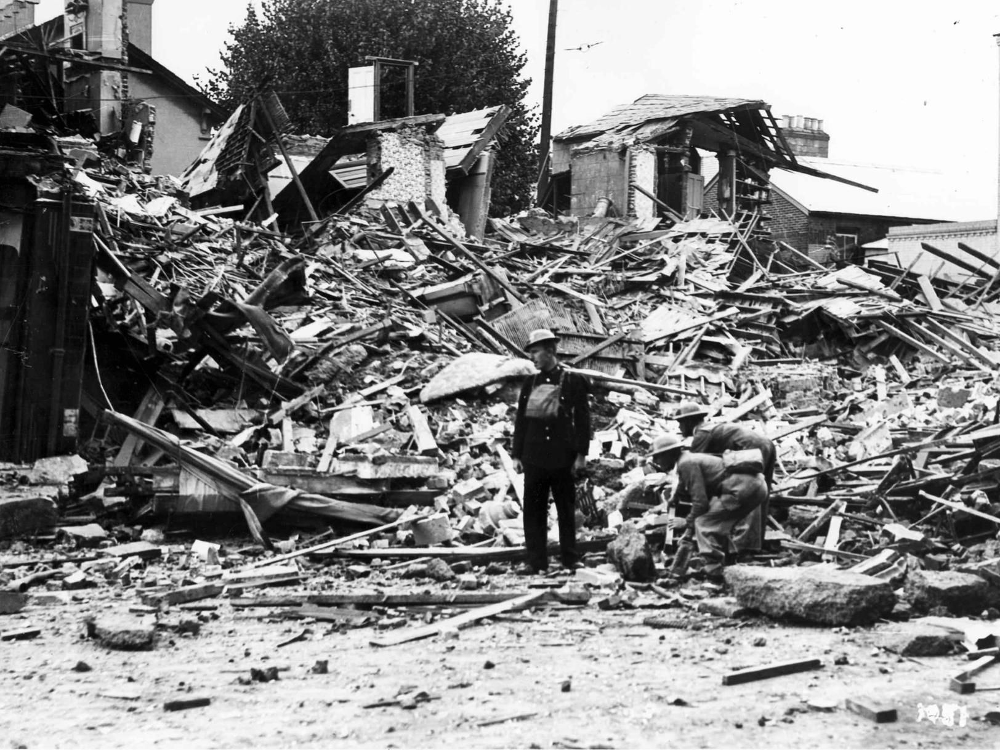
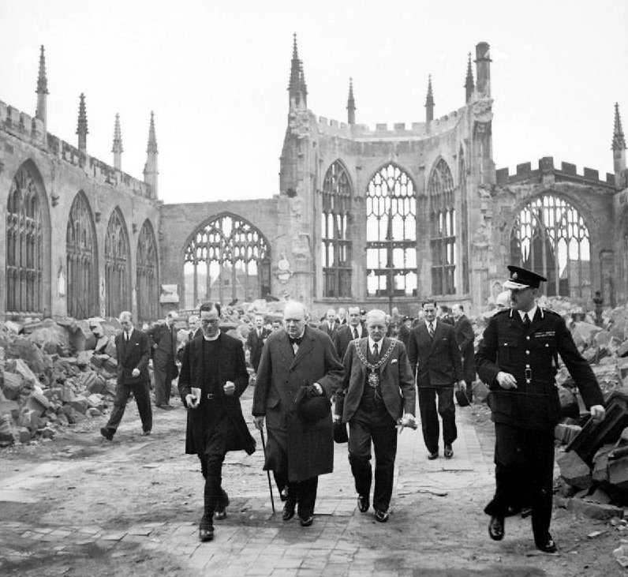
‘A Diminished State’ Governing Post-War Britain
‘The Problem’
Notes:
Britain emerged from the war battered and bruised.
Bombing of Coventry and Portsmouth

Slide 3

Clement Attlee
‘A Modest Man With Much To Be Modest About’
In the shadow of Churchill?
Sceptics in his own party
‘An old fashioned do-gooder’

Slide 4

In The Shadow of Churchill?
‘An empty cab drew up, and Mr. Attlee got out’
‘He is a sheep in sheep’s clothing’
Inherits Britain’s fervent imperialism
Notes:
Despite Attlee being a different character, he inherits reputation as an imperial power.

Slide 5
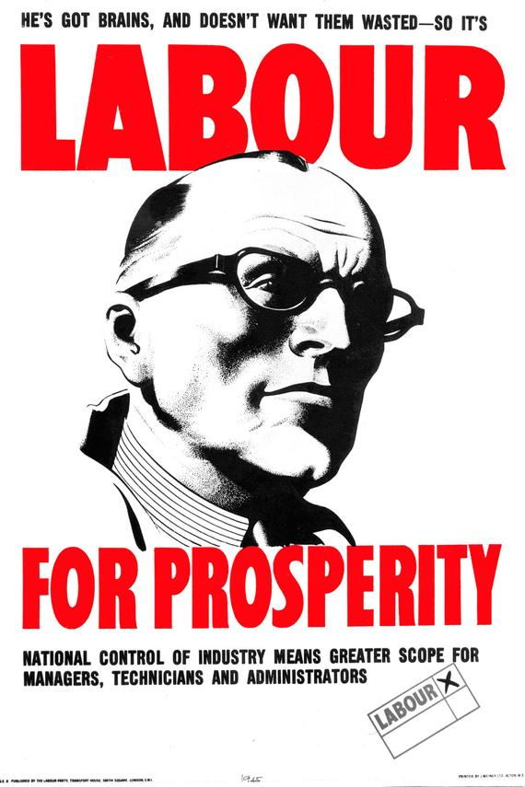
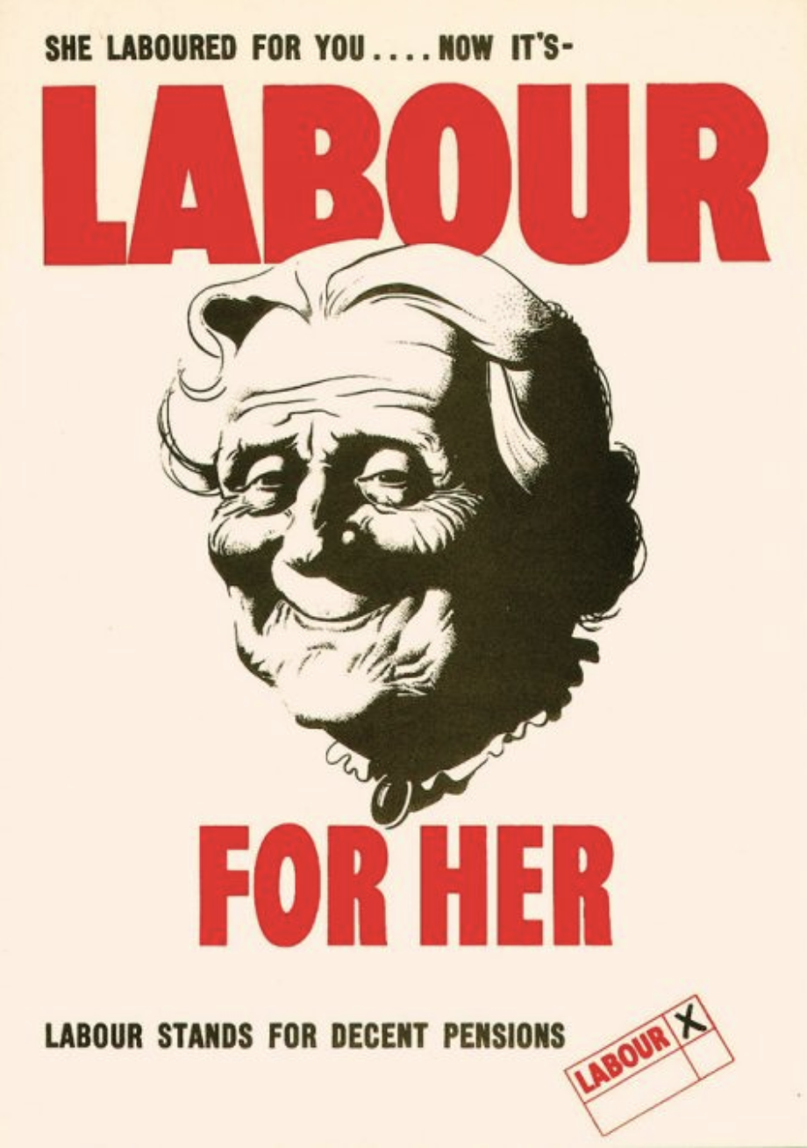
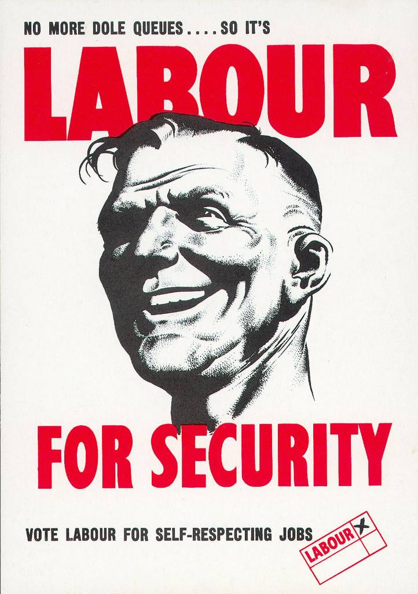
Labour for…
Notes:
Labour’s campaign is ambitious, new legislation is being supported but all this requires a lot of money.

Slide 6
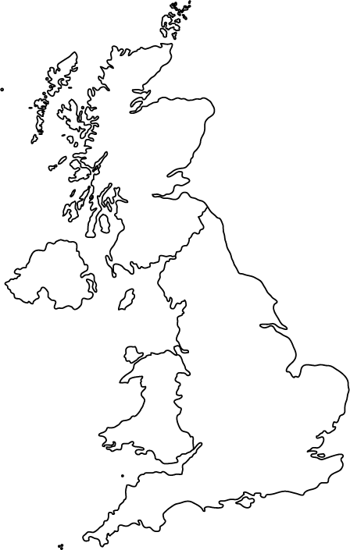
‘Advance Britannia’
Landslide Labour victory at election
Vision of a ‘New Jerusalem’
NHS, Welfare, Indian Independence and ‘Post-War Consensus’
Notes:
They want to build a ‘new Jerusalem’. (A land fit for heroes)

Slide 7
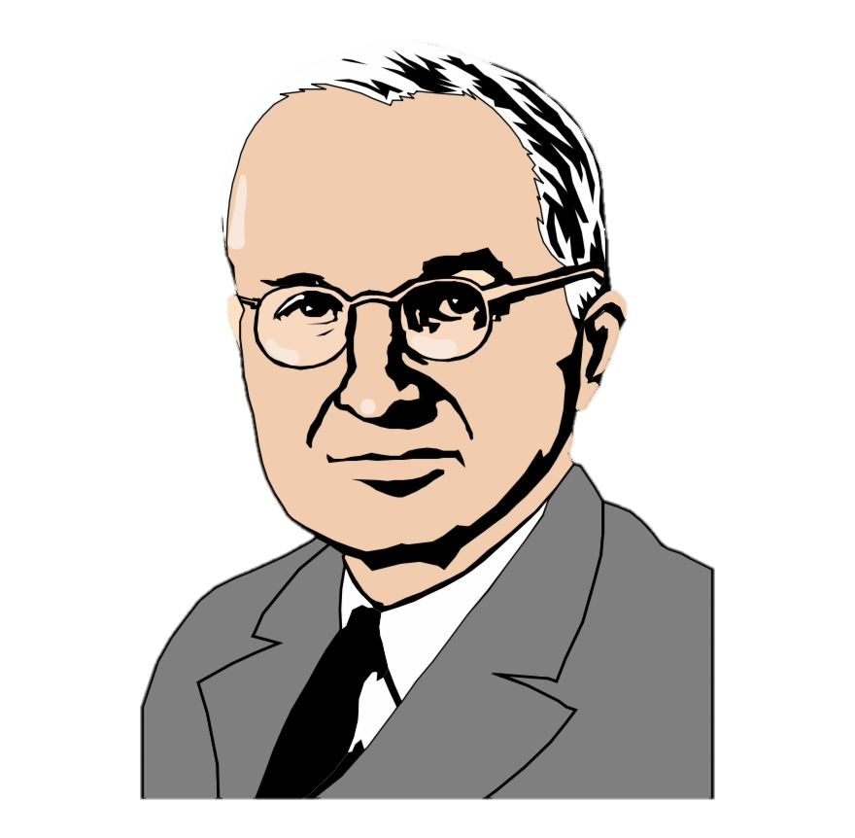
The American Problem
End of the Lend-Lease
Tough stance on future financing
Deeply suspicious of socialism and imperialism
Notes:
There was a large economic restraint. During the war years the US funded Britain through Lend-Lease.
After the war the US pull the plug and take a tough stance on future financing. They are deeply suspicious of socialism and imperialism.

Slide 8

Now Investigate
20
Complete ‘The Diminished State’ booklet using the sources and interpretations to support your conclusions
Consider how might Briton’s have felt about further involvement in international affairs?

Slide 9


Britain and Berlin
As you know Britain controlled territory in Berlin, the following footage comes from the British sector
Berlin –The Crisis
Berlin Ready for Winter

