Slide 1
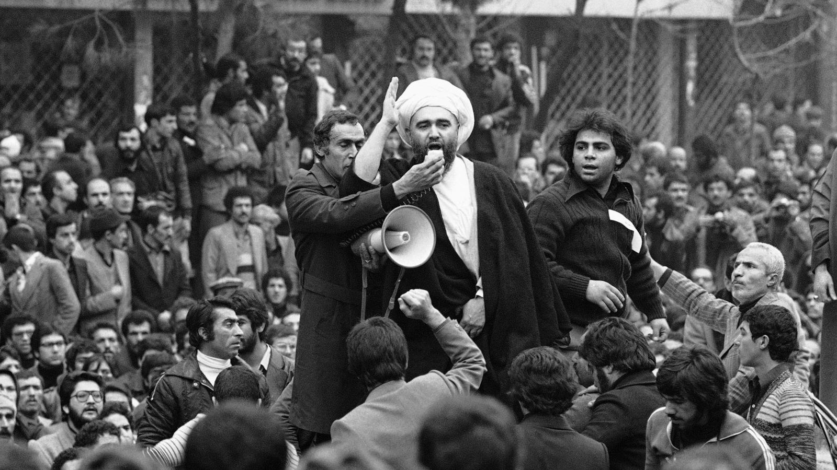
The Iranian Revolution 1978-1979

Slide 2
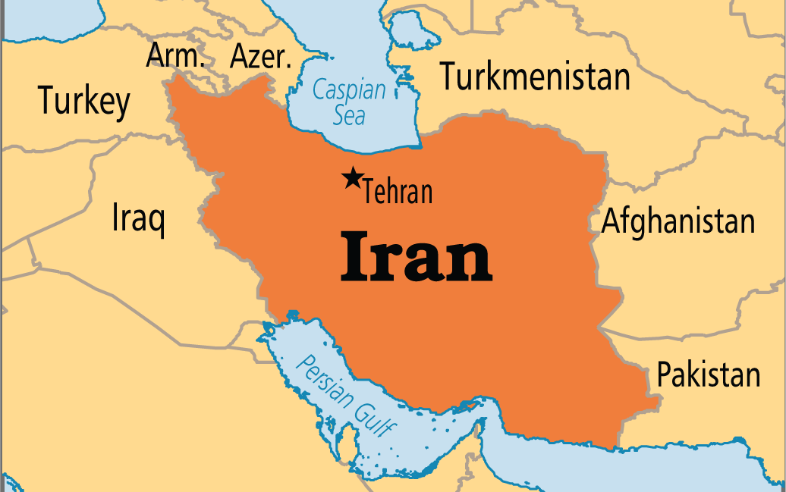

Slide 3
The 1946 Crisis
Moscow regarded Iran as vital for the Soviet Union’s security in the south
Washington saw it as significant to the US policy of containment and geopolitical dominance in the oil-rich Middle East.
The main issue in the 1946 Iranian Crisis was the refusal of the Soviet government to withdraw its troops from Iranian territory as it had agreed in the Tripartite Treaty of 1942.
When the war was over, the US agreed to withdraw its army from Iranian territory in June 1945 and left Iran in January 1946; British troops left on 2 March of the same year.
However, the Soviet refused to evacuate the northern part of Iran when the allocated time arrived.

Slide 4
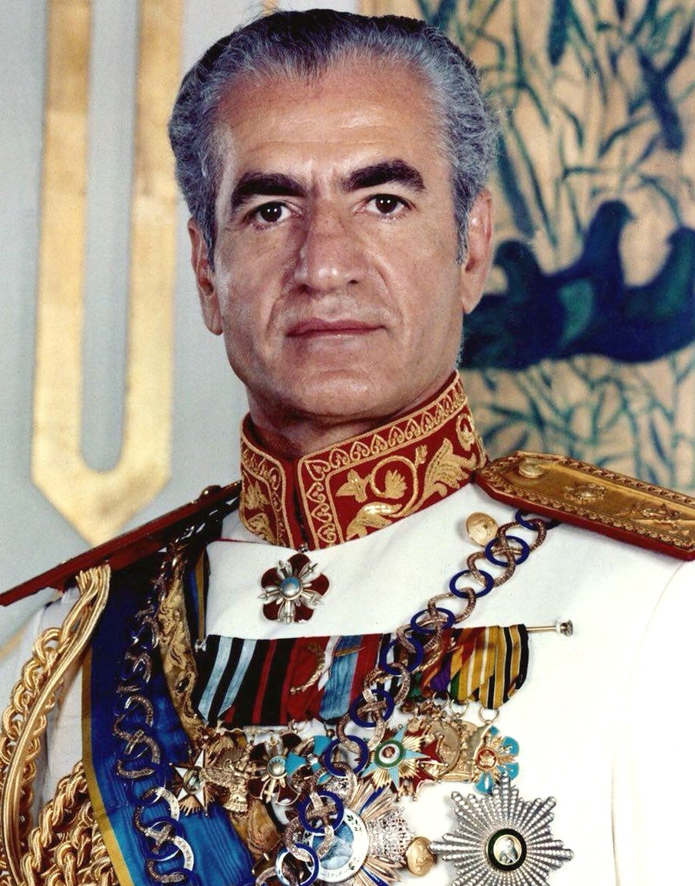
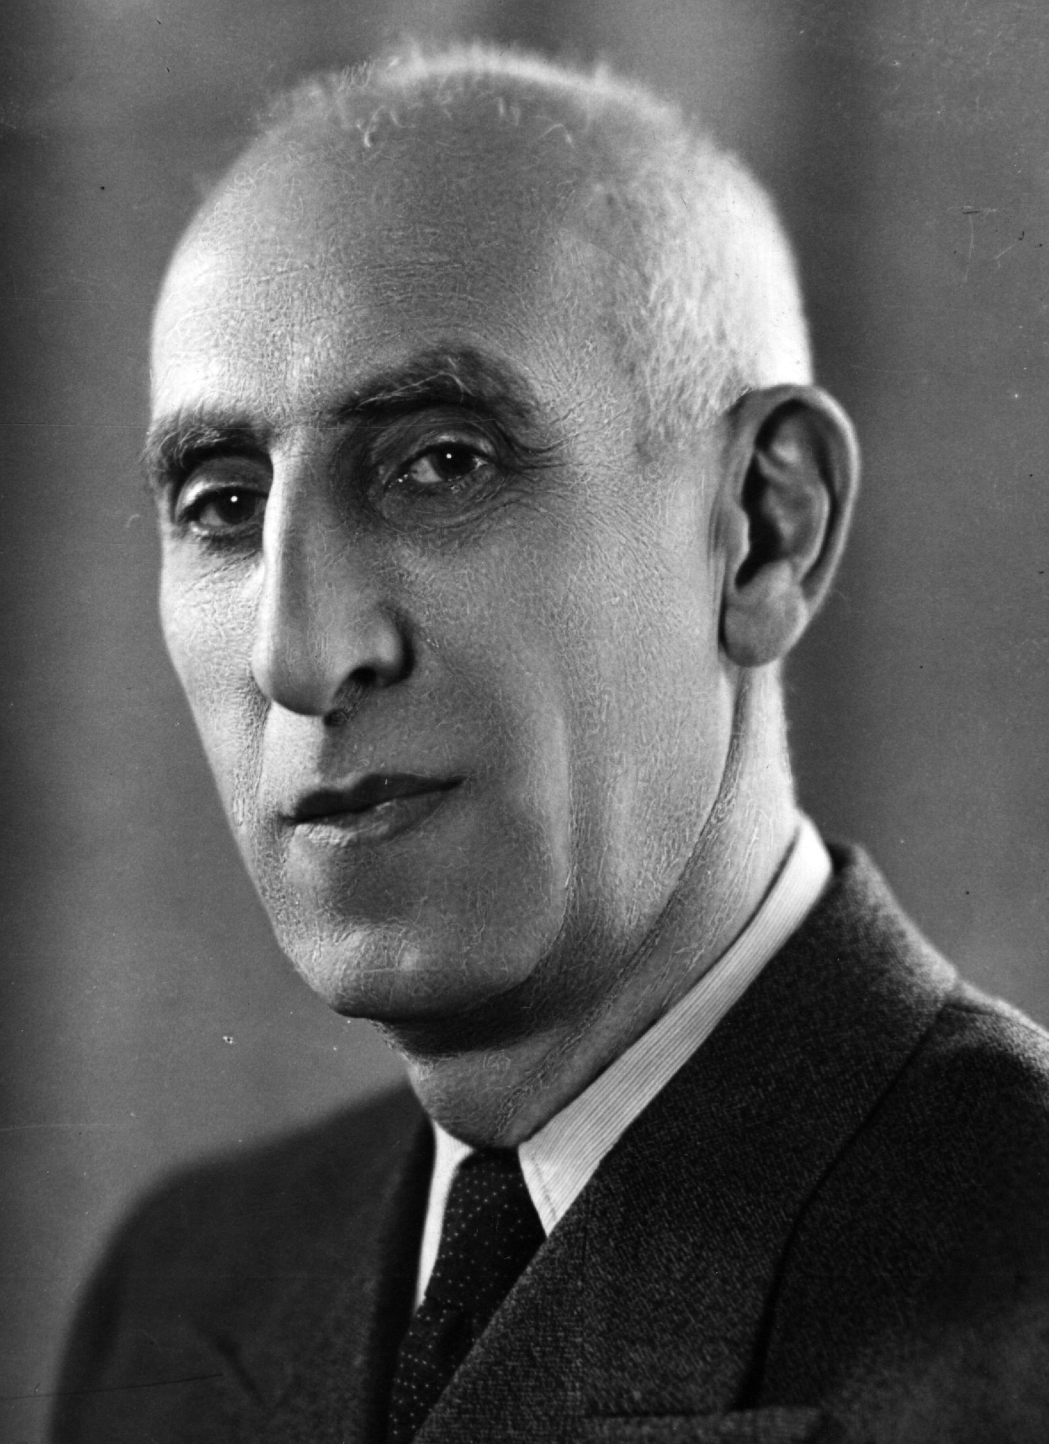
The 1953 coup d’état
The CIA helped overthrow Mosaddegh an elected, reformist government in Iran in 1953.
There had been a bitter power struggle between the pro-Western Iranian monarch Mohammad Reza Shah, and the veteran Iranian nationalist reformist politician, Mohammad Mosaddegh.
The shah was opposed to Mosaddegh’s approach, especially when it affected his traditional powers.
However, when the Majlis (National Assembly) elected Mosaddegh as PM on 30 April 1951.
Mohammad Reza Pahlavi, Shah of Iran from 16 September 1941 until his overthrow in the Iranian Revolution on 11 February 1979
Mohammad Mosaddegh served as Prime Minister of Iran 1951 - 1953, when his government was overthrown in the 1953 Iranian coup d'état

Slide 5
Mosaddegh
Mosaddegh’s first act in office was the nationalisation of the Anglo-Iranian Oil Company on 1 May.
The British rejection of the nationalisation but Mosaddegh refused to back down
London claimed that the pro-Soviet Iranian Communist party, Tudeh, was benefiting from Mosaddegh’s government.
In late August 1953, the CIA, assisted by British intelligence, engineered a coup d’état.

Slide 6
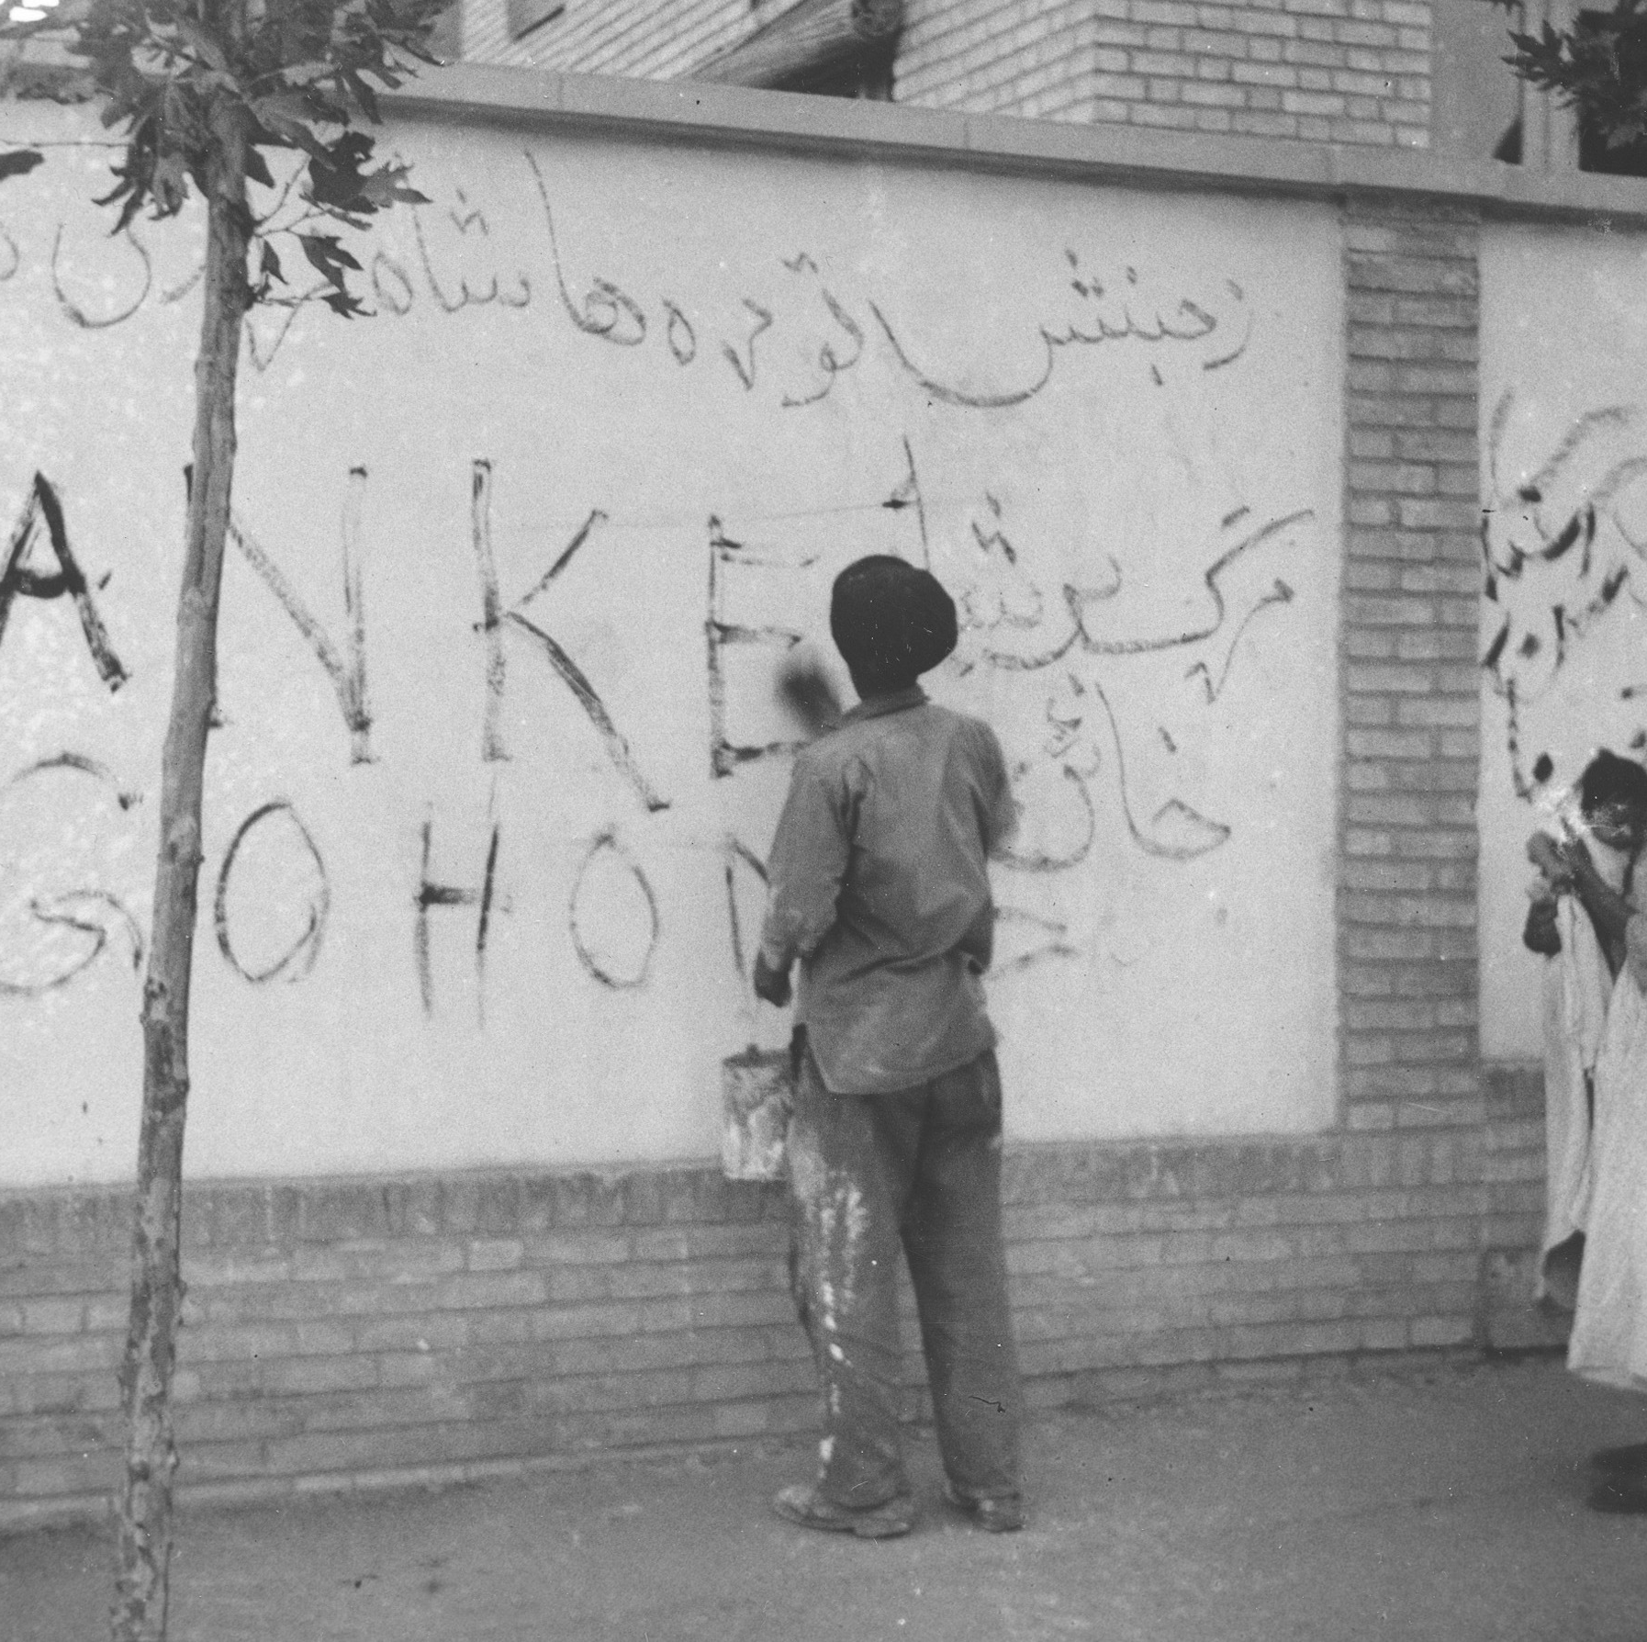
Coup d’état
The shah was initially reluctant to support CIA’s plans but they brought him back and re-installed him on the throne .
The CIA’s intervention was widely resented inside Iran and in the region.
The shah imposed a military dictatorship and made extensive use of a secret police force (SAVAK)
The Soviets condemned the development as a Western imperialist offensive against independent postcolonial regimes.

Slide 7
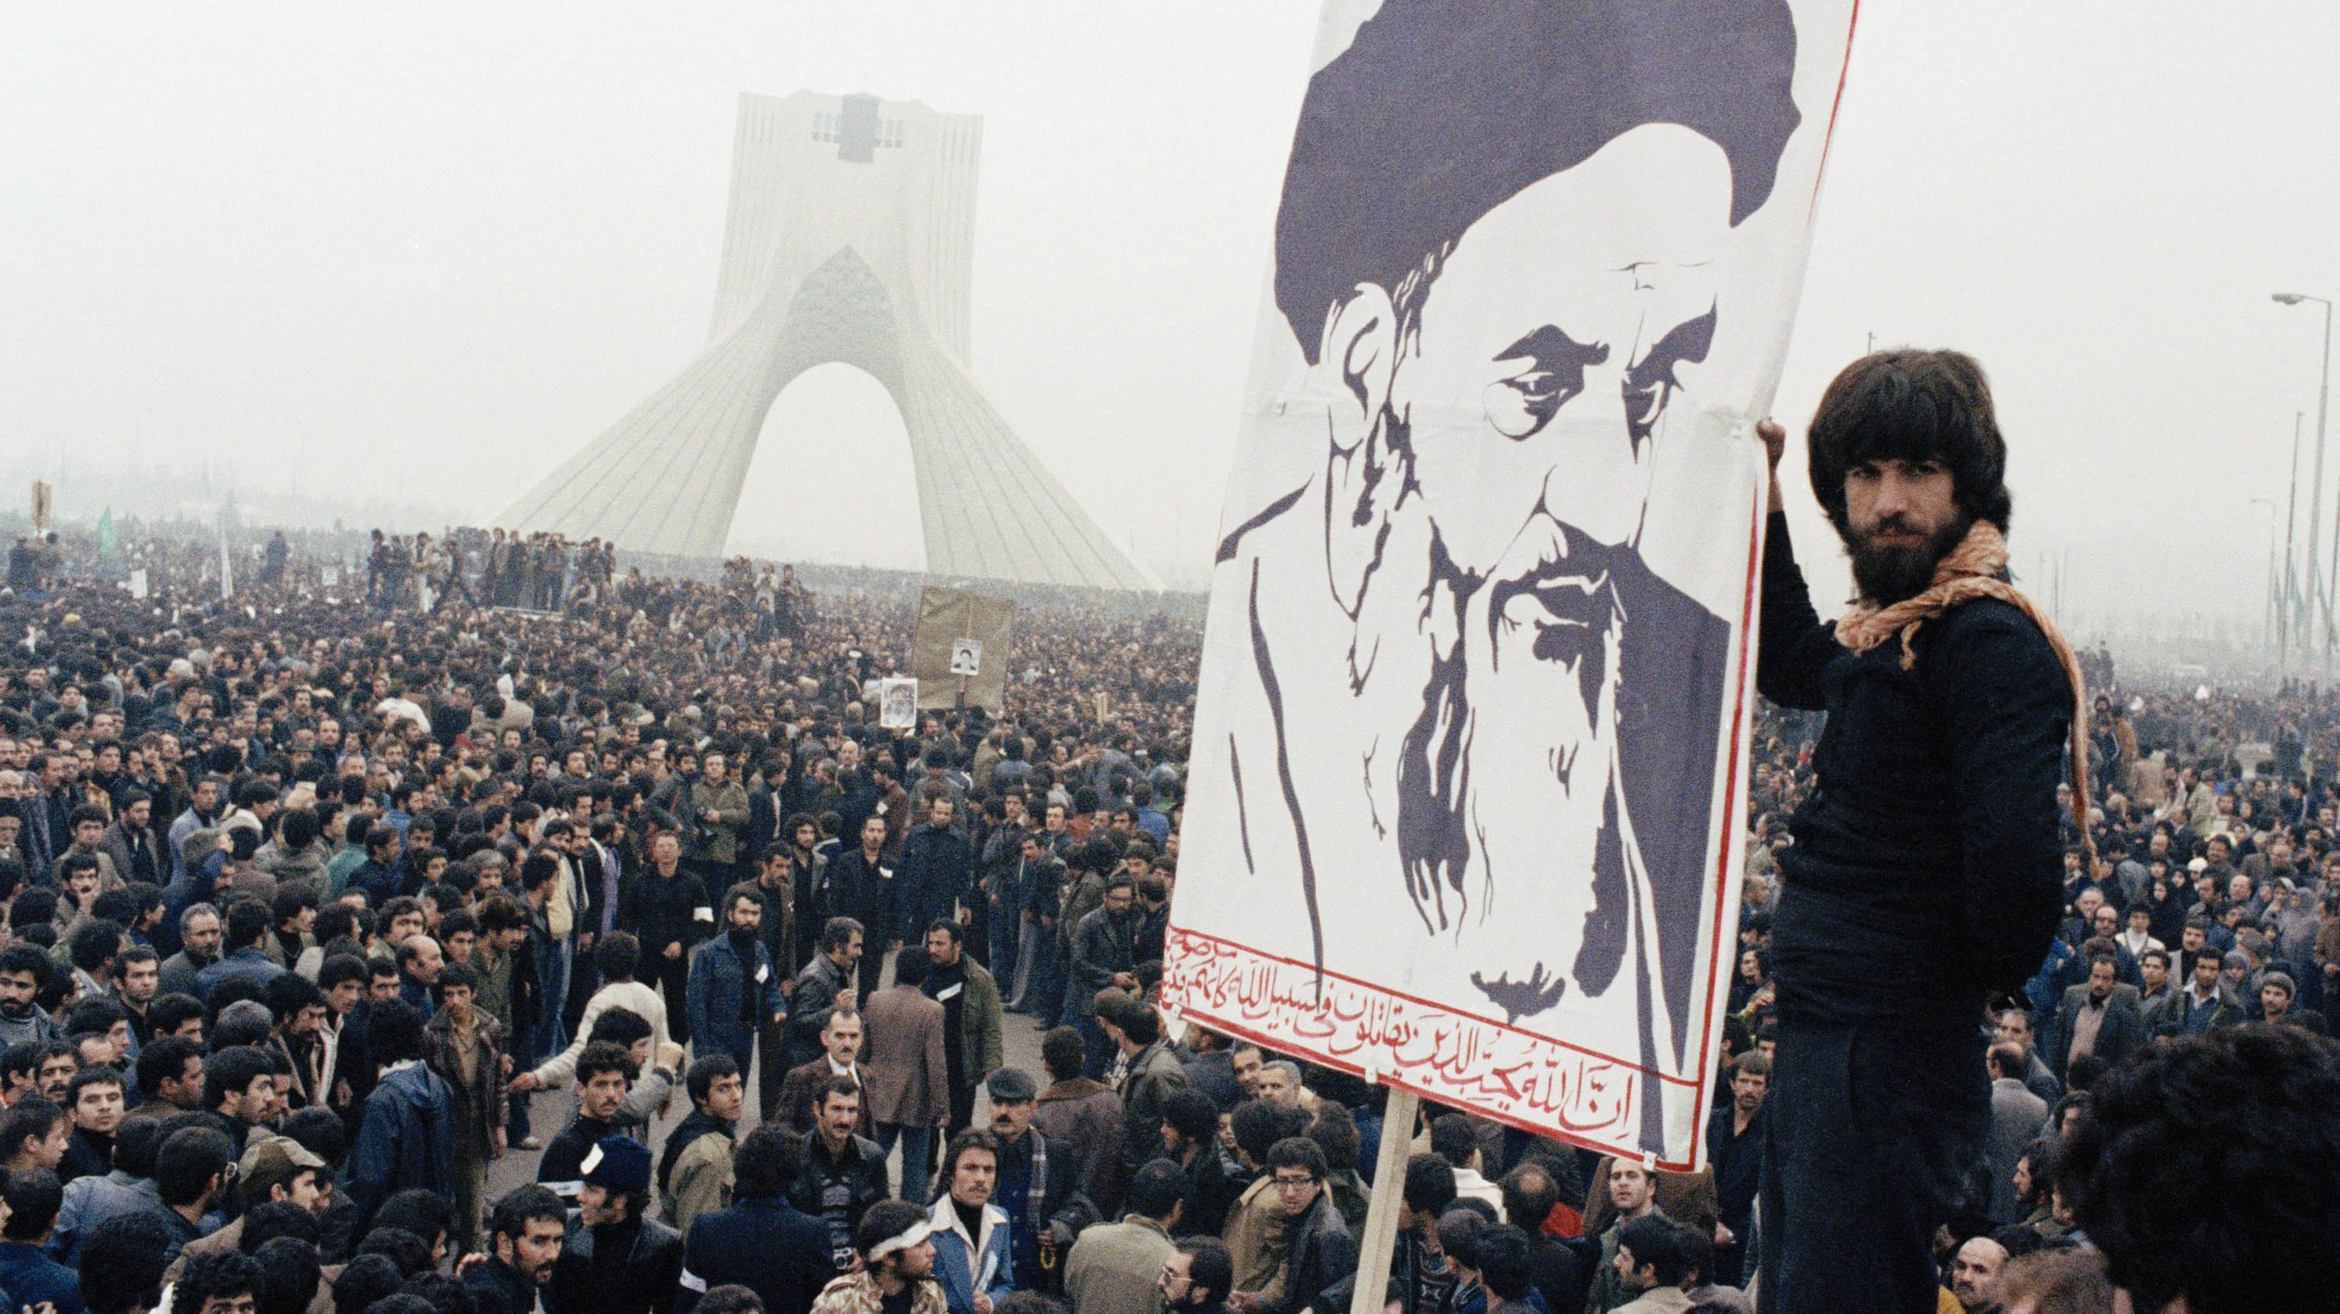
What were the causes of the revolution?

Slide 8
Iran underwent substantial socio-economic transformation in becoming an industrialised capitalist society.

Slide 9
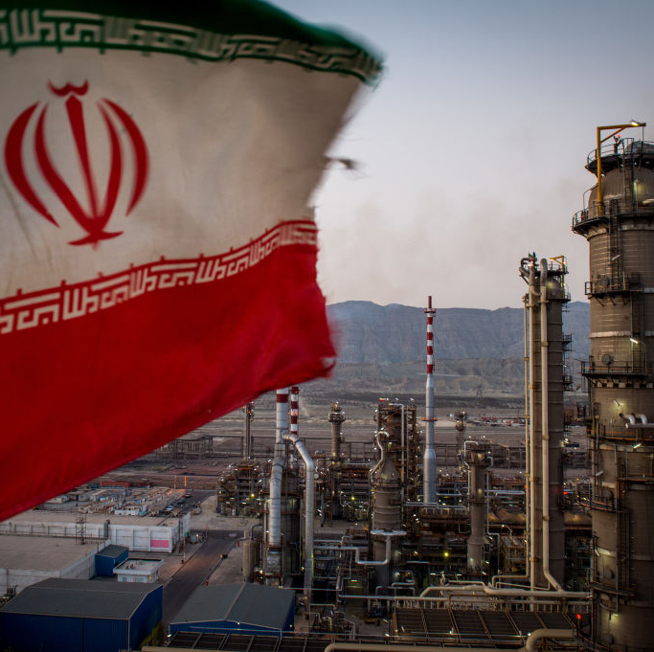
Socio-economic transformation
Economic expansion came from Iran’s oil industry, the revenues of which rose from $45 million in 1950, to $1.1 billion in 1970 and after the multiplication of prices by OPEC to $20.5 billion in 1976
Oil assisted economic change but also subsidised inefficient sectors.
There was a slowing of GNP and increased inflation leading the government to enforce price controls.

Slide 10
There were clear inequalities that developed during this time frame

Slide 11
Growing inequalities
By the mid-70s it was calculated that the top 10% of the population accounted for 40% of expenditure.
Land was cultivated in family-sized units relatively isolated from the rest of the economy
Towns had a long tradition of commercial and religious institutions groups around the bazaars which retained their independence and hostility to the Shah’s state.

Slide 12
The Shah’s personality helped to weaken the army and the state.

Slide 13
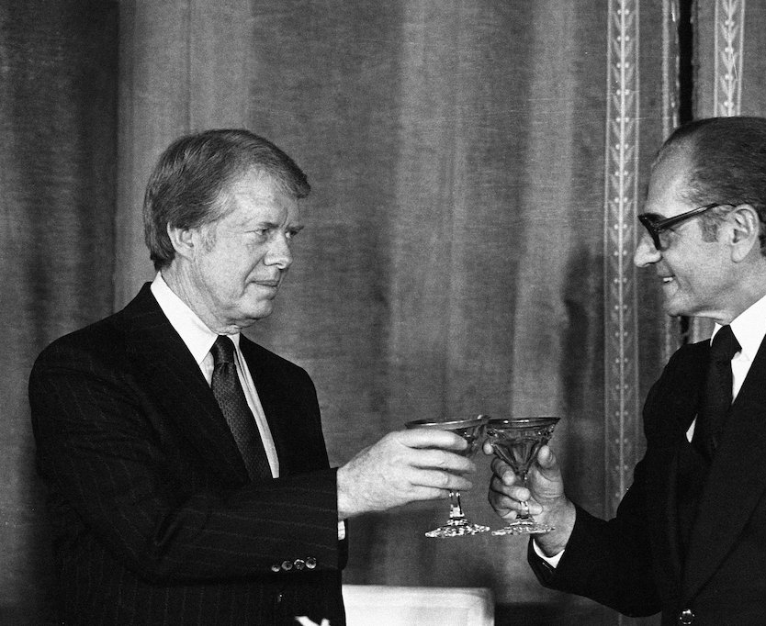
The Shah
He was ill-suited to the coping with the crisis of 1978
The regime never enjoyed widespread legitimacy
The Shah had had many thousands imprisoned and tortured
The boom of the mid 1970s also exposed a fatal weakness of the regime, the alienation of large sections of the middle class

Slide 14
The army was increasingly demoralised

Slide 15
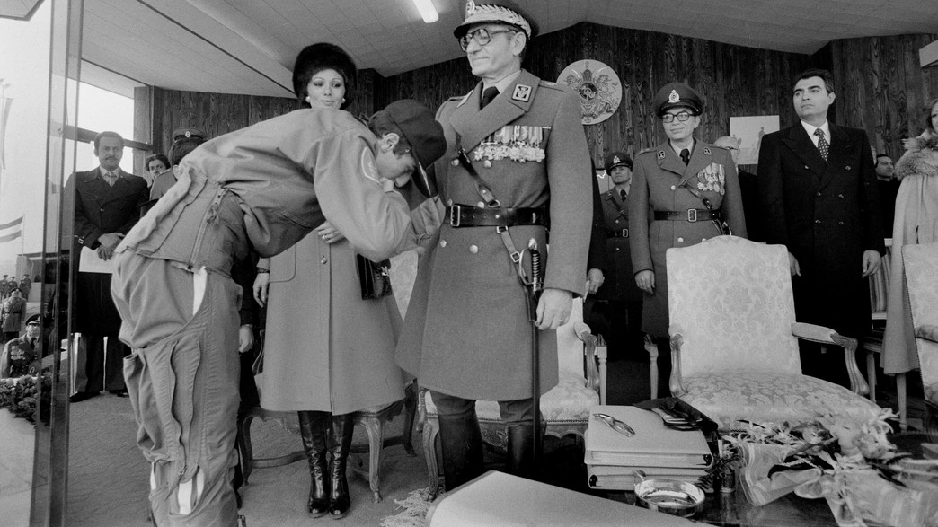
The army
Corrupt and liable to demoralisation, the Shah failed to give strong leadership to the army. In the final days they signed a secret agreement with the opposition.

Slide 16
The broad coalition of opposition was diverse and spontaneous

Slide 17
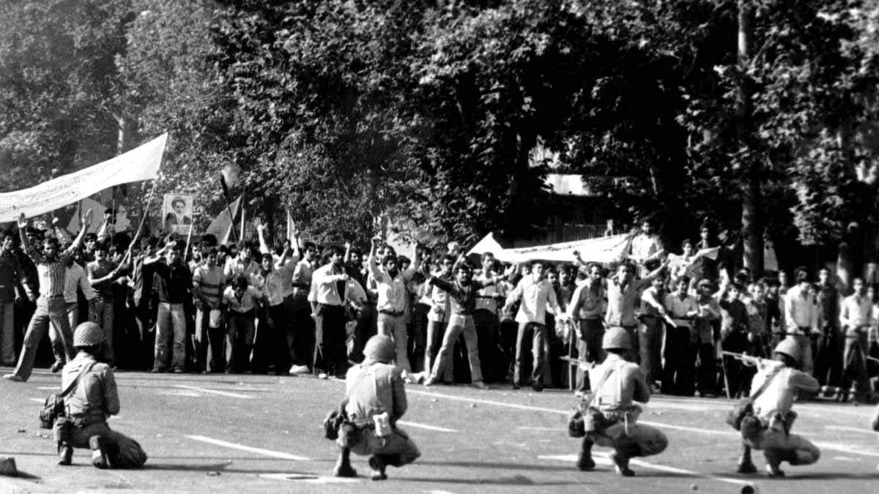
The clergy were an important organisation as they were able to use religious networks to mobilise the population.
The slogan raised in the final weeks was simply ‘Independence, Freedom, Islamic Republic.’

Slide 18
Islamic leadership played a large role in organising protest

Slide 19
Religion
SUNNI AND SHIA: BELIEFS AND PRACTICES
Similarities | Differences
Both Sunni and Shi‘a Muslims are committed to the five pillars of Islam (the declaration of faith, prayer, giving to the poor, fasting, and pilgrimage) | They hold different views about religious authority and the leadership succession after the death of the Prophet in 632
Both prioritise the Qur’an, Sunnah and Hadith, with minor differences | Sunnis focus on following the Prophet’s example; Shi‘as focus on Muhammad’s family lineage through a series of Imams
They adhere to Islamic law (shari‘ah), but follow different legal traditions. | Special status is afforded by Shi‘as to Ali, Hasan and Hussein; the suffering of Ali and Hussein is remembered in annual festivals
Iran became an officially Shi’ite State in 1502 and this adds another dimension to the revolution.
Shi’ism is an ideology which rejects secular belief, secular being where the state and religious institutions are separated.
Therefore Shi’ism promotes a theocratic state forming a direct opposition to the monarchy.

Slide 20
Khomeini had a history and a personality appropriate to his role.

Slide 21
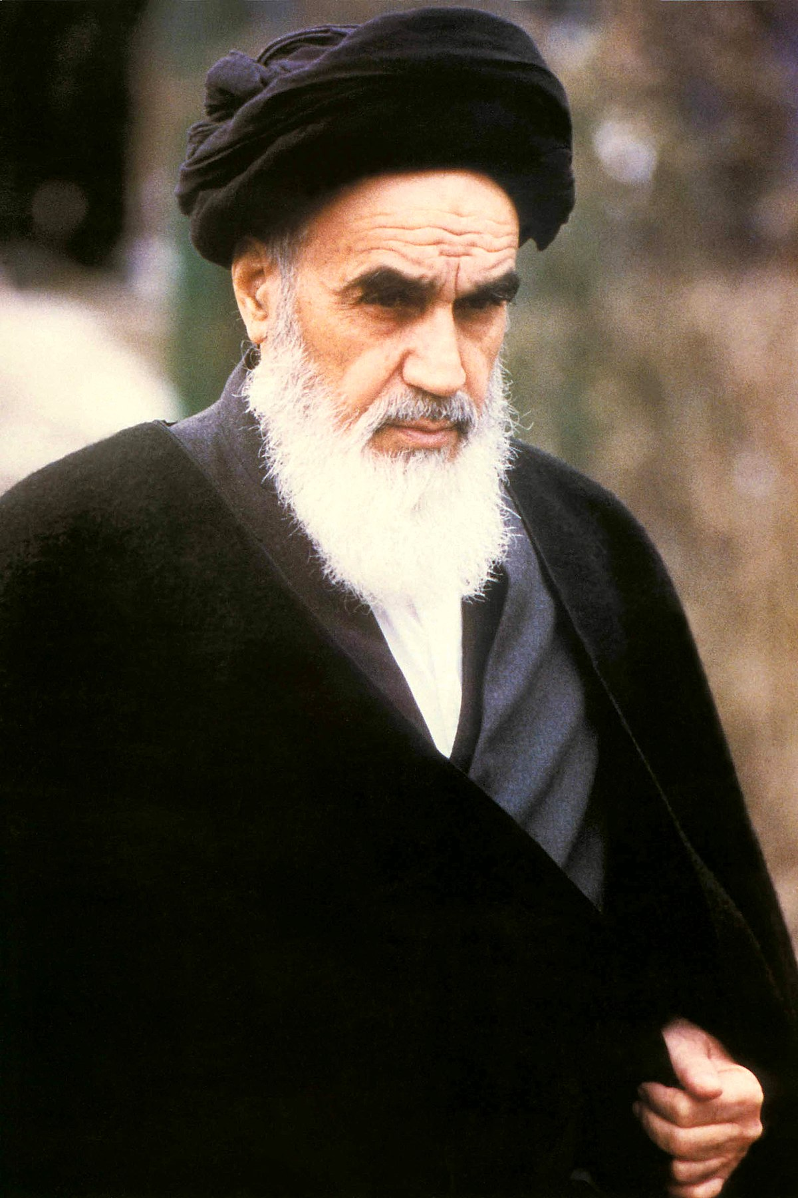
Ruhollah Khomeini
He had opposed the Shah in the early 1960s and had been exiled in 1964.
He also found the proper moment to strike
He appropriated the religious title of Imam to circumvent the problem of his not being the senior ayatollah

Slide 22
Foreign influence

Slide 23
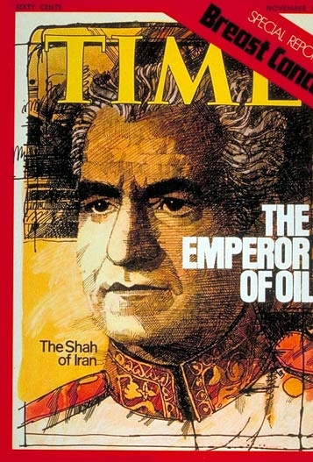
Foreign influence
The rate of Iran’s oil output – over 6 million barrels a day – was dictated by the demands of other countries for greater supply.
The Shah was clearly reliant on foreign support in 1953 and his visible friendship with the US together with his quiet but overt sympathy for Israel was other factor.
The US felt unable to intervene to save him
US critics focused attention on the Shah’s human rights violations and the high level of arms sales

Slide 24
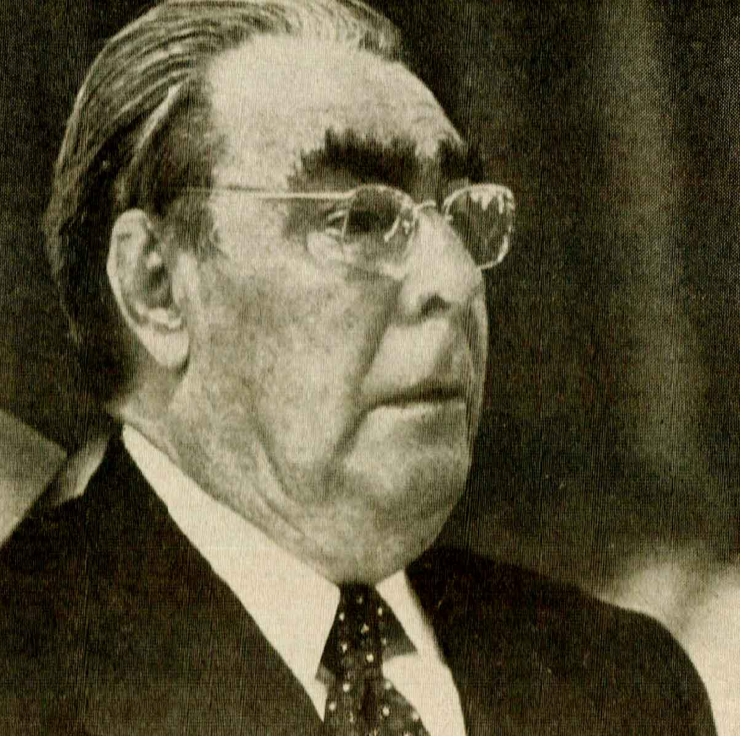
US reluctance
Post-Vietnam reluctance to engage in foreign wars
Brezhnev warned in November 1978 that action would run the risk of Soviet intervention
It encouraged the Islamic forces fighting the revolutionary Afghan government which came to power in April 1978.

Slide 25
The Revolution

Slide 26
Revolution - 1978
Jan 1978 street protests began
Sep. 1978 traditional religious processions rallied over 1 million people in Tehran for what became political protests.
8 Sep. imposition of martial law begins
In October a new wave of strikes begin
5 Nov. under pressure from military leadership, the Shah appointed a military government
A nation wide political general strike begins in late November and December.

Slide 27
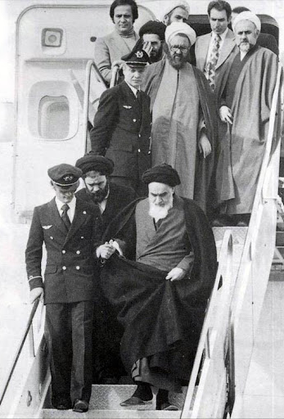
Khomeini comes to power
Khomeini had become a symbol of opposition and an increasingly active leader
15 Jan 1979 the Shah left Iran leaving behind a government headed by former opposition leader Shahpour Bakhtiar (which Khomeini refused to negotiate with).
After returning to Iran on 1 February, Khomeini announced Mehdi Bazargan head of a rival government.
The army command declared itself neutral in the conflict and Bakhtiar and his associates either fled or were arrested.

Slide 28
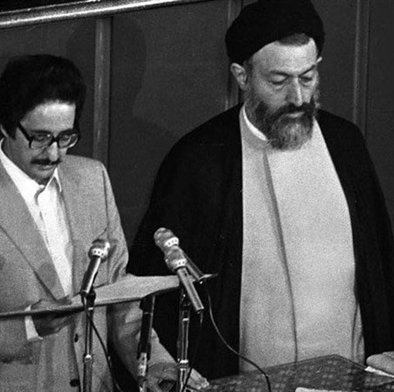
Post-revolutionary Iran
30 March, a referendum proclaimed Iran to be an Islamic Republic; November 1979, a new Islamic constitution was passed by referendum
Khomeini was officially accepted as the faqih or supreme judicial authority
Jan 1980 Abol-Hassan Bani-Sadr was elected president; the Islamic Republican Party selected Mohammad Ali Rajai as prime minister

Slide 29
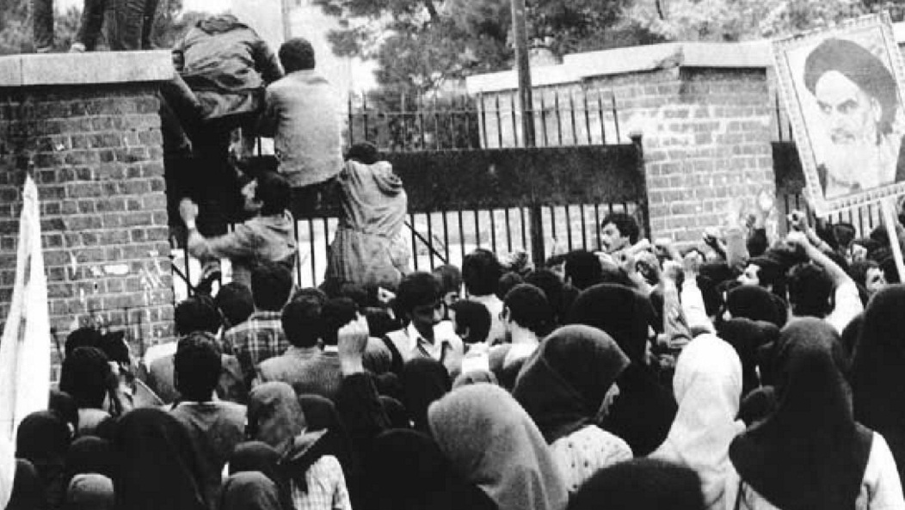
The hostage crisis

Slide 30
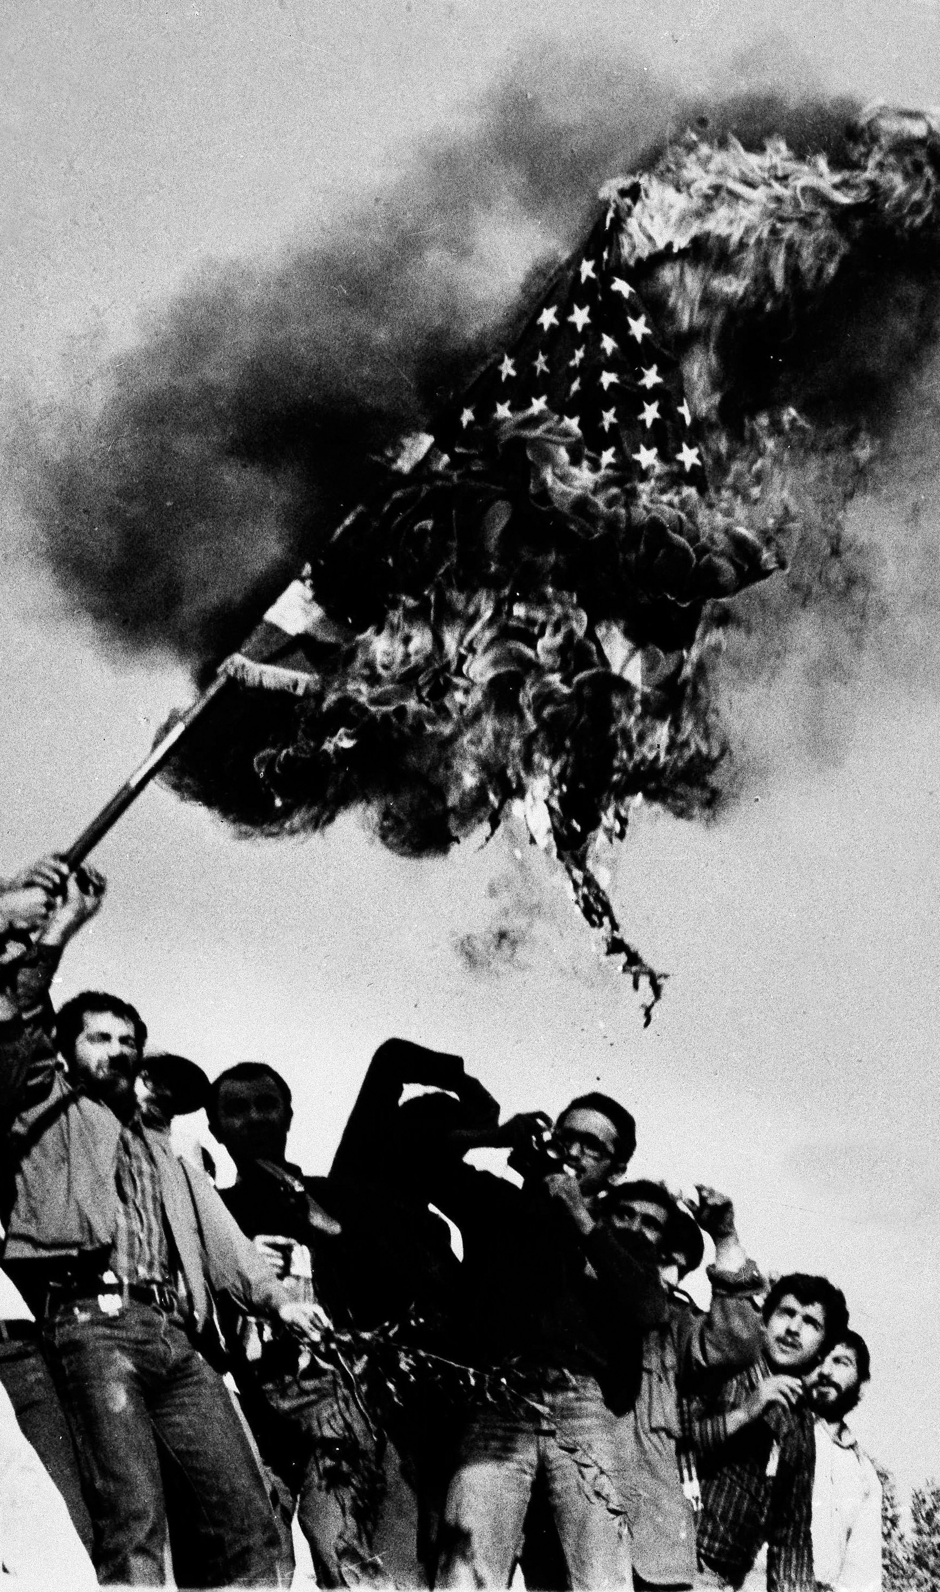
Hostage crisis
November 1979, after Carter allowed the Shah to receive treatment for cancer in the US
Students loyal to Khomeini took over the US embassy in Iran’s capital, Tehran, and seized 52 hostages.
The protests demanded that the shah be deported to Iran to stand trial.
In response, Carter froze billions of dollars of Iranian assets.
In April 1980, Carter ordered a secret rescue mission to free the captives, but it was unsuccessful.
For 444 days there was a stalemate that seriously damaged Carter’s administration.

Slide 31
Conclusions
“The Iranian Revolution was, only to some extent, a religious revolution: the values, personnel, goals were all defined in religious terms, and the society which has subsequently been created is one which its creators argue is modelled on the Qur'an and Islamic law… Material living conditions, opposition to royal dictatorship, and hostility to foreign influence all played important roles in preparing the Shah’s downfall.”
Fred Halliday

Slide 32
Bibliography
Fred Halliday, ‘The Iranian Revolution: Uneven Development and Religious Populism,’ in Fred Halliday, Hamza Alavi, State and Ideology in the Middle East and Pakistan, (New York,1988) pp.31-63
Zulkanain Abdul Rahman et al. ‘Britain, the United Nations and the Iranian Crisis of 1946’ Middle-East Journal of Scientific Research 18 (11): 2013 pp.1544-1556
Amin Saikal, ‘Islamism, the Iranian revolution, and the Soviet invasion of Afghanistan’ in Melvyn P. Leffler, Odd Arne Westad eds. The Cambridge History of the Cold War: Volume Three (Cambridge, 2010) p.121
John Stanley, The Cold War and the America (1945-1981) (Cambridge, 2016) pp.146-7
Centre for research and evidence on security threats, ‘Sunni and Shi’a Islam: Differences and Relationships’ https://crestresearch.ac.uk/wp-content/uploads/2016/05/16-005-01.pdf

