Slide 1
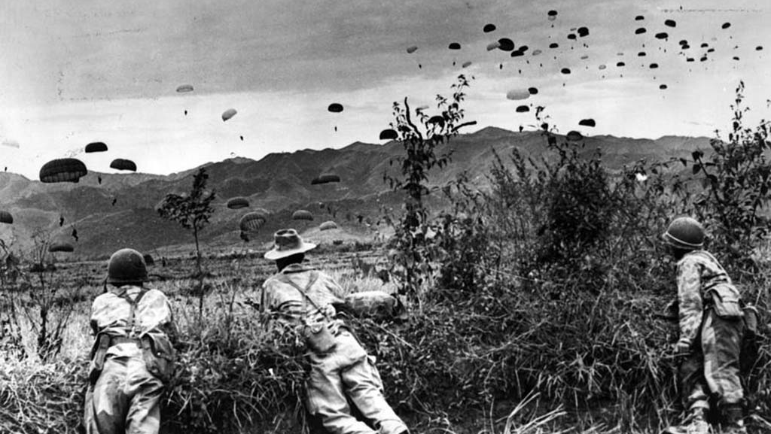
Conflict in Asia 1945-1955
The French in Indochina

Slide 2
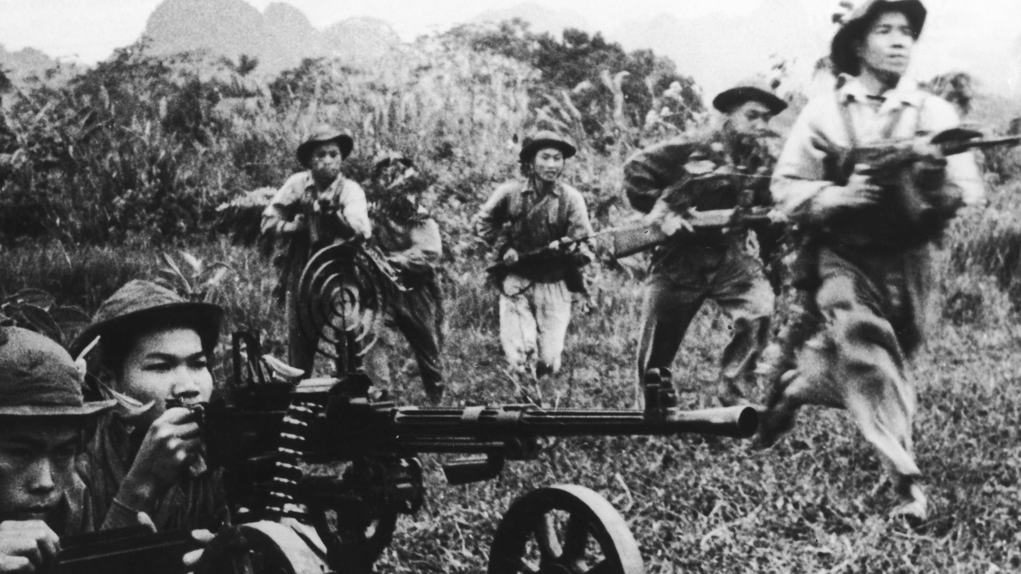
Part 1
French rule in Indochina and lead up to war c.1925-1945

Slide 3
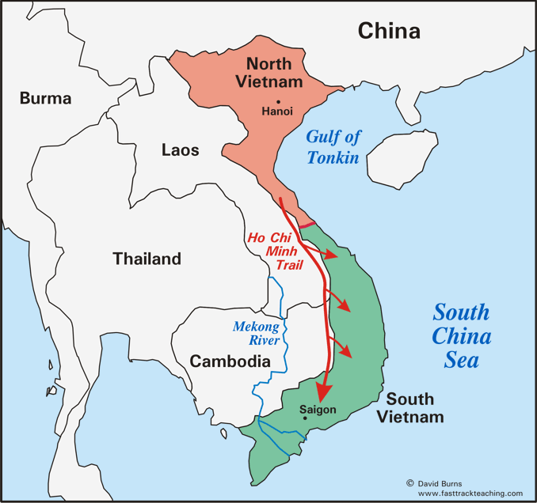

Slide 4
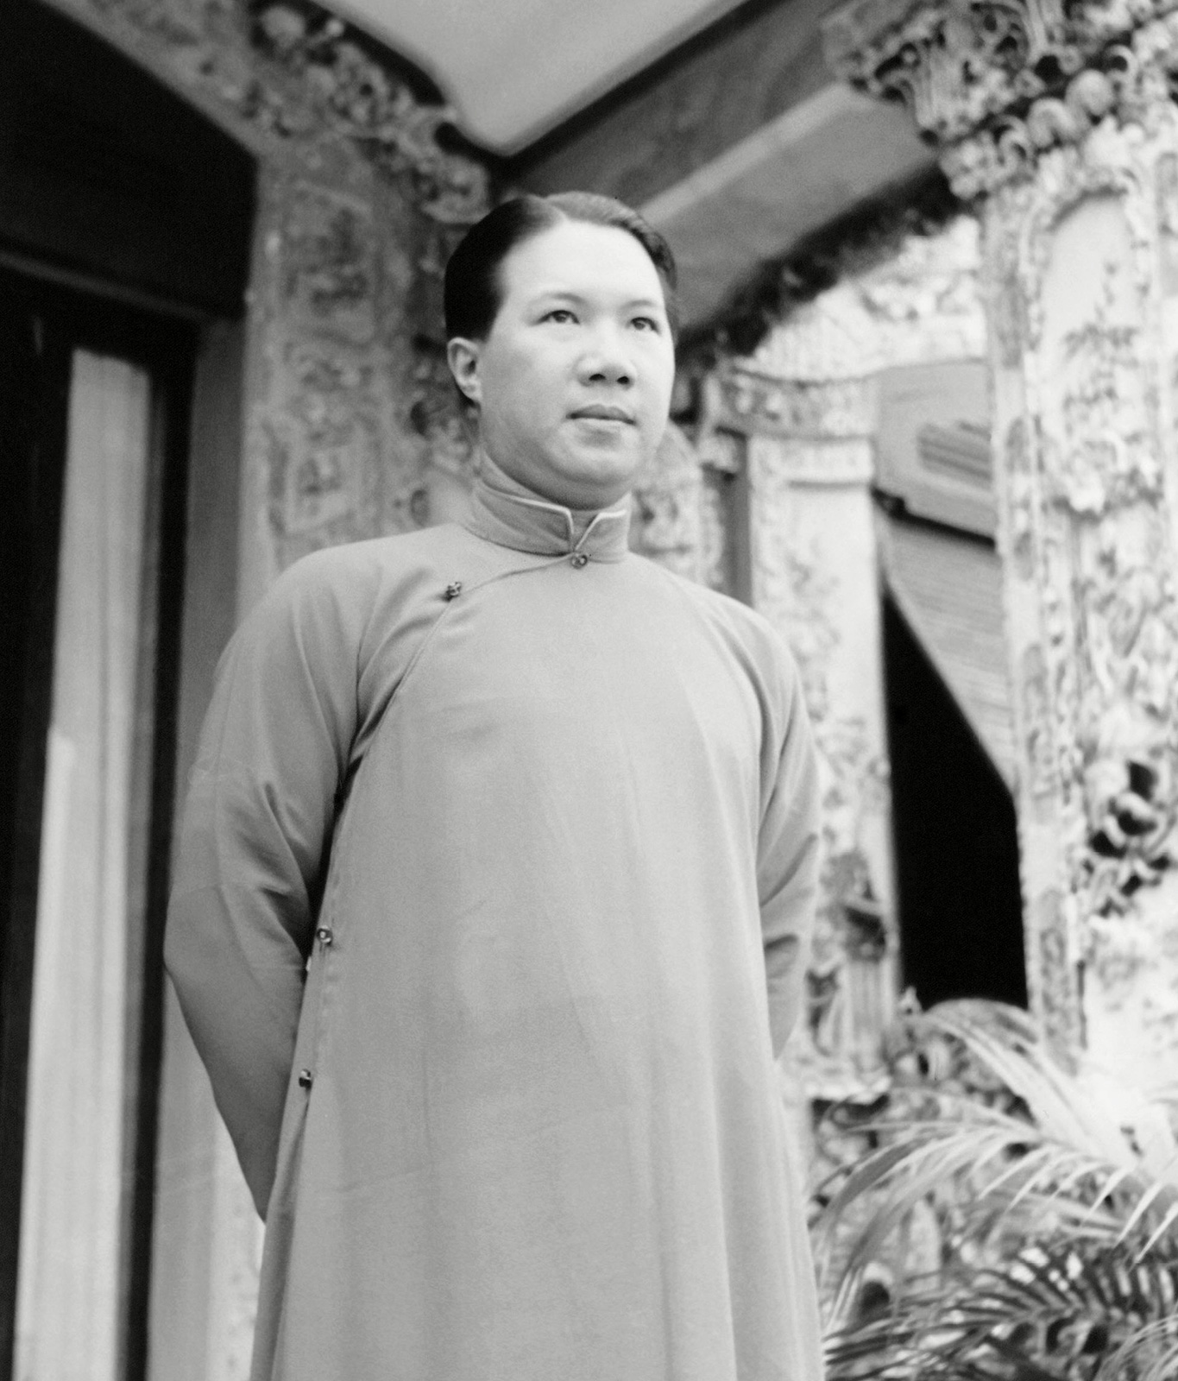
French rule in Indochina
A grouping of the three Vietnamese regions of Tonkin (north), Annam (centre), and Cochinchina (south) with Cambodia was formed in 1887.
Emperor Bao Ðai (1926-1945) was enthroned, but the French continued to run his regime.
His PM Nguyen Van Xuan was a naturalised French citizen who barely spoke Vietnamese.

Slide 5
French rule
They assigned French officers to direct administration and recruit and relegated Vietnamese employees to minor functions on minimal salaries.
At village level, the French relied on chiefs to collect taxes and mobilise labour which led to embezzlement and oppression.
Uprisings that threatened the corrupt system could only be quelled with force.

Slide 6
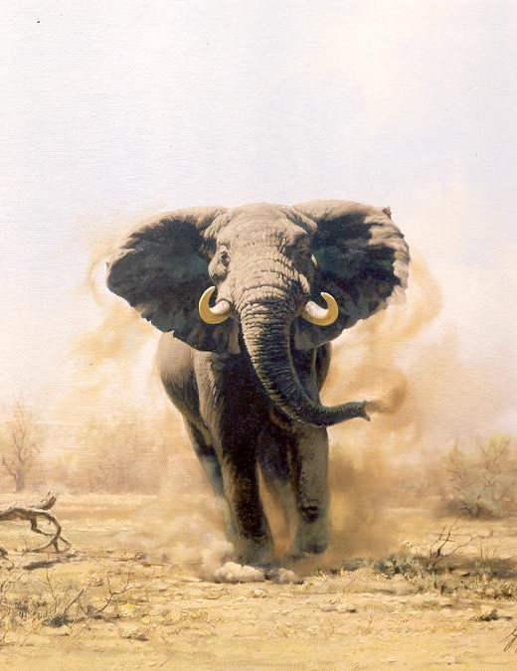
Penal code
Introduction of the French penal code was in part down to good will.
However it confused the Vietnamese traditional legal system.
It also lost credibility when colonial police jailed political suspects for years without trial.

Slide 7
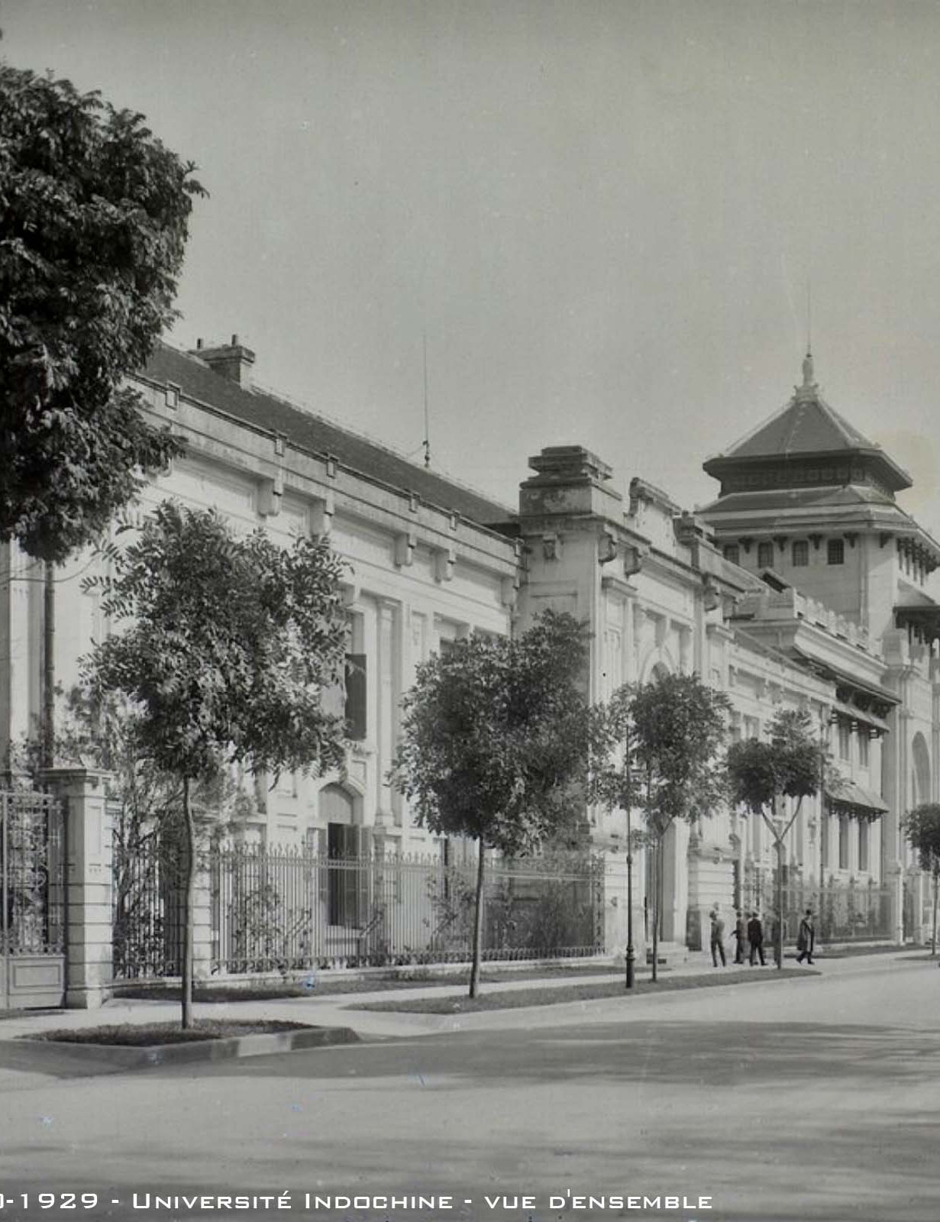
Education
Planned to revamp the education system
Banned Chinese characters and replaced them with French or quoc ngu
Young Vietnamese resisted colonial contamination
By the eve of WWII fewer than 1/5 of all school age boys were attending classes
Unofficial schools attracted Vietnamese youths, as they were absent of French assimilationist doctrine.

Slide 8
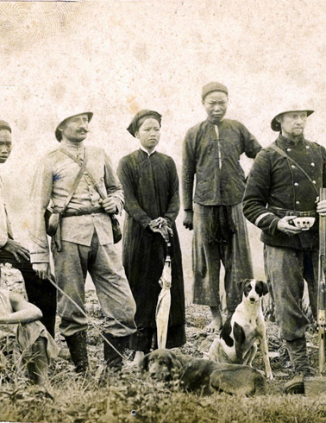
Economy
Paul Doumer single-handedly transformed Indochina to a profitable enterprise for France
Created unofficial monopolies to produce and market alcohol, salt and opium
His land policy dislocated rural Vietnamese
French made Indochina the world’s largest exporter of rice after Burma and Thailand which impoverished peasantry
Landless peasants worked in mines, rubber plantations, built roads and railways, with appalling conditions
In one plantation 12,000 of 45,000 died in the years 1917 to 1944.

Slide 9
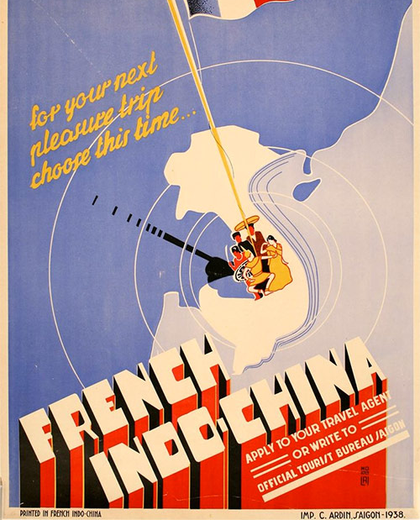
Exploitation
Vietnam became very profitable for the French, due to its rich supplies of coal, tin, zinc and rubber.
To transport all these goods, the French built a network of railways, roads and canals.
The French soon began to change the Vietnamese way of life dramatically. For example, people converted to Catholicism, abandoning Buddhism. French customs were introduced and those who resisted were punished.
This created a new elite class who helped the French keep control of the 30 million people living in Indochina.

Slide 10
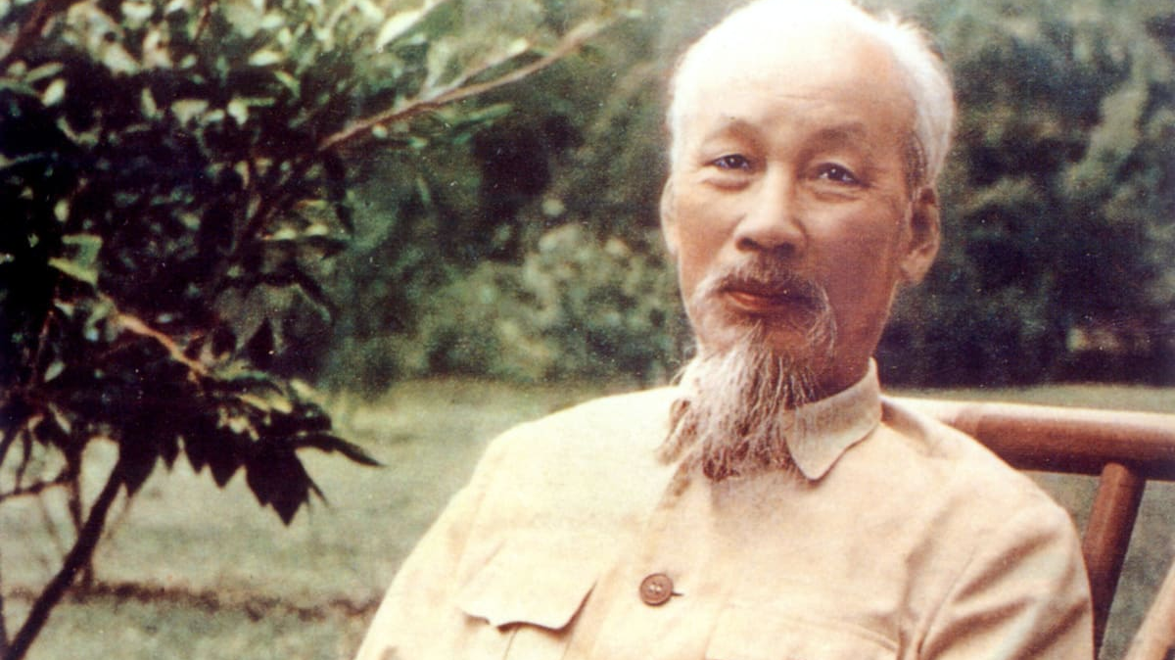
Ho Chi Minh

Slide 11
Ho Chi Minh
Ho Chi Minh was born 1890. His father a nationalist, taught his children to resist the rule of the French.
Ho grew up a committed nationalist willing to fight for Vietnamese independence.
Ho, as a sailor discovered that Vietnam was not the only country to suffer from exploitation.
Eventually Ho converted to communism and when the French Communist party was formed, he became one of its founder members.
Ho Chi Minh was greatly inspired by the Russian Revolution and while in the Soviet Union, he wrote to a friend saying that all communists duties were to:
“make contact with the masses to awaken, organise, unite and train them, and lead them to fight for freedom and independence”

Slide 12
World War Two
In 1940 a tidal wave swept SE Asia
The Japanese offensive of Vietnam timed with Germany’s conquest of France
The Japanese crushed the French administration in Vietnam, drove the British from Malaya, the Dutch from Indonesia and the US from the Philippines
In early 1941, Ho returned to Vietnam and went on to form the Vietnam Independence League or “Vietminh” in May 1941
He borrowed the name from his official pseudonym Ho Chi Minh which translated roughly to “bringer of light”
Ho feared the Japanese and though to count on them would be to “drive the tiger out the front door while letting the wolf in through the back”

Slide 13
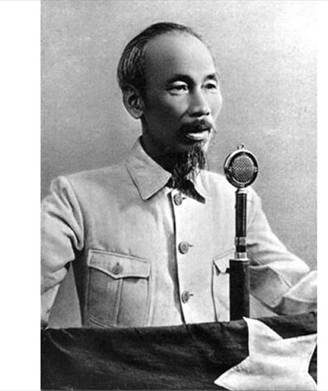
Independence 2nd September 1945 - Ba Dinh Square – Ho asserted Vietnam’s Independence. The Democratic Republic of Vietnam was founded

Slide 14
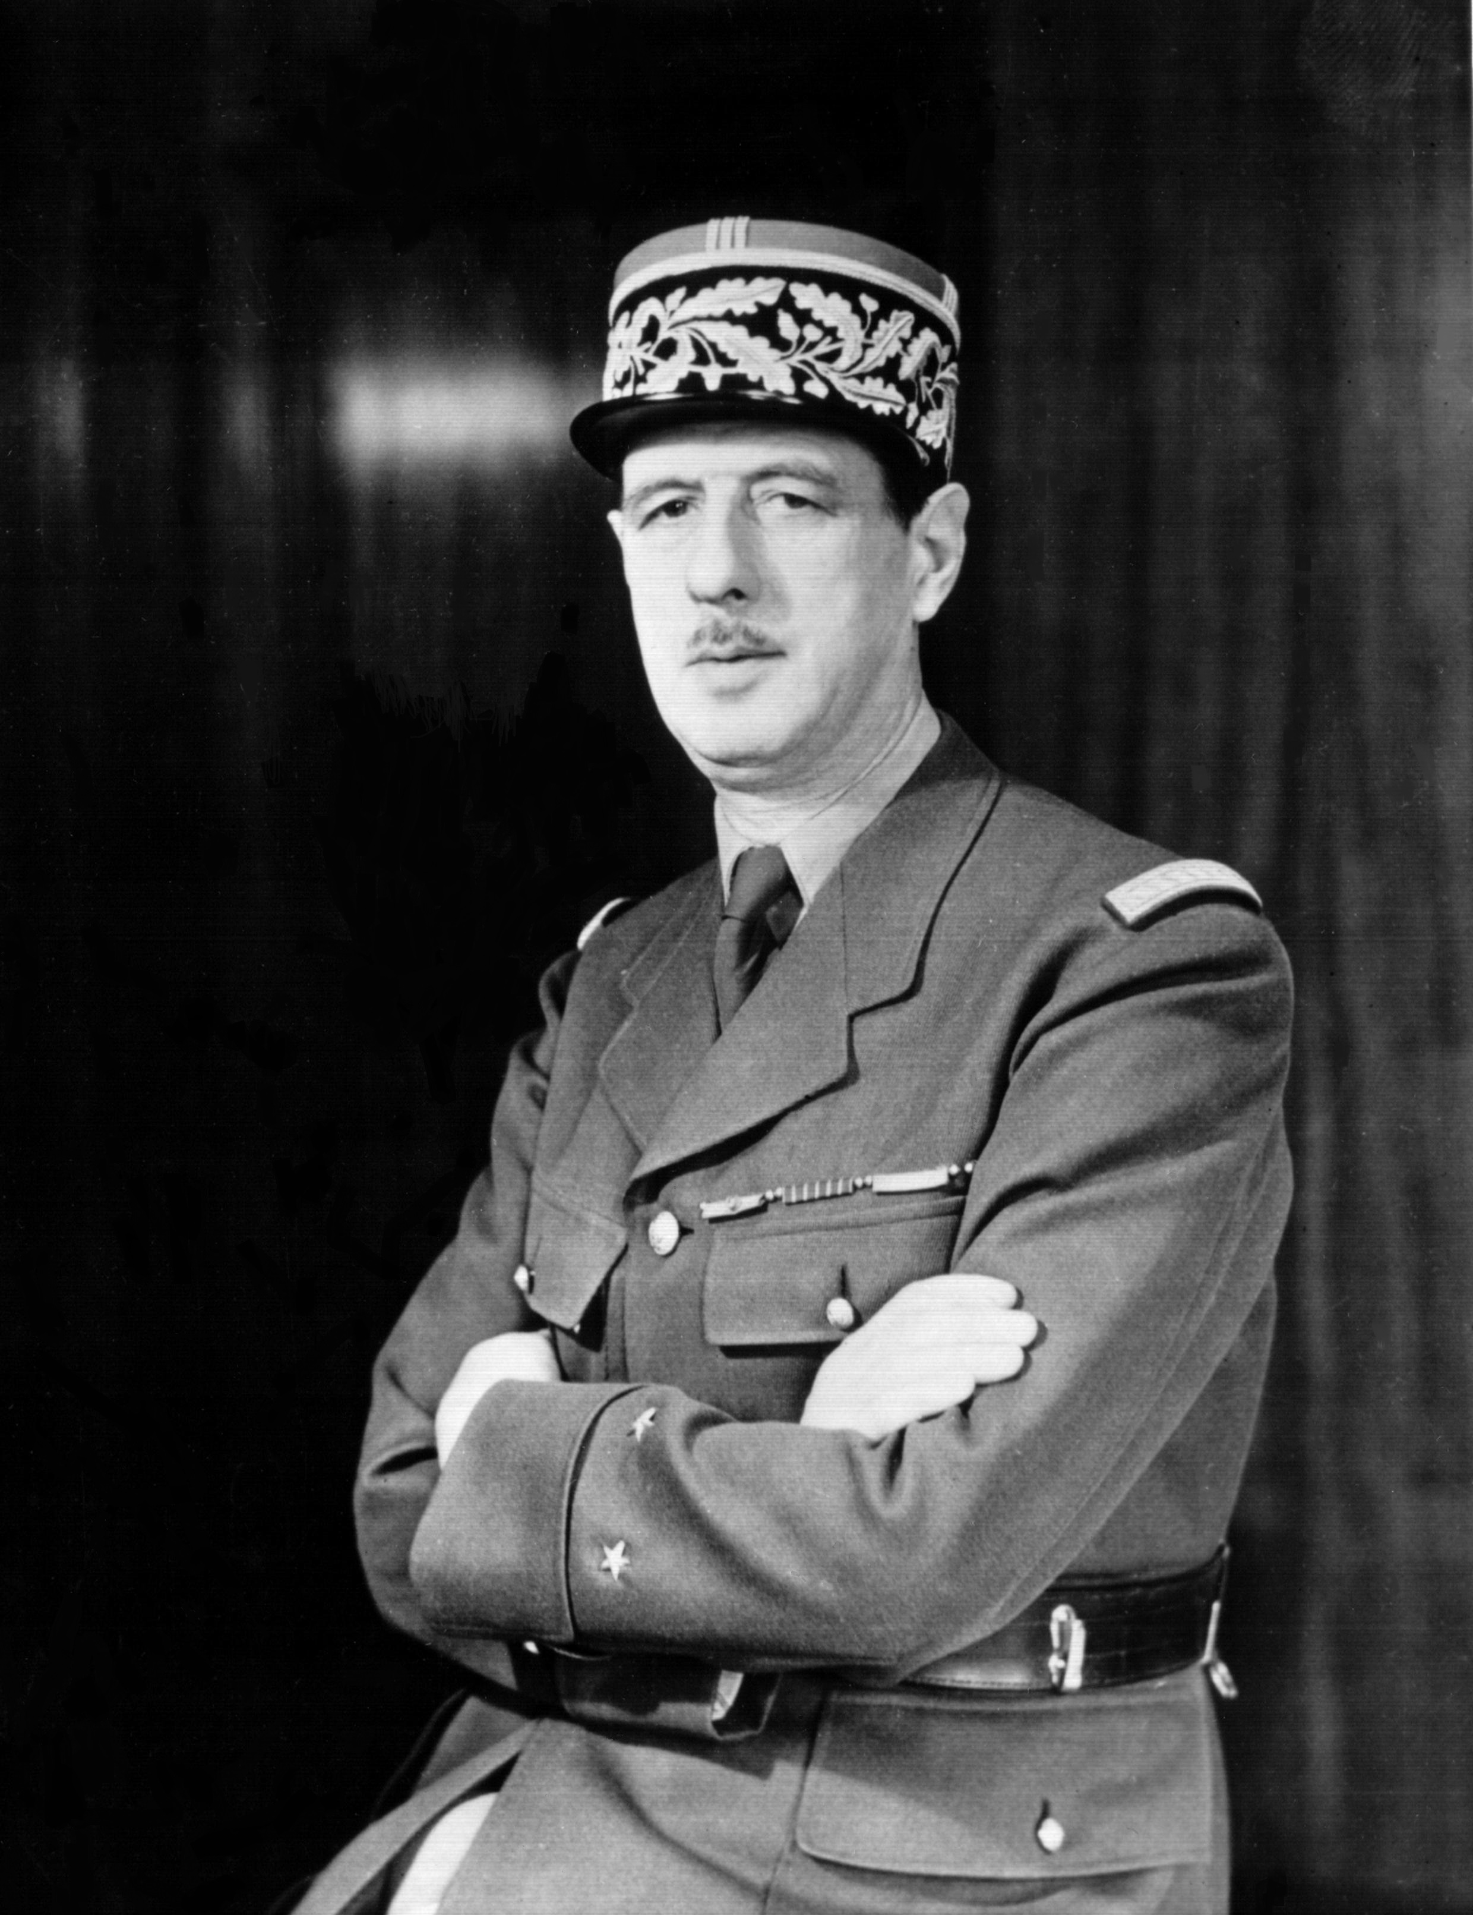
US position in the war years
The US were not especially interested in the region.
In 1942, Roosevelt promised Charles De Gaulle all of France’s overseas dominions after the war to reinvigorate him in the war against Germany; from private correspondence, however, it is clear he would work against France’s imperialist ambitions.
He amended a later suggestion saying that the French could repossess the territory by pledging its eventual independence.

Slide 15
Ho Chi Minh and the US
Initially, Ho sought out American officials to persuade them to furnish him with arms and ammunition
However, Ho’s feelings towards the US are difficult to gauge: “They are only interested in replacing the French… They want to reorganise our economy in order to control it. They are capitalists to the core. All that counts for them is business.” (speaking with Bao Dai in late 1945)
“Cochinchina is burning, the French and British are finished here, and we [the United States] ought to clear out of Southeast Asia.”
OSS chief Lieutenant Colonel A. Peter Dewey

Slide 16
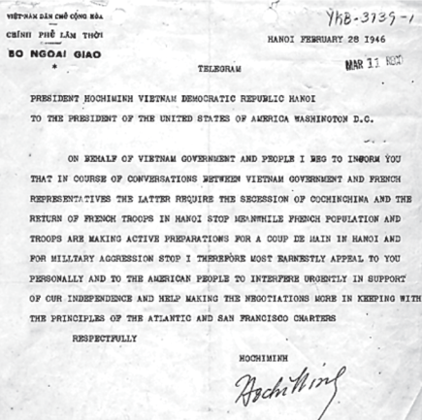
A telegram from Ho Chi Minh to President Harry S. Truman
Transcript:
Hanoi February 28 1946
Telegram
President Hochiminh Vietnam Democratic Republic Hanoi
To The President of the United States of America Washington D.C.
On behalf of Vietnam government and people I beg to inform you that in course of conversations between Vietnam government and French representatives the latter require the secession of Cochinchina and the return of French troops in Hanoi. Meanwhile French population and troops are making active preparations for a coup de main in Hanoi and for military aggression. I therefore most earnestly appeal to you personally and to the American people to interfere urgently in support of our independence and help asking the negotiations more in keeping with the principles of the Atlantic and San Francisco Charters.
Respectfully
Hochiminh

Slide 17
Questions
Transcript:
Hanoi February 28 1946
Telegram
President Hochiminh Vietnam Democratic Republic Hanoi
To The President of the United States of America Washington D.C.
On behalf of Vietnam government and people I beg to inform you that in course of conversations between Vietnam government and French representatives the latter require the secession of Cochinchina and the return of French troops in Hanoi. Meanwhile French population and troops are making active preparations for a coup de main in Hanoi and for military aggression. I therefore most earnestly appeal to you personally and to the American people to interfere urgently in support of our independence and help asking the negotiations more in keeping with the principles of the Atlantic and San Francisco Charters.
Respectfully
Hochiminh
Why does Ho Chi Minh appeal to President Harry S. Truman in this 1946 telegram?
What is the nature of the problem in Vietnam as defined by Ho Chi Minh in this telegram?
Ho Chi Minh calls on the American people to “interfere urgently” in support of Vietnamese independence. What was the probability that United States government officials would respond favourably? Explain. What could the United States have done, had they wanted to intervene?
What is meant by Ho Chi Minh’s reference to the Atlantic and San Francisco Charters? Evaluate how well these Charters support Ho Chi Minh’s appeal to President Truman.

Slide 18
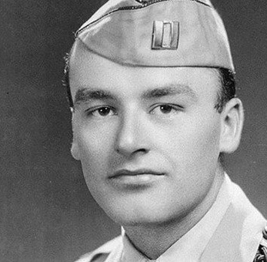
The first to fall (26 September 1945)
Dewey was assassinated (likely by Vietnamese) and was the first of nearly 60,000 Americans to be killed in Vietnam.

Slide 19
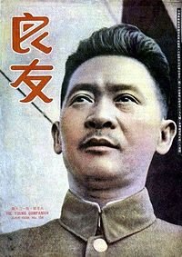
Broadening a support base
Ho formed the Vietminh as a nationalist front, masking its Communist leadership
He also needed to cooperation of the Chinese authorities, whose territory could be used as a sanctuary for his forces.
He faced some issues with Chang Fa-Kwei (warlord of the Guangxi province)

Slide 20
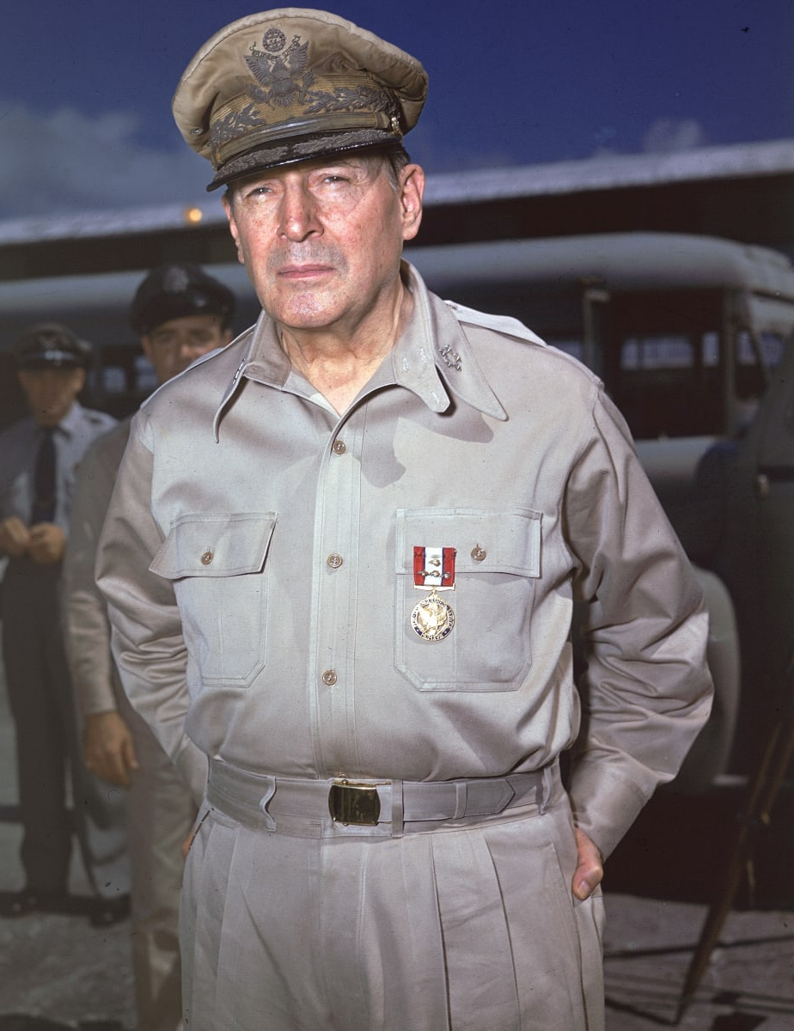
Turmoil ensues
By the end of 1944, US forces under General MacArthur had fought their way up through the Philippines.
General de Gaulle, parachuted French agents and arms into the area with order to attack the Japanese.
The Japanese wasted no time in reacting. Overnight (9-10 March 1945) the French imperial power had crumbled, and the Japanese seems to be doomed to defeat.

Slide 21
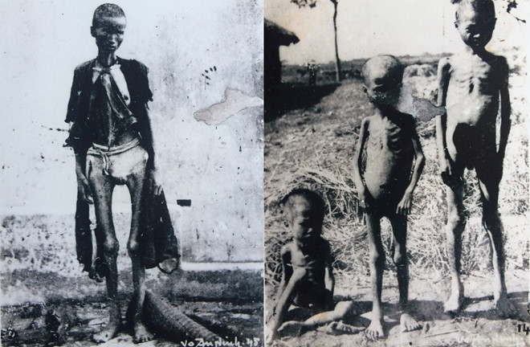
Turmoil ensues
By summer 1945, floods aggravated already serious food shortages.
Starving peasants in several places attacked French posts and stormed Japanese granaries. With the news of Japan’s surrender in August, the uprisings spread.
Vietminh agents quickly took advantage of the turmoil.

Slide 22
Ho takes control
Ho formed a ‘National Liberation Committee’ with himself as president, calling it “the equivalent of a provisional government.”
Bao Dai resigned and in an improvised ceremony, handed over “sovereign power” to the Vietminh.
He warned General de Gaulle “Should you re-establish a French administration here, it will not be obeyed. Every village will be a nest of resistance, each former collaborator an enemy, and your officials and colonists will themselves seek to leave this atmosphere, which will choke them.”

Slide 23
Bibliography
Christine Bragg, Vietnam, Korea and US Foreign Policy 1945-75 (Oxford, 2005) p.91
² Chen Jian, ‘China’s involvement in the Vietnam War, 1964-69,’ 142 (1995) p.359
Stanley Karnow, Vietnam: A History, the first complete account of Vietnam at war (New York, 1983)
¹ Roy, Saha, Armed Forces and Insurgents in Modern Asia (NY, 2016) p.87
Stein Tonnesson, ‘The longest wars: Indochina 1945-75,’ Journal of Peace Research, 22(1) 1985 pp.9-29

