Slide 1
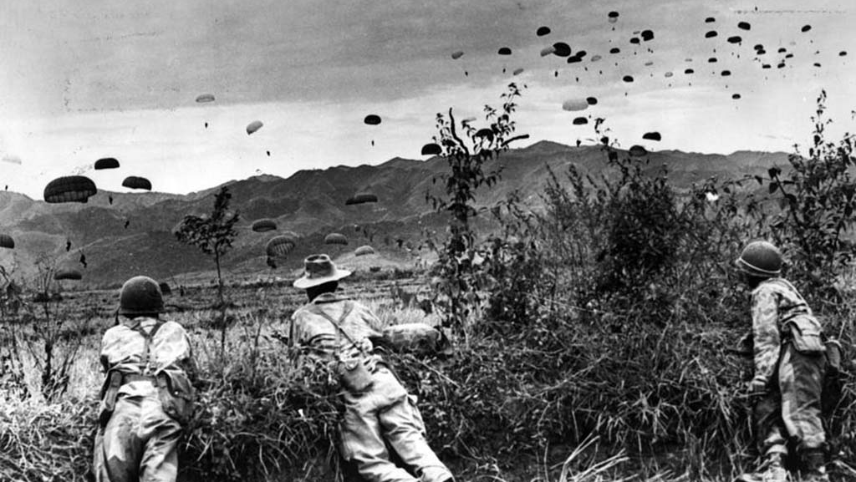
Conflict in Asia 1945-1955
The French in Indochina

Slide 2
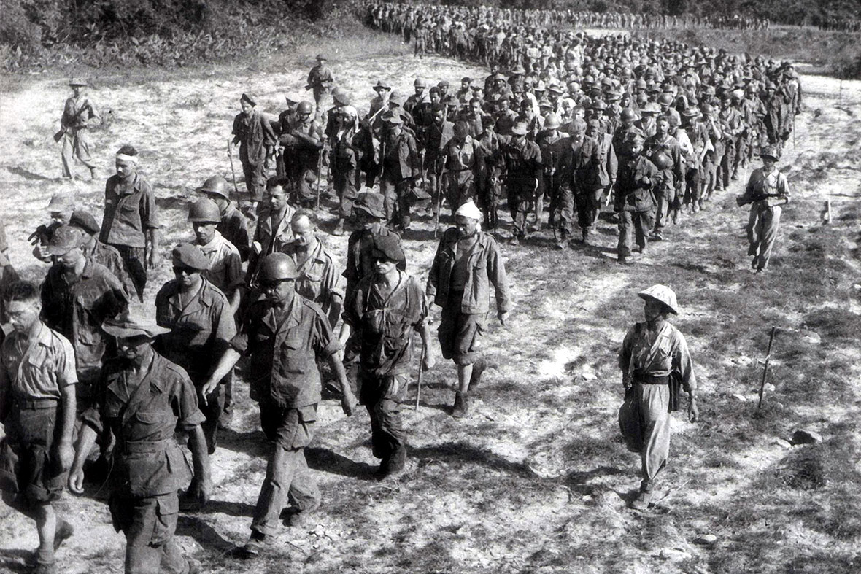
Part 2
The First Indochina War: French defeat and increasing US involvement

Slide 3
Causes of the French-Indochina war
The outbreak of war between France and the Vietnamese Republic in late 1946 needs to be understood on the background of 3 events:
The French ‘loss of Indochina 9 March 1945
Partition of Indochina into two allied zones at Potsdam July 1945
The Vietnamese Revolution 14 August 1945

Slide 4
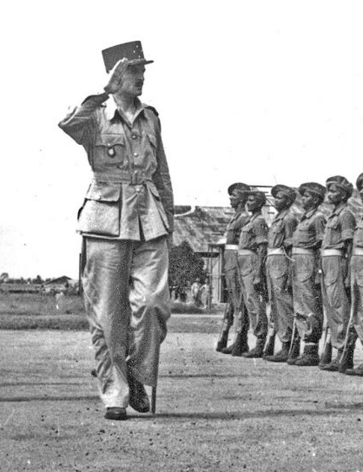
Initial hostilities
Saigon was in chaos and violence grew.
On 21st September 1945 General Gracey further exceeded his instructions by proclaiming martial law
He released and armed 1,400 French army troops, most
On 22 September, a day after their release, French paratroopers and Foreign Legionnaires went on a rampage.

Slide 5
Initial hostilities
The Vietminh launched a general strike on 24 September.
This could be considered the start of the first Indochina war
The strike and its aftermath initiated a momentum of conflict that could not be stopped.
A brutal episode occurred at the Cité Hérault, a residential suburb.
Vietminh agents smashed doors and windows, broke into bedrooms and massacred 150 French and Eurasian civilians

Slide 6
Attempts at negotiation
Ho felt his only alternative was to allow the French to come back on the condition that they recognised Vietnam’s independence.
France would recognise Vietnam as a free state within the French Union and Ho would permit the presence of 25,000 French troops in Vietnam for the next five years.
The final confirmation of this accord never came, however.

Slide 7
Escalation
The situation escalated on 23 November 1946 when Dèbes, demanded that the Vietminh authorities evacuate their troops from Haiphong within two hours.
French infantry and armoured units went through the city, fighting house to house against Vietminh squads.
French aircraft zoomed in to bomb and strafe while a cruiser in the harbour lobbed shells into the city, demolishing neighbourhoods.

Slide 8
Escalation
In May 1947 Ho rejected a ceasefire that required the Vietnam to lay down its arms
At the time, French public opinion favoured toughness to regain the national pride they had lost to the Germans in 1940.
France was thus led into war in Vietnam but a Socialist regime too unstable to withstand the challenge of its conservative critics.

Slide 9
Dwindling control
The French managed to persuade Bao Dai to sign a ‘protocol’ that was so hedged with qualifications it rendered it meaningless.
France ‘solemnly’ recognised Vietnam’s independence, but would keep control of its army, finances and foreign affairs.
March 1949, Bao Dai and France’s figurehead president Vincent Auriol signed the Elysée Agreement which reconfirmed Vietnam’s independence.

Slide 10
The tides change
Ho persuaded Moscow and Beijing to recognise his regime, the Democratic Republic of Vietnam, and his status in the eyes of the West changed overnight.
By late 1949, Acheson and other senior figures in the Truman administration were weighing tangible help for the French in Indochina through a foreign military aid program
The French were becoming too bogged down in Indochina to meet their military obligations in Western Europe.

Slide 11
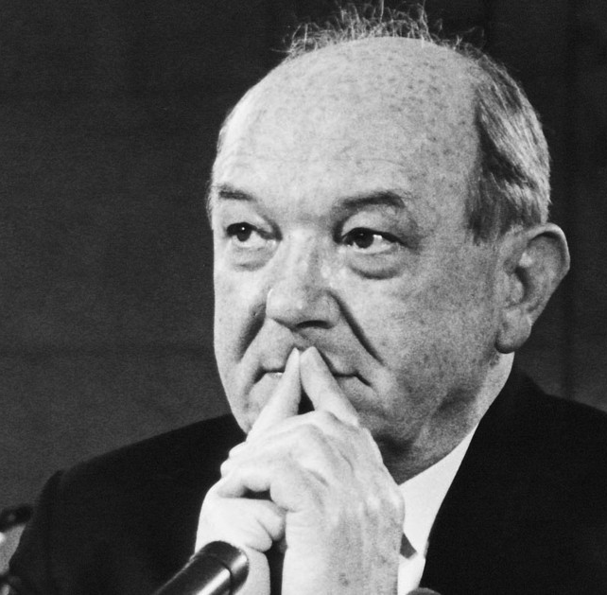
American involvement
Dean Rusk saw the French effort in Indochina as a stand against Soviet expansion and he argued in favour of US aid to France
The French resented intrusion in their affairs
A huge slice of American aid went to Bao Dai as a personal allowance.

Slide 12
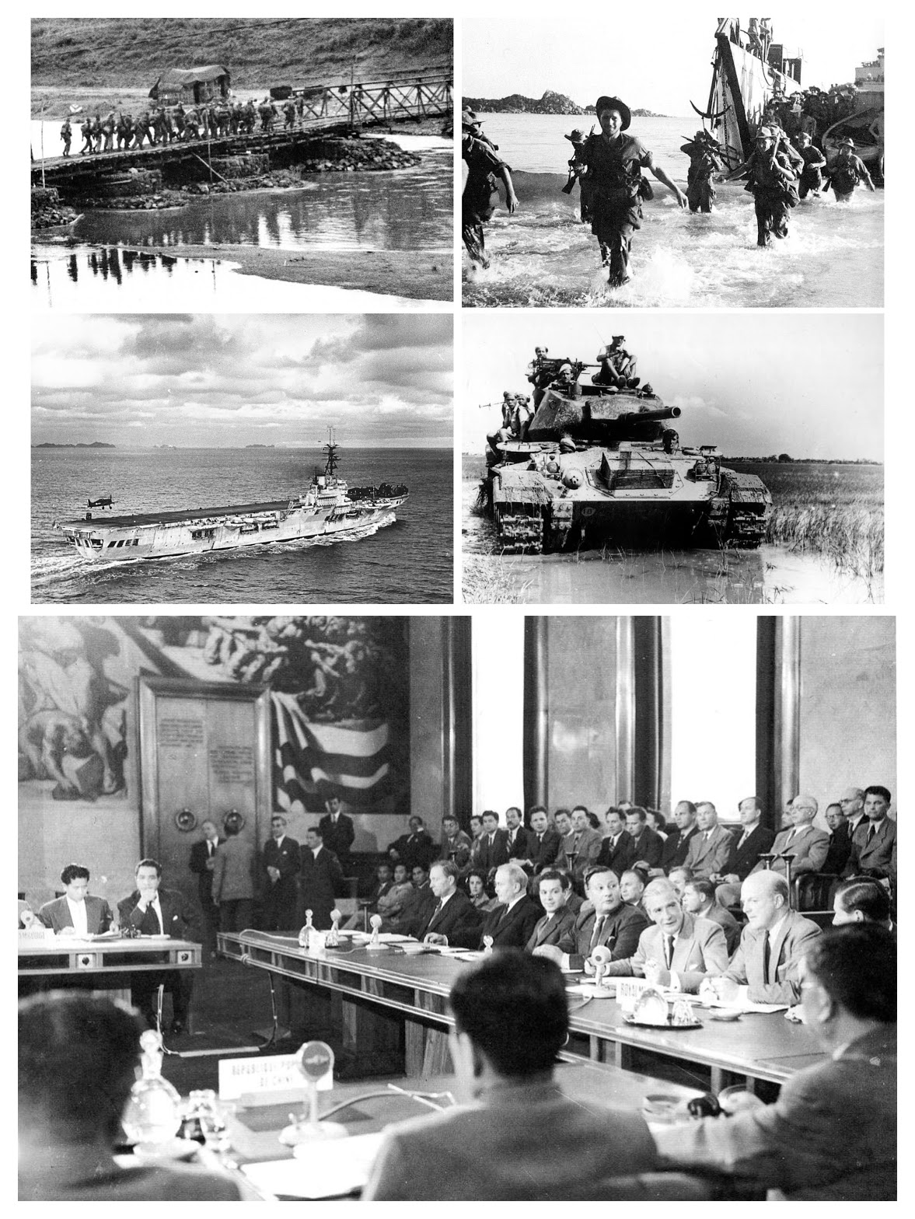
US position
During the course of the 8 year war, the US changed from seeing the conflict as “the war waged by the Expeditionary Corps” to “the defence of the free world against communism”
In 1952 the US supplied massive military hardware to the FEC
1950: $130 million
1953: $800 million (3/4 the cost of the French war effort)¹

Slide 13
Strengths of the Vietminh
Vietminh troops could disappear and dart out to ambush road-bound French columns
The terrain offered secure havens and Mao’s triumph in China gave them even safer sanctuaries across the border.
The Chinese Communists also supplied the Vietminh with advisers and modern American weapons captured from Chiang Kai-shek’s defeated Nationalists.

Slide 14
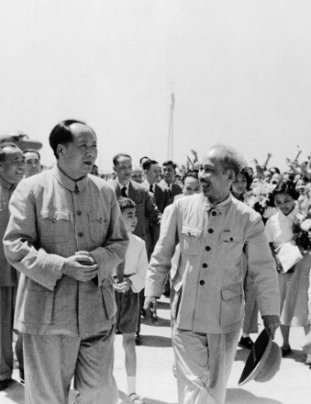
Chinese position
In 1950, Minh and Giap visited China which had just recognised the VM as the legitimate government of Vietnam
Vietminh soldiers could be trained in China, safe from French attack
1956-63 Chinese military aid:
- 270,000 guns
Over 100,000 pieces of artillery
2.02 million artillery shells
15,000 wire transmitters, 5,000 radio transmitters
Over 1,000 trucks, 15 planes, 28 naval vessels
1.18 million sets of military uniforms²

Slide 15
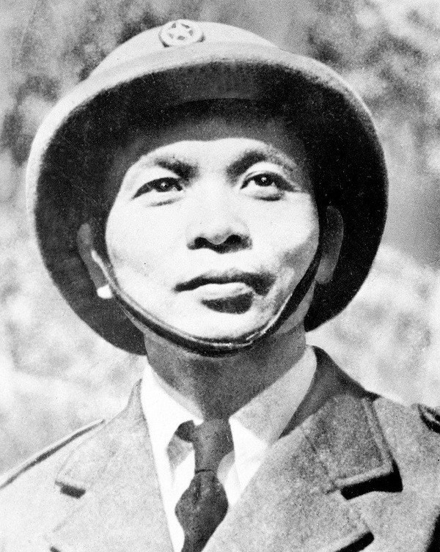
Giap’s campaigns
Giap began his drive gradually in 1949 by harassing the most isolated French garrisons.
He now had to conquer the main population centres surrounding Hanoi and Saigon and get the food his men desperately needed
He made several different attacks but miscalculated the ability of the French to resist and deploy reinforcements.

Slide 16
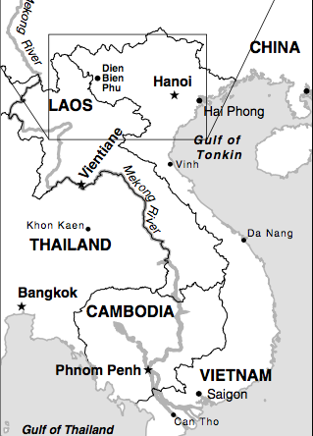
Laos
Meanwhile Giap dreamed of a more ambitious target – Laos.
He estimated the French would fight to protect Laos
He hoped to snare the French in the region along the Laotian border where their supply lines were stretched thin.
After a series of clashes, Giap drove into Laos in April 1953.

Slide 17
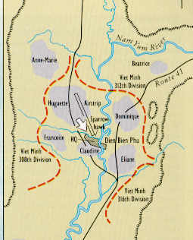
Dien Bien Phu: build up of forces
6th Dec 53 – 13th Mar 54
The French build strongpoints to defend garrison.
The Viet Minh surround the garrison.

Slide 18
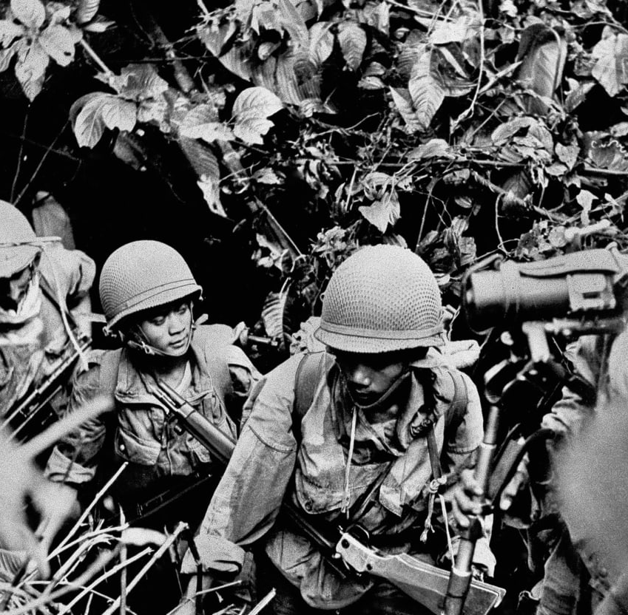
The Siege Begins
17:00 13th Mar 54 – Viet Minh artillery barrage followed by assaults.
“Beatrice”, falls, two days later, “Gabrielle” overrun, and three days later, “Anne-Marie”.

Slide 19
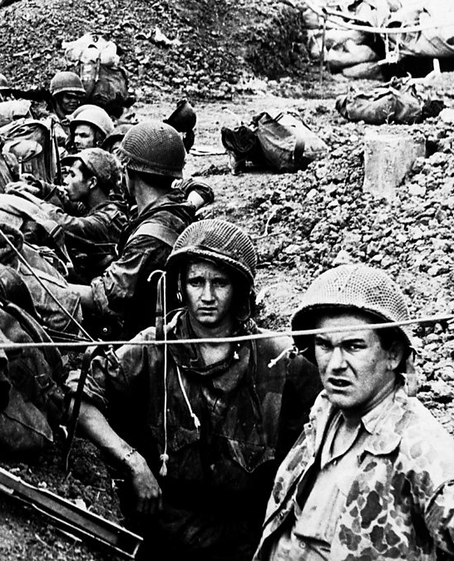
The Last Charge
2 May: Giap assaults on all fronts. In the next three days, he takes three more strongpoints, leaving the central area open.
6 May: Artillery barrages continue on remaining French troops, while Viet Minh mass.
7 May: At 1730, Viet Minh enter French command bunker and De Castris surrenders.
French estimate casualties as high as 20,000
Official VM figures at the time were 13,930 casualties including 4020 dead

Slide 20
Consequences
The war dragged on from 1946-1954. The French effectively controlled the towns and the Viet Minh the countryside.
The decisive event came in 1954 at Dien Bien Phu. A large, well-armed force of French paratroopers was comprehensively defeated.
The French lost 3000 dead in the battle and 8000 more died in captivity.
The Viet Minh forces had defeated the French in open battle with the help of modern weapons from the USSR and China.
A small Asian state had defeated a rich European state through a combination of effective leadership, the right tactics and sheer domination.
At the 1954 peace Conference, the country was effectively divided into North and South Vietnam until elections could be held to decide its future.

Slide 21
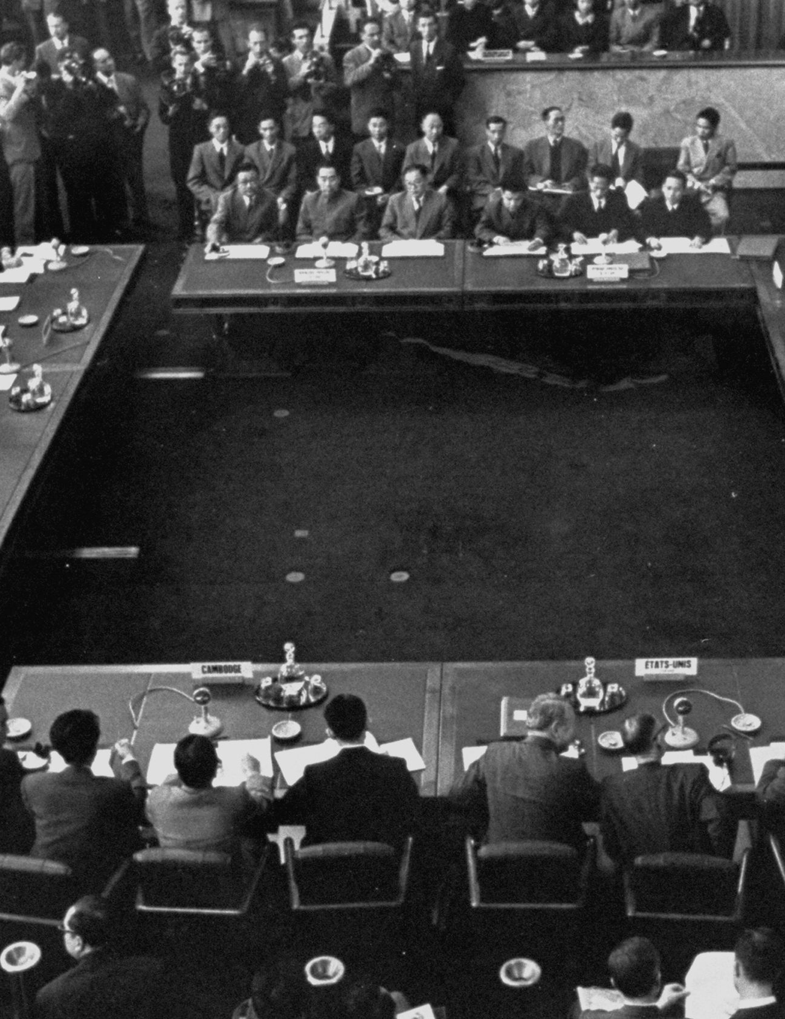
The Geneva Peace Accords 1954
The Geneva Peace Accords, signed by France and Vietnam in the summer of 1954, provided for the temporary partition of Vietnam at the 17th parallel, with national elections in 1956 to reunify the country.
In the North, a communist regime, supported by the Soviet Union and the People's Republic of China, set up its headquarters in Hanoi under the leadership of Ho Chi Minh.

Slide 22
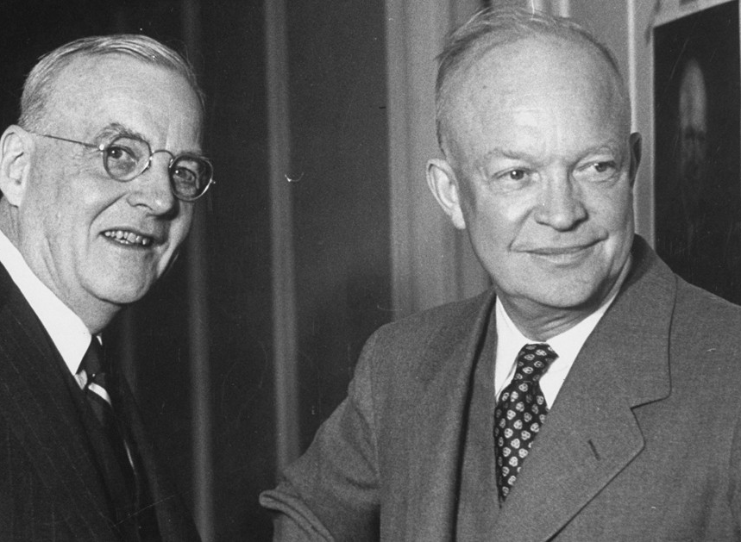
Opposition to the Geneva Accords
The United States prevented the elections that were promised under the Geneva conference because it knew that the Communists would win.
  Secretary of State John Foster Dulles thought the Geneva Accords granted too much power to the Communist Party of Vietnam.
He and President Dwight D. Eisenhower supported the creation of a counter-revolutionary alternative south of the 17th parallel.

Slide 23
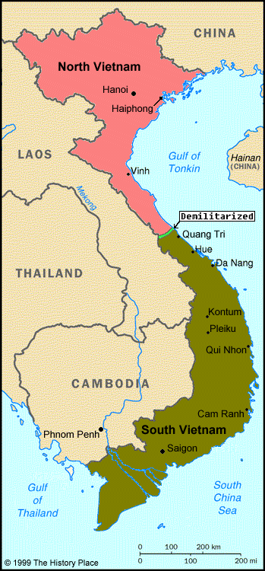
The Democratic Republic North Vietnam was set up by communist Ho Chi Minh.
The South Vietnamese government was led by the American-based Ngo Dinh Diem

Slide 24
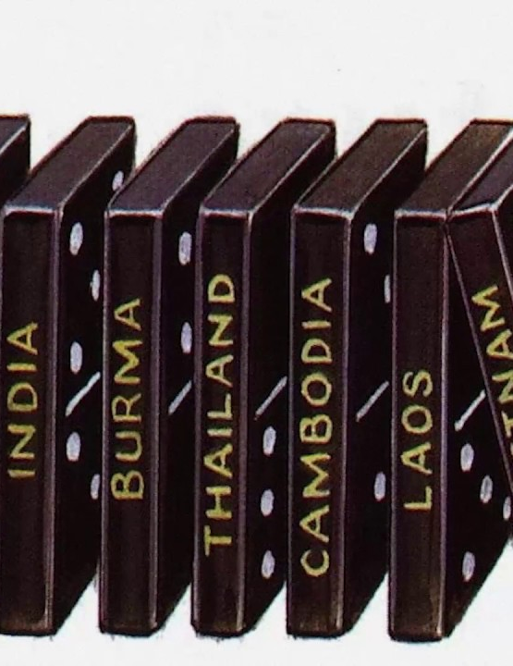
Under the terms of the cease fire, elections were to be held within two years to reunite the country.
However, the USA prevented the elections from taking place because it feared that the Communists would win.
WHY?
President Eisenhower was convinced that China and the USSR were planning to spread Communism throughout Asia. The idea was often referred to as the Domino Theory. – If Vietnam fell to Communism, then other Asian countries might also – like a row of dominoes.
The USA saw Vietnam first in the line of the dominoes and were determined not to let it fall.

Slide 25
Bibliography
Christine Bragg, Vietnam, Korea and US Foreign Policy 1945-75 (Oxford, 2005) p.91
² Chen Jian, ‘China’s involvement in the Vietnam War, 1964-69,’ 142 (1995) p.359
Stanley Karnow, Vietnam: A History, the first complete account of Vietnam at war (New York, 1983)
¹ Roy, Saha, Armed Forces and Insurgents in Modern Asia (NY, 2016) p.87
Stein Tonnesson, ‘The longest wars: Indochina 1945-75,’ Journal of Peace Research, 22(1) 1985 pp.9-29

