Slide 1
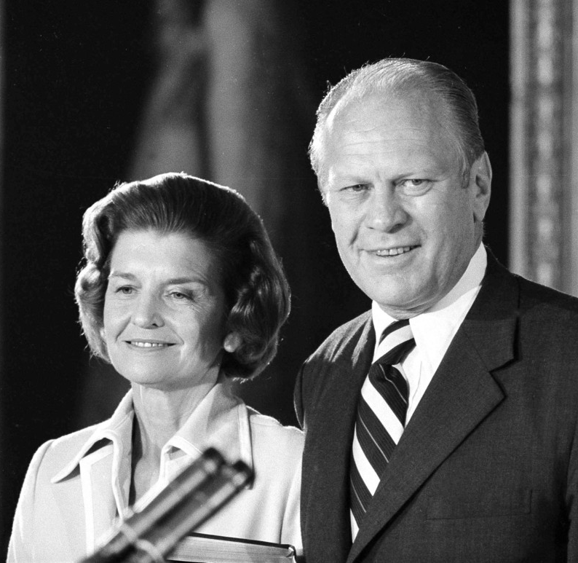
Why did détente meet more opposition under Gerald Ford?
1974-77

Slide 2
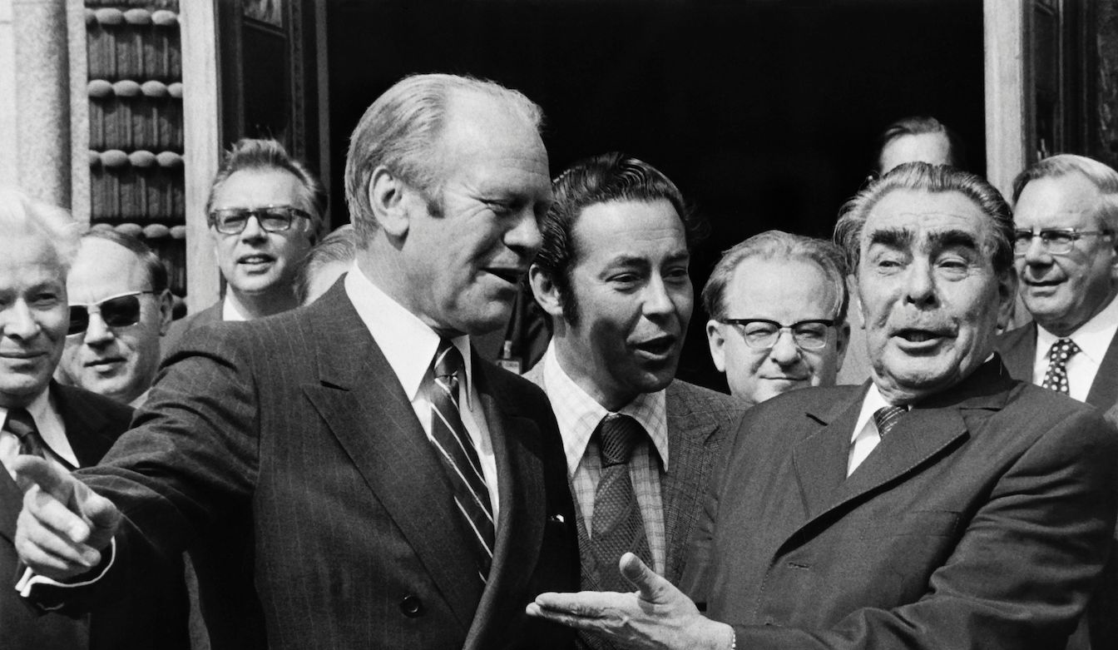
The first months
Vice President Gerald Ford succeeded Nixon in August 1974
He vowed to continue the foreign policies set out by Nixon and Kissinger.
Kissinger remained secretary of state and national security adviser.
Ford met with Brezhnev at Vladivostok in late November and early December 1974; SALT II would limit each side’s nuclear delivery vehicles (ICBM’s, SLBMs, and long range bombers) to 2,200.

Slide 3
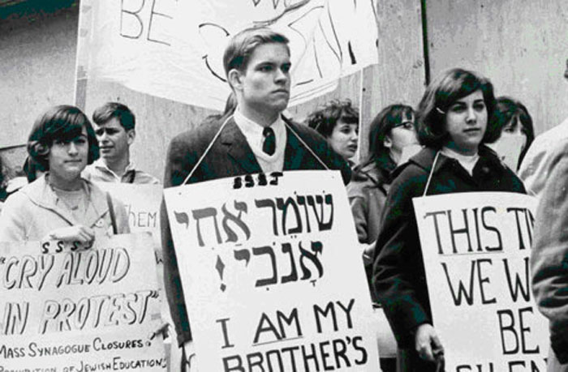
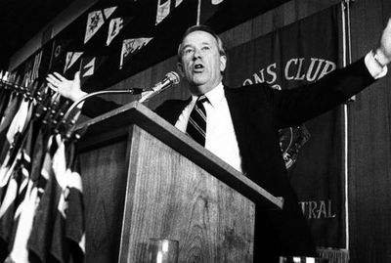
Jackson-Vanik amendment
Senator Henry Jackson and Congressmen Charles Vanik sponsored an amendment to the 1972 Trade Reform Bill. The Bill proposed to grant the Soviets the status of a most favoured nation in trade with the US if the Soviets agreed to lift a recently imposed exit tax on Jewish emigrants wishing to leave the Soviet Union.
In December 1974, the Jackson-Vanik amendment was attached to the 1974 trade bill and approved by unanimous vote, with Ford signing it into law on 3 January 1975.
The SU responded to the new law by aborting talks over a potential trade agreement.

Slide 4
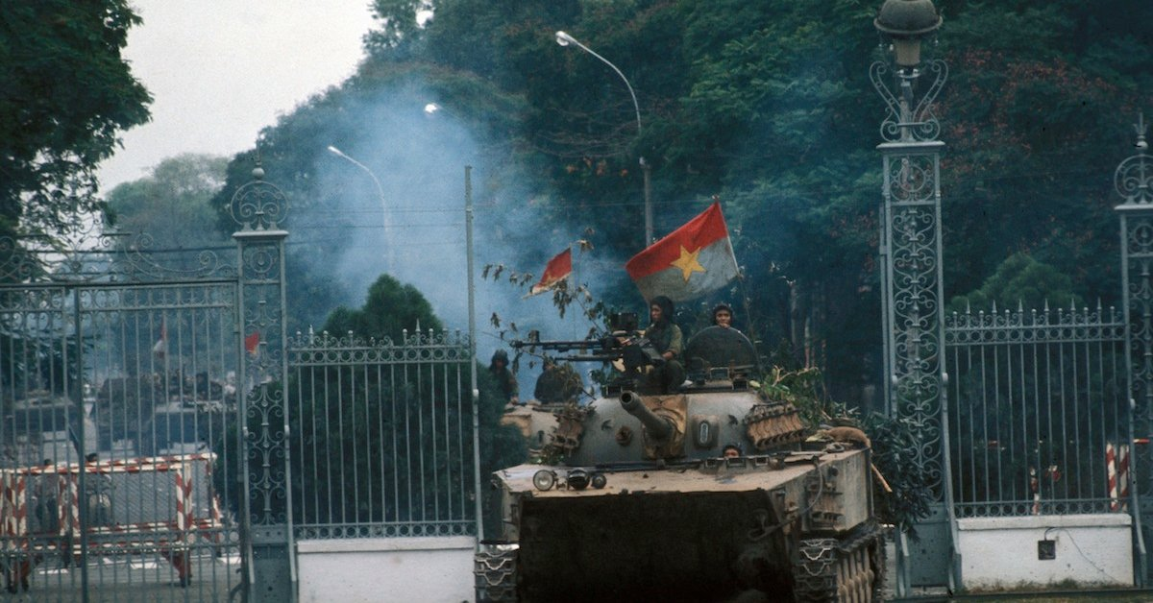
Ending the war in Vietnam
In 1975, the Ford administration was preoccupied with the deteriorating situation in Vietnam.
March: armed forces of North Vietnam intensified an offensive against the South; the Army of the Republic of Vietnam retreated in disarray
Late April: North Vietnamese and National Liberation Front troops surrounded Saigon, forcing the last Americans to leave.
30 April: Communist forces captured the presidential palace in Saigon and declared victory in the war.

Slide 5
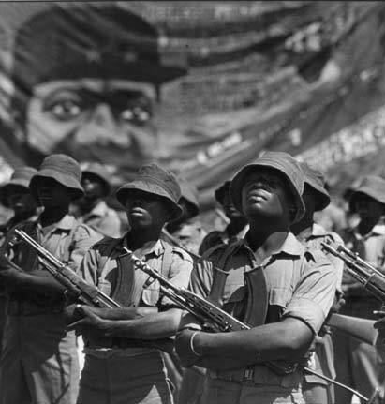
The Angolan Civil War
In July, Kissinger insisted the CIA provide additional financial and military aid to the National Front for the Liberation of Angola (FNLA)
Kissinger advocated intervention in the Angolan civil war as a counter to the Soviet Union which supported the Popular Movement for the Liberation of Angola (MPLA), a rival faction.
Kissinger believed that the Soviets supported the MPLA because they felt emboldened by the American defeat in Vietnam.

Slide 6
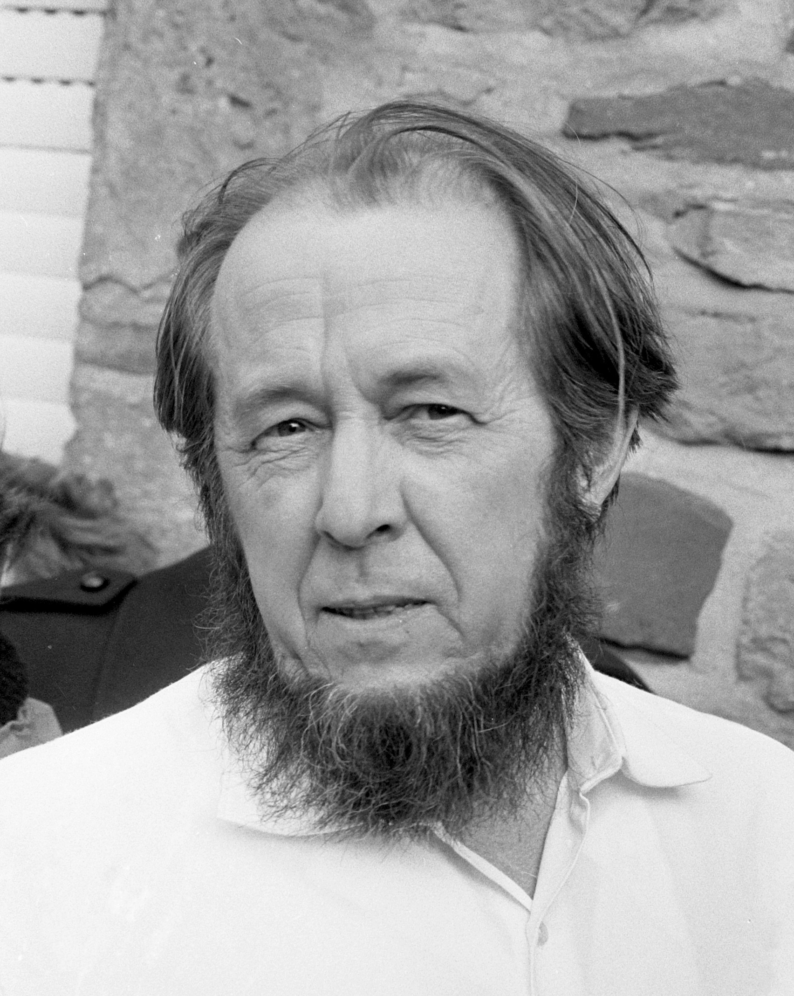
Aleksandr Solzhenitsyn
In August 1975, the Soviet Union endorsed the Helsinki Accord which committed the USSR to upholding the basic principles of human rights.
This period encouraged dissidents, including Andrei Sakharov and Alexander Solzhenitsyn.
Solzhenitsyn’s book The Gulag Archipelago (about his experiences in the labour camp system) was published abroad in 1973.
His works were highly critical of the Soviet system; his treatment in the USSR received a lot of publicity in the West.
He was stripped of his Soviet citizenship and exiled from the USSR in 1974.

Slide 7
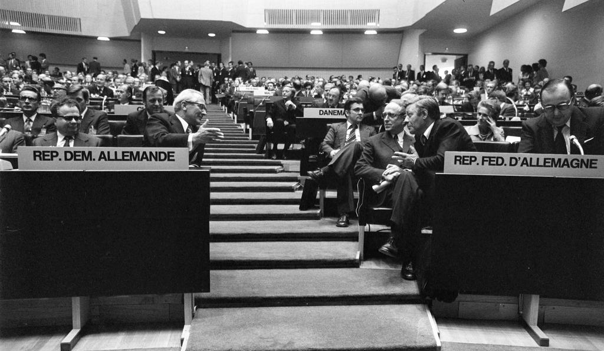
Opposition to the CSCE
Ford declined to meet with expelled Soviet dissident writer Aleksandr Solzhenitsyn.
Solzhenitsyn denounced the CSCE meeting in Helsinki in 1975 as a “betrayal of Eastern Europe.”
Many Americans of Eastern European ancestry opposed to Soviet influence in Eastern Europe and complained that the acknowledgment of current borders validated the 1940 Soviet occupation and annexation of the Baltic states of Lithuania, Latvia, and Estonia.

Slide 8
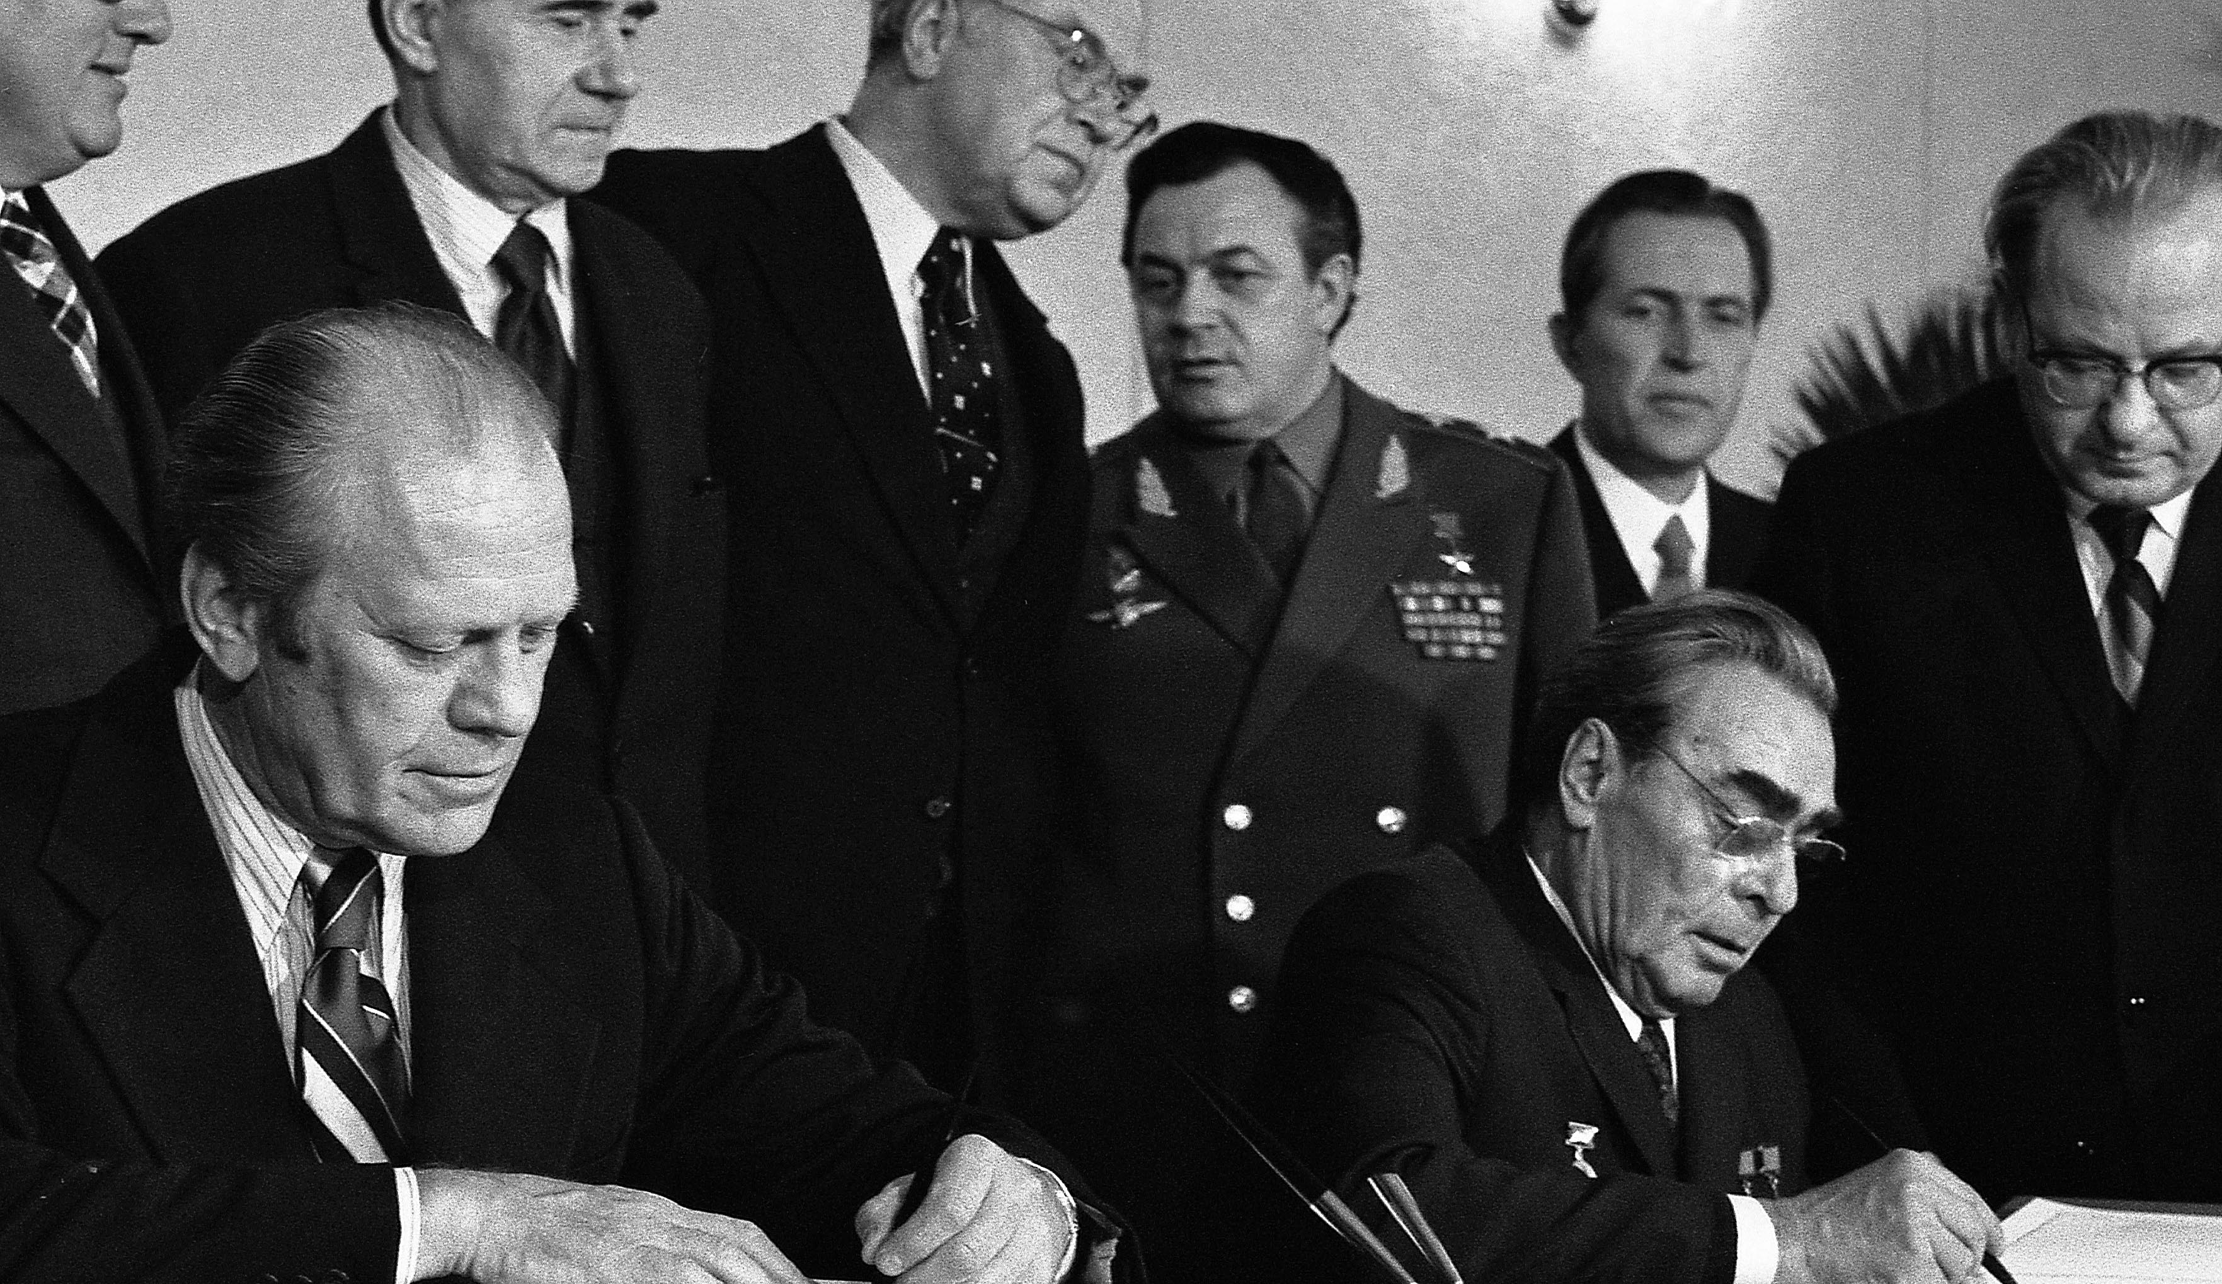
Ford changes track
Ford’s trip to the conference was unpopular; he sought to recover by adopting a more confrontational stance toward the Soviet Union.
He looked directly at Brezhnev during his speech and insisted that the Soviets “realize the deep devotion of the American people and their government to human rights and fundamental freedoms.”
Ronald Reagan, who was preparing to challenge Ford for the Republican presidential nomination in 1976, asserted that “all Americans should be against” the Helsinki Final Act.

Slide 9
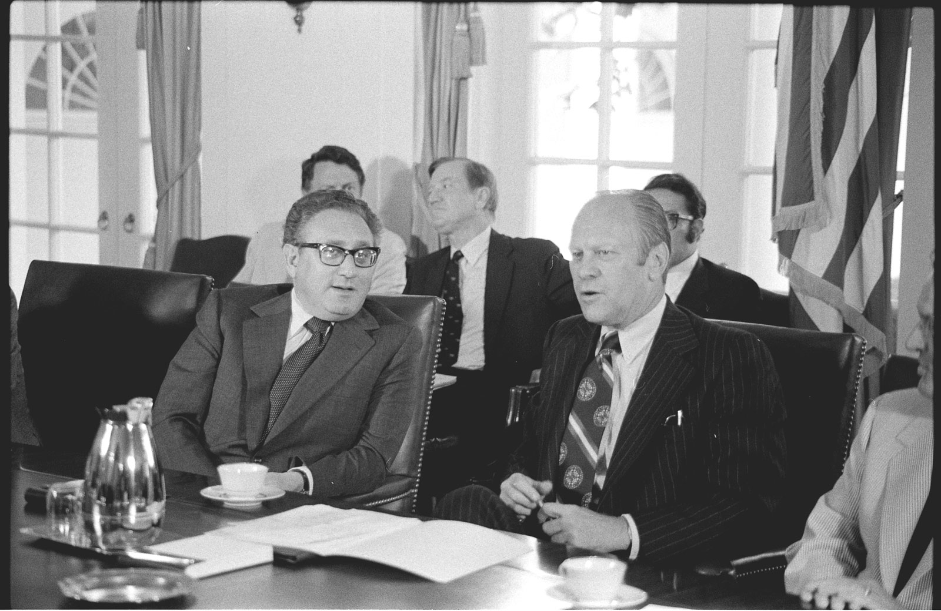
Détente diminishing?
Ford replaced Kissinger as national security adviser. Kissinger remained secretary of state, but his authority was clearly diminished.
In February 1976, Ford explained that officials in his administration would no longer use the word “détente” to characterize US–Soviet relations.
Brezhnev did not visit the United States after the Vladivostok meeting of November 1974.

Slide 10
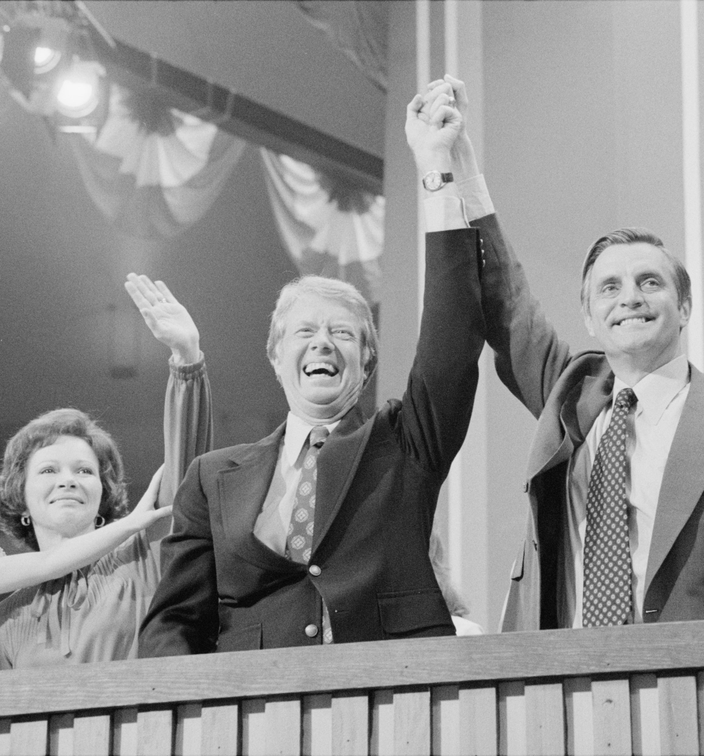
Ford defeated
Carter condemned Ford for declining to meet with Solzhenitsyn in the summer of 1975.
Ford blundered in a televised debate with Carter when the president, attempting to defend the Helsinki Final Act, denied that the Soviet Union dominated Eastern Europe.
Carter defeated Ford in November 1976, and he owed his election in part to the public’s sense that détente gave unfair military advantages to the Soviet Union while betraying traditional American commitments to expand human rights abroad.

Slide 11
Want more?
BBC sounds podcast on Aleksandr Solzhenitsyn
An overview of the life of Gerald Ford by Jim Kratsas
A film shown at the Gerald R. Ford Presidential Museum (20 minutes)
Ford falling down a set of airplane steps…

Slide 12
Bibliography
Rob Bircher, Oxford AQA History: A Level and AS Component 2: The Crisis of Communism: The USSR and the Soviet Empire 1953-2000’ (Oxford, 2015) p.59
Simon Davis and Joseph Smith, The A to Z of the Cold War (Oxford, 2005) p.180
Ruud van Dijk, Encyclopaedia of the Cold War (New York, 2013) p.470
Robert D. Schulzinger, ‘Détente in the Nixon–Ford years, 1969–1976’ in Melvyn P. Leffler and Odd Arne Westad eds., The Cambridge History of the Cold War: Volume II Crises and Detente (Cambridge, 2010) pp.388-392
Allan Todd, History for the IB Diploma: The Soviet Union and Eastern Europe 1924-2000 (Cambridge, 2012) p.134

