Slide 1
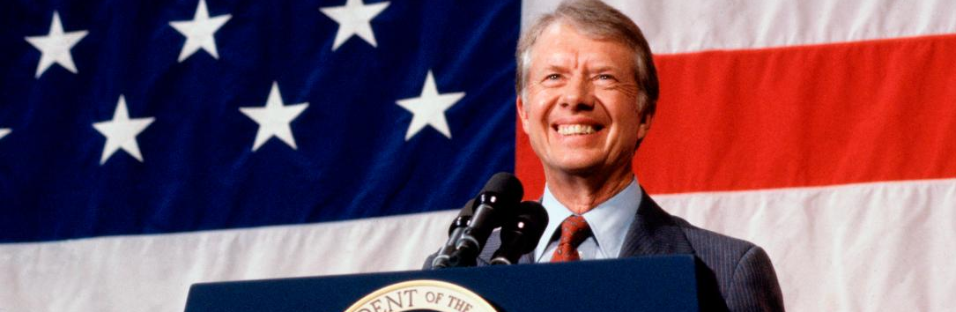
Trapped in the Manichean view of the Cold War?
The Carter years (1977-1981)

Slide 2
Starter: Why did the Cold War freeze again by the 1980s?
What do you already know about the following events, that contributed in some way to the collapse détente by 1980?
Iranian Revolution
Human Rights
Collapse of SALT II
The Moscow and Los Angeles Olympics
Civil wars in Nicaragua, El Salvador and Angola
New nuclear weapons
Afghanistan

Slide 3
Why did the Cold War freeze again by the 1980s?
Revolution in Iran
The Shah of Iran was overthrown in 1979. The USA had supported the Shah because it needed Iran’s oil. The new government was strongly anti-American but also strongly anti-communist. The revolution changed the balance of power in the Middle East and increased tension between the superpowers, who were worried about how each other would react.
New nuclear weapons
In 1977, the USSR began replacing out-of-date missiles in eastern Europe with new SS-20 nuclear missiles. The West saw these missiles as a new type of battlefield weapon that could be used in a limited nuclear war confined only to Europe. In response, President Carter allowed the US military to develop the Cruise missile. By 1979 the USA had stationed Pershing missiles in western Europe as an answer to the SS-20s.
Afghanistan
In 1979 the pro-Soviet regime in Afghanistan was under serious threat from its Muslim opponents, the Mujahideen. To protect the regime, Soviet forces entered Afghanistan on 25th December 1979. Wester powers were alarmed that the USSR could get so close to the West’s oil supplies in the Middle East. President Carter described the Soviet action as ‘the most serious threat to peace since the Second World War.’ The USA secretly began to sent large shipments of money, arms and equipment to Pakistan and from there to the USSR’s Mujahideen opponents. The campaign became the Soviet Union’s equivalent of the Vietnam War. It was a nightmare campaign, virtually unwinnable for the Soviet forces, although they remained there until the early 1990s.
Civil wars in Nicaragua, El Salvador and Angola
Communist rebels (supported by Cuban and Soviet money and experts) tried to overthrow the governments of these states in South America and Africa. The USA funded the governments against the revels. In Angola, the USA and the USSR helped to fund a long-running Civil War.
Collapse of SALT II
The main terms of the SALT II agreement had been set out as early as 1974. It was not until June 1989 that SALT II was finally signed. By that time, relations between the USA and USSR had deteriorated so much that the US Congress refused to ratify SALT II.
The Moscow and Los Angeles Olympics
In protest at Soviet involvement in the Afghan War, the USA boycotted the 1980 Olympic games held in Moscow. In retaliation, the USSR and eastern European teams boycotted the Los Angeles Olympics held four years later.
Human rights
Jimmy Carter openly criticised the USSR’s suppression of dissidents – people who spoke out against the government in both the USSR and easter Europe.

Slide 4
Iranian Revolution
Collapse of SALT II
Which of these events do you think was most responsible for freezing relations by 1980? Are there any missing?
Organise your ideas using the diagram below.
Civil wars in Nicaragua, El Salvador and Angola
The Moscow and Los Angeles Olympics
Most responsible
Human Rights
Afghanistan
New nuclear weapons
Least responsible

Slide 5

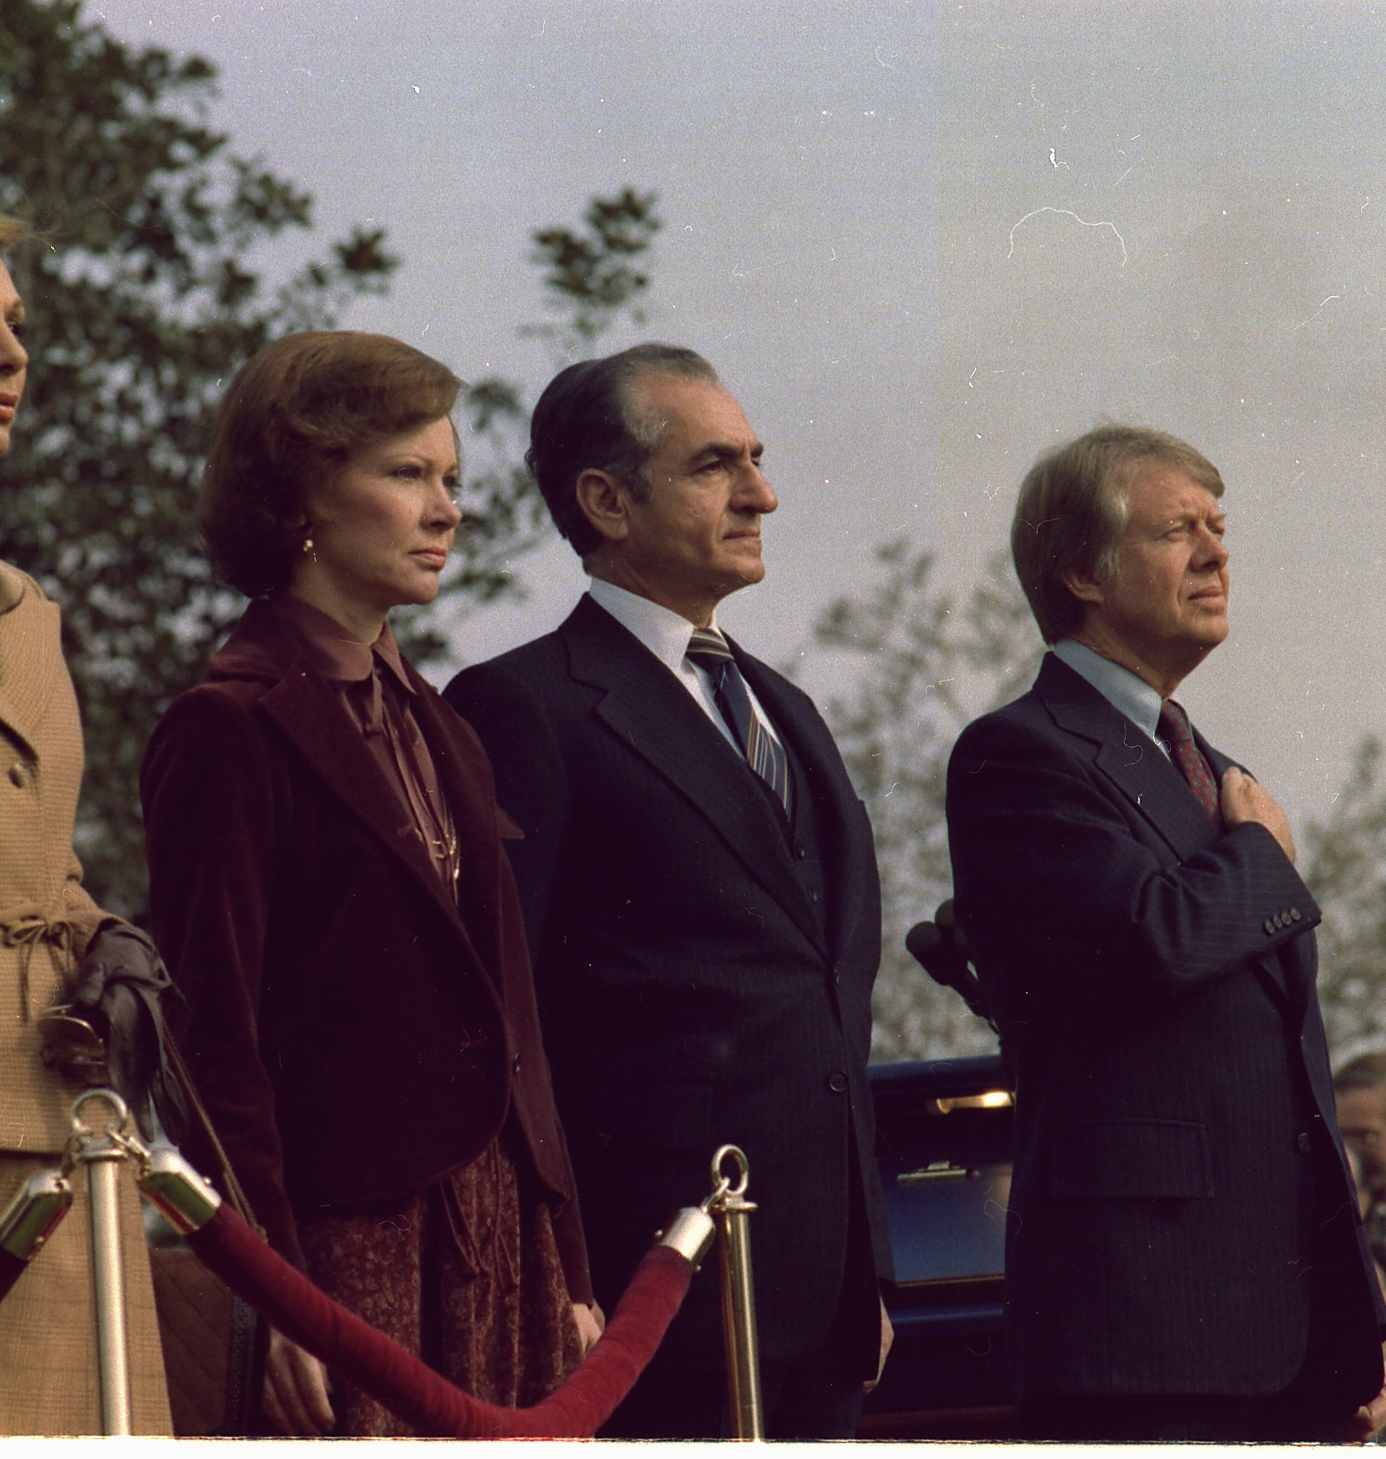
Part 1: Carter – a policy review
Part 3: Case studies
Part 2: Ethiopia
Content
China
The Middle East
Central America
Poland

Slide 6
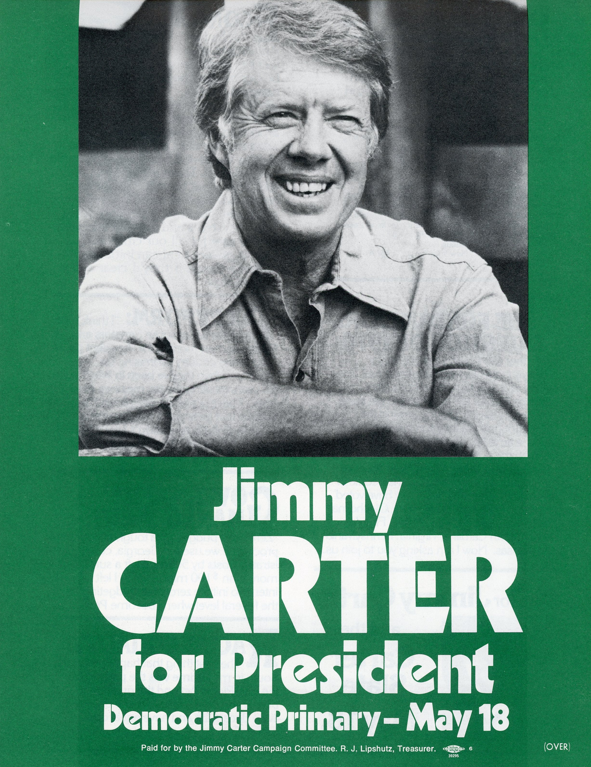
Carter on the campaign
Carter ran a smart campaign in 1976, discussing the humans rights issues that had been raised in the aftermath of the Helsinki Accords.
Liberals believed Carter would distance the United States from right-wing dictators in the Third World; conservatives thought he would put pressure on the Soviet Union. Either way, Carter didn’t elaborate.
During the campaign, Carter promised to maintain détente, but by 1976 no one was sure what that meant.
Détente described a slight reduction in tensions; a tug-of-war at a country fair where both teams, feet dug deep into the earth and faces red and blotchy, pause for a second.
Carter inherited an extremely contradictory policy toward the Soviet Union (which he didn’t necessarily bring clarity to!)

Slide 7
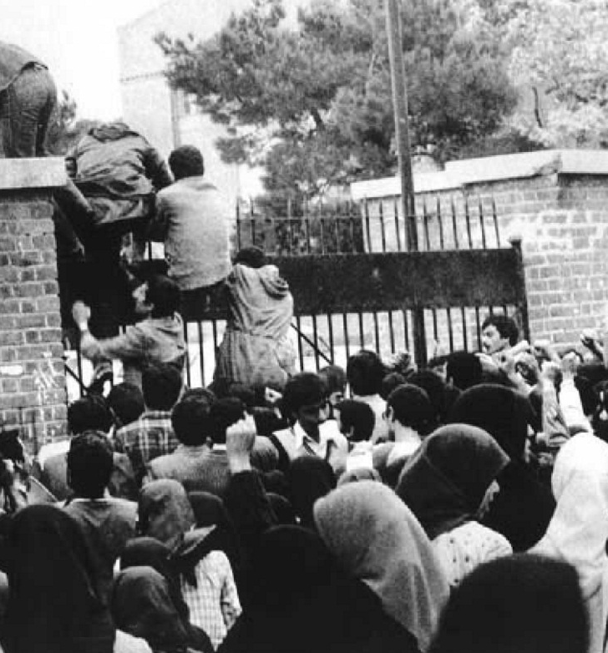
Stuck with a the Manichean view of the Cold War?
Against the backdrop of the US loss in Vietnam, the Cuban and Soviet intervention in Angola acquired significance
After this point, the phrase détente seems to have been air-brushed out by the Republican Party.
Americans focused on their inability to stop the Communists in Ethiopia, Afghanistan, and Nicaragua which overshadowed important developments in favour of the US (normalisation of diplomatic relations with China, excluding the Soviet Union from the Middle East peace process, and the challenge to Soviet control over Poland).
On top of this, the Iranian humiliation detracted from the bigger picture.

Slide 8
A divided inner-circle
The press gave particular attention to the stark differences between the dovish secretary of state, Cyrus Vance, and the Polish-born and hawkish national security adviser, Zbigniew Brzezinski.
“Carter should have fired Vance, or he should have fired me. Or I should have shut up. I didn’t know how much it was hurting the presidency.” (Brzezinski, 20 March 2007)
The real problem was that Carter held both their viewpoints simultaneously: he believed in patient diplomacy and in the dramatic gesture, he saw beyond the Cold War and he was a firm Cold Warrior.
President Jimmy Carter talks with top foreign-policy aides National Security Adviser Zbigniew Brzezinski (centre) and Secretary of State Cyrus Vance (right), outside the Oval Office, September 11, 1979. The two advisers were rivals for the president’s attention.

Slide 9
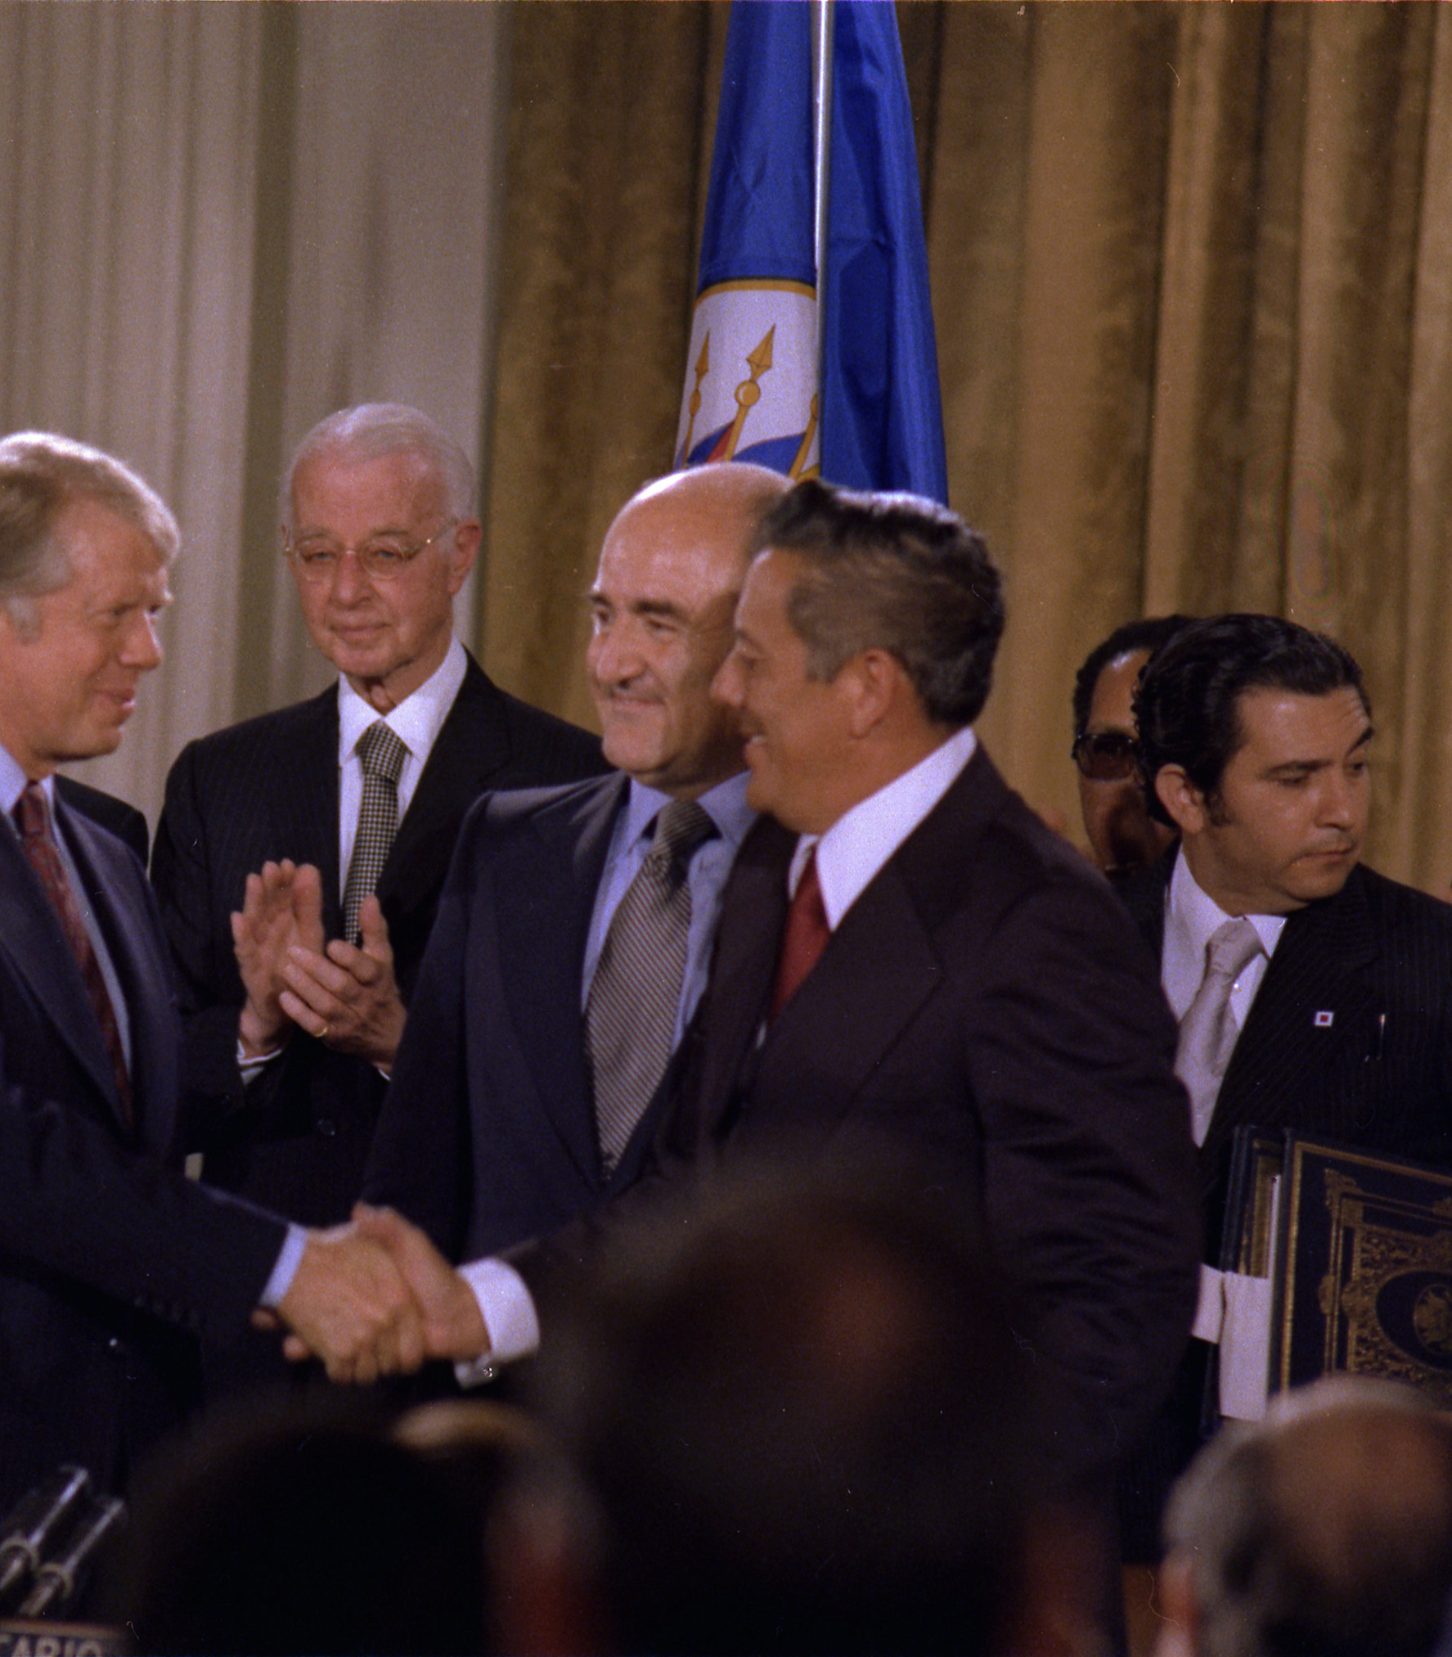
Contradiction?
Carter’s decision to pay serious attention to issues on the periphery (Panama Canal negotiations and governance in Rhodesia) made it appear that he was turning away from the Cold War
However, he was waging a more complex, pre-emptive Cold War.
His policy was, however, contradictory: he would fight Communism more effectively by not being so obsessed with fighting Communism.
Part of the problem was that Carter had such an overcrowded agenda in his first year that he did not convey a clear sense of his priorities.

Slide 10
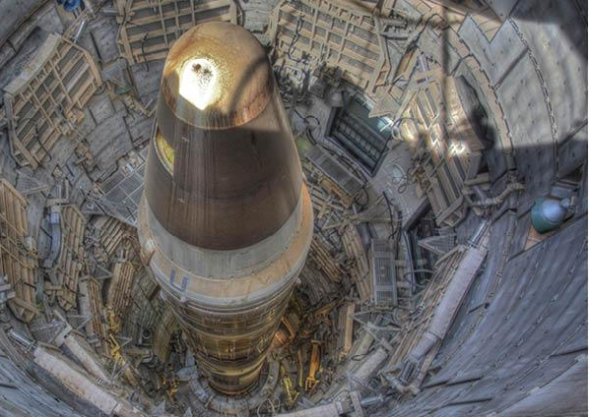
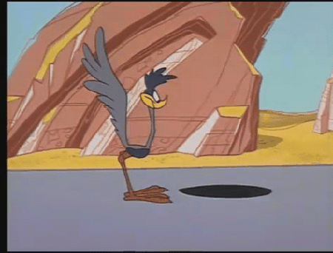
Defence spending
Technicians developed the neutron bomb, as an antitank device, but its opponents in Europe and in the United States seized on the fact that it would kill people while leaving buildings intact.
To defend new MX missiles technicians suggested placing them in perpetual motion on trains running along multiple rail tracks in Utah and Nevada.
Bumper stickers began appearing: “MX –May the Farce Be With Us.”
The technicians, and the politicians who embraced their schemes, had fallen prey to the roadrunner syndrome. They were like the cartoon figure Wile E. Coyote who, in hot pursuit of the Roadrunner, kept running on thin air.

Slide 11
SALT II
Brezhnev had been leading the Soviet Union since 1964 and his time in power hadn’t been easy - the Prague Spring, border clashes with China, a deteriorating economy and invasion of Afghanistan had all challenged him.
He considered SALT I to be one of his greatest achievements, and he was eager to settle the details of the SALT II accord, having laid the foundations with Ford.
Carter presented a complete contrast to the Ford years, supporting the voice of Soviet dissidents (namely Aleksandr Ginzburg, Sakharov and the Czech movement Charter 77).
Vance travelled to Moscow in March 1977. Besides reneging on promises the Kremlin believed had been made at Vladivostok, Carter’s cuts deprived the USSR the heart of their nuclear force, their large ICBMs, while leaving the US force, more reliant on bombers, largely in place; Brezhnev was appalled.

Slide 12
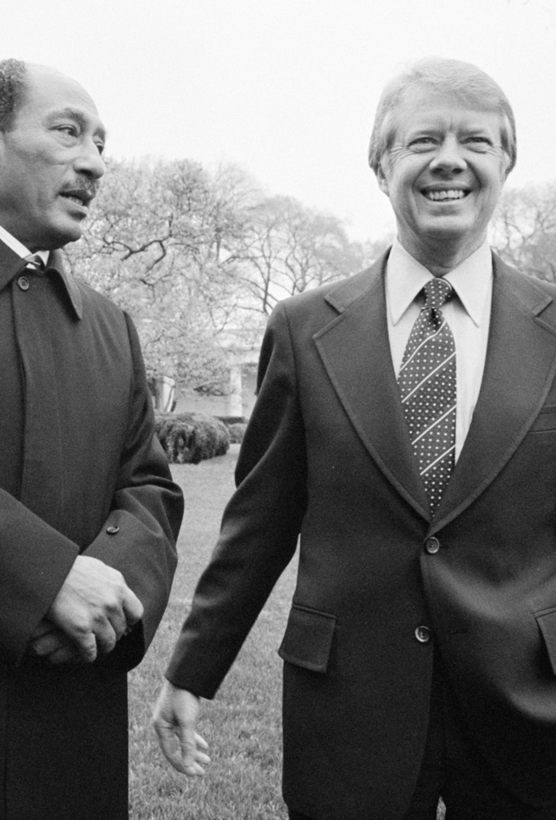
Relations with Sadat
Four days after Vance left Moscow empty-handed, President Anwar Sadat of Egypt was in Washington meeting Carter for the first time
Sadat affected Carter’s perception not only of the Arab–Israeli conflict but also Soviet policy in Africa.
He and the Saudi royal family were deeply concerned about growing Soviet influence on the continent, particularly in the Horn of Africa.
On the second day of Sadat’s visit – April 5, 1977 – Carter wrote a message to Vance: “Find ways to improve relations with . . . Somalia.”

Slide 13
Research Task: African case studies
Angola
Mozambique
Unimportant
Mark on the spectrum, how significant these wars were in influencing détente in the 1970s and briefly explain why
Very important

Slide 14
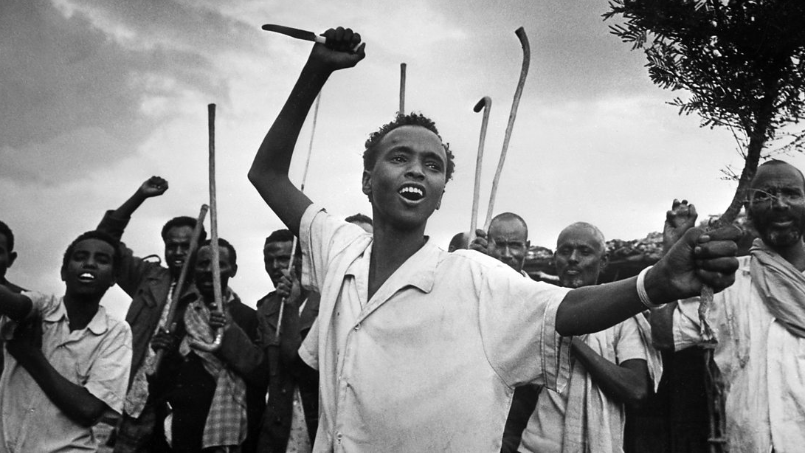
Ethiopia
The Ogaden War

Slide 15
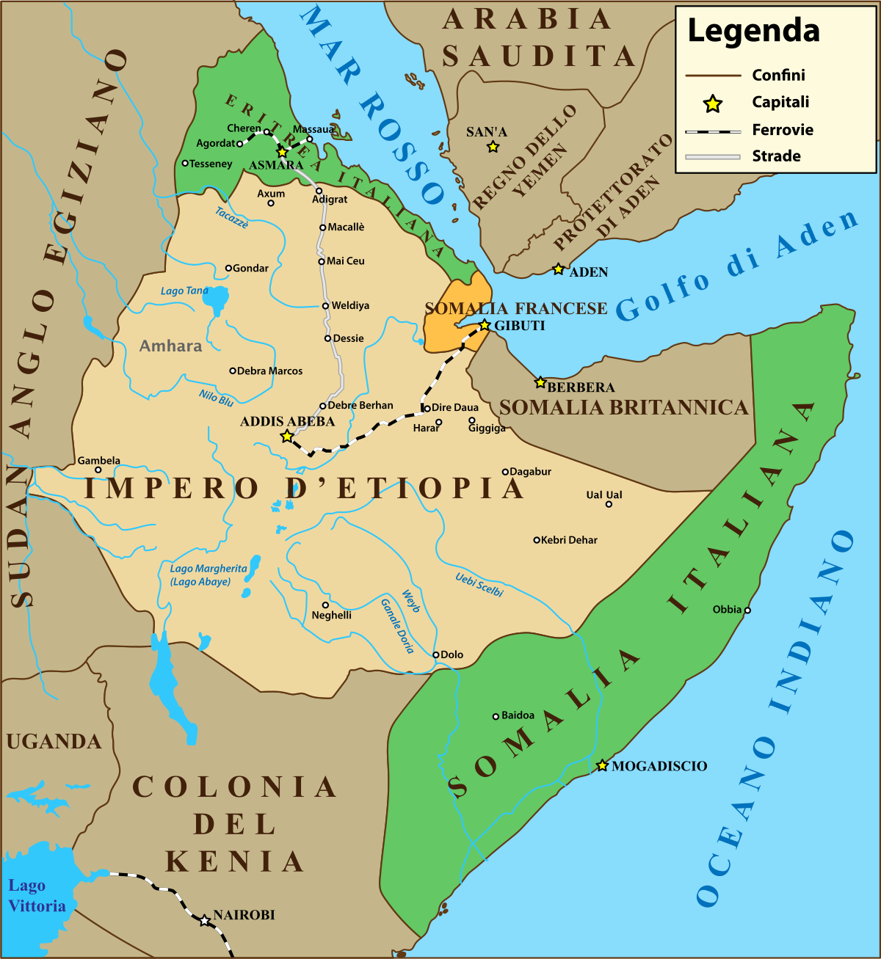
Background
After WWII the British unintentionally set the stage for conflict between Ethiopia and the future country of Somalia when it awarded the traditionally Somali territory of Ogaden to Ethiopia.
From 1950 to 1960 the General Assembly of the UN persistently (and unsuccessfully) pressed Ethiopia, Italy (the U.N. designated trustee from 1950) and Somalia to establish an agreed boundary.
In 1960, the British and Italian regions of what is now Somalia became independent and were united to form the nation state of Somalia.

Slide 16
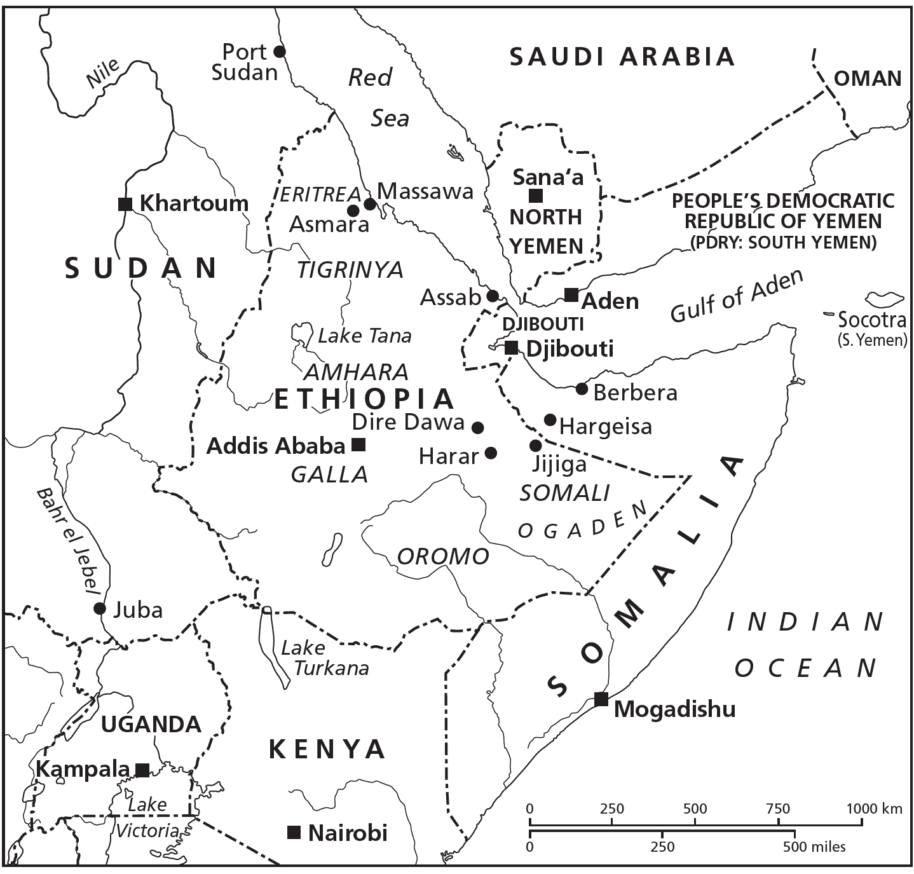

Slide 17
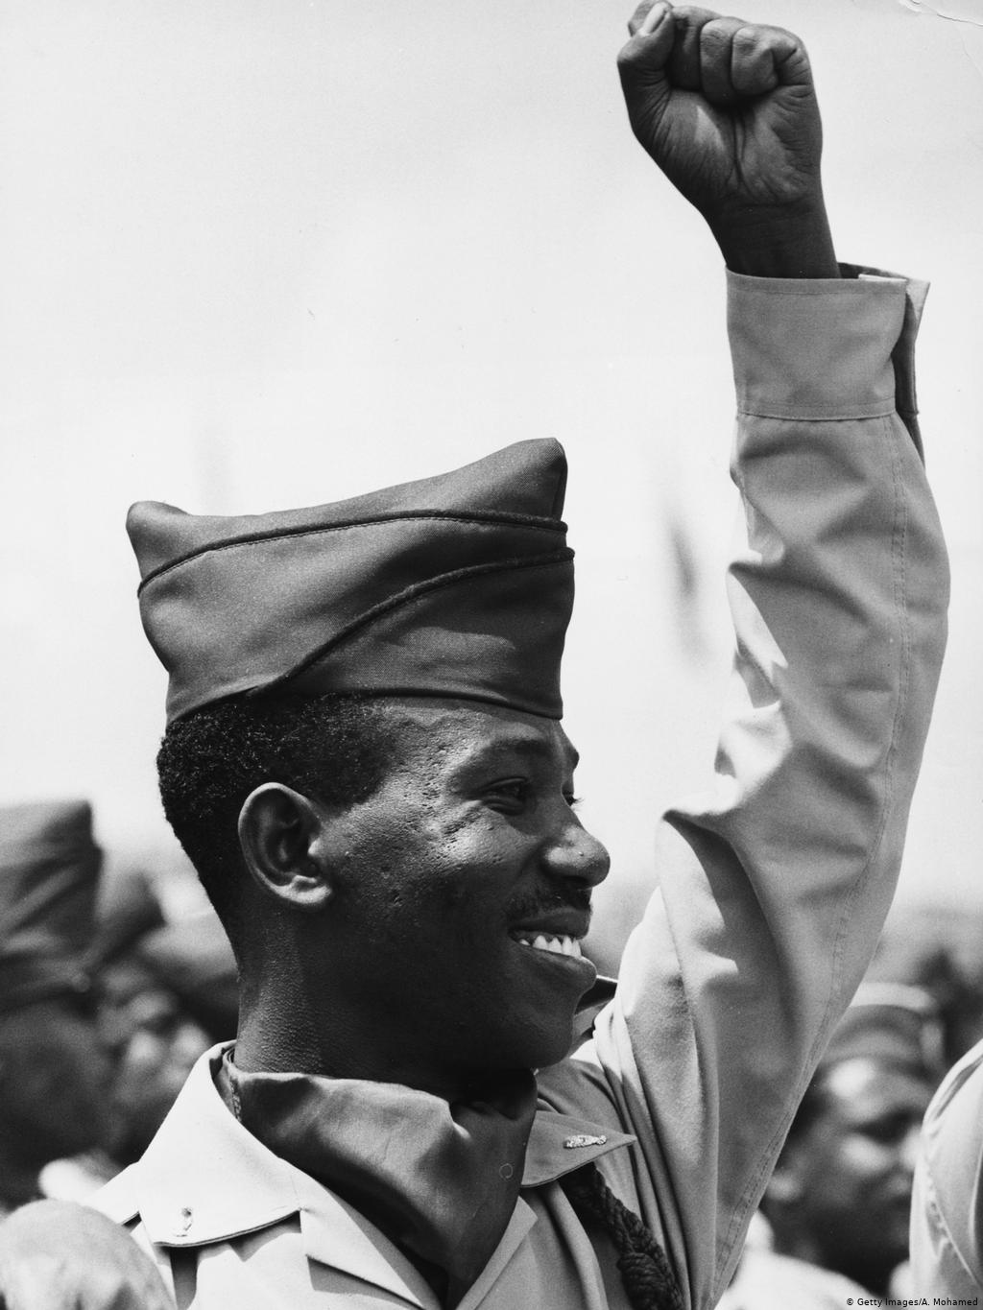
Ethiopia
Ethiopia had been an ally of the US, but after 1974 had veered towards an increasingly anti-American direction.
The new Ethiopian leaders approached Moscow for aid, but the Kremlin hesitated, in part because the Soviet Union’s most important ally in sub-Saharan Africa, Somalia, was Ethiopia’s sworn enemy.
Somalia claimed almost a third of Ethiopia’s territory – the Ogaden desert, inhabited by ethnic Somalis.
The Soviet Union had poured more than $400 million into Somalia. In return, the Somali president, Mohamed Siad Barre, had given the Soviets access to the port of Berbera.
Now Moscow was being wooed by Ethiopia, a US ally whose ruthless leader, Mengistu Haile Mariam (right) was suddenly swearing allegiance to Lenin.

Slide 18
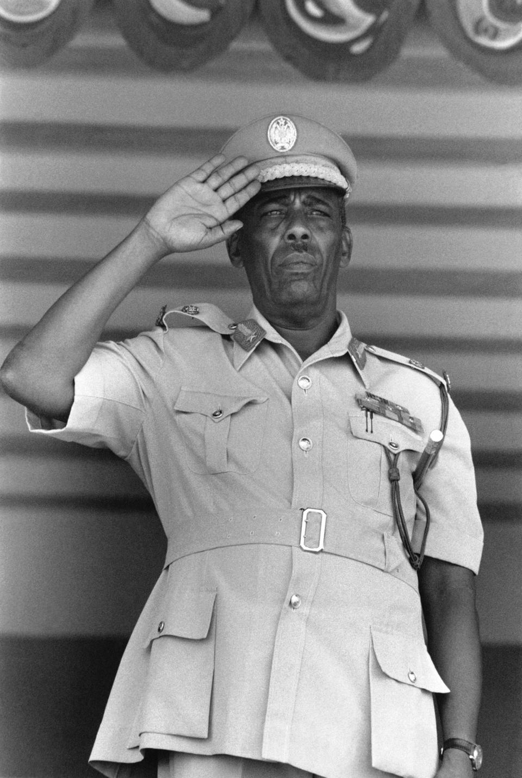

Somalian request for aid
During the spring of 1977, the Soviets began sending arms to Ethiopia.
On 23rd April, Mengistu expelled almost all US diplomats and military personnel from Ethiopia.
Meanwhile, despite Soviet threats, Siad Barre (left) refused to renounce his country’s claim to the Ogaden.
Abdullahi Addou, the Somali ambassador to the United States, had been pressing his case for; Somalia wanted to turn toward the United States for military and economic assistance.
Addou was finally ushered into the Oval Office on 16th June (‘77).

Slide 19
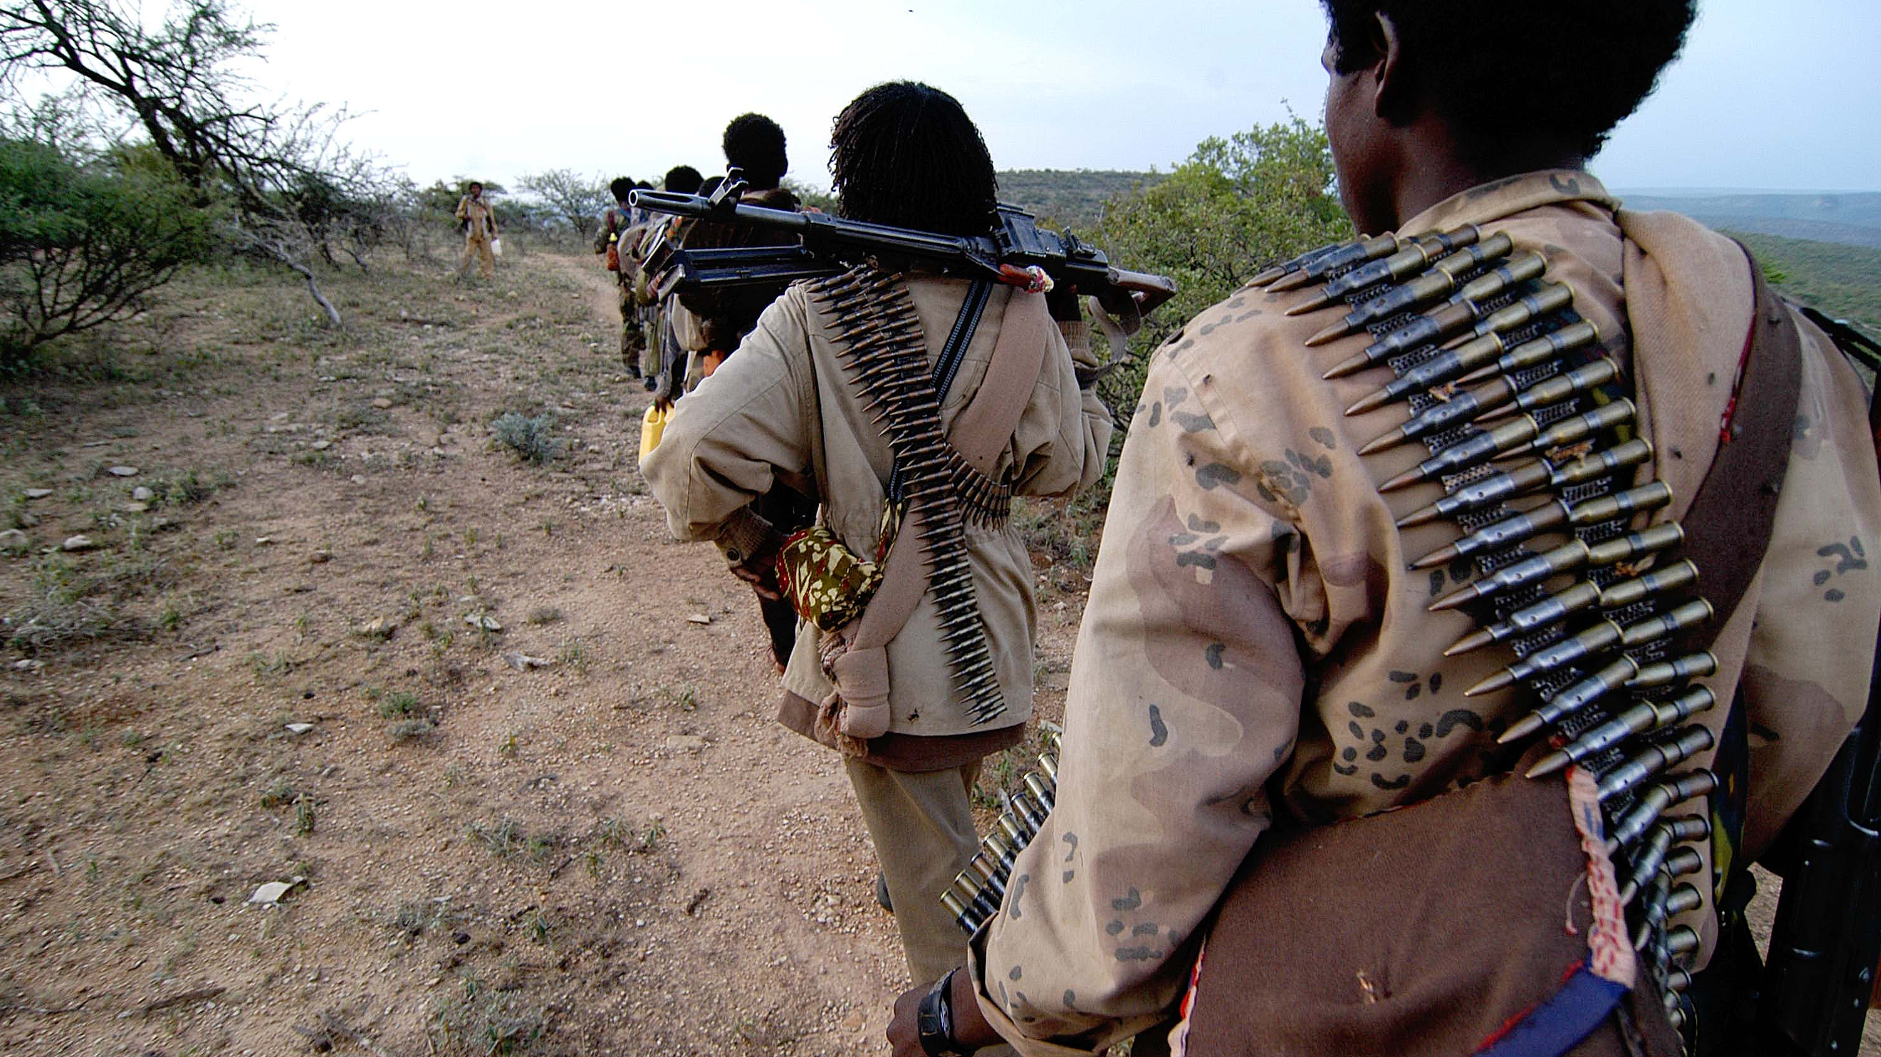
Uncertainty
Depriving the Soviets of Berbera would enhance the security of Western trade, particularly oil.
However, Somali troops were supporting Ogadeni guerrillas fighting against Ethiopian troops, and the administration were concerned that backing an aggressor would damage their relations with the continent.
On top of this, Carter had pledged during his campaign to reduce arms transfers: sending arms to Somalia would directly contradict this.
The situation was extremely unpredictable – Somali had neither broken ties with Moscow nor expelled its 4,000 Soviet military and technical advisers.

Slide 20
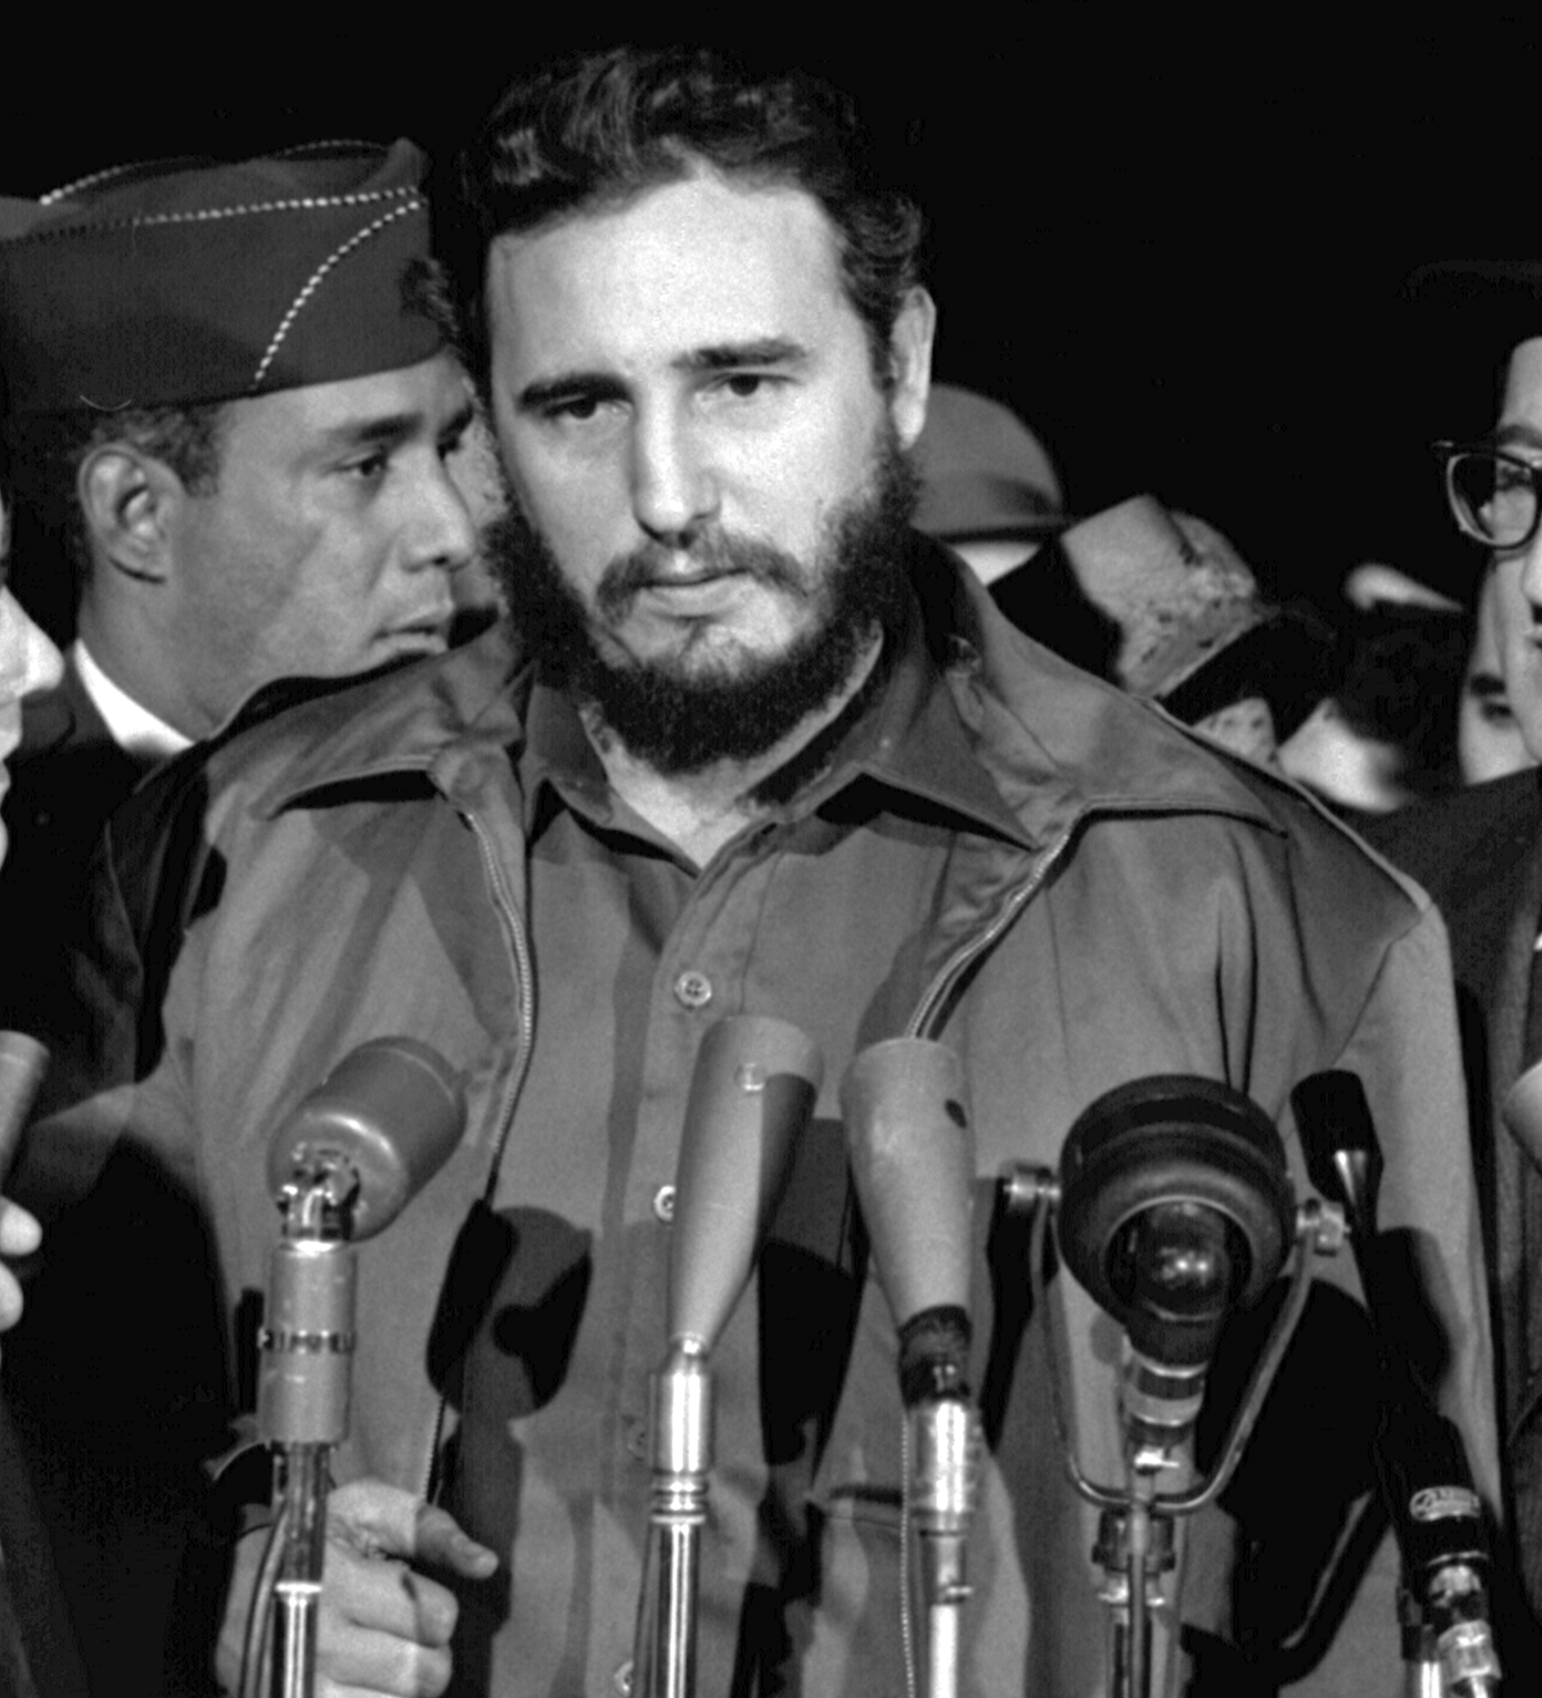
Attempts to negotiate
In March 1977, Castro went to Aden to meet with the leaders of Ethiopia, Somalia and South Yemen to try to resolve the crisis but negotiations failed.
He remarked: “They [Somalis] had already worked out a plan, which they later put into practice, to invade Ethiopia” despite pledging that they wouldn’t.
Similar Soviet proposals to end the conflict in May and August 1977 were also rejected.
Somalia’s President Barre publicly voiced discontent regarding the increased military aid to Ethiopia; the Soviets defended their intervention, arguing that they were defending established borders.

Slide 21
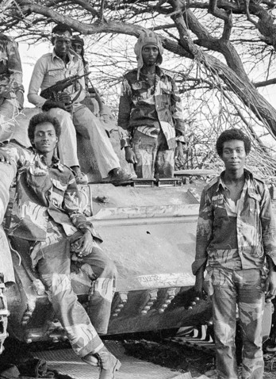
Ogaden War (July 1977 to March 1978)
On 16th June, Carter told Addou that “it was difficult for us to give [Somalia] military assistance, but we were working with our allies to see that Somalia had adequate defence capabilities without relying on the Soviet Union.”
Unfortunately, through this wording Carter seemed to be promising that Somalia could depend on the United States.
Regardless, on 23rd July 1977, regular Somali troops began a well-planned assault on the Ogaden and Washington drew back.
It did not send weapons but secretly encouraging third parties – Saudi Arabia, Egypt, and France – to help Somalia.
By September, the Somalis controlled almost all the Ogaden, but they could not conquer two key towns, and the war stalemated.

Slide 22
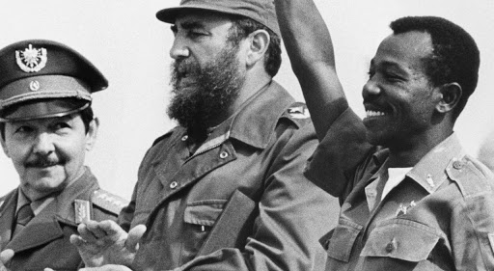
Soviet and Cuban assistance
Between March 1977 and May 1978, Moscow sent Ethiopia $1 billion of military equipment as well as advisers.
On 13th November 1977, Siad Barre ejected virtually all the Soviet advisers and diplomats, withdrew Moscow’s access to Berbera, and broke relations with Cuba.
On 25th November, Fidel Castro decided to send Cuban troops to Ethiopia.
By the middle of December, there were 1,000 Cuban troops in Ethiopia. By late January, there were 5,000; by the end of March, there were 12,000.

Slide 23
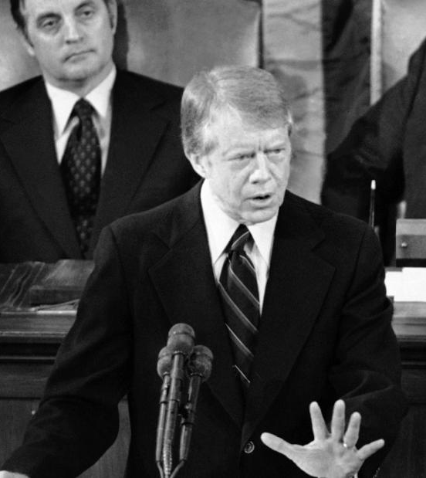
US response
At a news conference on the 12th January 1978, Carter expressed “concern about the Soviet Union’s unwarranted involvement in Africa.”
The White House failed to arouse international disapproval because the Soviets and Cubans had been invited by the Ethiopian government and they were fighting a blatant aggressor.
Carter’s only option was to threaten the Soviets that their behaviour in Ethiopia would hurt détente and, in particular, SALT II.
Brzezinski was right - doing nothing in the Horn made the United States look and feel weak. But Vance was also right - supporting Somalia was not worth derailing SALT.

Slide 24
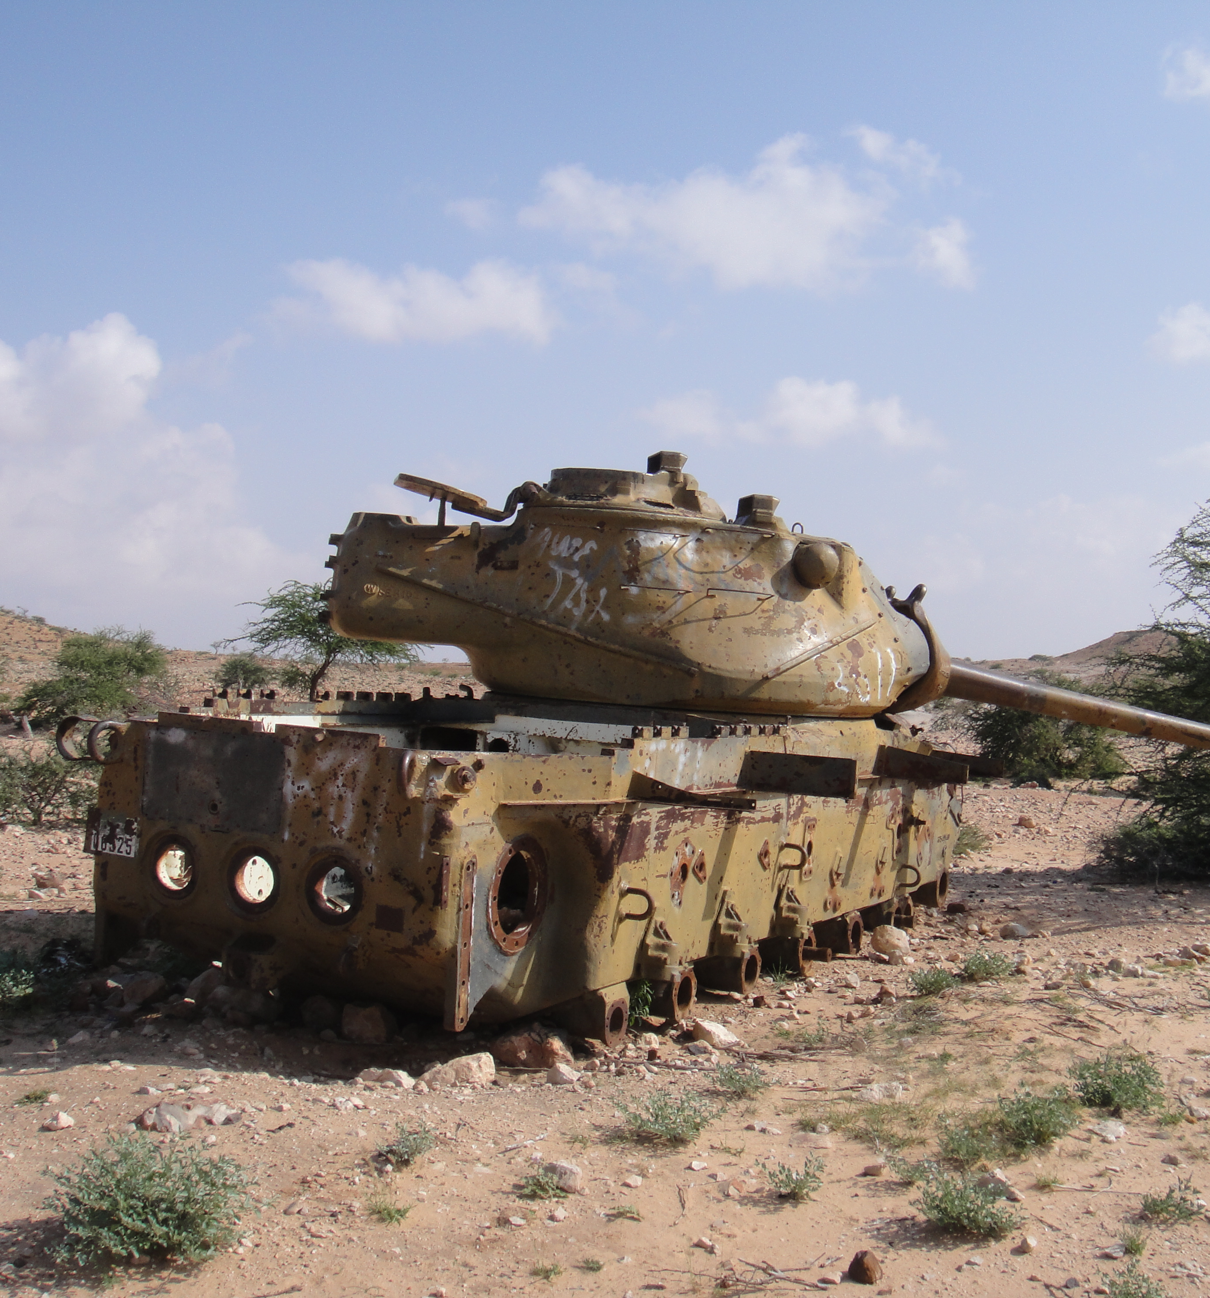
Outcomes
The Soviet and Cuban involvement on the side of Ethiopia in the Ogaden War, added to the lack of international support for Siad, led, almost inevitably, to Somali defeat.
The Soviets lost access to Berbera and failed to secure a comparable base in Ethiopia.
In his memoirs, Marshal Sergei Akhromeyev, the chief of the General Staff of the Soviet armed forces, delivered a succinct verdict on Soviet policy in the Horn; Ethiopia “was a serious mistake.”
At the time Americans believed that the United States had lost prestige.

Slide 25


Task
Listen to the BBC World Service podcast ‘The Ogaden War’ (10 minutes).
Listen to BBC Radio 4 podcast ‘The Angolan Civil War’ (15 minutes)
Comparing the two civil wars, what were the similarities and differences in causes, events and aftermath. Which intervention most impacted Cold War relations in your view?
20:16 Angola
38:48 Ethiopia

Slide 26
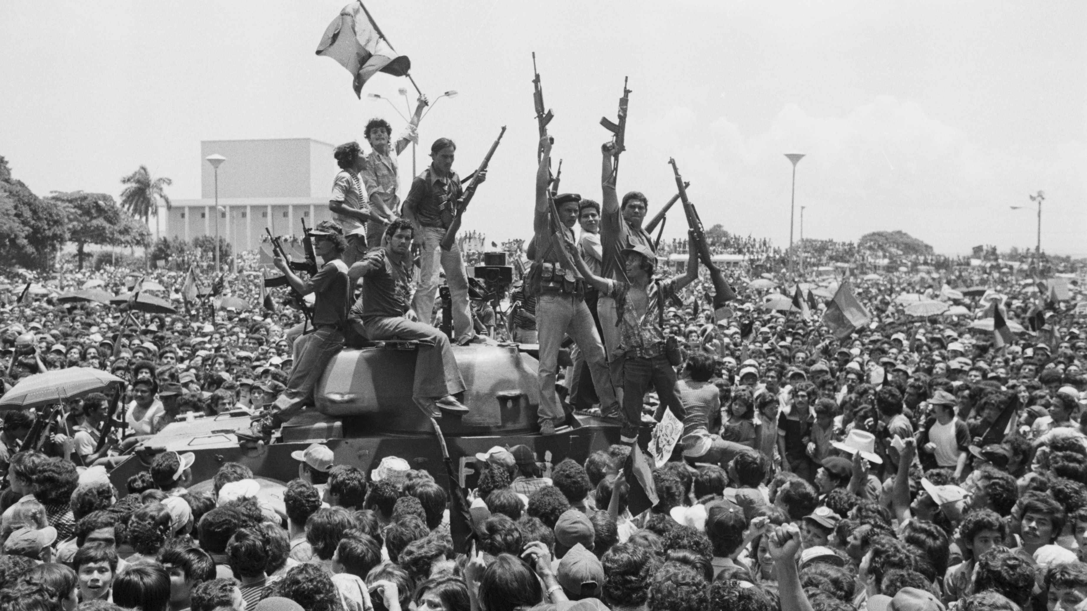
Case studies

Slide 27
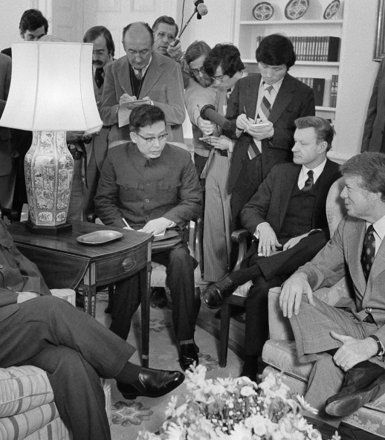
China
August 1977, Vance was the first senior member of the administration to travel to Beijing, when neither side was ready for normalization.
Carter wanted full normalization by the end of the year; Brzezinski was the man to get it done.
Carter considered it counterproductive to sever ties with any nation and hoped that opening diplomatic relations with would give US negotiators leverage to achieve the best possible SALT II treaty from Moscow.
Brzezinski and his Chinese hosts used their shared anti-Sovietism to break the ice and forge bonds.

Slide 28
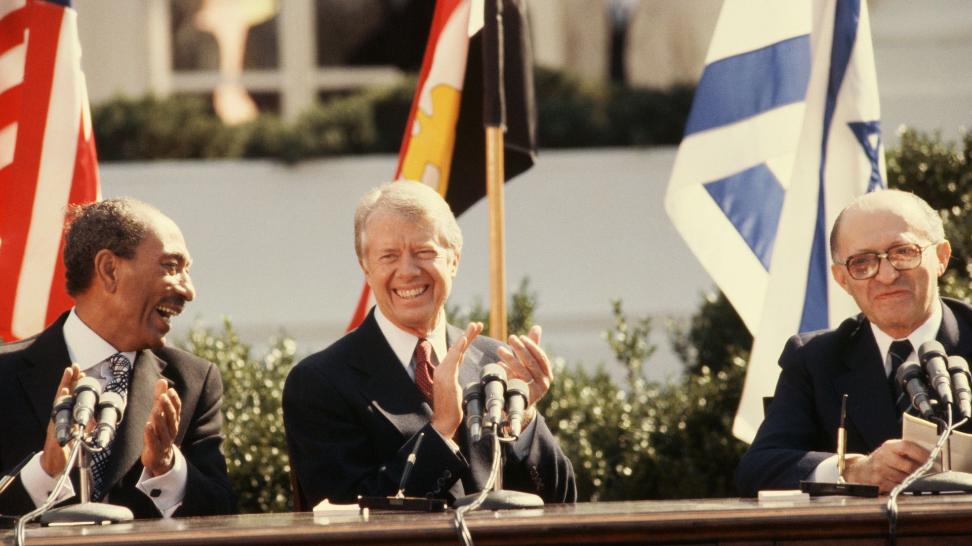
Middle East peace process
Carter wanted to return to the promise of comprehensive peace held out by the Geneva conference from December 1973.
On 1st October 1977, Vance and his Soviet counterpart, Andrei Gromyko, released a joint declaration calling for a revived conference These attempts were dead in the water as the declaration mentioned the “legitimate rights of the Palestinian people.”
Sadat, however, seized the initiative when on 19th November 1977, he travelled to Jerusalem.
Carter invited Sadat and the prime minister of Israel, Menachem Begin, to Camp David where he would personally mediate between them.
The two treaties that emerged from this marginalized the Soviets; by removing the Egyptian army from the equation, the Camp David Accords removed the ability of the Kremlin’s Arab allies – Syria and Iraq – to threaten Israel.

Slide 29
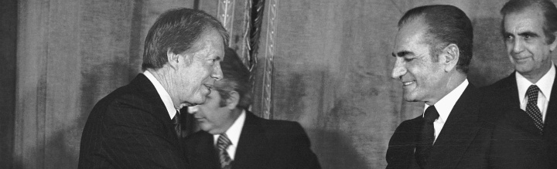
Iran
In May 1977, Carter deployed Vance to Tehran.
Assumptions were made that Vance would broach the Human Rights issue, but Vance did not mention the subject.
Later in 1977, Carter pushed through Congress a $1.2 billion sale of AWACS (airborne warning and control system) surveillance planes to Iran.
In December, the president travelled to Iran and delivered the now infamous toast: “Iran,” Carter announced, lifting his glass to the shah, “is an island of stability.”

Slide 30
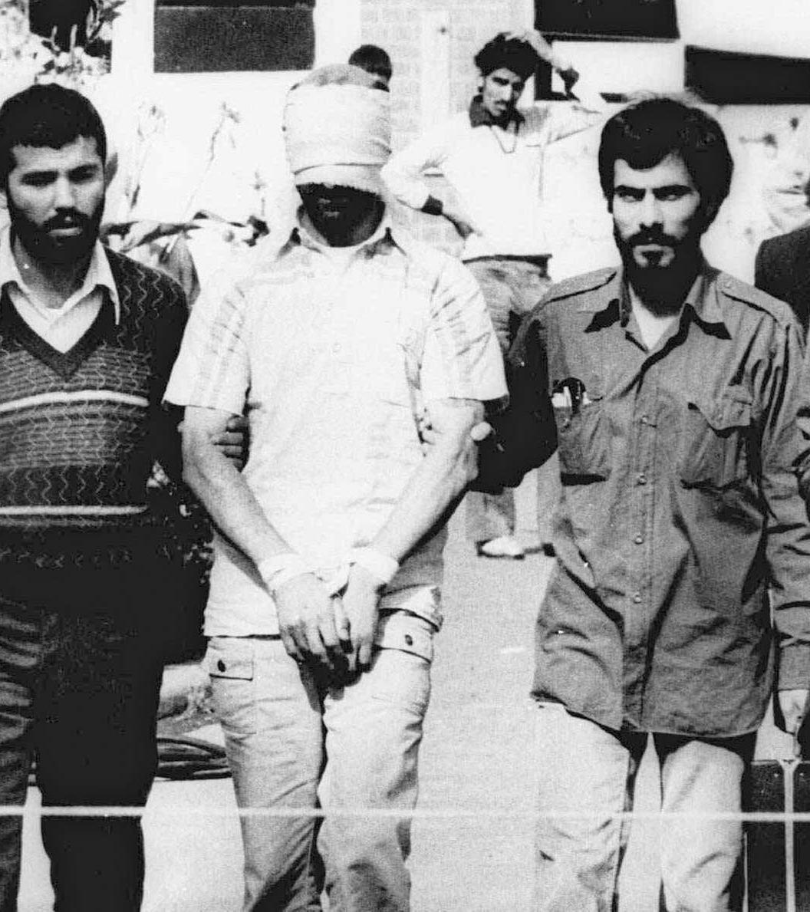
Crisis
On 8 September 1978, the shah had declared martial law; thousands of protesters had gathered in central Tehran, and soldiers had shot into the crowds, killing at least eighty-six.
The next day, from Camp David, Carter called the shah to convey his firm support.
It was not until 9th November that the Carter administration realized that a revolution was underway.
On 16th January 1979 the shah fled into exile
This was followed on 4th November by Iranian militants storming the US Embassy in Tehran, taking 66 Americans hostage.
The 444-day hostage crisis humiliated the United States.

Slide 31
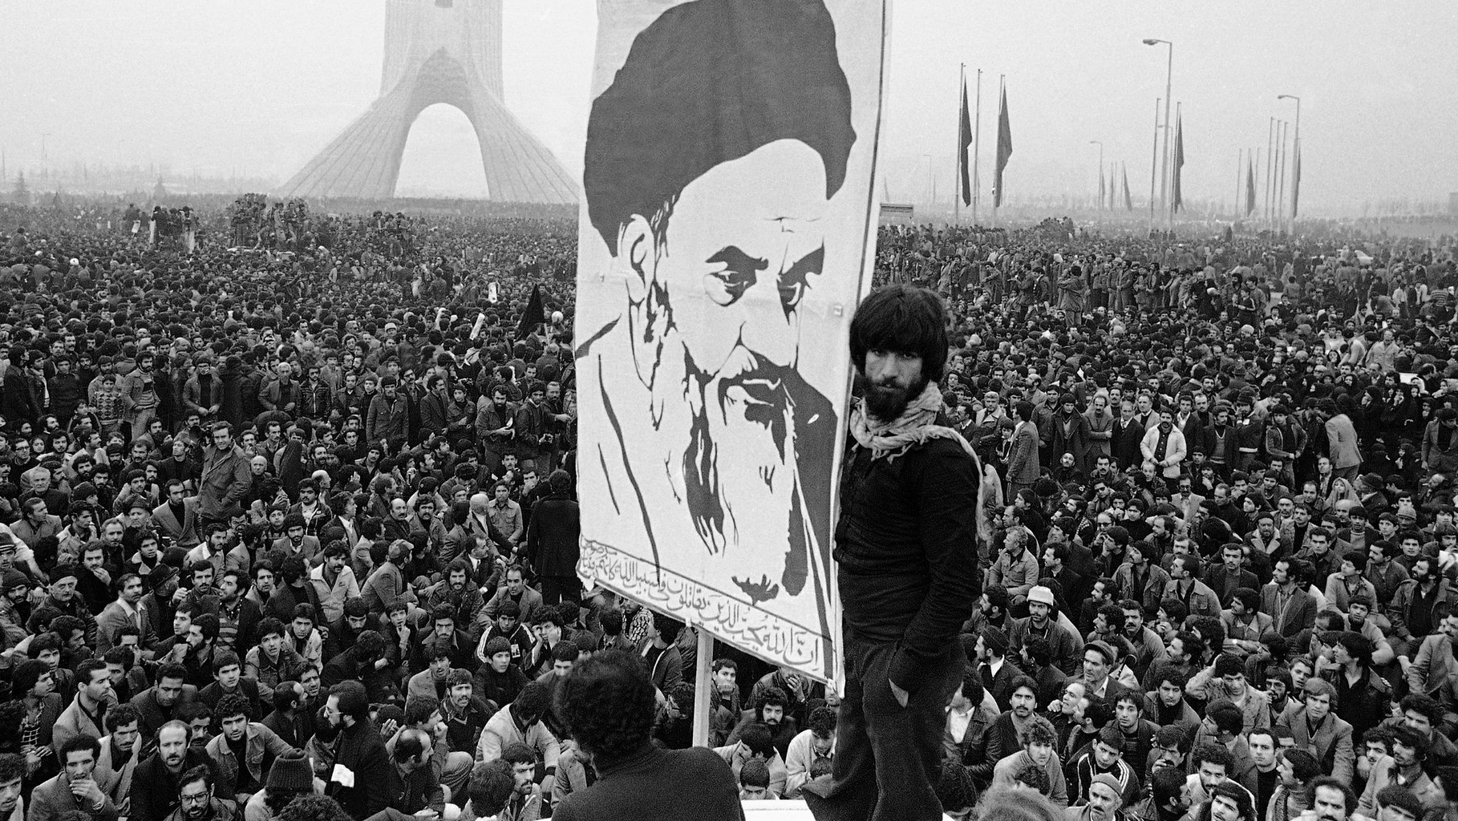
Lose-lose
The rise of an Islamist state on its border threatened Soviet security in a much more immediate way than it imperilled the United States.
The revolution was a lose–lose situation. The militants who seized the US Embassy also contemplated storming the Soviet Embassy as well.
Washington, however, blinkered by its Cold War mindset and reeling from its loss, failed to understand this.

Slide 32
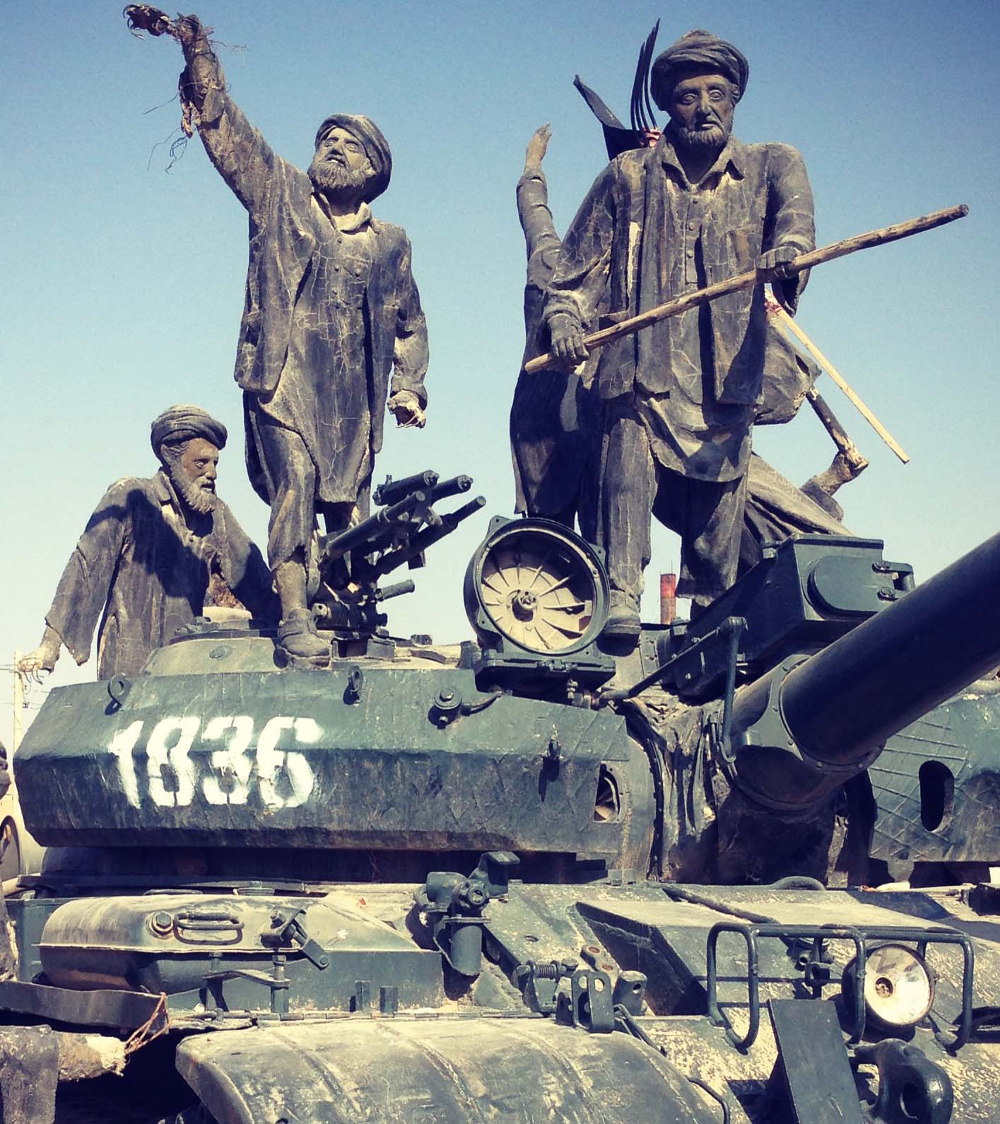
Afghanistan
In April 1978, the Communist Party had seized power in Kabul and drawn closer to Moscow, but alienated Afghans.
On 10th March 1979, insurrection in the western city of Herat resulted in the deaths of hundreds of Soviet advisers and their families.
The Politburo met in emergency session to decide what to do; these meetings show clearly that the Politburo was loath to send Soviet troops into Afghanistan.
Iurii Andropov stated, “We will look like aggressors, and we cannot permit that to occur.”
Gromyko added, “We would be largely throwing away everything we achieved with such difficulty, particularly détente, [and] the SALT II negotiations would fly by the wayside.”

Slide 33
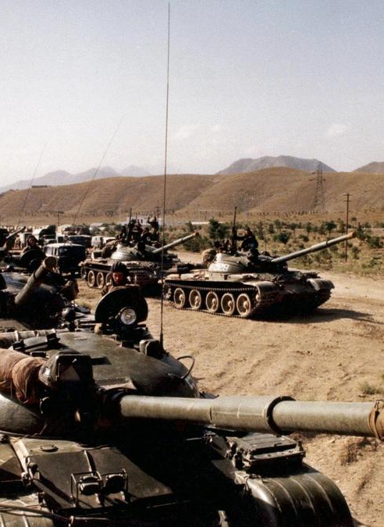
Soviet invasion
Before this, the CIA had developed a plan to funnel covert aid through Pakistan to Afghan rebels opposed to the rising Soviet presence.
By December 1979, three factors changed the Kremlin mindset: increasing fears of chaos in Iran, rising anxiety about the Afghan regime’s tilt toward the United States, and the realization that the US Senate was not going to ratify the SALT II treaty.
On Christmas Eve, Soviet troops crossed the border. By January, 85,000 Soviets were fighting the Mujahideen.
Carter’s reaction was reminiscent of President Harry S. Truman’s response to the invasion of South Korea.
Carter had not imagined that Brezhnev would betray him in this way.

Slide 34
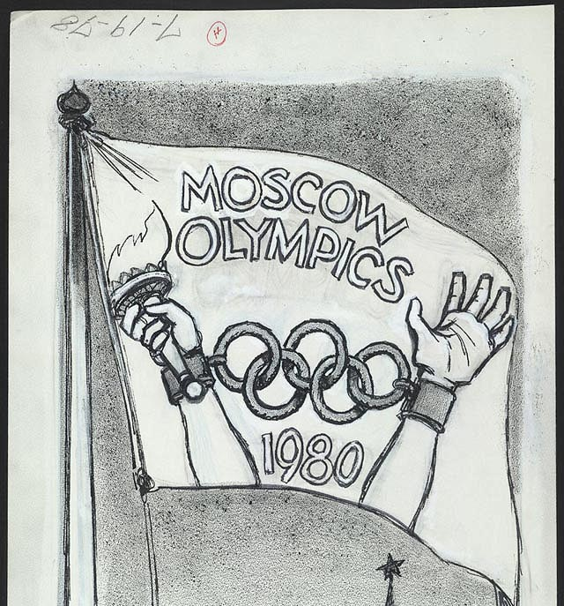
US response
In response, Carter:
halted grain and high technology exports
cancelled fishery agreements, scrapped cultural exchanges
recalled the US ambassador
boycotted the Moscow Olympics
jump-started the creation of the Rapid Deployment Force
increased aid to Pakistan and the Mujahideen
appealed to the United Nations, NATO, and the international community
and stopped SALT II in its tracks.
The Soviets were propelled by weakness, not adventurism. That is not, however, how the Americans saw it.

Slide 35
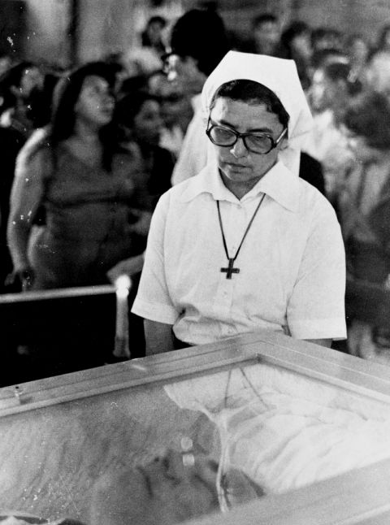
Central America
The Sandinistas’ victory in Nicaragua in July 1979 was followed by a growing insurgency in El Salvador.
In 1980 alone, more than 8,000 Salvadorans were slaughtered or disappeared in the military’s bloody campaign against leftists.
The archbishop of San Salvador, Óscar Romero, wrote to Carter: “Since you are a Christian and have said you want to defend human rights . . . I ask you . . . do not authorize military aid to the Salvadoran government.”
A month later, on 24th March 1980, as the archbishop raised the chalice, he was shot through the heart by a sniper from a right-wing death squad.
Carter decried the murder and all the other massacres and abuses, but he did not stop the flow of US military supplies because he considered the insurgents Communists, and Communists had to be stopped. Human rights would wait.

Slide 36
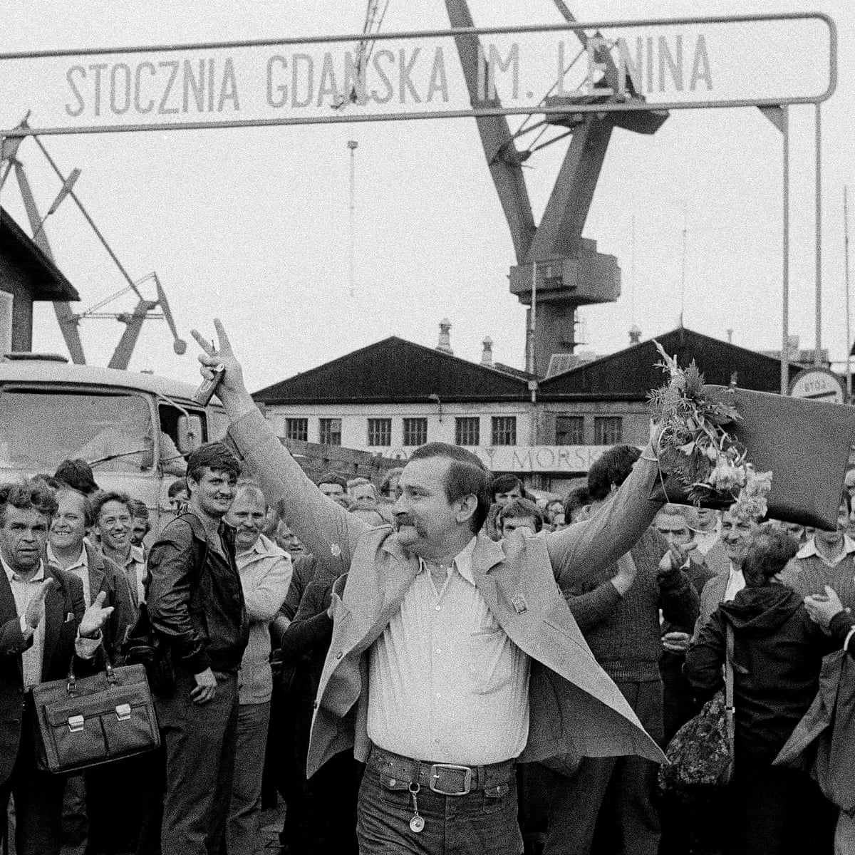
Solidarity in Poland
On 14th August 1980, in the Lenin Shipyard in Gdansk, Lech Walesa, a man who took very seriously the idea that he and his fellow workers had human rights, began to lead a strike.
The union that would emerge, Solidarity, roared through Polish factories and farms and cities and towns.
It gathered power, and it demanded freedom. It challenged the very foundation of Soviet authority.

Slide 37
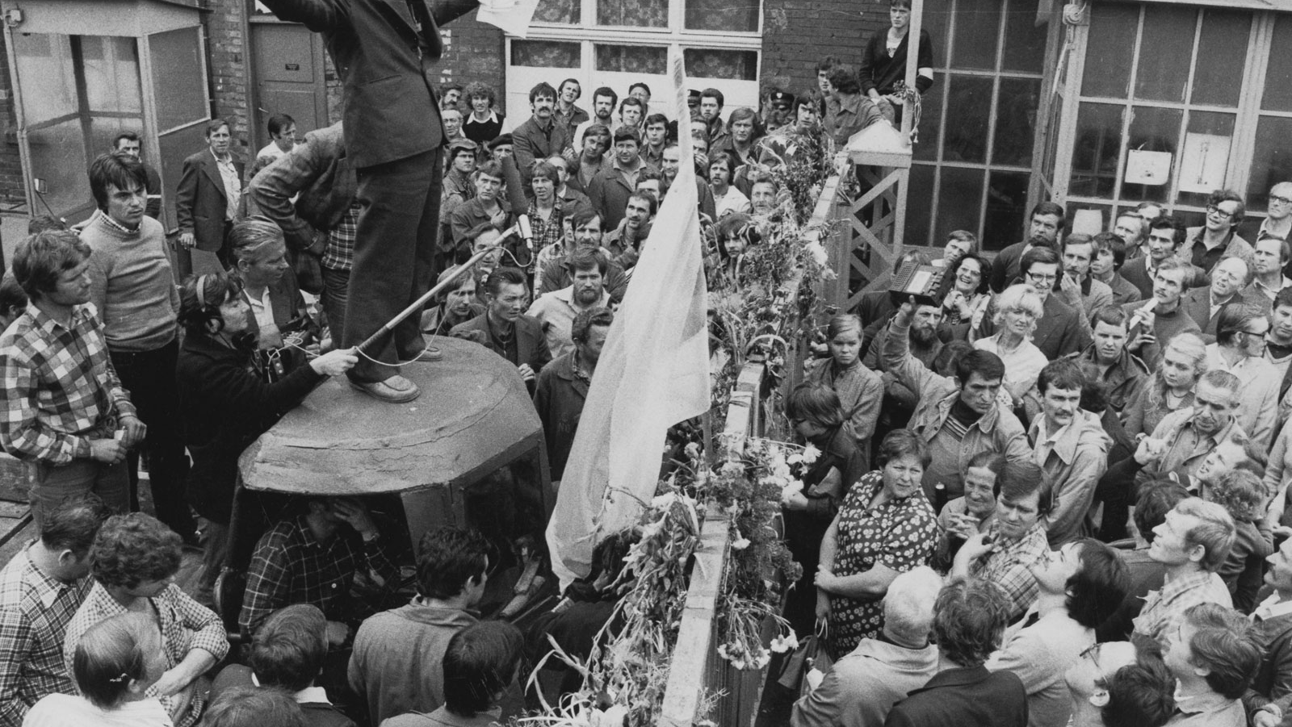
Solidarity in Poland
The Carter administration was surprised that the Polish government bowed to Solidarity’s demands for the right to organize, to strike, and to have a free press, and it expected the Soviets to respond as they had in Hungary and Czechoslovakia.
The Carter administration warned Moscow not to invade Poland, and it worried about its limited options should Soviet tanks cross another border.
But it failed to appreciate the formidable power of the human rights doctrine Carter had been advocating for three years previous.

Slide 38
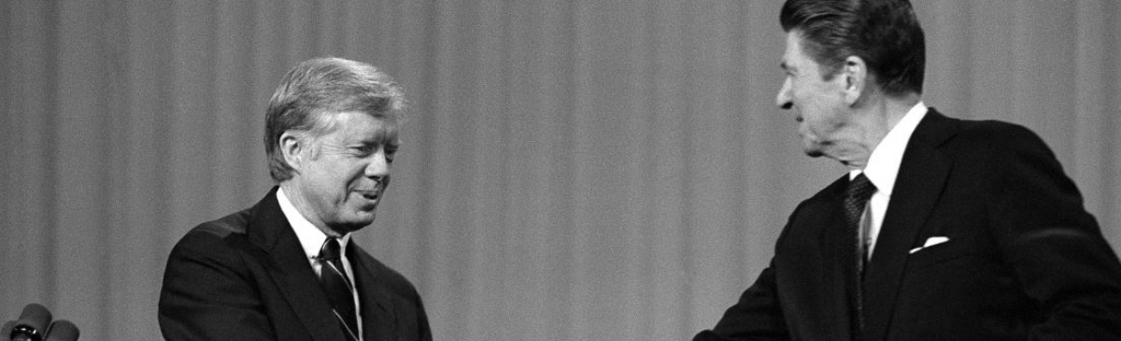
Conclusions
The sense of vulnerability, compounded by setbacks in the Horn of Africa, Iran, Afghanistan, Nicaragua, El Salvador and the Iranian hostage crisis created an inescapable narrative of American impotence.
This, in addition to the complex international affairs in the late 1970s, caused even well-informed and wise commentators to underestimate the perils the Soviet Union faced.
It led Carter, in his final year as president, to put into motion an escalated defence budget.
This policy, which Reagan would embrace, appealed to the American public. It made them feel strong again.

Slide 39
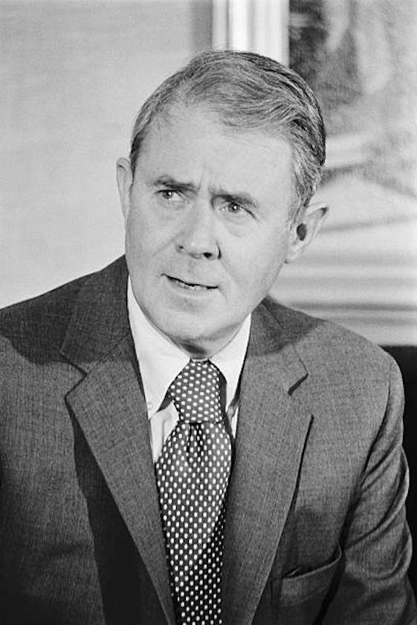
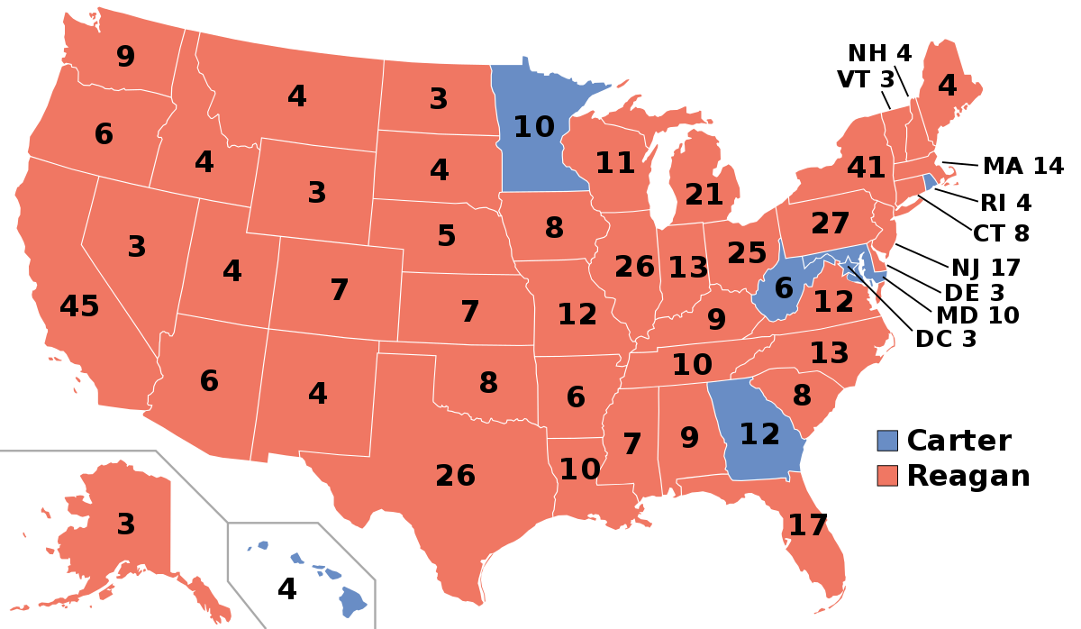
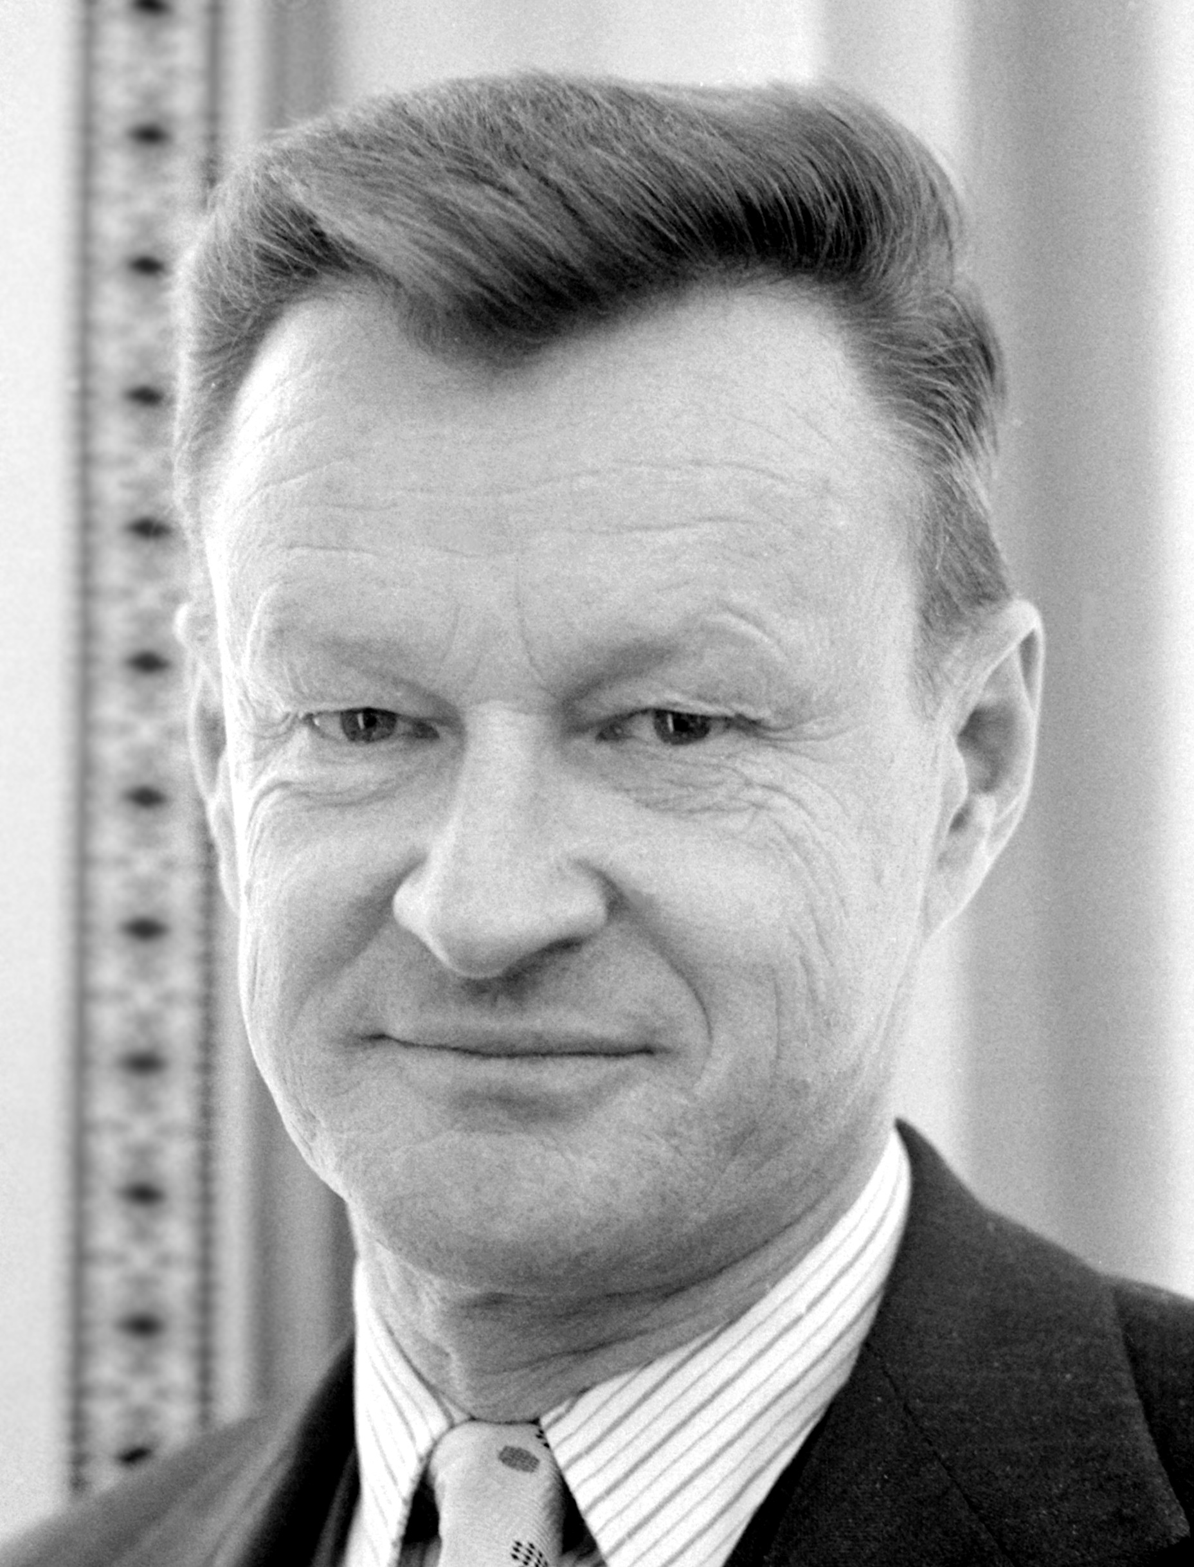
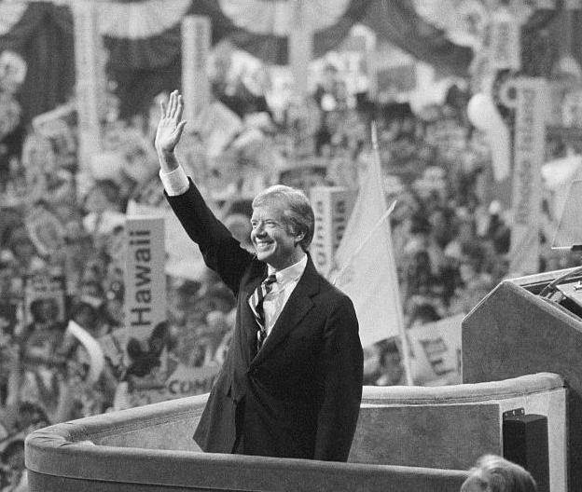
Research Task: Jimmy Carter’s Presidency
Cyrus Vance
Failure to win
re-election
Zbigniew Brzezinski
Unimportant
Mark on the spectrum, how significant these two advisers were on Carter’s pursuance of détente in the 1970s and briefly explain why.
Very important

Slide 40
Bibliography
Donna Jackson, ‘The Ogaden War and the Demise of Détente’ The ANNALS of the American Academy of Political and Social Science 632 (2010) pp.26-40
Nancy Mitchell, ‘The Cold War and Jimmy Carter’ in Melvyn P. Leffler and Odd Arne Westad eds., The Cambridge History of the Cold War: Volume III Endings (Cambridge, 2010) pp.66 – 88

