Slide 1
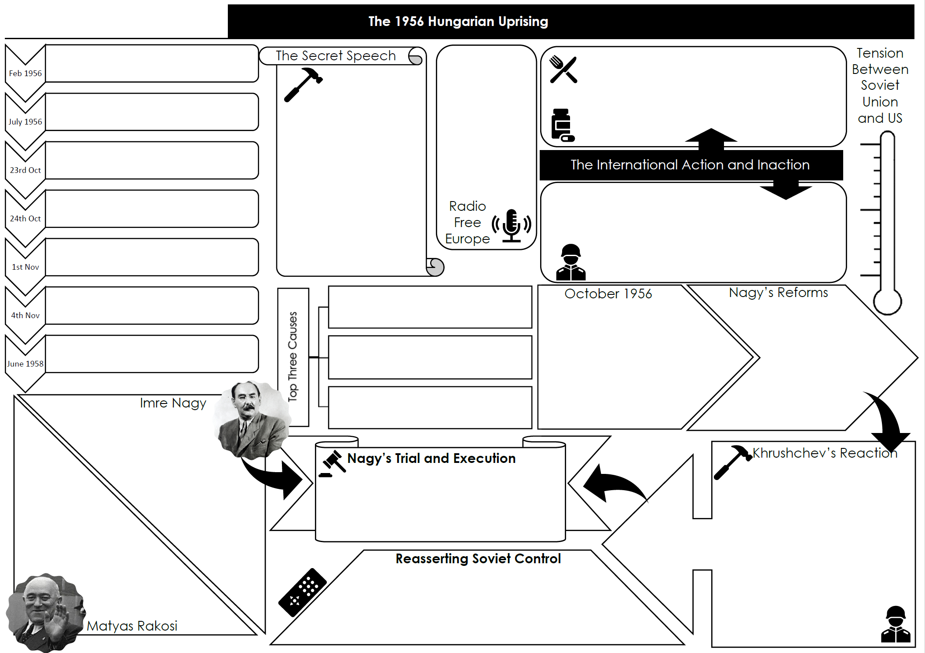
How much of this could you fill out without looking back at your notes?

Slide 2
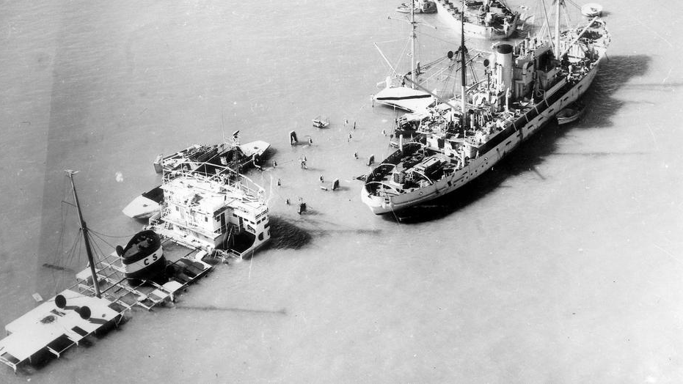
The Suez Crisis
How did the Cold War extend into the Middle East?

Slide 3
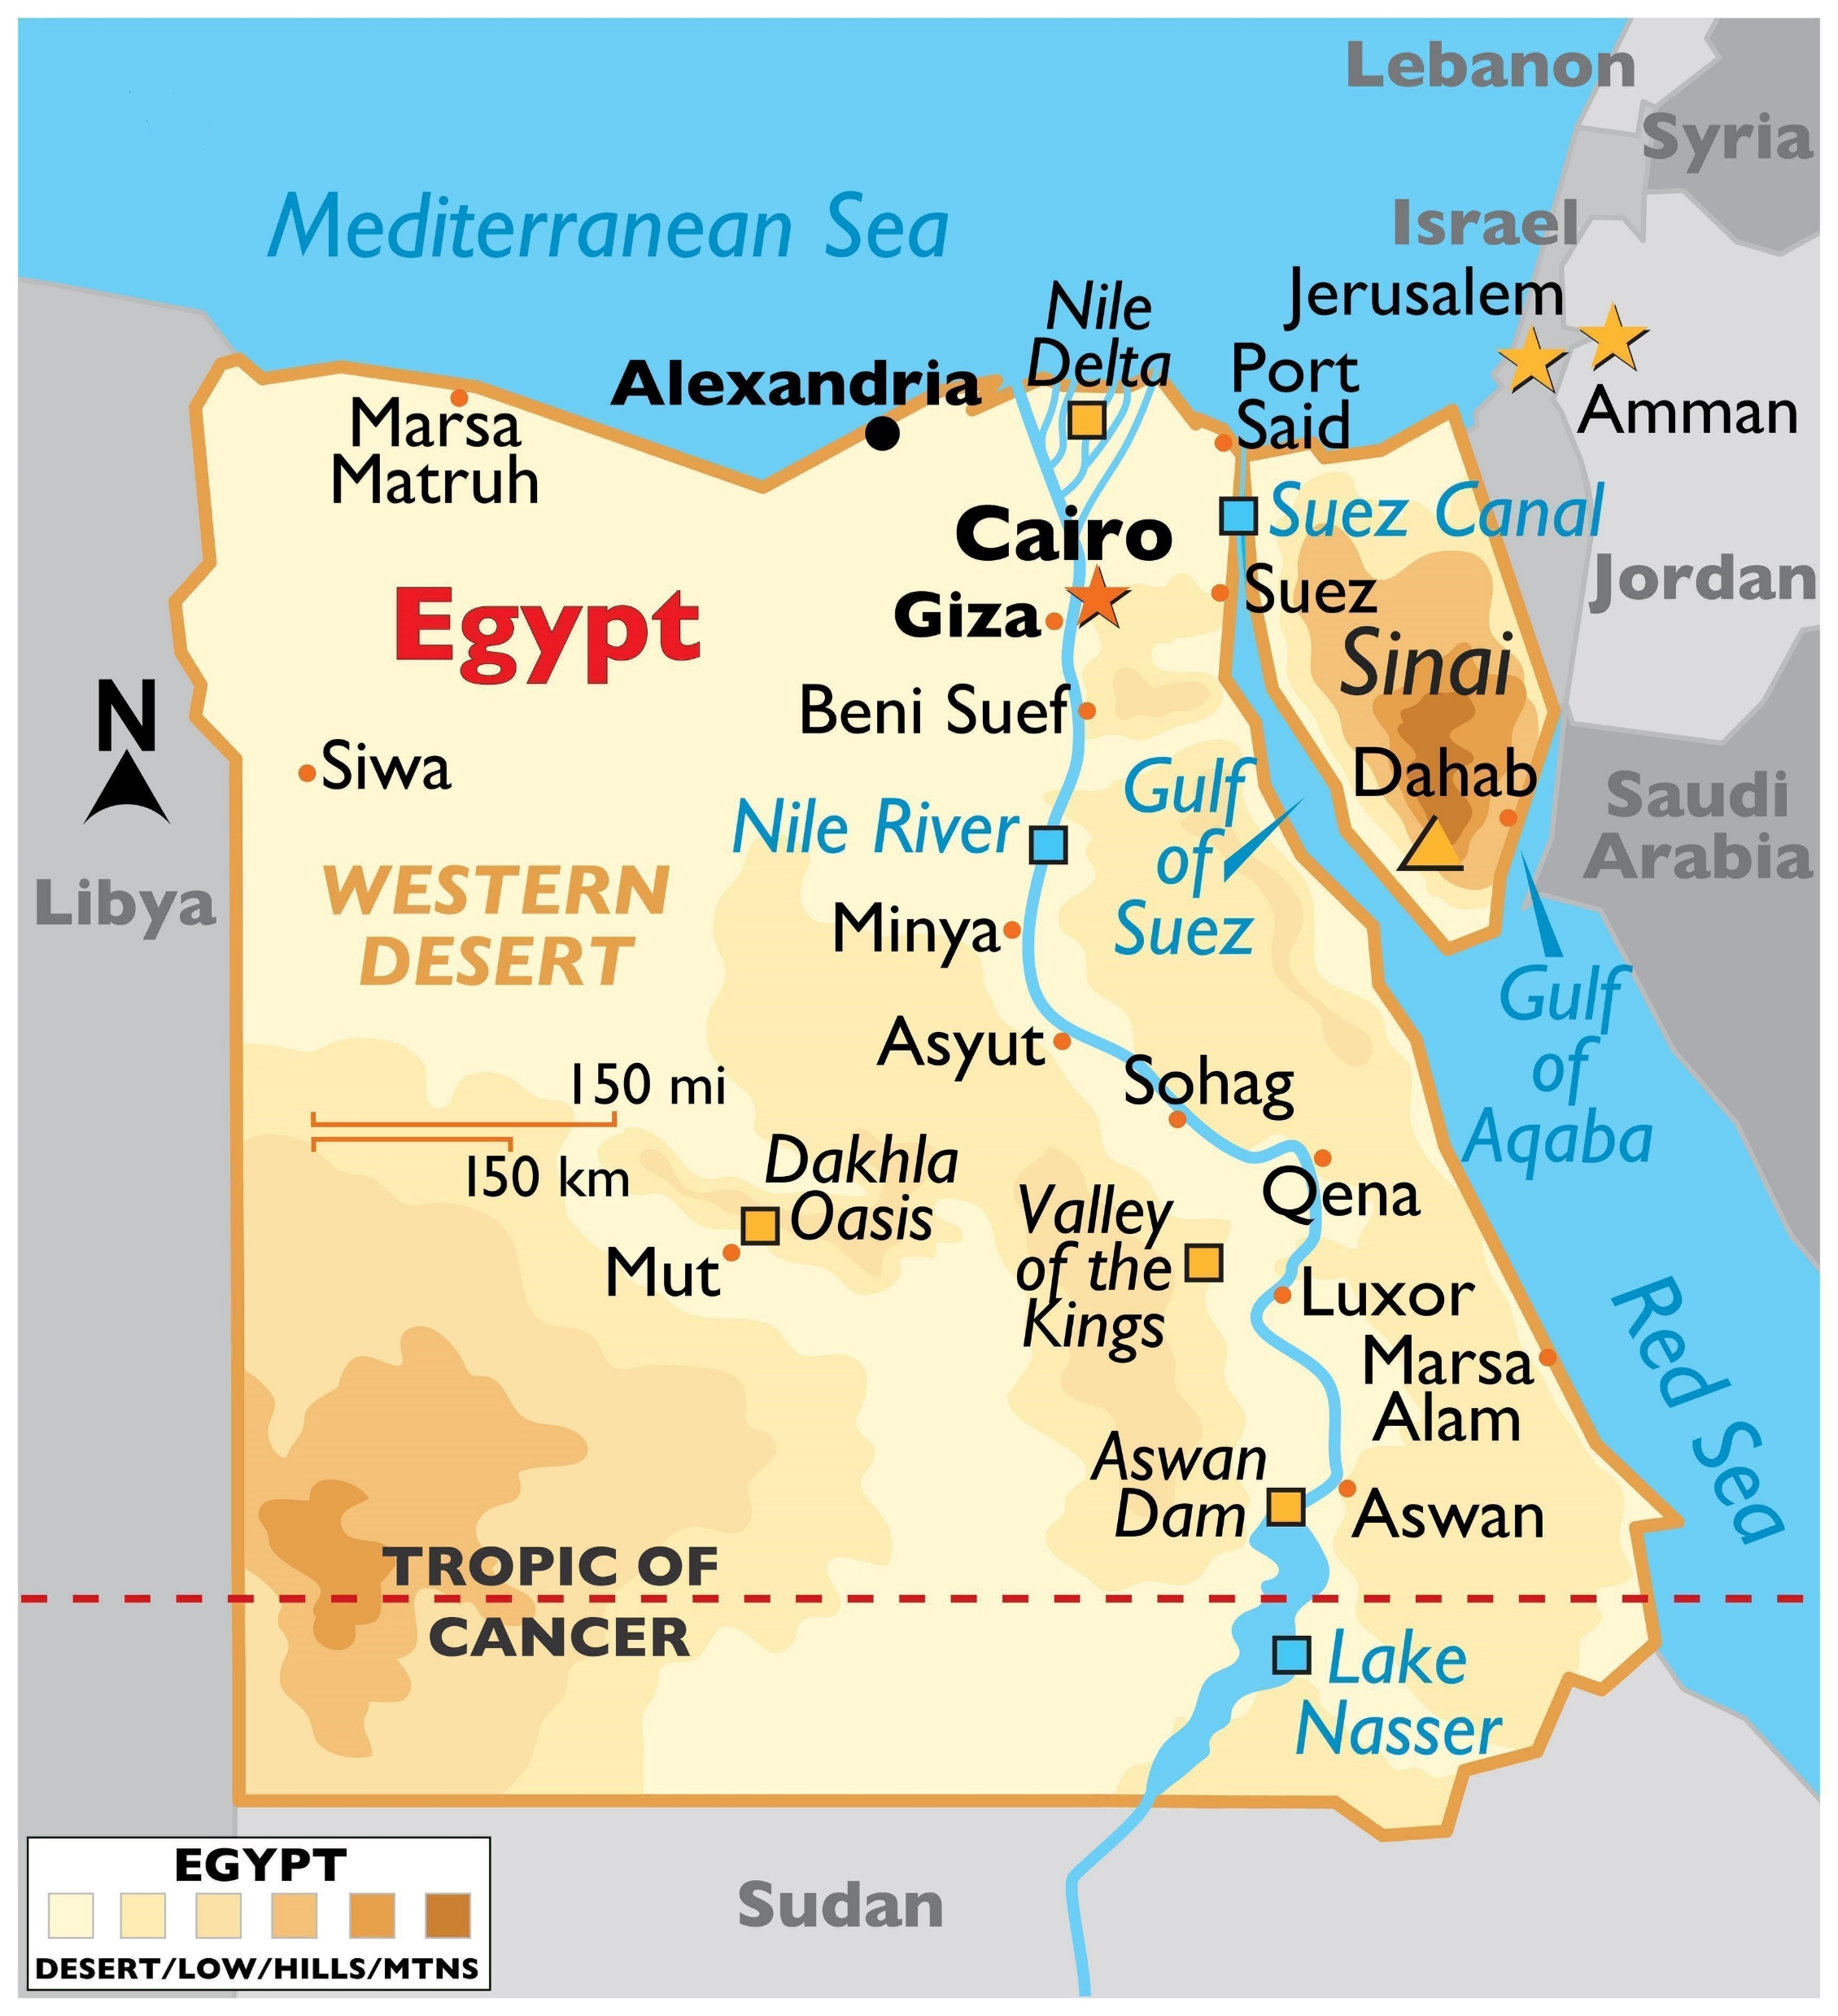
Overview
Background
Egypt was a former British colony where many Egyptians resented the continuing British influence over the corrupt and inefficient government of King Farouk.
After the Second World War, Egyptian army officers formed the revolutionary Free Officers Movement to bring about change.
In 1952, the Free Officers ousted Farouk. The new government, under Nasser, negotiated a British withdrawal from the Suez Canal zone and organised loans for an ambitious Aswan Dam project.
Relations between Egypt and Israel remained tense because of Egyptian backed incursions by Palestinians into Israel, and Israeli reprisals.
Western countries were angered by Nasser's foreign policy, and suspicious of his links with the Soviet bloc. They with drew their offers of loans for the Aswan dam. Nasser nationalised the Suez Canal (July 1956) intending to use the revenues to fund the dam project. Attempts to resolve the issue by diplomatic means failed.
Events
Britain, France and Israel drew up a secret plan to invade Egypt, seize the Suez Canal and force Nasser from power.
On the 29th of October 1956, Israel launched its attack on Egypt.
The Israeli invasion and occupation of the Sinai Peninsula was followed by Anglo-French air strikes and a seaborne invasion, resulting in an international crisis.
On the 5th of November 1956, Britain and France dropped paratroopers into the canal zone. On the following day these two countries launched a full scale invasion.
The United Nations General Assembly proposed a resolution (November 1956) demanding an immediate end to the invasion, which was passed by 64 votes to 5.
A week later, UN peacekeeping troops arrived to oversee the ceasefire.
Under pressure from the USA, Israel reluctantly agreed to withdraw its forces from Sinai early in 1957.
Outcomes
The USA joined the USSR, the United Nations, the Commonwealth and the rest of the world in condemning the invasion.
Britain, France and Israel were forced to withdraw from Egypt.
Britain lost its influence in the Middle East, faced suspicion in the Arab world, and was forced to acknowledge the predominance of the USA in dictating foreign policy.
The United Nations sent a peacekeeping force to monitor the border between Israel and Egypt. This enhanced the UN's role in world affairs.
As a result of the Suez Crisis, the USA and the USSR became more involved in the Middle East. The superpowers increased the tensions in the region by supplying arms and the Cold War extended into the Middle East.
The USA feared Soviet influence in the region, a factor which ensured future American support for Israel.
The Suez Crisis was a triumph for Nasser, who gained increased prestige and influence in the Arab world.

Slide 4
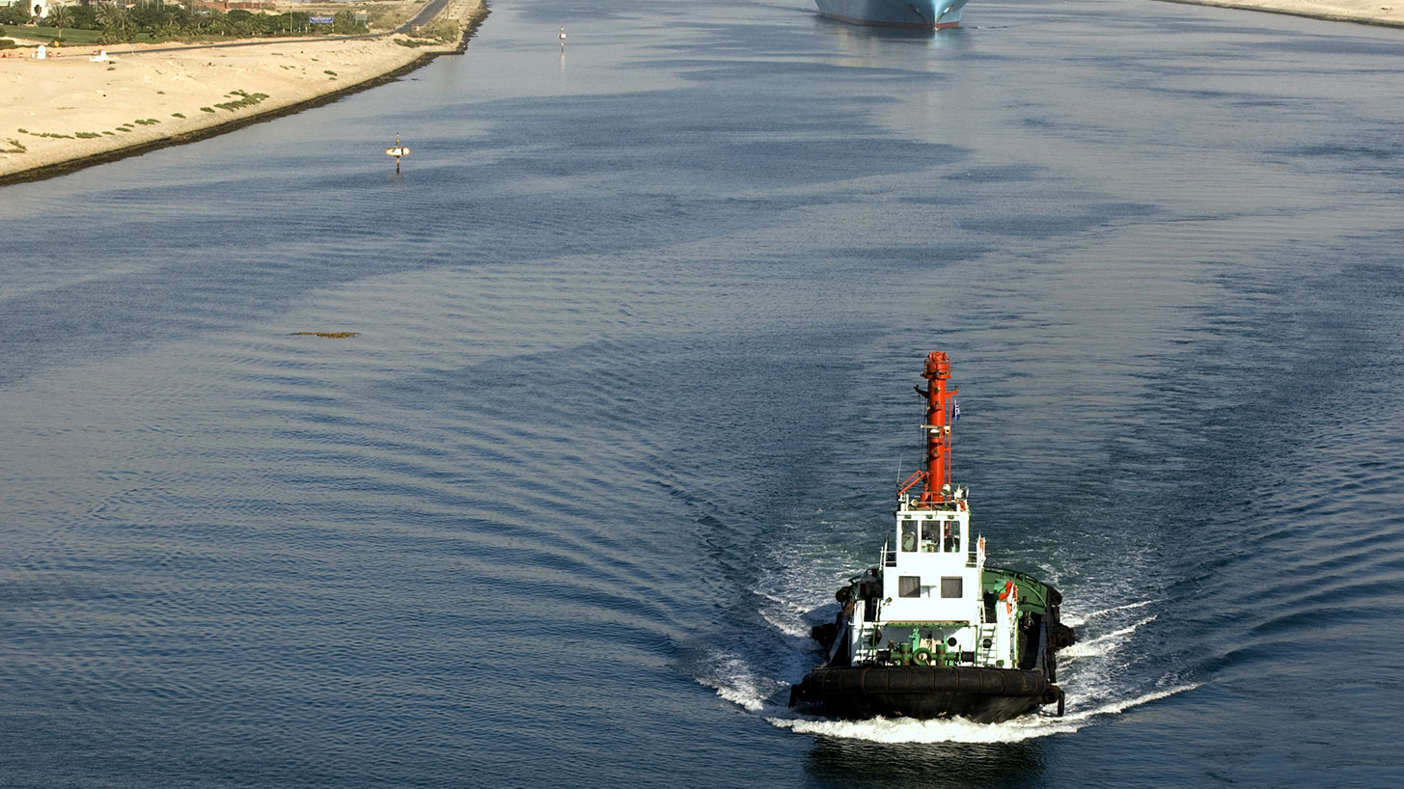
The Suez Canal
The canal was built with British and French funds between 1859 and 1869.
An estimated 120,000 Egyptian workers died during the construction.
After the discovery of oil in the Persian Gulf region, it became the main route for oil supplies to Europe.
Egypt became a British protectorate in 1882 when Britain invaded Egypt; in 1888, an international treaty guaranteed freedom of passage through the canal for all states.
The Suez Canal Company owned, operated and profited from the canal, which was the major trading link between Europe and Asia. The British and French governments were major shareholders in the Suez Canal Company.

Slide 5
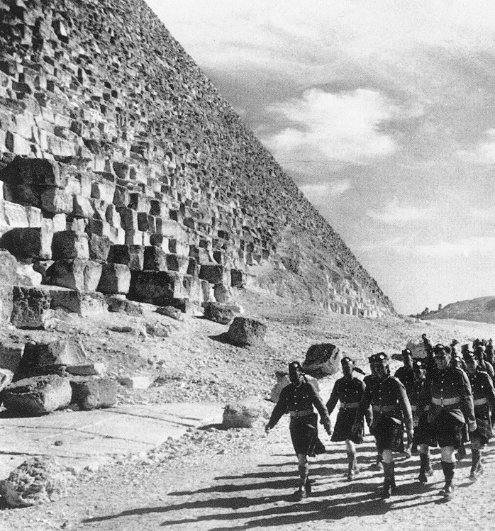
British presence
Britain formally recognised Egypt’s independence in 1922, confirmed in a 1936 treaty which gave Britain the right to station troops in the canal zone until 1956.
During WWII, Egypt became a base for 250,000 British and other allied troops.
Egypt remained officially neutral for most of the war, resisting British pressure to join the allies until 1945.
After the Second World War, Britain continued to maintain garrison of 70,000 troops in the canal zone - much of the oil on which Europe depended still came through the canal from the Persian Gulf.
Profits from the Suez Canal were worth $100 million annually by the 1970s.

Slide 6
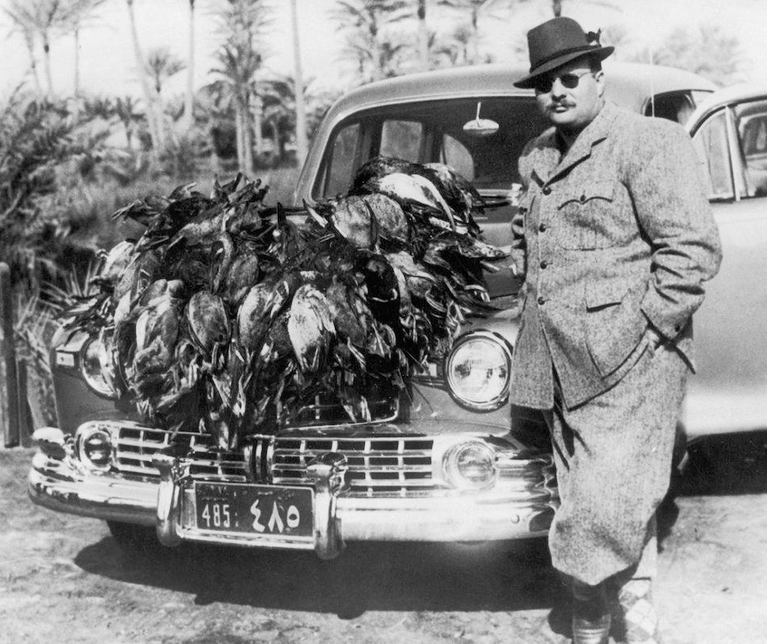
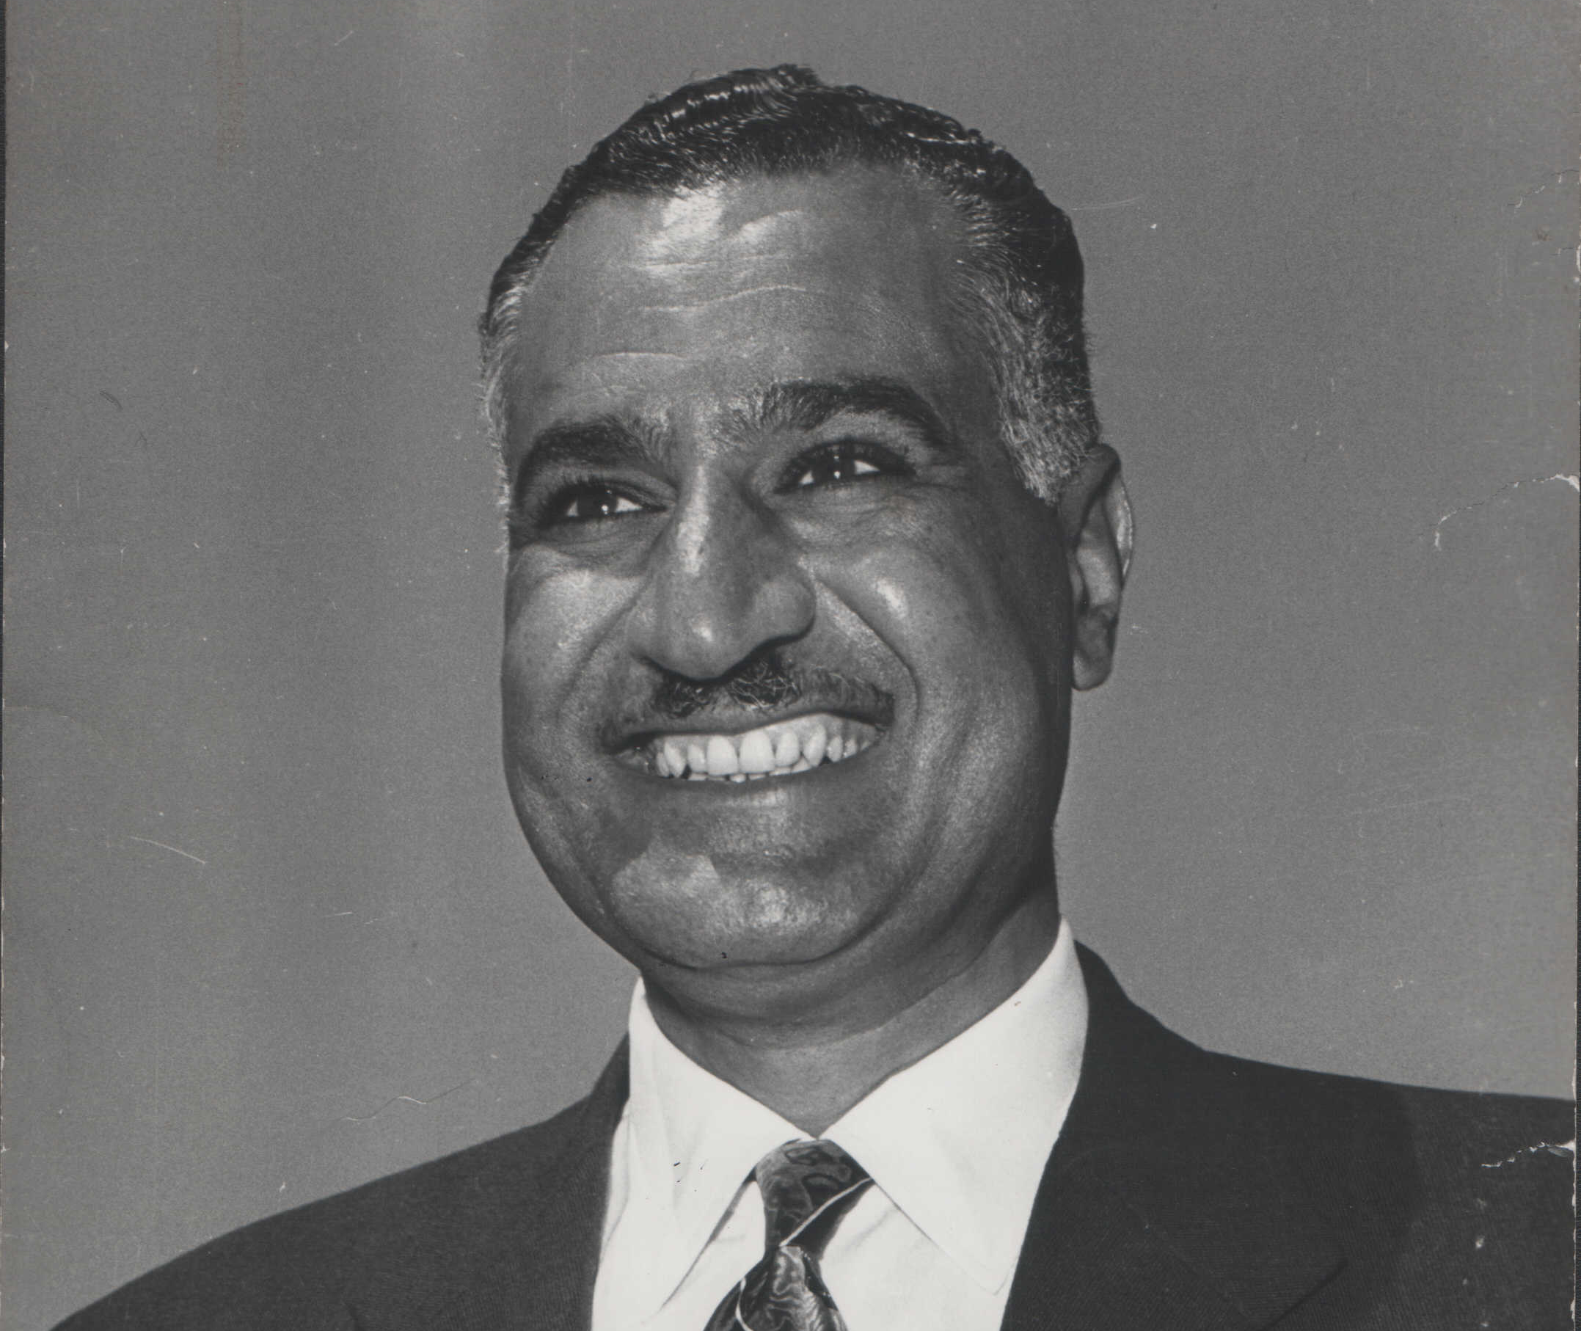
Key figures
King Farouk (r. 1936-1952)
His love of luxury, excess and extravagance put him totally out of touch with ordinary Egyptians.
Many Egyptians resented his willingness to allow the virtual occupation of the country by Britain during the war – his cooperation with them continued after the war.
Egyptians also blamed Farouk and his government for Egypt’s humiliating defeat in the 1948-49 war against Israel.
Gamal Abdel Nasser (President 1954-1970)
Nasser played an active role in the Egyptian national movement early on.
He and other army officers formed the Free Officers Movement.
Nasser fought in the 1948-49 war against Israel, played a leading role in the 1952 coup, and led Egypt from 1954 until his death in 1970.

Slide 7
Read the source and watch the hyperlinked video:
J Kohler and J Taylor, Africa and the Middle East (London, 1985) p.104
“It was not only the King’s inability to remove British influence that outraged the Free Officers. His expensive appetite for pleasure and self indulgence was well known. Scandal, corruption and incompetence were commonplace in the government and bureaucracy. All these contributed to Egypt’s defeat by Israel in the 1948 war: money for arms and supplies was misapplied; soldiers were given obsolete or unserviceable weapons, and the military leaders wasted soldiers lives through contradictory orders and impractical objectives. Not surprisingly the Free Officers became convinced that it was necessary to remove the monarchy as well as the British if Egypt’s honour was to be retrieved.”
Why did the Free Officers blame Egypt’s defeat by Israel in the 1948 to 1949 war on the government of King Farouk? Was it valid to hold the government fully responsible for this defeat?
Notes:
https://www.youtube.com/watch?v=eTMRMX7Pw5U&t=12s

Slide 8
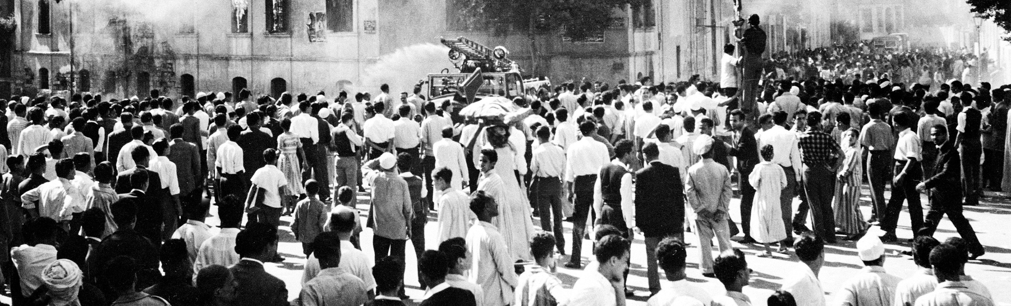
Rising Egyptian nationalism
In 1951, there were guerrilla attacks on the British Garrison in the canal zone. The British reacted harshly, and 50 Egyptian policemen were killed in a raid on Ismailia.
For a while, the Egyptian government cut off supplies of food and labour to the British bases.
The tensions also resulted in attacks on British property in Cairo, led by the Muslim Brotherhood.
Britain increased its garrison in the canal zone to 80,000.

Slide 9
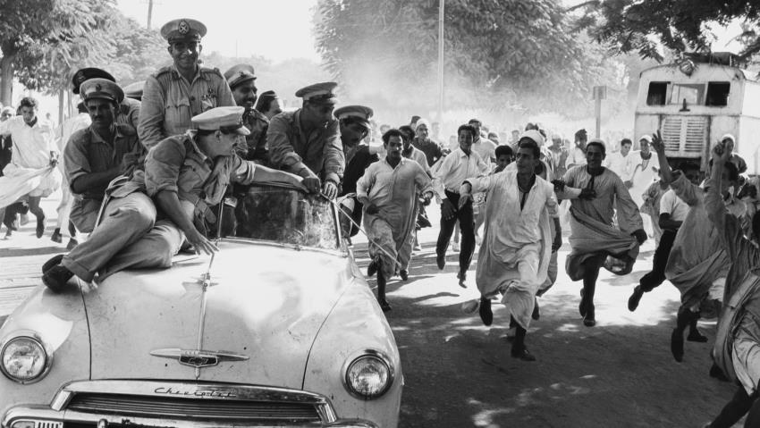
Military coup (July 1952)
In July 1952, the Free Officers seized control of the Egyptian army headquarters, the airport and the communication centres in Cairo in a bloodless coup.
Farouk was forced to abdicate, and was allowed to leave the country to go into exile.
General Mohammad Naguib became president of Egypt, but the most powerful member of the new government was Colonel Gamal Abdel Nasser.
In 1954, Neguib resigned and Nasser took over the positions of President and Prime Minister.
In 1954, Nasser negotiated a new treaty in which Britain agreed to withdraw its troops within two years.

Slide 10
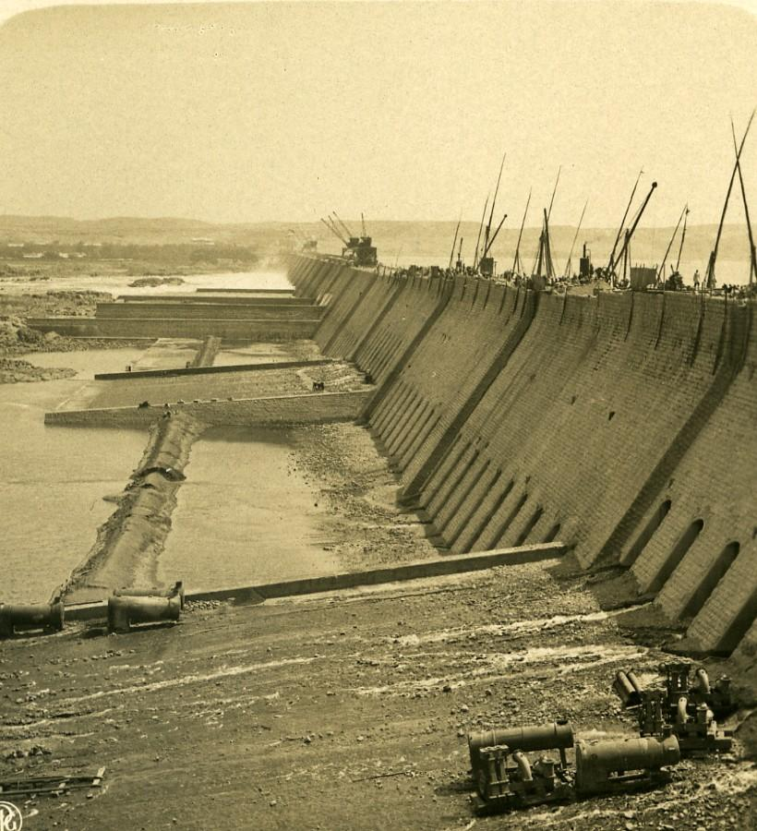
Nasser in power
The evacuation of British troops from the canal zone was completed in March 1956, ending a 74-year British military presence in Egypt.
Nasser's most ambitious project was the construction of a high dam across the river Nile at Aswan.
The dam would provide hydroelectric power for industry and the stored water that could be used for irrigation (increasing arable land by 25%). It also had the potential to improve Nasser’s popularity and prestige.
Egypt secured promises of loans to fund the project from the USA, Britain and the World Bank.

Slide 11
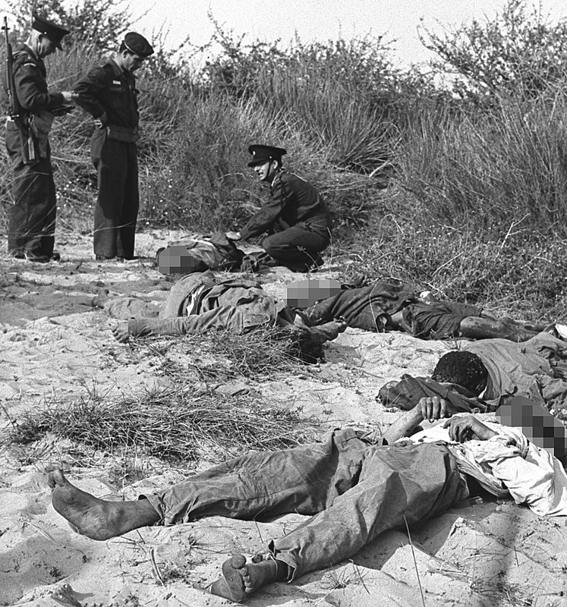
Relations between Egypt and Israel
The Arab states refused to recognise Israel or trade with it (Egypt did not allow Israeli ships or any ships trading with Israel to use the Suez Canal).
Frequent raids by Palestinians across the border of Gaza into Israel were met by instant and harsh reprisals from the Israeli Defence Force (IDF).
In 1954, Israeli agents tried to damage Egypt’s relations with the USA by attacking American owned buildings in Cairo and blaming it on the Egyptians.
On the 28th of February 1955, the IDF launched an attack against the Egyptian military headquarters in Gaza, destroying it and killing 35 Egyptian soldiers – this fuelled Egyptian desire for revenge.
Nasser looked to strengthen Egypt’s defences by seeking supplies of armaments, resulting in an arms deal with Czechoslovakia.

Slide 12
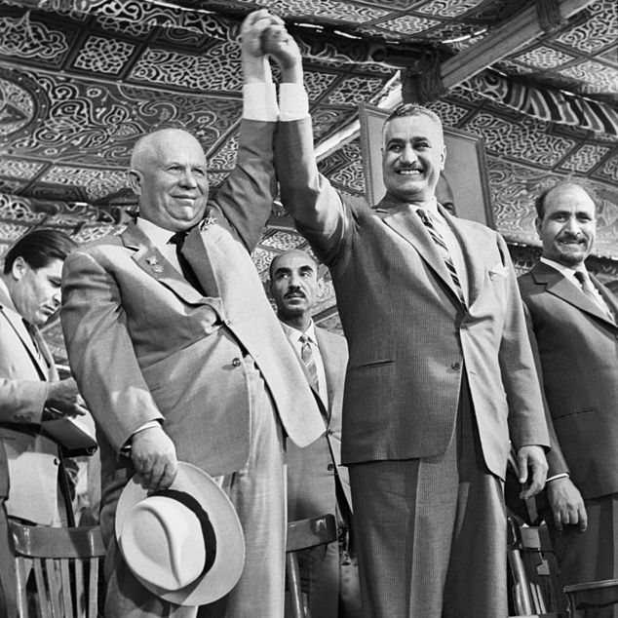
What led to the Czech arms deal?
Nasser could not accept the terms of an American arms deal; the British and American position was that Egypt could obtain arms only if it would join an anti-Soviet defence pact modelled along the lines of NATO and SEATO.
Czechoslovakia was known as a major exporter of arms to Third World countries; its massive arms deal with Israel in 1948 was thought to be crucial to Israel’s victory in its war with the Arab states that year.
The real change in the Soviet attitude towards the Third World would appear only with Khrushchev’s rise to power in the years 1953-55.
Page 127
(Image) Soviet leader Nikita Khrushchev and Egypt’s President Gamal Abdel Nasser raised hands during Khrushchev’s visit to the Middle East in 1964.

Slide 13
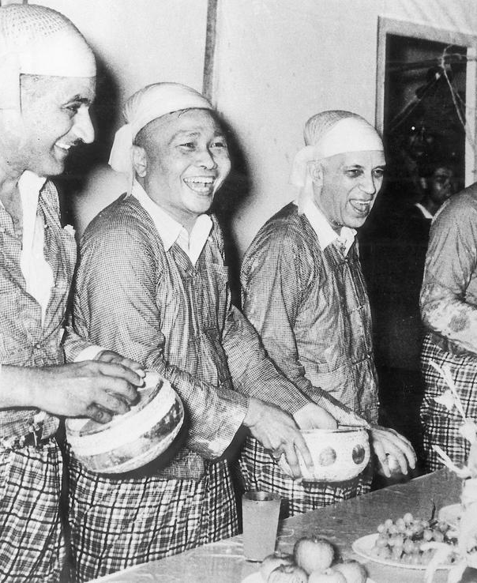
Influence of the Cold War
The USA and its allies were suspicious of Soviet intentions.
The NATO countries were afraid instability in the Arab states would make them vulnerable to Soviet intervention, so a similar alliance was formed in the Middle East in 1955 - this was the Baghdad pact.
Nasser refused to join the Baghdad pact, calling it an instrument of imperialism in the Middle East - he actively opposed Iraq’s membership and persuaded the new King of Jordan not to join.
When Nasser attended the Bandung conference in April 1955, he professed his support for non alignment.
When Egypt formally recognised communist China in May 1956, the USA with drew its offer of loans for the Aswan project. Britain and the World Bank also with drew their financial support for the project.
April 1955 - Colonel Gamal A. Nasser, the Burmese Prime Minister, U Nu, the Indian Prime Minister, Jawaharlal Nehru celebrate the Burmese New Year in traditional costume.

Slide 14
Nationalizing the Suez Canal
On the 26th of July 1956 , Nasser declared that Egypt would nationalise the Suez Canal company.
Extract from the speech by Nasser in which he announced the nationalisation of the Suez Canal on 26 July 1956:
The canal was dug by Egypt’s sons and 120,000 of them died while working. The Suez Canal company in Paris is an impostor company...
But history will never repeat itself. On the contrary, we shall build the high dam. We shall restore our usurped rights. We shall build the high dam as we want it. We are determined to do it... Thus , today, citizens, when we build the high dam we are actually building the dam to defend our dignity, freedom, and pride, and to eradicate humiliation and submission.
Egypt... announces that it will fight to the last drop of its blood... for the sake of Egypt. We shall not let warmongers, imperialists, or those who trade in human beings dominate us. We shall depend on our hands and on our blood... we shall build a strong and dignified Egypt, the Arab Egypt...
Today, citizens, the Suez Canal company has been nationalised... today our wealth has been restored to us.

Slide 15
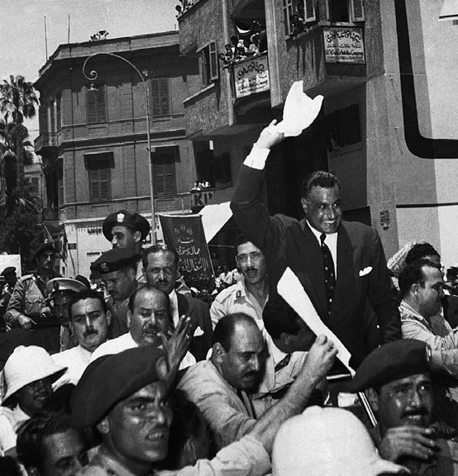
Failed diplomacy
Britain began to consider taking military action.
Eden explained his views in correspondence with the US president, but Eisenhower indicated that the USA did not support the use of force.
Initially there were attempts to settle the issue by diplomacy; a Suez Canal conference was held in London in August 1956.
Their proposal that the canal should be placed under international control was rejected by Nasser.
The USA suggested the formation of a Canal Users’ Association to control and operate the canal and pay Egypt for the use of it, but this was also rejected by Egypt.

Slide 16
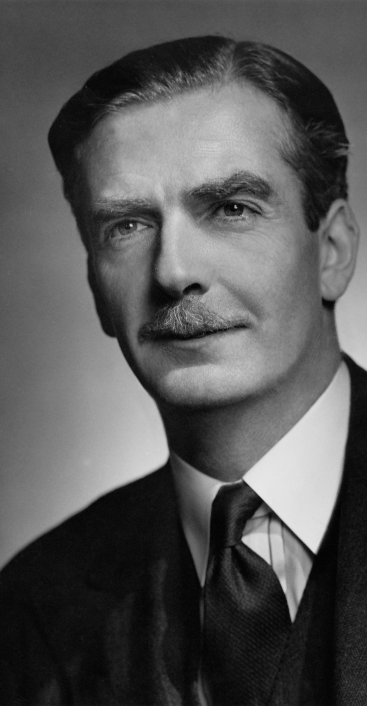
Anglo-French reaction
The British and French tried a number of methods to pressurise Nasser; they tried to get the UN to support a motion condemning Nasser's actions and placing the control of the canal under an international body, but the USSR vetoed this.
Eden came to believe that military action would be necessary to force an outcome that suited British interests.
In October 1956, Britain joined the secret discussions with France and Israel. They jointly agreed that Nasser should be forced from power.
While Britain wanted to maintain their influence in the Middle East and France hoped that anti-colonial uprisings in Algeria would collapse without Egyptian support, Israel had the most to gain.

Slide 17
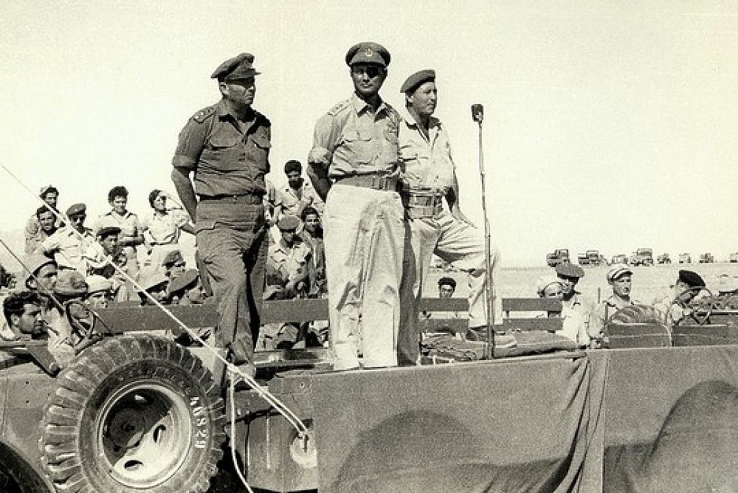
The plan
2. UK and France issue an ultimatum calling for both sides to withdraw troops from the canal
1. Israel launch an attack into Egypt across the Sinai Peninsula – get to Suez Canal ASAP
3. Nasser rejects these demands
4. An armed Anglo-French intervention begins using airstrikes and a seaborne invasion
5. Israel take the opportunity to occupy the whole of the Sinai and extend control
On 24th of October 1956, Sèvres protocol was agreed, detailing plans and a precise timetable for how to achieve Nasser’s overthrow.
Notes:
Moshe Dayan reviews troops in Sharm el-Sheikh at the end of the 1956 war.

Slide 18
What happened?
2. 30th October Britain and France issue an ultimatum; they threaten to use force if rejected
1. 29th October 1956 Israel launch its attack, with paratroopers dropped near the Suez
3. Nasser rejects these demands
4. UK and France bomb Egyptian airfields and Port Said while Israel forces advance
5. 5th November UK and Fr. drop paratroopers into the canal zone - 6th November full scale invasion
Britain and France began sending warships and transports to the eastern Mediterranean and transferring paratroopers and air crews to bases in Malta and Cyprus.
The Egyptians sank ships filled with concrete in the canal in an effort to slow the British and French advance.
Notes:
Moshe Dayan reviews troops in Sharm el-Sheikh at the end of the 1956 war.

Slide 19
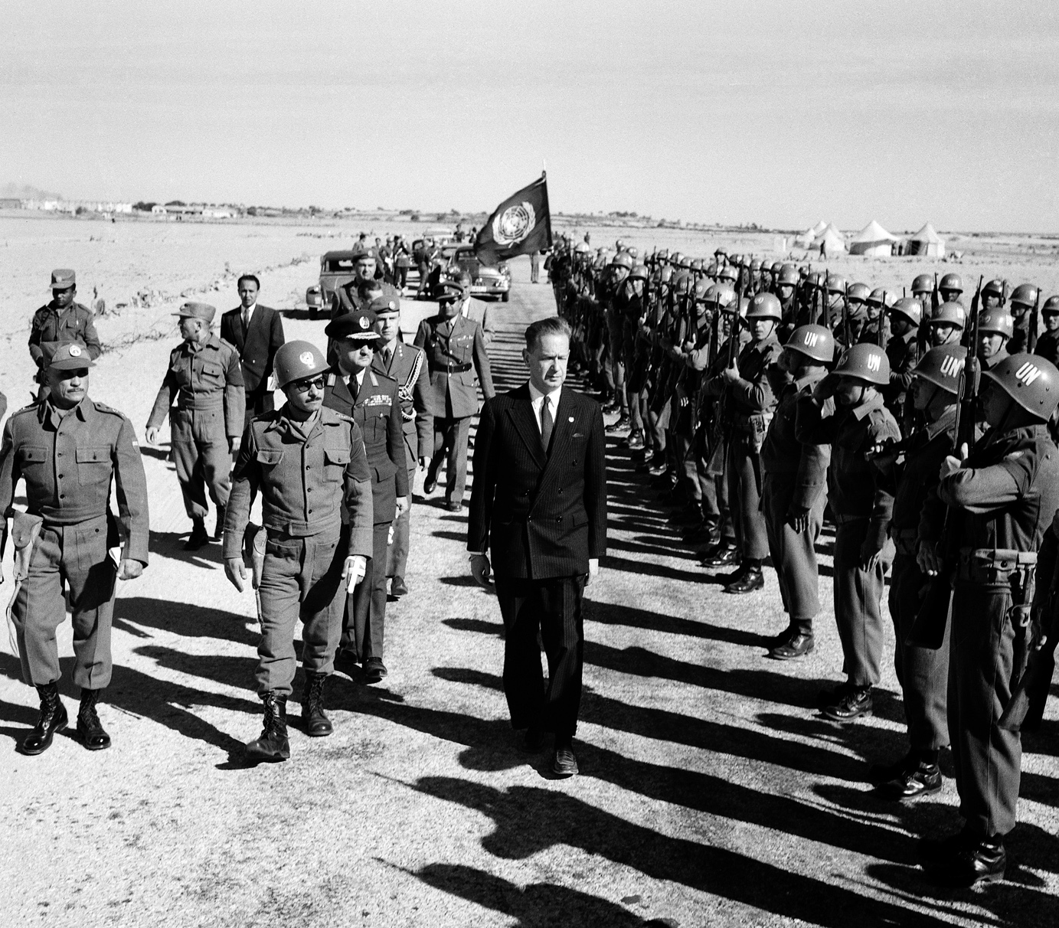
International reaction
In the Arab countries, the direct pipelines carrying oil to the terminals on the Mediterranean were attacked, effectively cutting off Europe’s oil supplies.
The United Nations General Assembly proposed a resolution demanding an immediate end to the invasion, which was passed by 64 votes to 5.
The USA led the criticism of their actions. It joined the USSR, the Commonwealth and the rest of the world in denouncing this imperialist aggression.

Slide 20
Read the source:
Extract from the Soviet newspaper Pravda, 2nd November 1956:
The Israeli attack on Egypt was but the first step in carrying out the conspirators‘ carefully elaborated conspiracy. Following this attack came the Anglo-French ultimatum to Egypt and a hasty movement toward the Egyptian shores of England’s and France’s armed forces concentrated for a long time in the eastern Mediterranean... In its statement on the armed aggression against Egypt, the Soviet government rigorously condemned the aggressive acts of the governments of England, France and Israel which are incompatible with the principles and aims of the United Nations... The peoples of Africa and Asia have succeeded in recent years in achieving great success in the struggle for their national independence. Forced to retreat under pressure of the mighty national liberating movement which triumphed in many countries of Asia and Africa, the colonisers have not abandoned the thought of revenge. The Anglo-French colonisers do not conceal the fact that in committing aggression against Egypt they pursue much further aims. Their schemes are not limited to attempts to seize the Suez Canal and to occupy Egyptian territory. It is a matter of direct threat to all Arab states that thrive to strengthen their national independence.
What evidence is there in this source that the secret plot hatched at Sèvres was obvious to outsiders? How did the USSR seek to gain political advantage out of the Suez crisis? How does the information in the source help to explain why the USA was quick to condemn Britain and France?
Notes:
https://www.youtube.com/watch?v=eTMRMX7Pw5U&t=12s

Slide 21
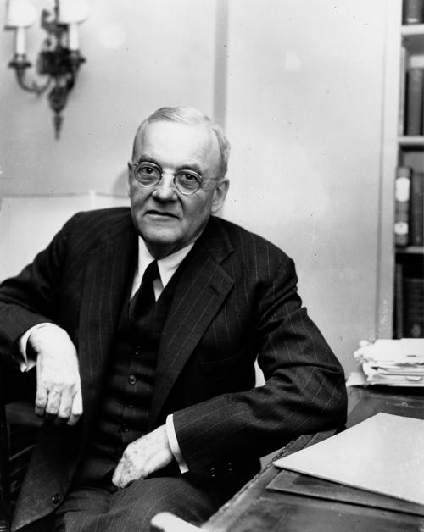
John Foster Dulles at a press conference on 2nd October 1956:
“The United States cannot be expected to identify itself 100% either with the colonial powers or the powers uniquely concerned with the problem of getting independence as rapidly and as fully as possible...”
John Foster Dulles, minutes from a National Security Council meeting, 1st November 1956:
“For many years now, the US has been walking a tightrope between the effort to maintain old and valued relations with our British and French allies on the one hand, and on the other hand, trying to assure ourselves of the friendship and understanding of the newly independent countries ... Unless we now assert and maintain our leadership, all of these newly independent countries will turn from us to the USSR.”
Source: W.M. Roger Louis, ‘Dulles, Suez and the British’ in Richard H. Immerman ed. John Foster Dulles and the diplomacy of the Cold War (Princeton, 1990)

Slide 22
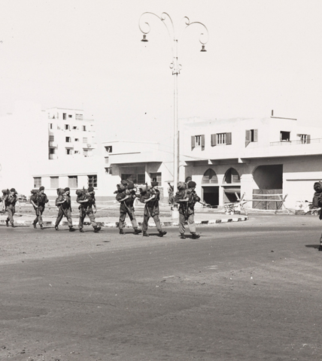
Evacuation
Less than 24 hours after landing at Port Said, British and French troops began to be evacuated from Egypt.
A week later, UN peacekeeping troops arrived to oversee the ceasefire.
Under pressure from the USA, Israel reluctantly agreed to withdraw its forces from Sinai early in 1957.
A total of 33 British and French troops, 171 Israelis and over 1000 Egyptians, mainly civilians, died in the Suez crisis and the Sinai War.

Slide 23
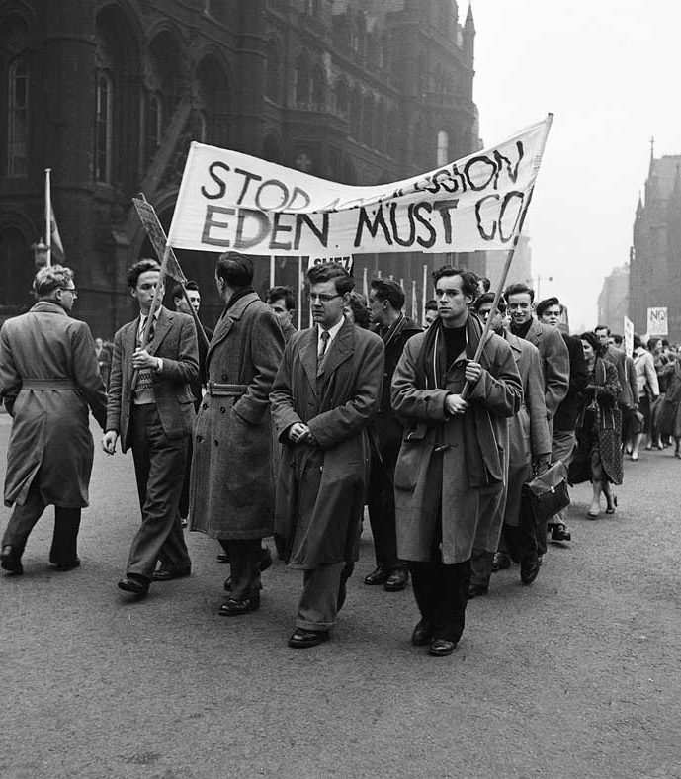
Impact on Britain
There were expensive petrol shortages in Britain and the introduction of petrol rationing.
Eisenhower refused to allow additional oil supplies from South America, Britain’s only remaining source of oil. The USA refused to lend any money or to approve a loan to Britain from the IMF.
The British government gave in to the pressure and agreed to withdraw its troops.
The Suez Crisis achieved exactly the opposite of what Britain and France had intended. British and French companies and banks in Egypt were nationalised, and foreigners were expelled.

Slide 24
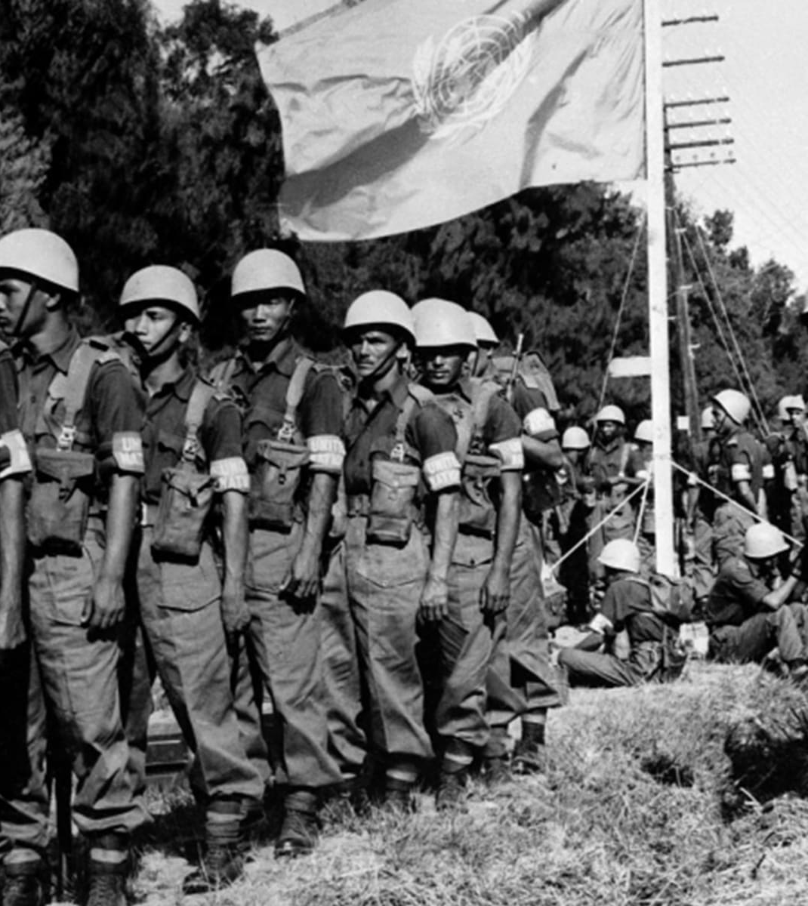
The UN
The UN created a United Nations Emergency Force (UNEF) to be sent to the Middle East to oversee the ceasefire.
This was made up of 6000 troops from 10 member countries seen as neutral and impartial, as well as acceptable to the Egyptian government.
After the British, French and Israeli forces were withdrawn, the UNEF was stationed on the ceasefire line for the next 10 years.
Its purpose was to prevent another conflict between Israel and Egypt and to supervise the clean-up of the Suez Canal which was reopened to shipping in April 1957.

Slide 25
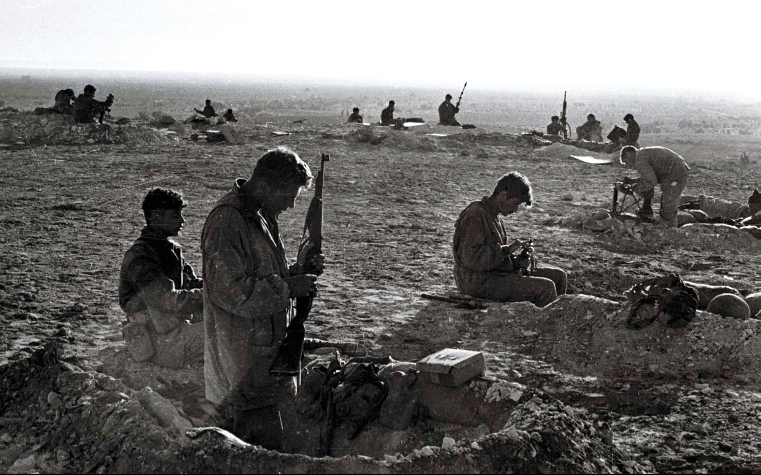
Israel
The success of Israel’s army strengthened the position of the Israeli politicians who supported intervention and reprisal in Israel’s dealings with the Arab states.
The USA was angered by Israeli actions during the Sinai War, but the shifting power relations in the Middle East that resulted from the war led to significant and lasting changes in American policy towards Israel.

Slide 26
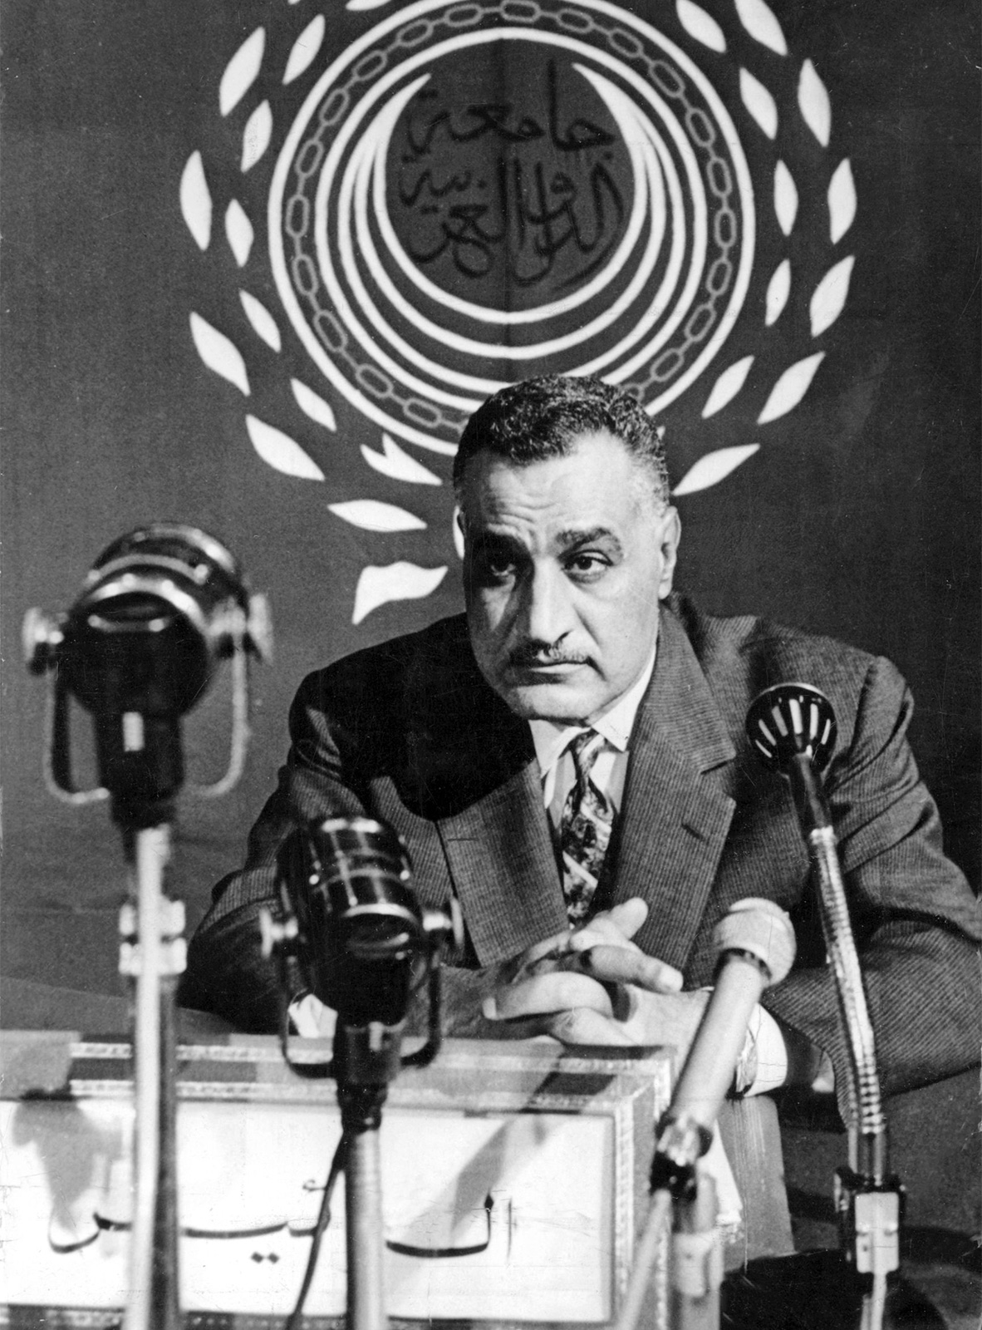
Egypt
The Suez affair was also a triumph for Nasser and his popularity increased enormously.
Under Nasser's leadership Egypt now had complete control of the Suez Canal.
As a result of the Suez Crisis, many Arab states turned against the West and increasing anti-Israeli sentiments were felt in the Arab countries.
This had particular consequences when looking forward to the 1967 and 1973 wars.

Slide 27
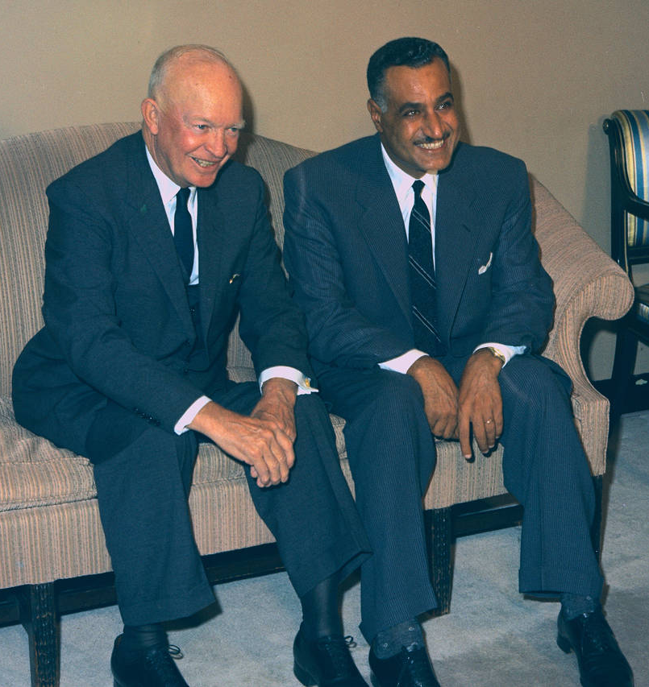
The role of the USA
Between August and October 1956, the USA used its influence to promote a diplomatic solution to the crisis.
The USA could not approve of Anglo-French actions; it did not want to risk alienating the Arab states, or the newly independent Asian and African nations, and drive them into an alliance with the USSR.
Eisenhower later wrote that the USA could not afford to let the USSR take the lead in condemning the use of force against Egypt.
1956 was also an election year in the USA and Eisenhower was running for re-election – he didn't want the USA to be involved in any world conflict that might influence his position with the voters.

Slide 28
Eisenhower Doctrine
In March 1957, the US Congress approved the Eisenhower Doctrine – this offered economic and military aid, including troops, to any Middle Eastern country that believed it was threatened by communist aggression.
Although Arab states such as Iraq, Jordan and Saudi Arabia took immediate advantage of this offer, Egypt and Syria stuck to their policy of non-alignment.
The implication of the Eisenhower Doctrine was that the USA was taking over the role, previously assumed by Britain, of managing the affairs of the Middle East.

Slide 29
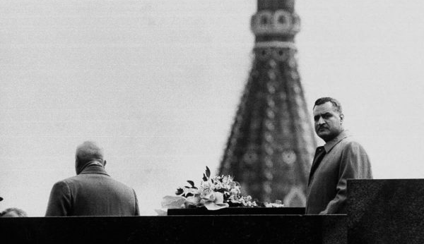
The role of the USSR
The USSR warned that it was willing to use military power, and even hinted at nuclear strikes on London and Paris, if British and French forces were not withdrawn.
The Suez Crisis proved to be useful because it distracted world attention from the revolt in Hungary – the Soviets were not prepared to be drawn any further into the Middle East crisis.
The USSR increased its aid to Egypt to rebuild its military forces, and for the Aswan high dam project. The USSR gained prestige because it stood up for Egypt against imperialist aggression.
However, Egypt maintained its non aligned status.

Slide 30
Activity suggestions Select one or more of the following activities (time permitting)
Read Andrew Jones’s ‘The 1956 Suez Crisis’ from the Modern History Review February 2018 and attempt the questions on page 32. | Watch Epic History’s TV’s analysis of the Suez War (30 minutes) | Design a flow chart to illustrate the key events during the Suez crisis. Use arrows to indicate the sequence of events, the links between them, and the cause and effect relationships. | Analyse the role of the Super powers in the Suez crisis and the impact of the crisis on the Cold War.
Explain how Nasser was at the centre of tensions that were developing in the Middle East by 1956. | Find out the details about the top secret negotiations between Israel, France, and Britain that culminated in the Sevres Protocol. | Look into either the declining status of Britain as a world power and as a colonial power or the anti colonial nationalist movements in Africa. | Find out how Aswan high dam project eventually went ahead, and whether it brought about the dramatic economic and social transformation that the Egyptian government hoped it would.

Slide 31
Bibliography
Jean Bottaro, The Arab-Israeli Conflict 1945-79: History for the IB Diploma (Cambridge, 2012) pp.93-119
Browne H. Flashpoints: Sinai and Suez (London, 1971) pp.92-3
Kallaway, P. ed. History Alive (South Africa, 1987) p.281
J Kohler and J Taylor, Africa and the Middle East (London, 1985) p.104
Guy Laron, ‘Cutting the Gordian Knot: The Post-WWII Egyptian Quest for Arms and the 1955 Czechoslovak Arms Deal’ Cold War International History Project no.55 (2007)
W.M. Roger Louis, ‘Dulles, Suez and the British’ in Richard H. Immerman ed. John Foster Dulles and the diplomacy of the Cold War (Princeton, 1990)

