Slide 1
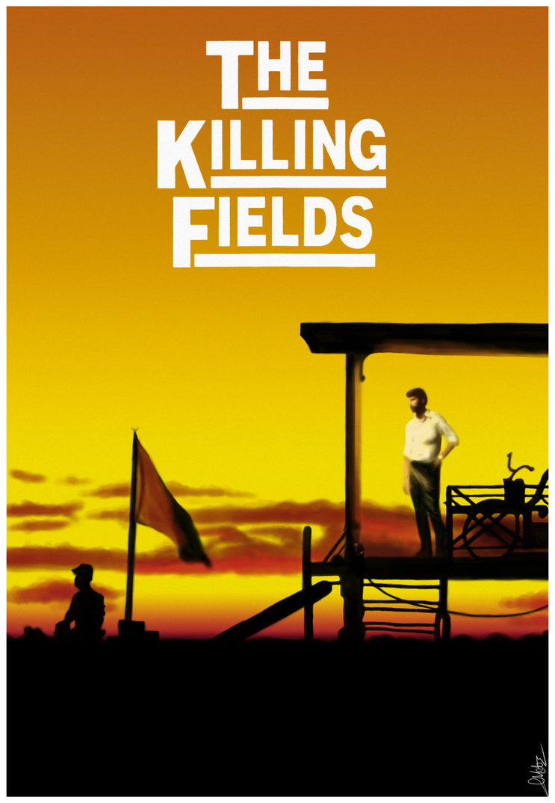
Key words/terms/individuals—Nixon’s policies in Vietnam
Vietnamisation
Nixon Doctrine
Henry Kissinger
ARVN
Paris Peace Talks
Spring Offensive
Khmer Rouge
Pol Pot
Nguyen Van Thieu
‘peace with honour’
Lon Nol
A film about the Khmer Rouge
Stretch and challenge: See what Nixon himself said during a Presidential Address about the war in Vietnam on YouTube (1969).
How far does the evidence back up Nixon’s arguments?

Slide 2
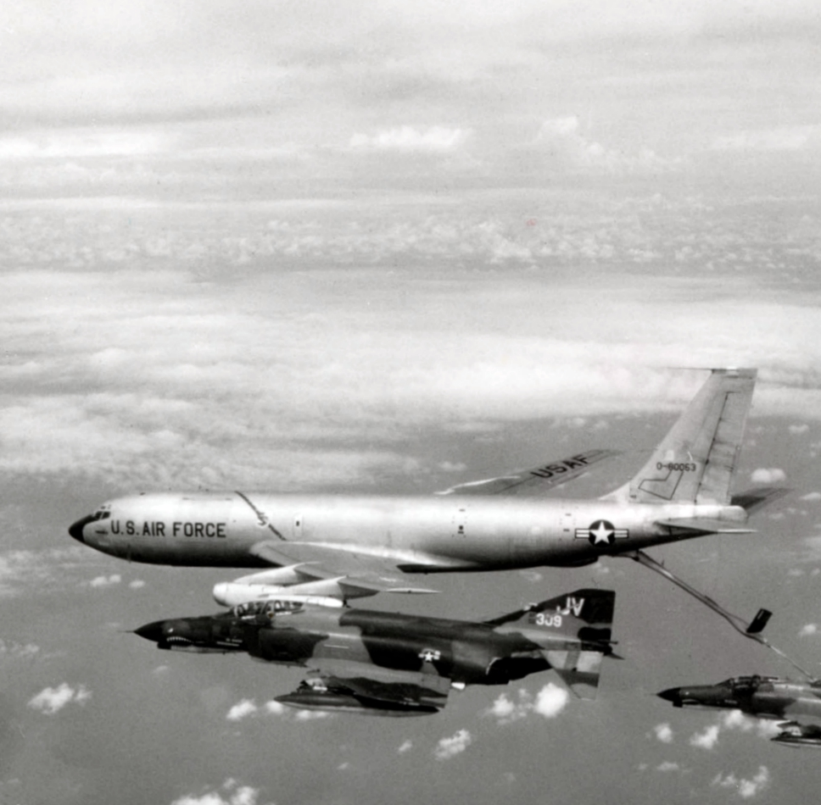
Nixon’s policies in Vietnam
Deadlock and dissention 1972-4

Slide 3
‘Nixon’s policies towards Vietnam, in the years 1968 to 1972, were a total failure.’

Slide 4
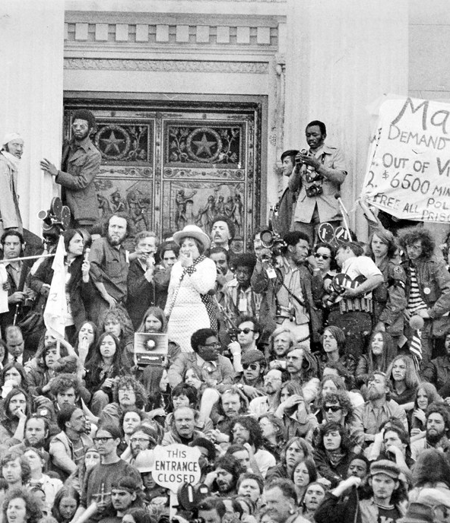
Domestic opposition
Early 1971, the Vietnam Veterans Against the War (VVAW) conducted the ‘Winter Soldier’ investigation of US war crimes.
April: veterans gather at the Capitol to tell their own stories and throw away medals.
Mayday Tribe: 30,000 aim to shut government down (left); 12,000 are arrested, most without charge.

Slide 5
Domestic opposition
The trial of Calley bought public attention to the horrors of war, though Nixon pardonably intervened and ordered for him to be released from prison.
The New York Times began publication of the Pentagon Papers (leaked by Ellsberg).
Nixon took unprecedented steps to secure an injunction against the publication.

Slide 6
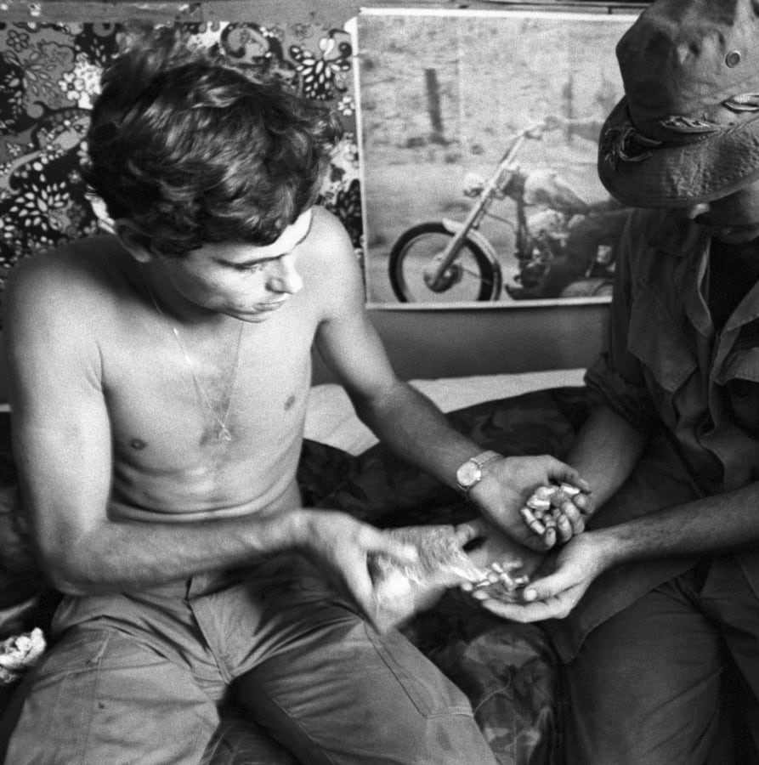
Malaise
The purpose of war became more murky; many troops were reluctant to put their lives on the line.
In 1970 there were more than 200 incidents of assassination attempts against officers.
Drug culture grew; up to 65,000 US service personnel were using.

Slide 7
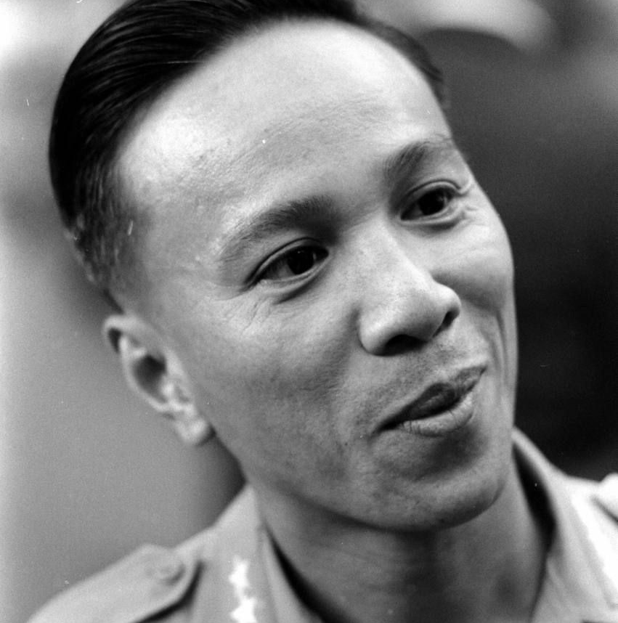
New peace offers (May 1971)
May 1971: the most comprehensive peace offer the US offer so far.
In exchange for release of American POWs the US would withdraw all troops within 7 months and abandon the concept of mutual withdrawal.
It was rejected. Thieu’s removal remained an essential precondition – they suggested the US withdraw support for Thieu in the upcoming elections.

Slide 8
Failing peace
Thieu interfered in the political process and was re-elected – Nixon and Kissinger were unwilling to abandon him at this stage.
Kissinger’s new offer included elections 60 days after ceasefire and Thieu’s withdrawal one month in advance. This was also rejected.
Neither side was willing to make serious concessions – the north prepared for a final offensive; the US looked to improve relations with the SU and PRC.

Slide 9
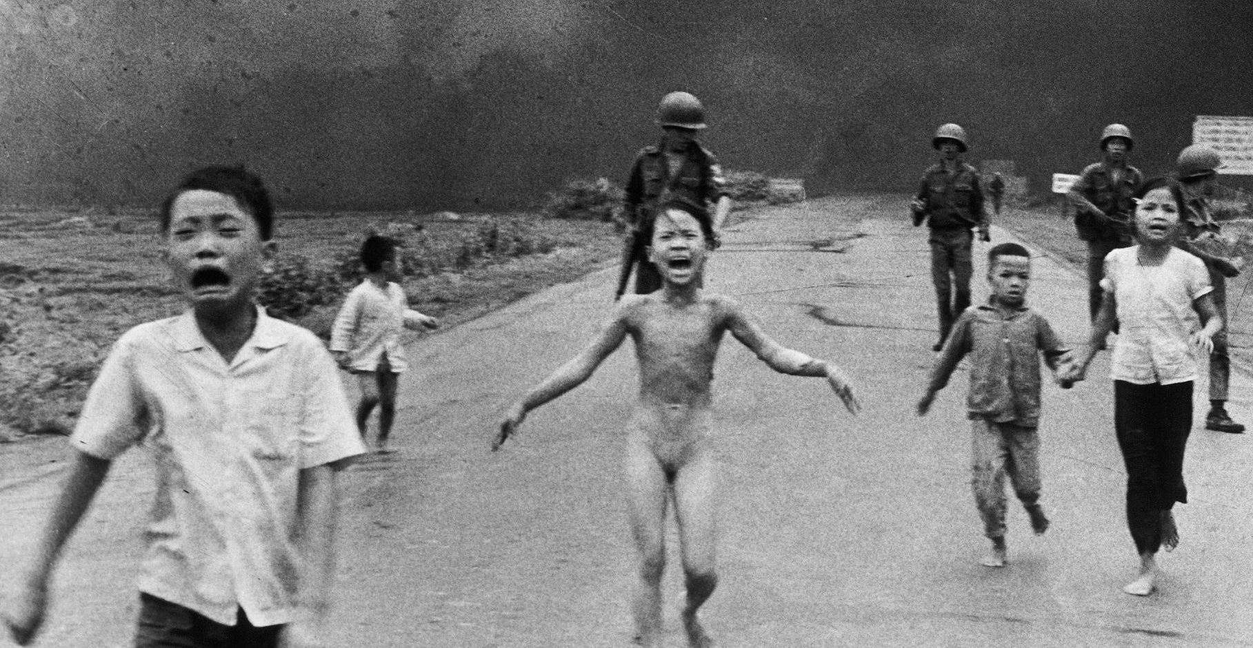

Slide 10
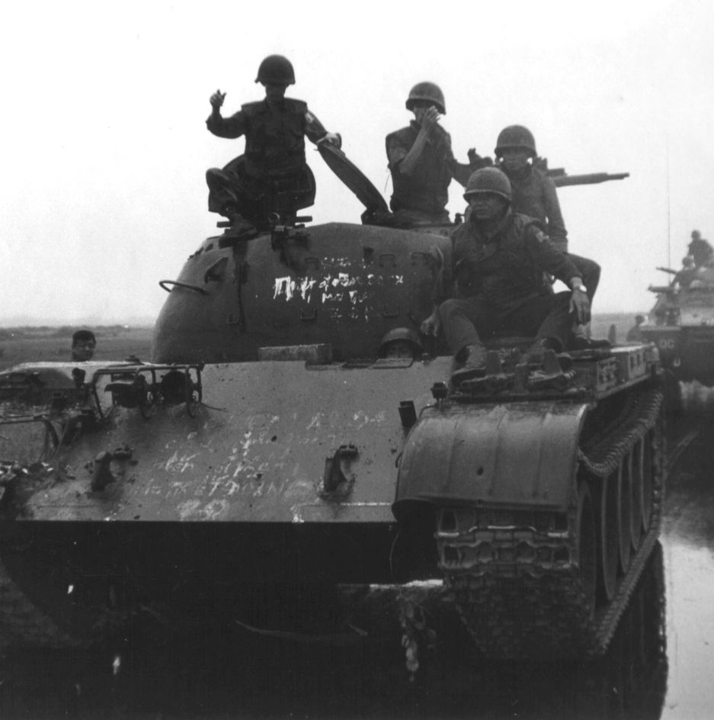
The Easter Offensive (30 Mar 1972 – 22 Oct 1972)
A massive conventional invasion of the South was launched to coincide with the beginning of the American presidential campaign.
The offensive was aimed a the ARVN, enabling the NLF to take the countryside, disrupt pacification and strengthen their position in peace talks.
The US retaliated with B-52 strikes across the DMZ, Hanoi and Haiphong.
Kissinger met secretly with Brezhnev and warned that continuation of the war would damage US-Soviet relations.

Slide 11
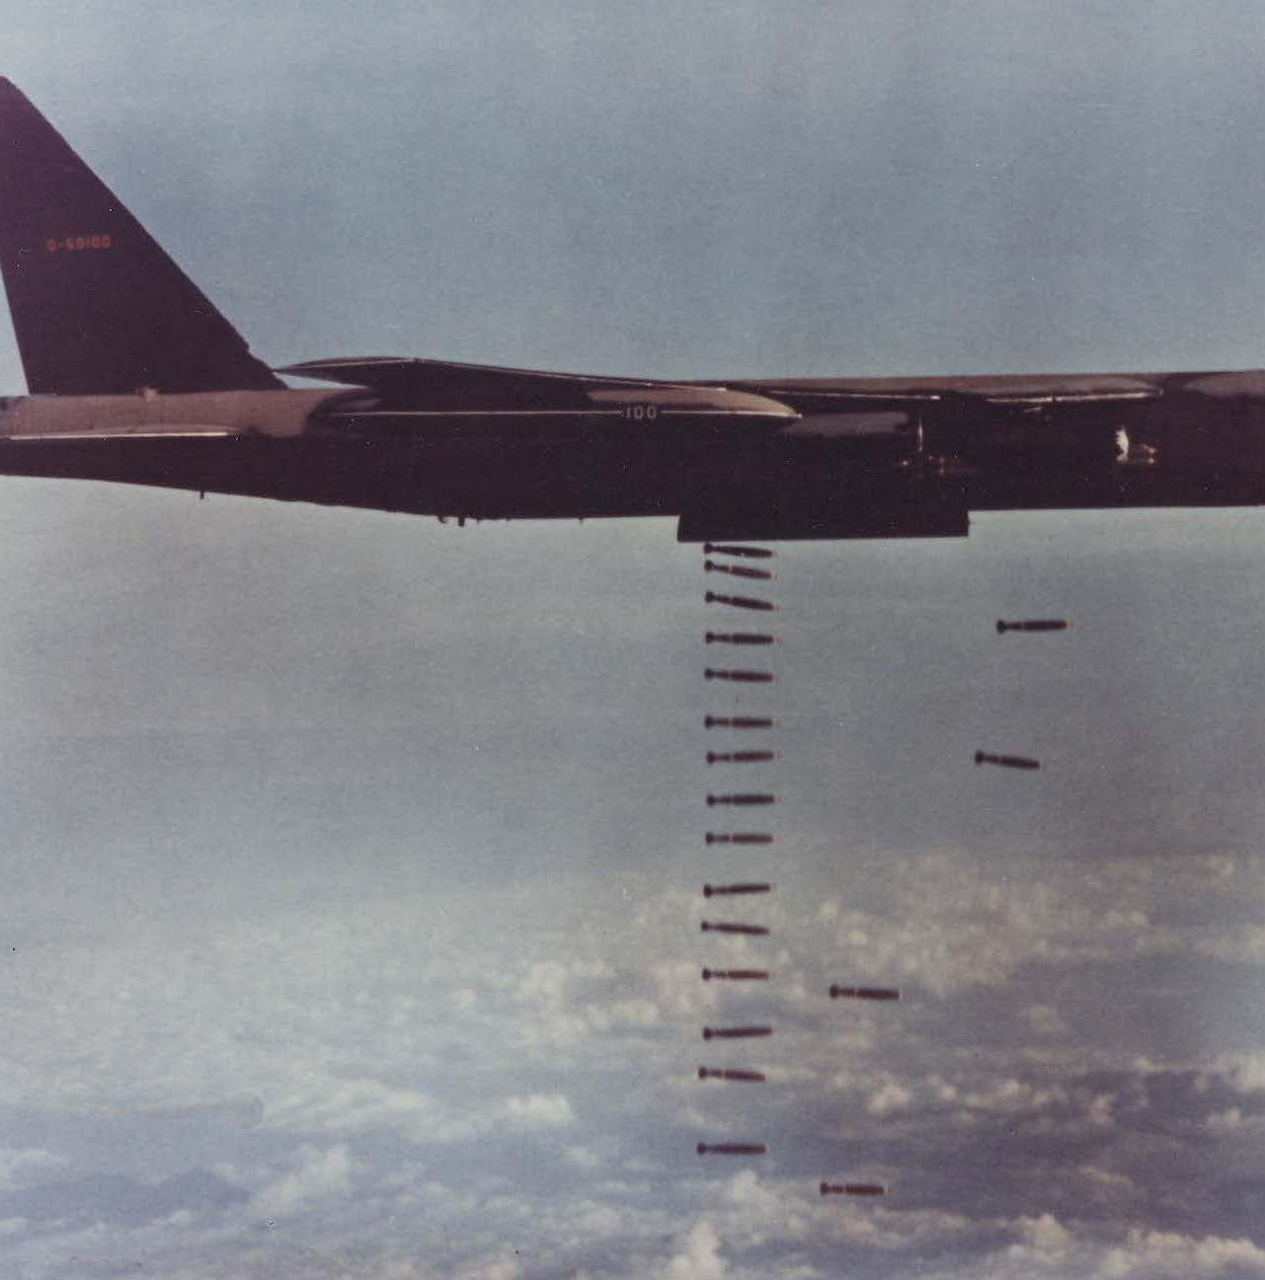
LINEBACKER I
8th May 1972: Nixon announces the mining of Haiphong harbour, a naval blockade and massive sustained bombing of the north.
The Soviets and Chinese both continue to provide massive military and economic assistance, however…
… the planned Moscow Summit went ahead and both sides urged Hanoi to reach an agreement.
Nixon’s approval rating went up despite LINEBACKER delivering ~120,000 tonnes of bombs devastating the north’s economy, transport systems and air defence.

Slide 12
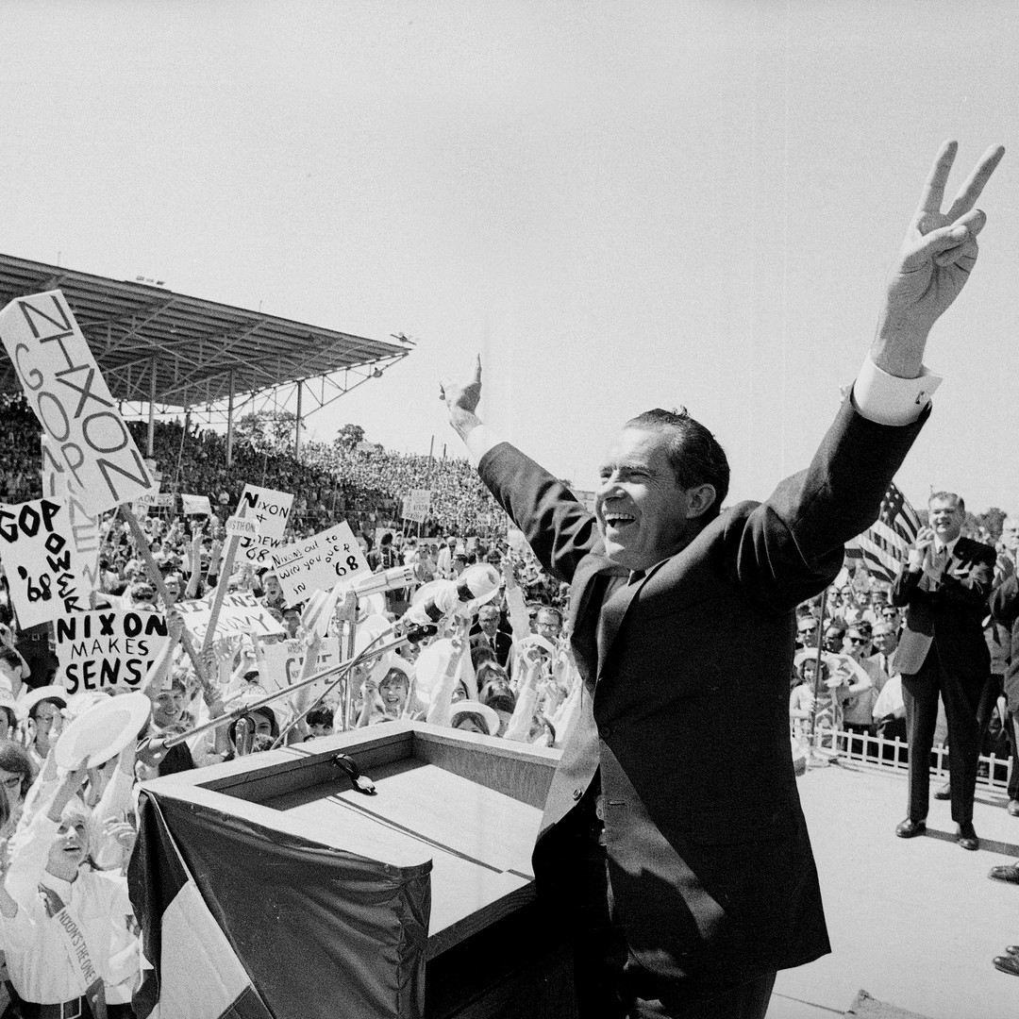
Results
Casualties were high (north: ~10,000, south: ~108,000) but Vietnamization simply couldn’t compensate for lack of national will.
NLF scored major gains in the Mekong delta, but north offensive capabilities were set back for three years.
Nixon won a landslide victory in 1972.
Thieu clung to power; the north seek peace while preparing for continued war.

Slide 13
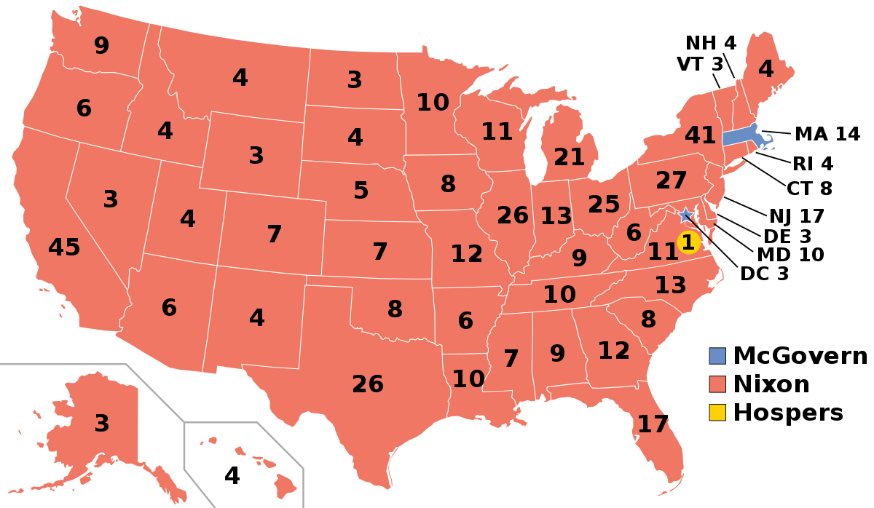

Slide 14
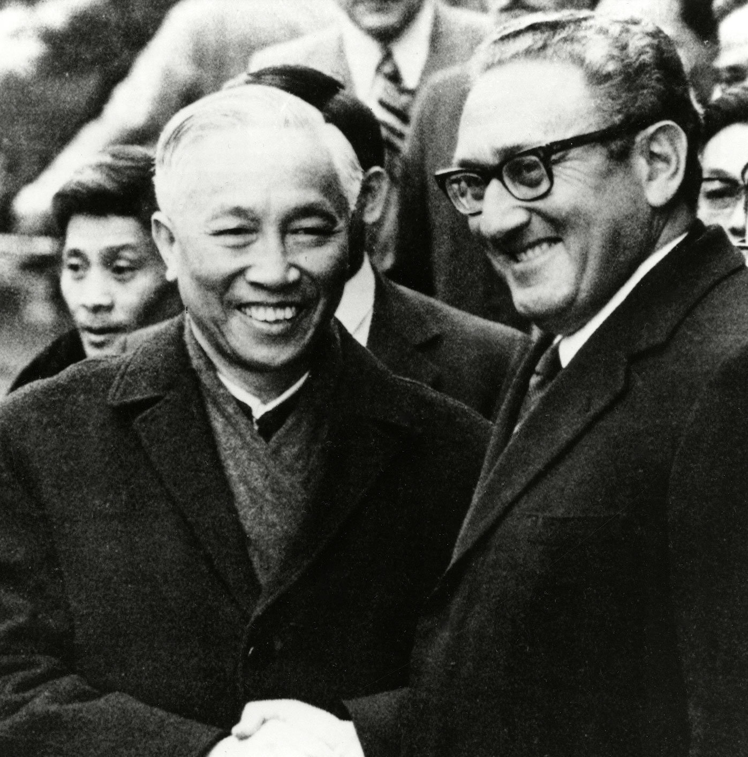
October Agreement
The US agreed to a tripartite Electoral Commission and the north dropped their insistence on removing Thieu.
Kissinger and Le Duc Tho hammed out the fundamentals on an agreement (henceforth referred to as the ‘October Agreement’):
US troop withdrawal within 60 days of ceasefire
North Vietnam to return American POWs
Political settlement to be arrange by the Tripartite National Council of Reconciliation and Concorde.

Slide 15
Blocked by Thieu
Thieu was furious he wasn’t consulted and found the terms unacceptable.
A sticking point was his want to establish a DMZ as a boundary between two sovereign states.
Kissinger urged Nixon to go ahead without Thieu’s cooperation – but Nixon’s support of Thieu ensured a breakdown of the October Agreement.
Secret discussions resumed in early November and the US brought up 69 points for reconsideration – the north angrily rejected these proposals.

Slide 16
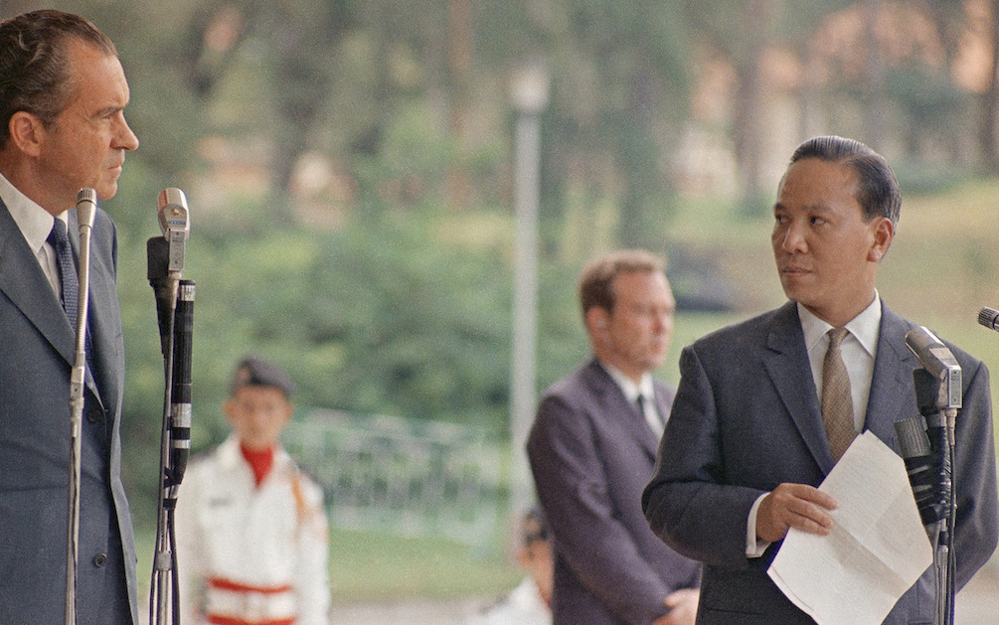
Talks break off
By mid-December there was an essence of compromise but Nixon and Kissinger broke off talks.
Their relationship became more complicated, compounded by poor communication.
Nixon ordered the immediate delivery of $1billion of military hardware to S. Vietnam.
Nixon assured US support if the north violated peace, but warned Thieu he would seek a settlement based on US interests if he rejected the best treaty they could obtain.

Slide 17
“Jugular diplomacy”
Nixon ordered a massive dose of bombing against Hanoi and Haiphong over Christmas 1972 (Linebacker II) to force the north to conclude an agreement.
Over 12 days 36,000 tonnes of bombs were dropped.
Despite the ferocity, bombing did not severely impact the north’s war-making capability.

Slide 18
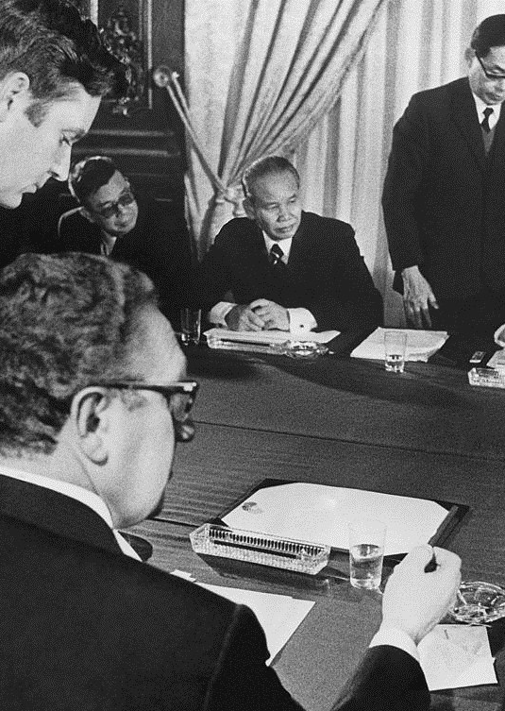
Reaction
There was public outrage across the world – the Swedish PM likened it to an act of cruelty on level with the crimes committed by the Nazi regime.
Nixon’s approval rating plummeted overnight to 39%.
The north agreed to resume talks on Nixon’s offer to stop the bombing – negotiations resume in Paris (8th Jan 1973).
Changes from the October Agreement were largely cosmetic.

Slide 19
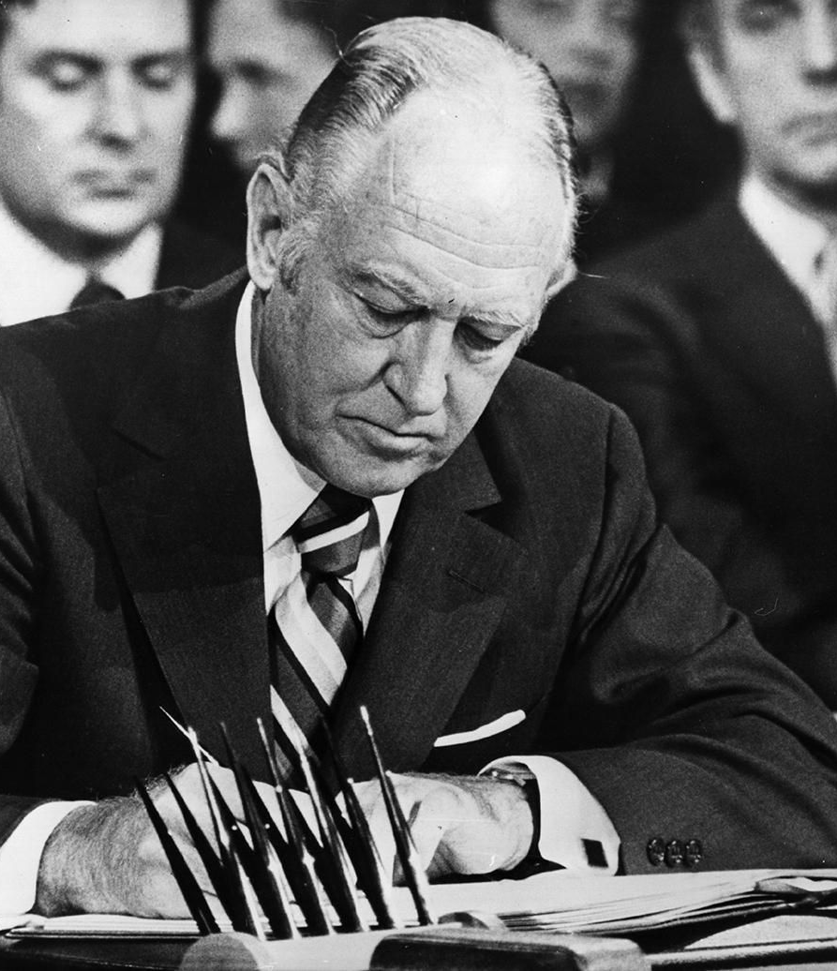
Peace at last?
The agreement was imposed on Thieu – Nixon affirmed he would continue to provide support to the south.
There was also the threat of a cut off is he did not sign.
He gave in after several days.
Nixon claimed to achieve ‘peace with honour.’

Slide 20
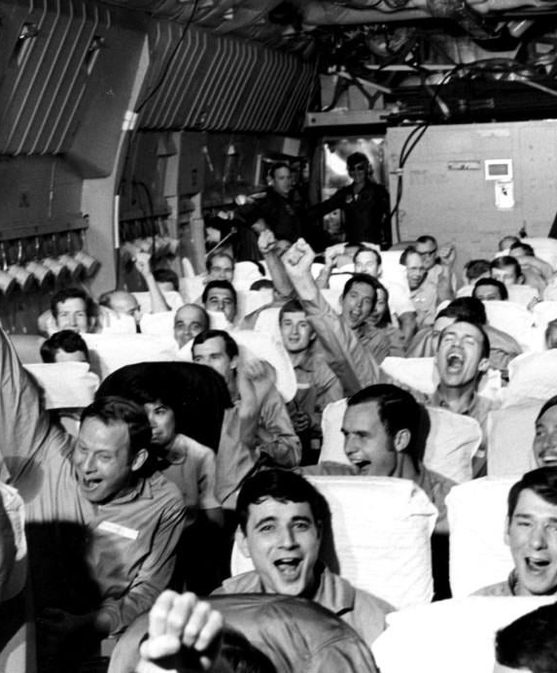
Peace at last?
Short term success – American extraction (29 March 1973) return of most POWs and Thieu’s government in place (for now…)
Failure – the political future of South Vietnam unresolved.
Honour? There were still 150,000 north Vietnamese troops below the DMZ…
US forces had left, and Congress were certainly not inclined to permit their return.

Slide 21
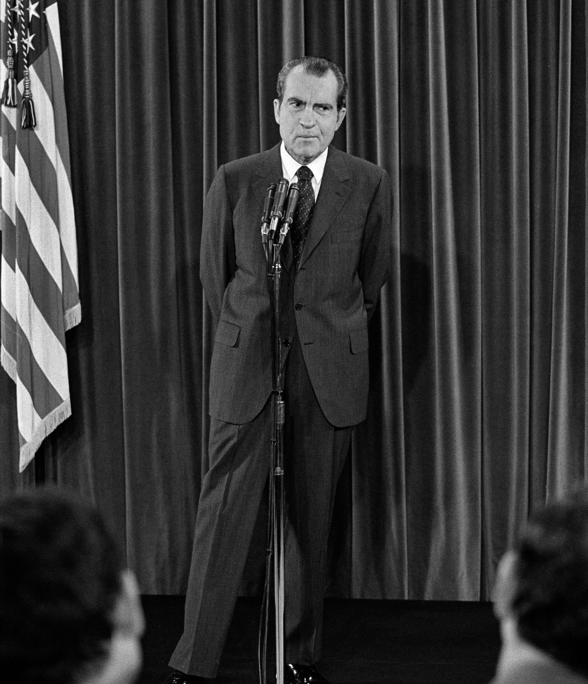
Did Nixon fail?
He succeeded in buying some time for Vietnamisation, but at an enormous cost.
US estimates place S. Vietnamese battle deaths at 107,504 for the years 1969-73. N. Vietnamese and NFL sit at more than 500,000. More than 58,000 Americans were killed.
The extreme measures he took to defend his Vietnam policy led directly to Watergate and his resignation.

Slide 22
Vietnamisation
Impact of Vietnamisation
The extension of the war into Cambodia
The extension of the war into Laos
1969
President Nixon’s Policies in Vietnam
1972
Relations with China
The beginning of the Paris Peace Talks

Slide 23
‘Nixon’s policies towards Vietnam, in the years 1968 to 1972, were a total failure.’

