Slide 1
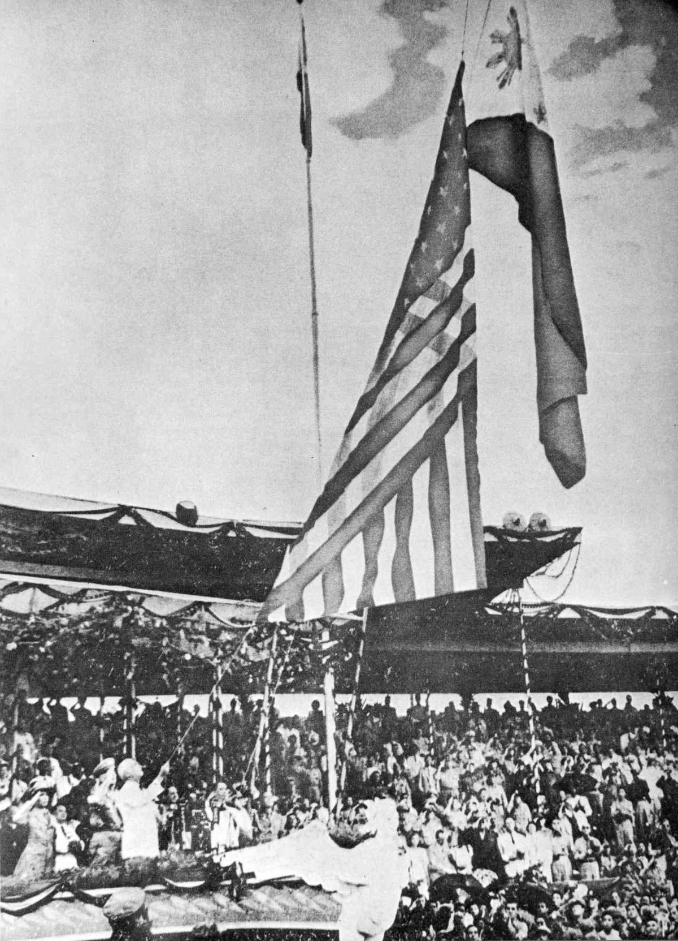
Read the case study on the Philippines
How well did the USA achieve their aims of:
creating a model state of freedom and democracy
a prosperous Filipino economy
a market for US goods
a source of raw materials for US military operations in the region
a strong political ally in the front line of defence of South-East Asia?
Provide evidence for and/or against each point in turn.

Slide 2
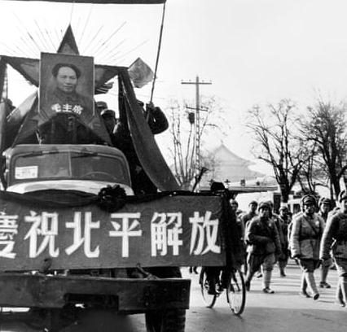
Did the US ‘fail’ to prevent a Chinese communist victory in 1949?

Slide 3
What impact did China’s victory have on US foreign policy?

Slide 4
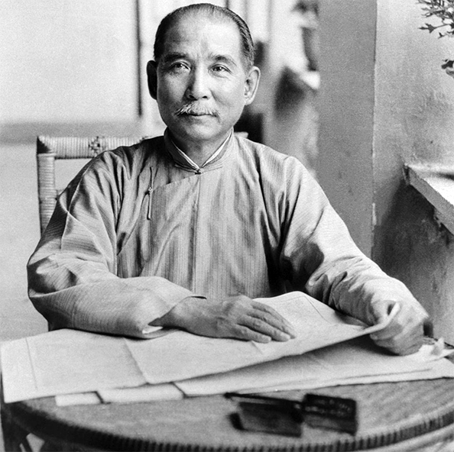
Civil War
When the Japanese invaded China in 1937 it was in the midst of Civil War.
The government in power was led by Jiang Jieshi (leader of the Nationalist Party Guomingdang).
Against these Nationalists was the CCP (Chinese Communist Party).
Both sides sought to destroy the other.
Sun Yat-sen, the founder of the Nationalist Party

Slide 5
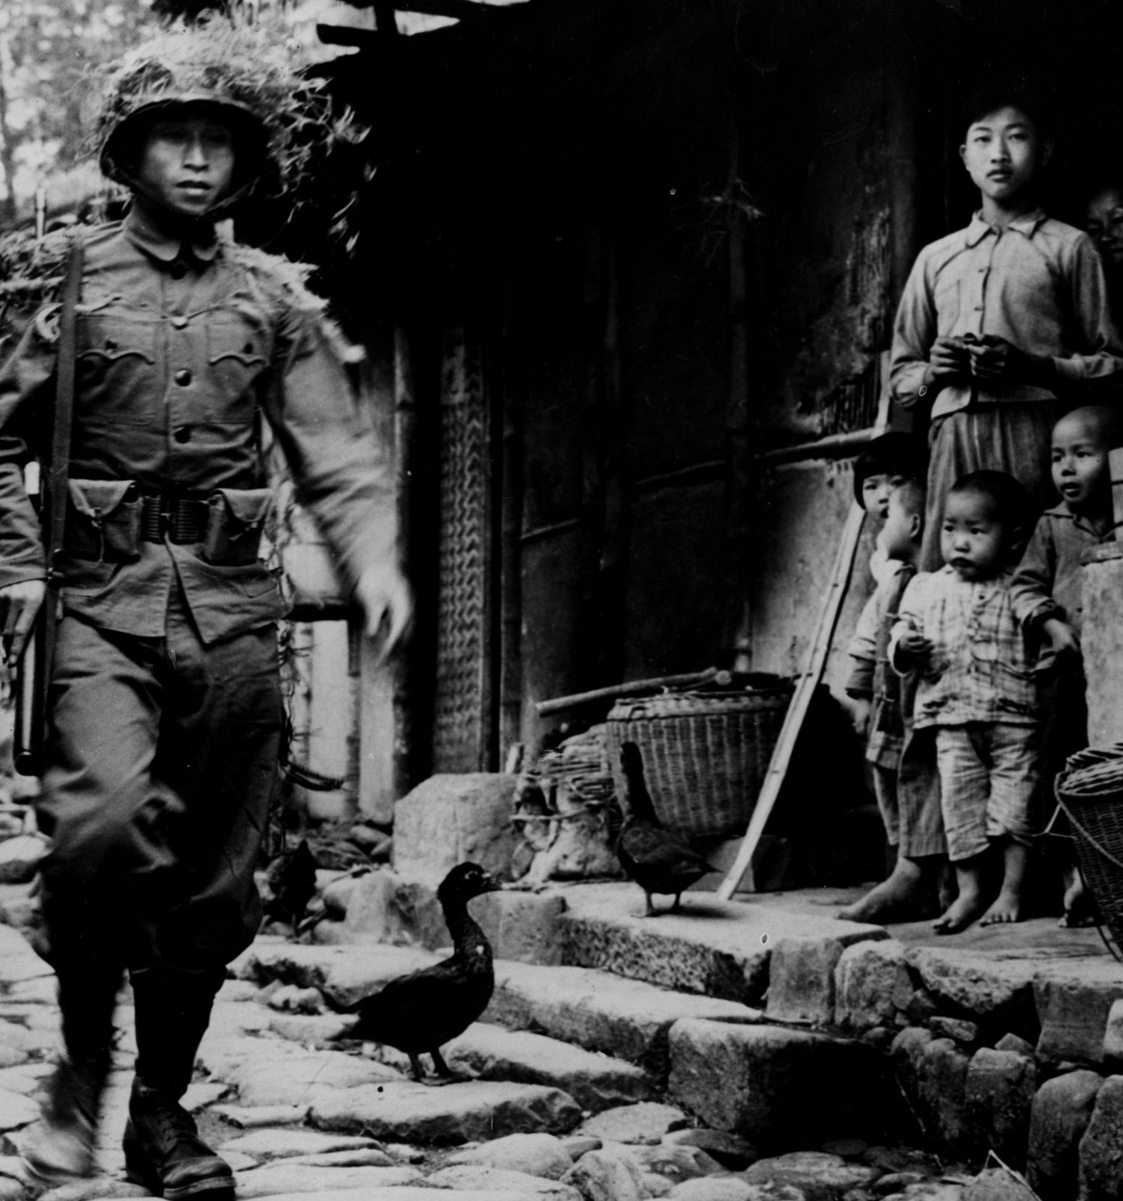
Japanese aggression
The CCP and Nationalists established a United Front upon Japanese invasion (1937).
In exchange for the CCP halting revolutionary activities and placing their army under the Nationalists, the Nationalists allowed CCP liaison offices in several cities.
The Nationalist government was forced to flee inland by Japanese forces.

Slide 6
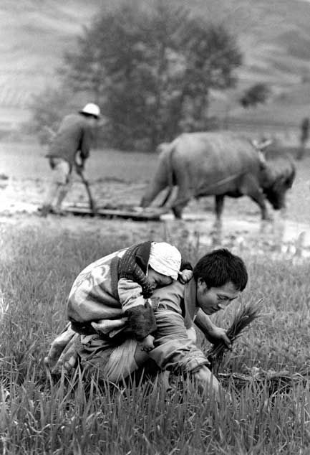
CCP strength
The United Front fell apart by 1941 and the CCP was left virtually untouched, allowing time to build its support.
By 1945, Party membership had grown to 1.2 million and the Red Army to 910,000.
The CCP gained a strong reputation with the peasants while the Nationalists alienated them.

Slide 7
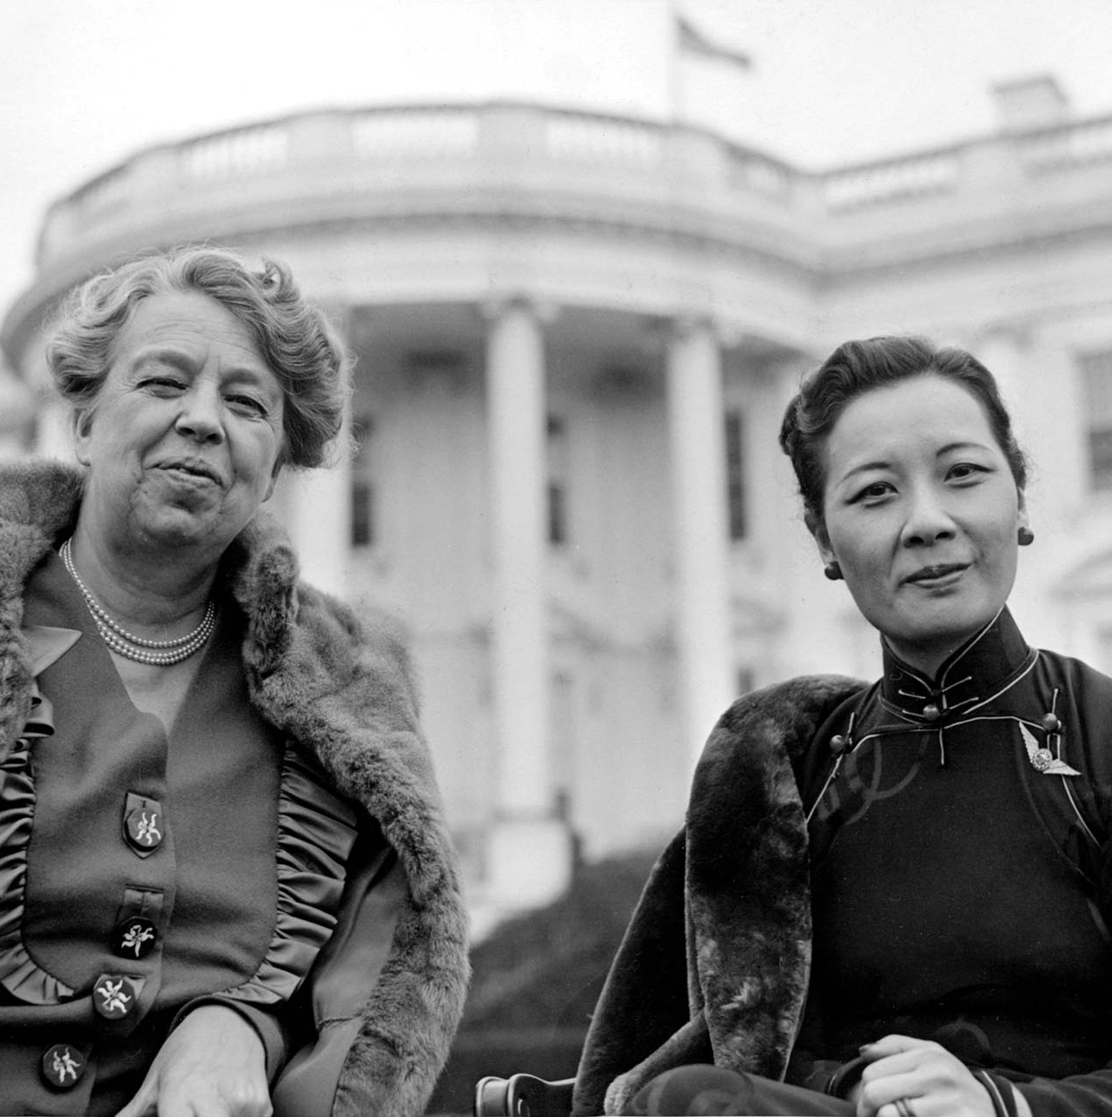
US support
The USA supported the Nationalists and transported assistance over the Himalayas using the Flying Tigers.
They were very popular in the USA and Jieshi’s wife (Soong May-ling) made goodwill tours to the USA to rally US support.
Those officers that spent time in China had a very different and more realistic picture of Nationalist failings.
Soong May-ling with Eleanor Roosevelt
Notes:
From the beginning of the Japanese invasions the USA had supported the nationalists by providing funding, and once the USA joined the war effort in December 1941 they transported assistance over the Himalayas using the flying tigers.
The flying tigers was the first American volunteer group of the Chinese Air Force comprised of US pilots from all branches of the military who served in China from 1941 to 1942 under Claire Lee Chennault.
The nationalists were very popular in the USA, seen by the general public as combating Japanese aggression, and Jiang Jieshi’s wife Soong May-ling, made several goodwill tours of the USA to rally American support behind the Chinese.
Many Americans supported the nationalists as they thought of them as representing American ideals and a commitment to democracy but this showed a lack of understanding of the situation in China.
Foreign service officers and military officials that spent time in China had a very different picture of the nationalists and had a positive view of the Chinese communists; they also had a more realistic picture of what was happening in China.

Slide 8
Soviet support
In reality the CCP and Nationalists were fighting a two-front war against the Japanese and each other.
The Nationalists were corrupt and often spent US aid against the CCP.
The Soviets cooperated with the Nationalists, believing the CCP were too weak but the Nationalists not strong enough to rival Soviet interests.
The Nationalists recognised Mongolian independence and the Soviets promised to withdraw from China three months after the defeat of Japan.
Notes:
In reality, both the CCP and nationalists were fighting a two-front war, engaged in fighting the Japanese and each other.
The nationalists were far more corrupt and they often spent money received from the USA in their battle against the communists, rather than the Japanese.
Most Americans in China knew that civil war was looming and that it would become a reality after the Japanese were defeated, and they were unsure of the outcome.
The Soviets had cooperated with the nationalists in the past, and as the war against Japan drew to a close they came to an agreement in which the USSR recognised the nationalist government and agreed to stop assisting the CCP.
Stalin likely preferred dealing with the Nationalists rather than the Communists because he assumed that, at least in the near future, the Communists were too weak to overthrow the Nationalists, while the latter were not strong enough to threaten Soviet interests in East Asia.
Later on, Stalin also preferred a weak Nationalist China that was willing to cooperate with the Soviet Union than a China ruled by Communists who refused to follow the Soviet pattern
In exchange, the nationalists recognised Mongolian independence and accepted the Soviet acquisition of Tsarist lands, mostly situated along the railway lines. Additionally, Stalin promised to withdraw from China three months after the defeat of Japan.

Slide 9
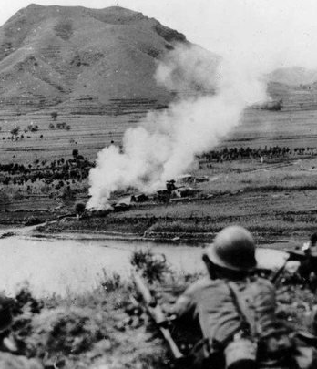
Attitudes towards the CCP
The US assumed the CCP was a Moscow puppet.
However, their views were extremely divergent.
Stalin believed the Chinese should be subservient, Mao felt they should be on even footing.
Soviet troops (1.5 million) engaged against the Japanese in China and redistributed confiscated weapons to the CCP.

Slide 10
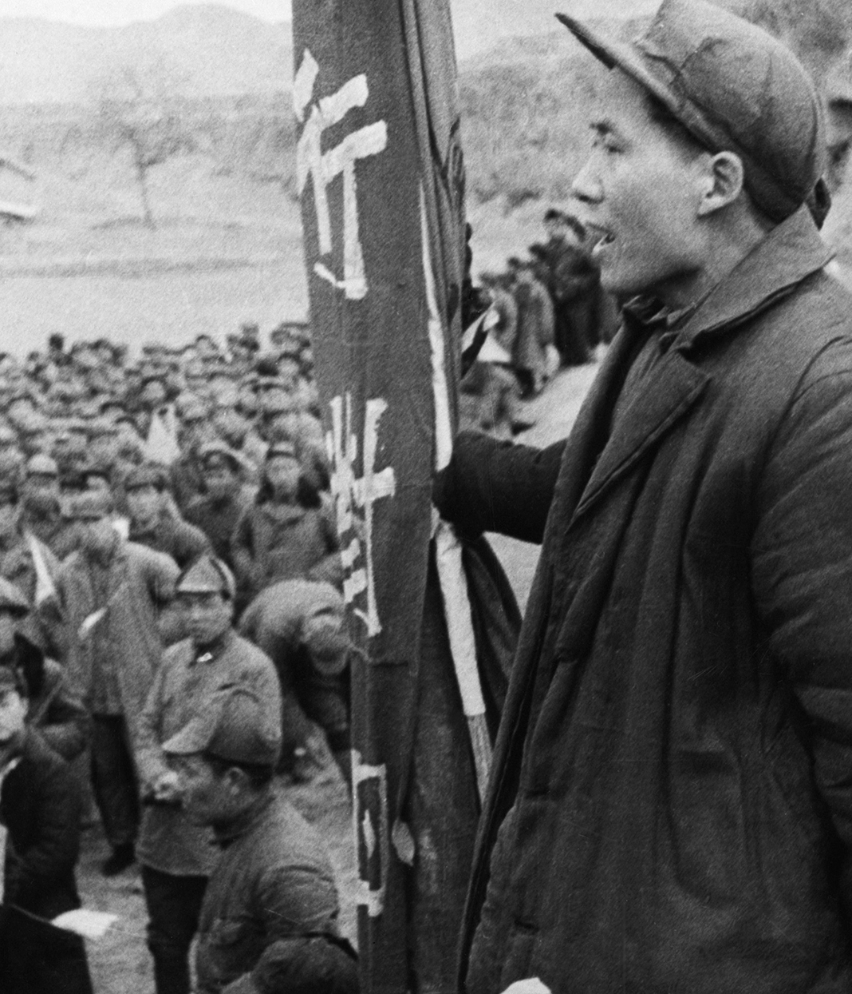
Civil war resumes
Following Japanese defeat, the Nationalists took control of the cities and the CCP took control of the countryside.
The US sent troops and advisers to China (53,000 Marines to Beijing).
General George Marshall was sent to mediate but talks broke down and civil war resumed.

Slide 11
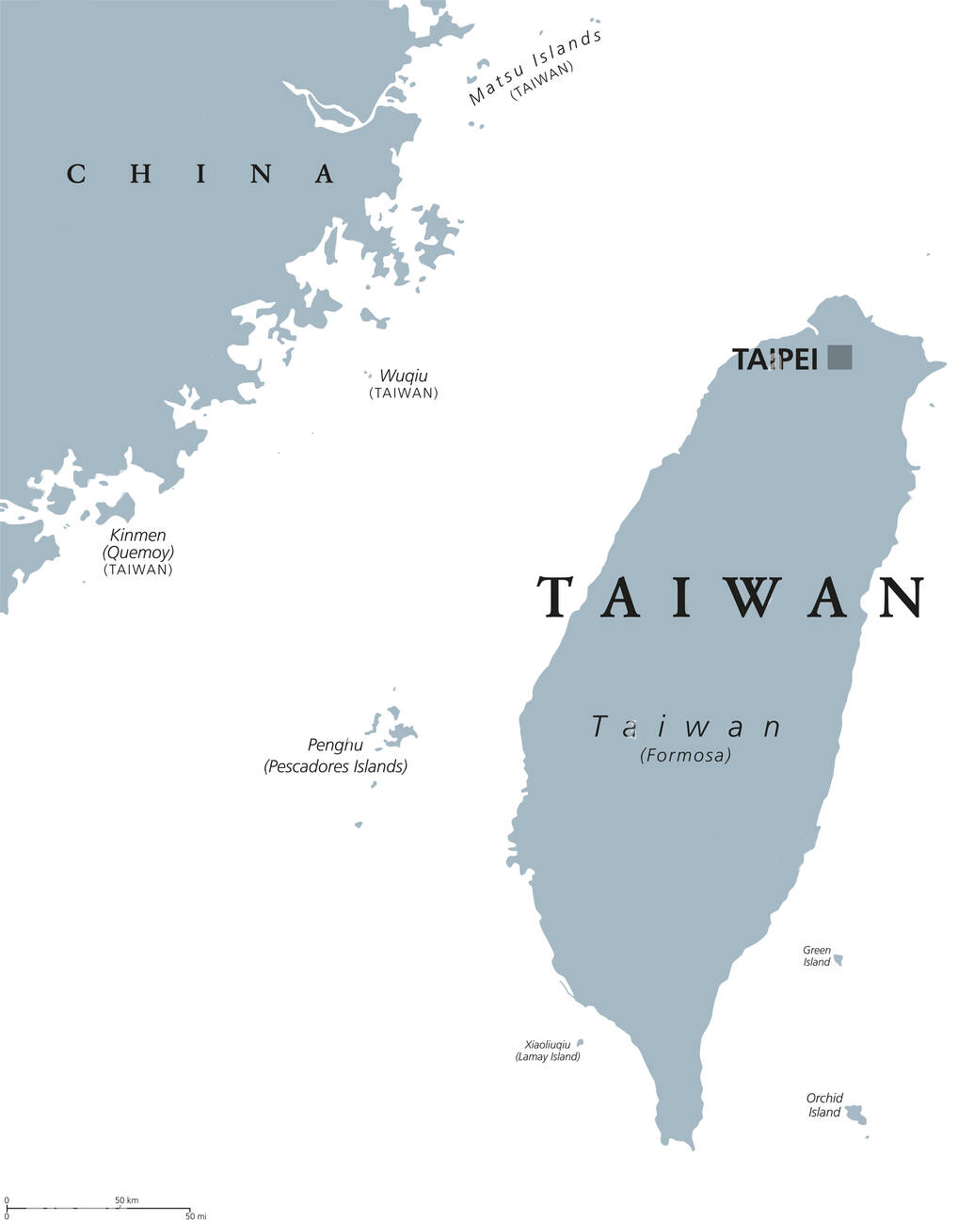
CCP victory
The USA sold $900 million worth of military equipment to the Nationalists for $175 million.
The Soviets withdrew from Manchuria to give the CCP a stronghold in northern China.
In October 1949, the CCP defeated the Nationalists and over 2 million fled to Taiwan where they established their government.

Slide 12
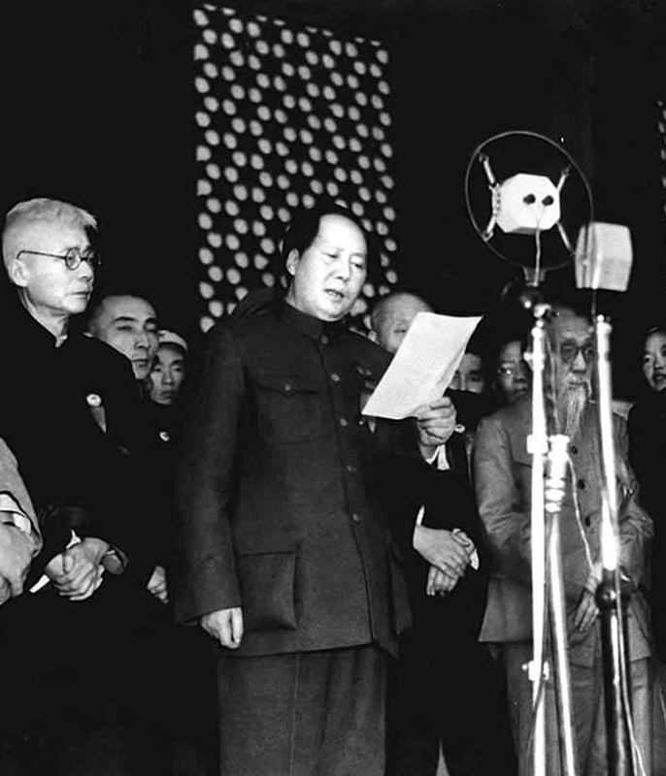
Recognition
The USA and other western powers refused to recognise the newly formed PRC (recognised by the USSR on 2nd Oct 1949).
The Republic of China (ROC) was instead recognised as the legitimate government and retained the position on the UN Security Council.

Slide 13
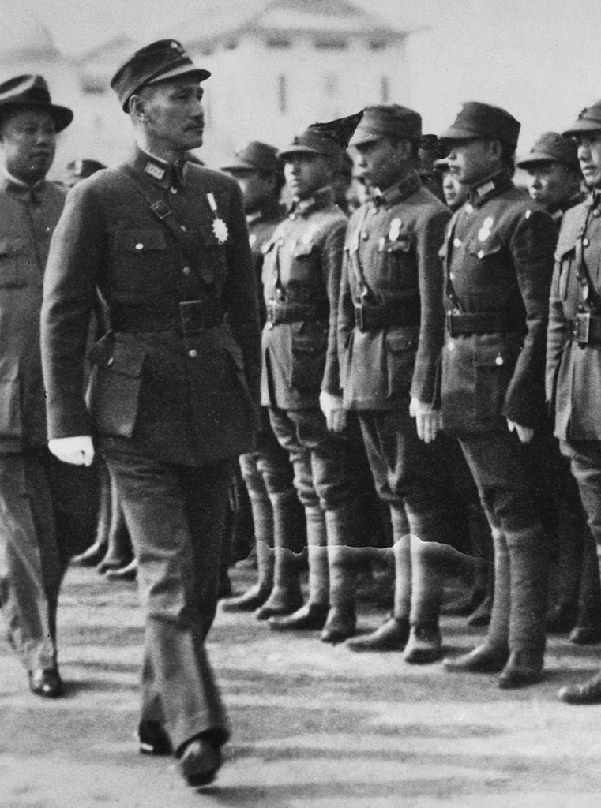
Did the USA ‘fail’?
The USA were well aware of Jiang’s corruption but continued their aid.
Of the US equipment on loan, 80% was lost (of this 75% fell into Communist hands).
Jiang was unpopular but the US were intent on preventing Communist victory.
But did they do enough?

Slide 14
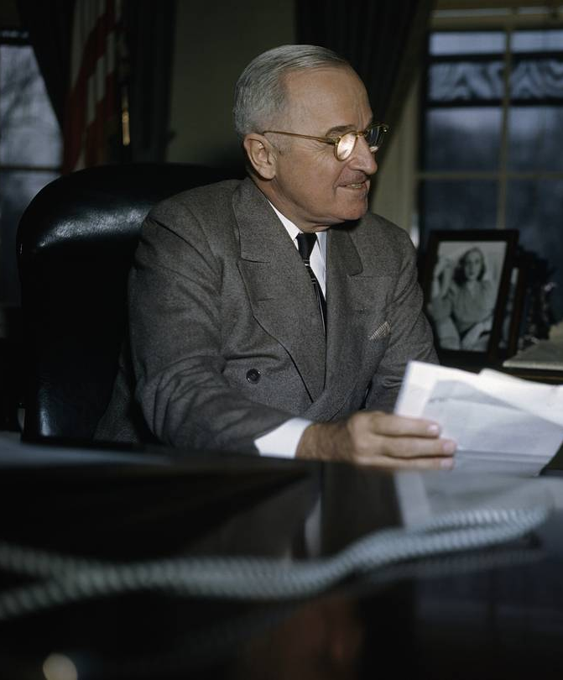
Did the USA ‘fail’?
Leading Republicans wanted Truman to defend Taiwan.
The Taiwan China Lobby were successful in persuading the US government not to recognise the PRC.
Conservatives and Republicans criticised the Truman administration of ‘losing China’ leading the publication of the China White Paper.

Slide 15
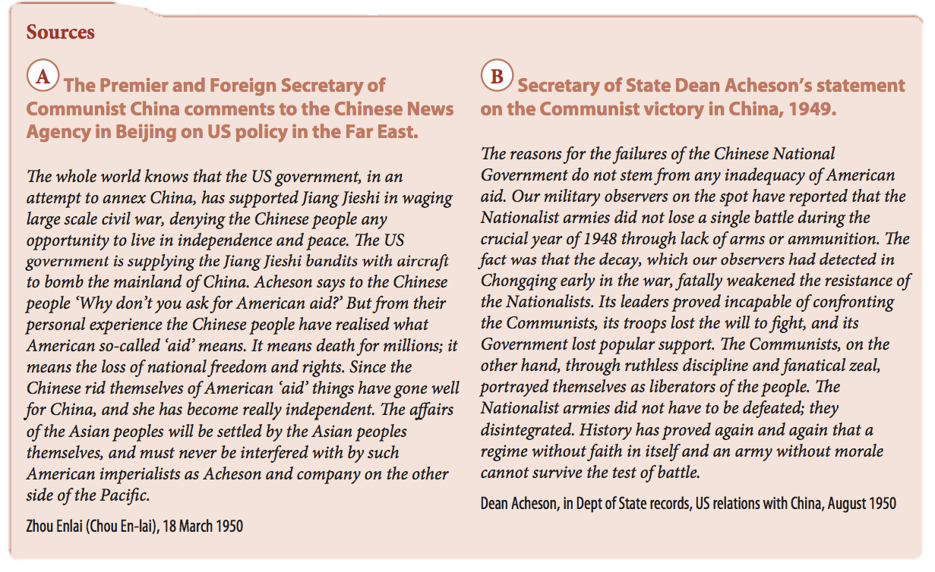
1. Why did the USA fail to prevent the fall of China to communism? Which of these ideas can you find in Sources A and B?
Insufficient military aid from the USA.
Support for an unpopular and corrupt Chinese Nationalist government.
Poor morale in Jiang’s armies; communist propaganda.
US priorities placing Europe above Asia.
A strong Chinese independence movement which opposed US imperialism.
Soviet military support for the CCP.
Communists within the US administration undermining containment policy.
2. Can you think of any reasons not on this list, and can you find evidence for them? Now place all the reasons in order of importance in answering the question.

Slide 16
Work in a group of four, with each person taking a position of either Nationalist China, Communist China, the USSR or the USA. Present to the rest of the group your position regarding the breakdown of relations after the Second World War, and how it affected your position in the region.

