Slide 1
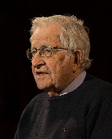
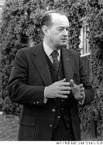
What were the US Policies towards China?
Chapter 5: US Containment in action in Asia
Read the two quotes from the historians regarding China and answer the questions.
“In 1949, China declared independence, an event known in Western discourse as "the loss of China" – in the US, with bitter recriminations and conflict over who was responsible for that loss. The terminology is revealing. It is only possible to lose something that one owns. The tacit assumption was that the U.S. owned China, by right, along with most of the rest of the world, much as post-war planners assumed. The "loss of China" was the first major step in "America's decline." It had major policy consequences.” Noam Chomsky – Historian and critic of American policy
Summarise what Chomsky is saying about China:
_____________________________________________________________________________________________________________________________________________________________________________________________________________________________________________________________________________________________
Do you agree with Chomsky? Why?
____________________________________________________________________________________________________________________________________________________________________________________________________________________________________________________________________________________________________________________________________________________________________________________________
"The China the Americans knew—Pearl Buck's peasants, rejoicing in the good earth—had been dependable, democratic, warm and above all pro-American. Throughout the great war the United Nations Big Four had been Churchill, Roosevelt, Stalin and Chiang. Stalin's later treachery had been deplorable but unsurprising. But Chiang Kai-shek! Acheson's strategy to contain Red aggression seemed to burst wide open...Everything American diplomats had achieved in Europe—the Truman Doctrine, the Marshall Plan, NATO—momentarily seemed annulled by this disaster in Asia."
William Manchester– Historian and critic of American policy
What is William Manchester saying regarding the impact of China turning communist?
______________________________________________________________________________________________________________________________________________________________________________________________________________________________________________________________________________________

Slide 2
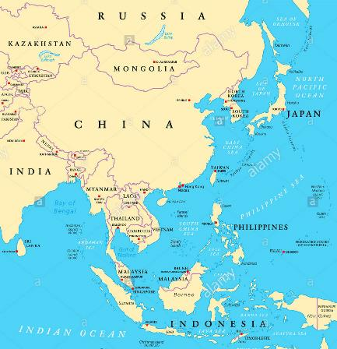
What were the US Policies towards China?
Chapter 5: US Containment in action in Asia
Read USA’s support for Jiang Jieshi and policies towards China and Taiwan p39. and answer the following questions.
What was Mao’s initial concerns with America?
________________________________________________________________________________________________________________________________________________________________________________________________________________________________________________________________________________________________________________________________________________________________________________________________
What was America's policy to Asia?
________________________________________________________________________________________________________________________________________________________________________________________________________________________________________________________________________________________________________________________________________________________________________________________________________________________________________________________________________________________________________________________________________________________________________________________________________________________________________________________________
TASK: What was the defensive perimeter strategy and why was there criticism towards it?
________________________________________________________________________________________________________________________________________________________________________________________________________________________________________________________________________________________________________________________________________________________________________________________________
TASK: Draw on the map the defensive perimeter and list the countries that it covered.

Slide 3
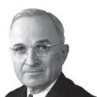
Why was NSC68 a huge shift in American foreign policy?
Chapter 5: US Containment in action in Asia
Explain it like I’m 5. What was NSC68?
______________________________________________________________________________________________________________________________________________________________________________________________________________________________________________________________________________________________________________________________________________________________________________________________________________________________________________________________________________________________________________________________________________________________________________________________________________________________________________________________________________________________________________________________________________________________________________________________________________________________________________________________________________________________________________________________________________________________________________________________________________________________________________________________________________________________________________________________________________________________________________
Why was the NSC68 such a shift in American foreign policy?
________________________________________________________________________________________________________________________________________________________________________________________________________________________________________________________________________________________________________________________________________________________________________________________________________________________________________________________________________________________________________________________
How do you think this effected cold war relations?
________________________________________________________________________________________________________________________________________________________________________________________________________________________________________________________________________________________________________________________________________________________________________________________________________________________________________________________________________________________________________________________
HOT: Write a 2 sentence review of NSC68 in the perspective of Truman and Stalin. Imagine it being a press conference after NSC68 was formally declared.

Slide 4
Evaluating primary sources
Chapter 5: US Containment in action in Asia
With reference to Sources 2 and 3 and your own understanding of the historical context, assess the value of these sources to an historian in explaining the USA’s attitude towards China by 1949.
Annotate the source in reference to the question. Remember to think about nature, origin, purpose, tone. What is the source saying about USA’s attitudes towards China? Is this similar to what you have learned?
Source 1: From an article written by Mao in August 1949, as the USA withdrew its diplomatic presence from China
The war to turn China into a US colony, a war in which the United States supplies the money and guns, and Jiang Jieshi the men, to fight for the United States and slaughter the Chinese people, has been an important component of the US imperialist policy of worldwide aggression since the Second World War. The three main targets are Europe, Asia and the Americas. China, the centre of gravity in Asia, is a large country with a population of 475 million; by seizing China, the United States would possess all Asia. With its Asian front consolidated, US imperialism could concentrate its forces on attacking Europe.
TASK: Quickfire judgment. Colour in the thermometer to show how valuable this source is to a historian and write an explanation for why you put it there. What words would you use to evaluate it e.g., somewhat? Extremely? Etc…

