Slide 1
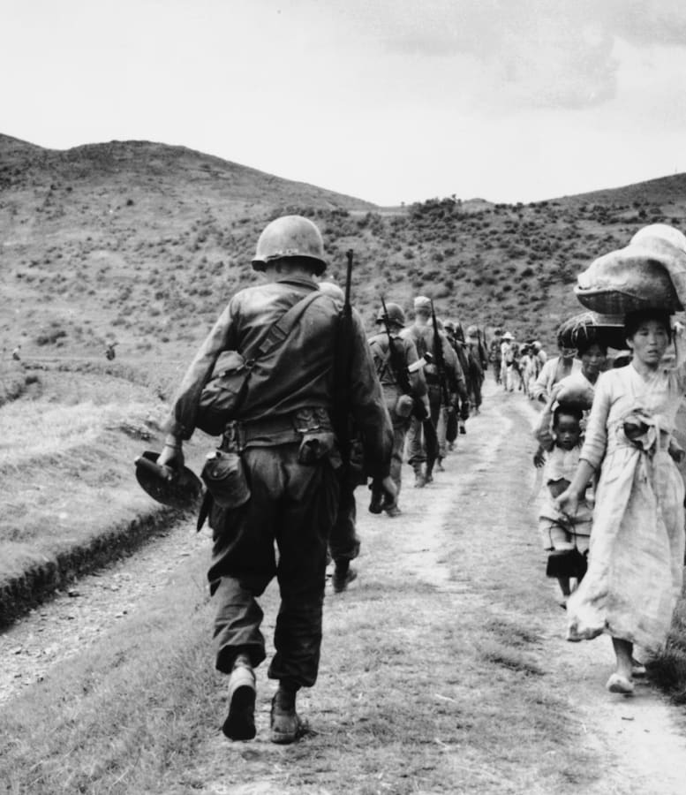
The Korean War
To what extent was the outbreak of the Korean War due to Cold War tensions?
Why did the Chinese become involved but not the Soviets?
What was the impact of the Korean War on the development of the Cold War?

Slide 2
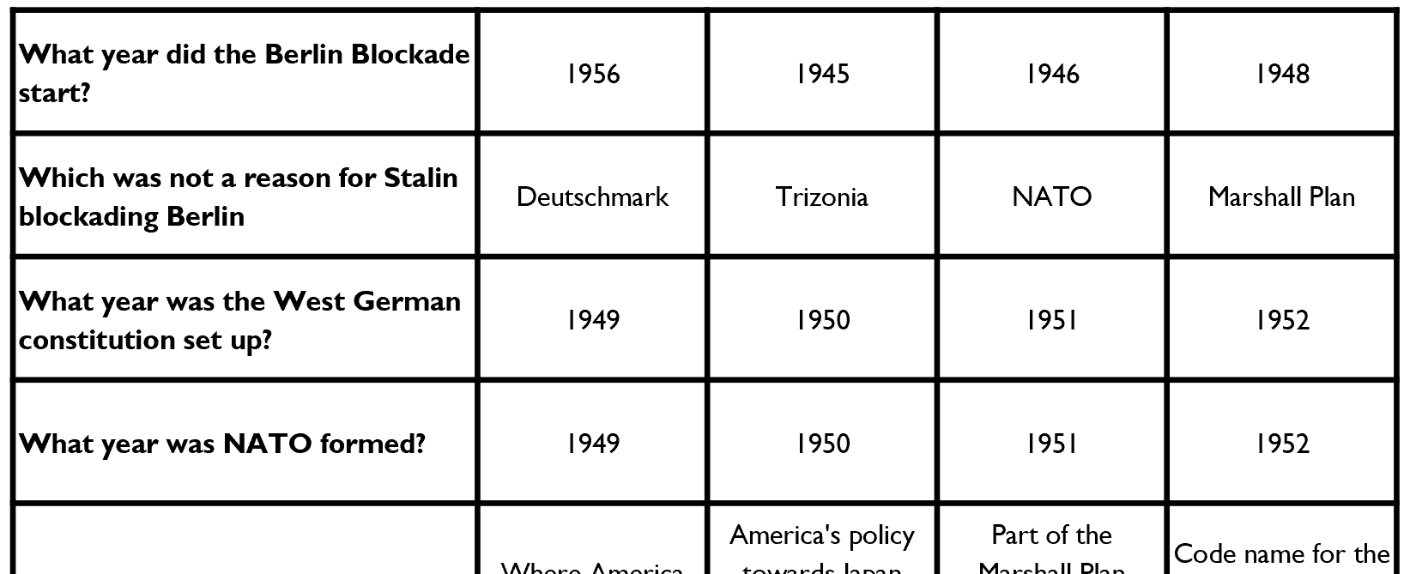
Task
Circle the correct answer for each of the questions on the front of your pack.

Slide 3
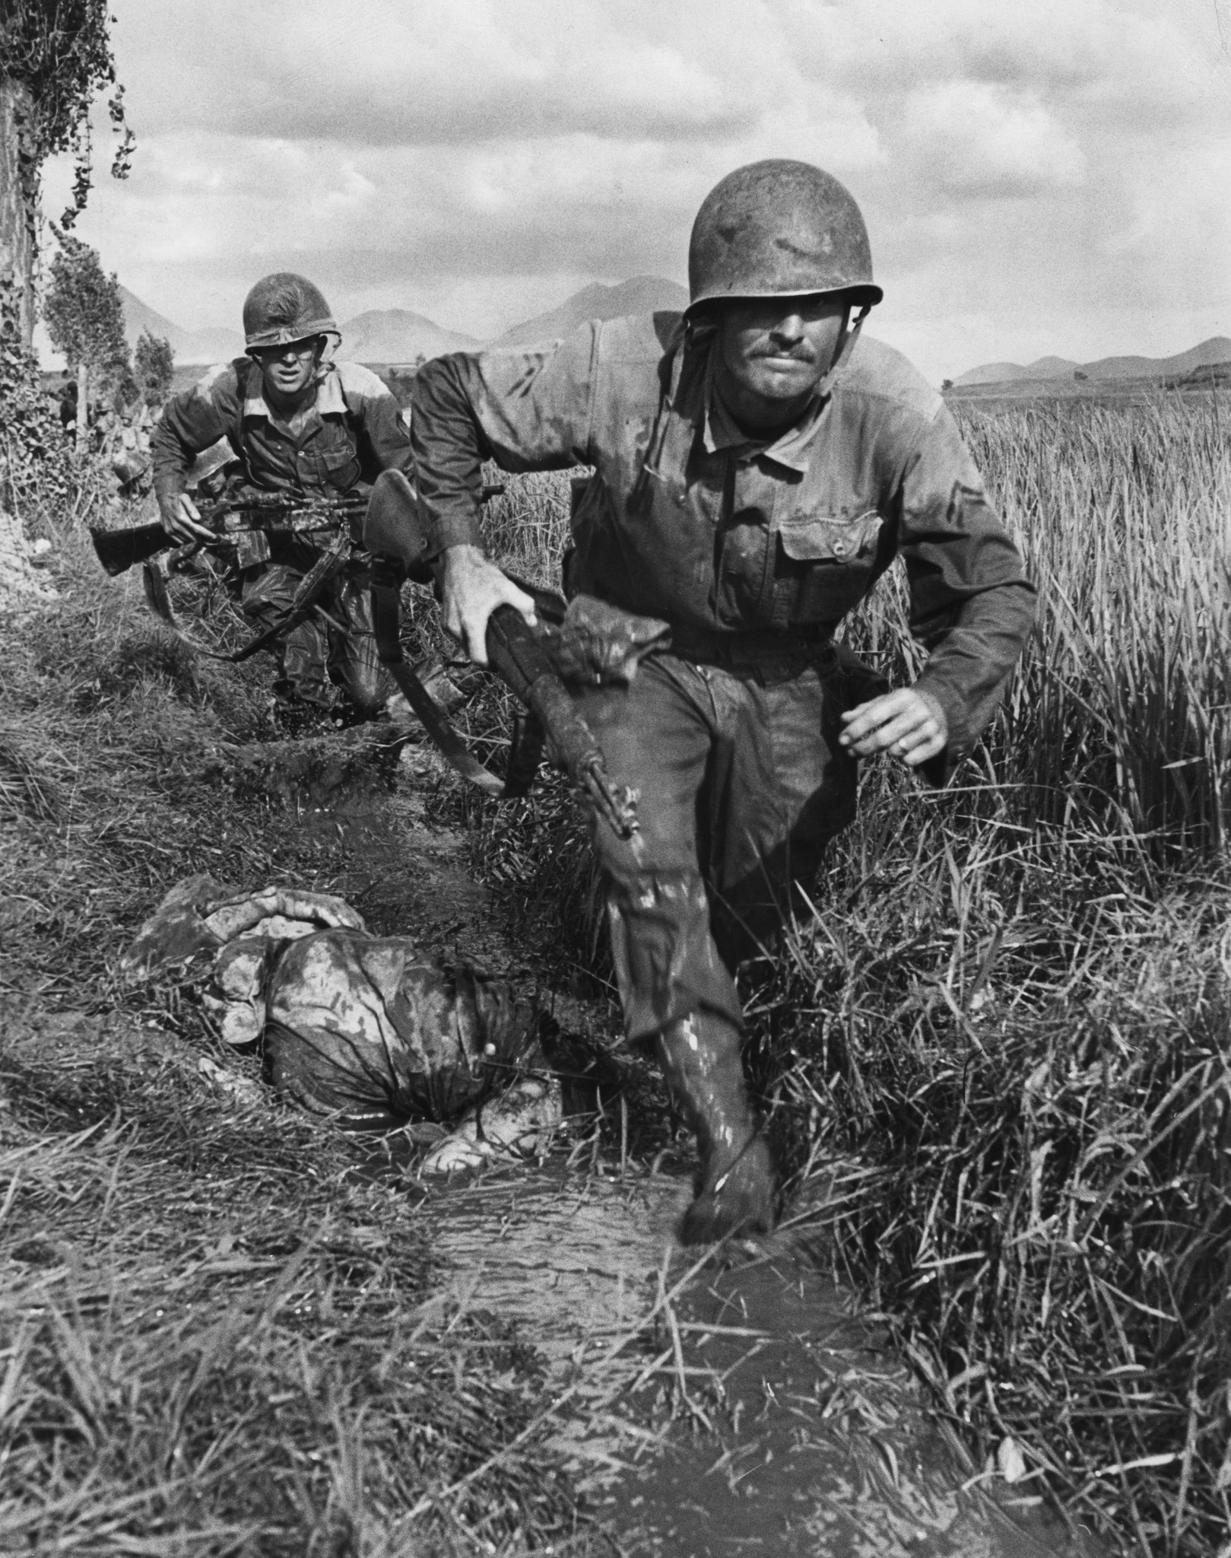
What do you already know about the Korean War?

Slide 4
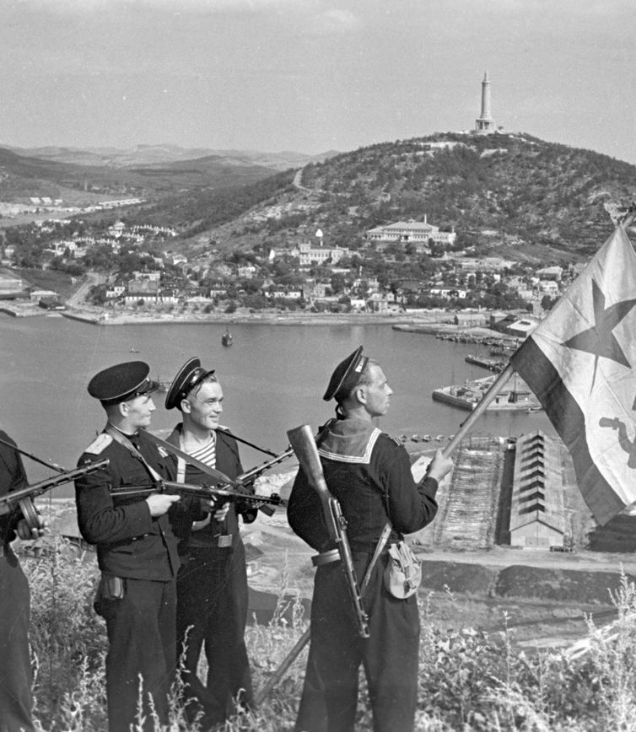
Background
Japan annexed Korea in 1910; once Japan surrendered, there needed to be a method to returning independence to the country.
At Potsdam, freedom and independence was promised, but how would this take shape?
Korea had been of Russian interest in the 19th century and Soviet troops entered north eastern Korea 12th August 1945.

Slide 5
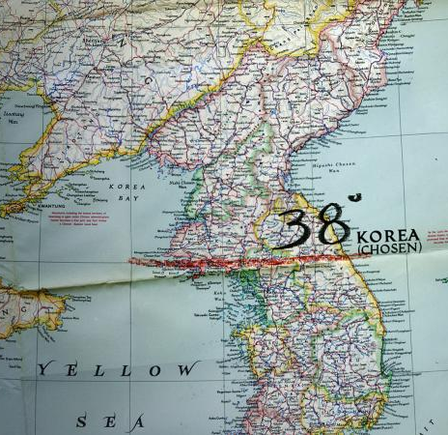
Division
Roosevelt envisioned a trusteeship but when Turman became POTUS there were increasing concerns regarding the spread of communism.
Korea was divided along the 38th parallel following Japanese surrender; the US occupied the southern part.
The Soviet Union occupied north of the 38th parallel and did not advance further.

Slide 6
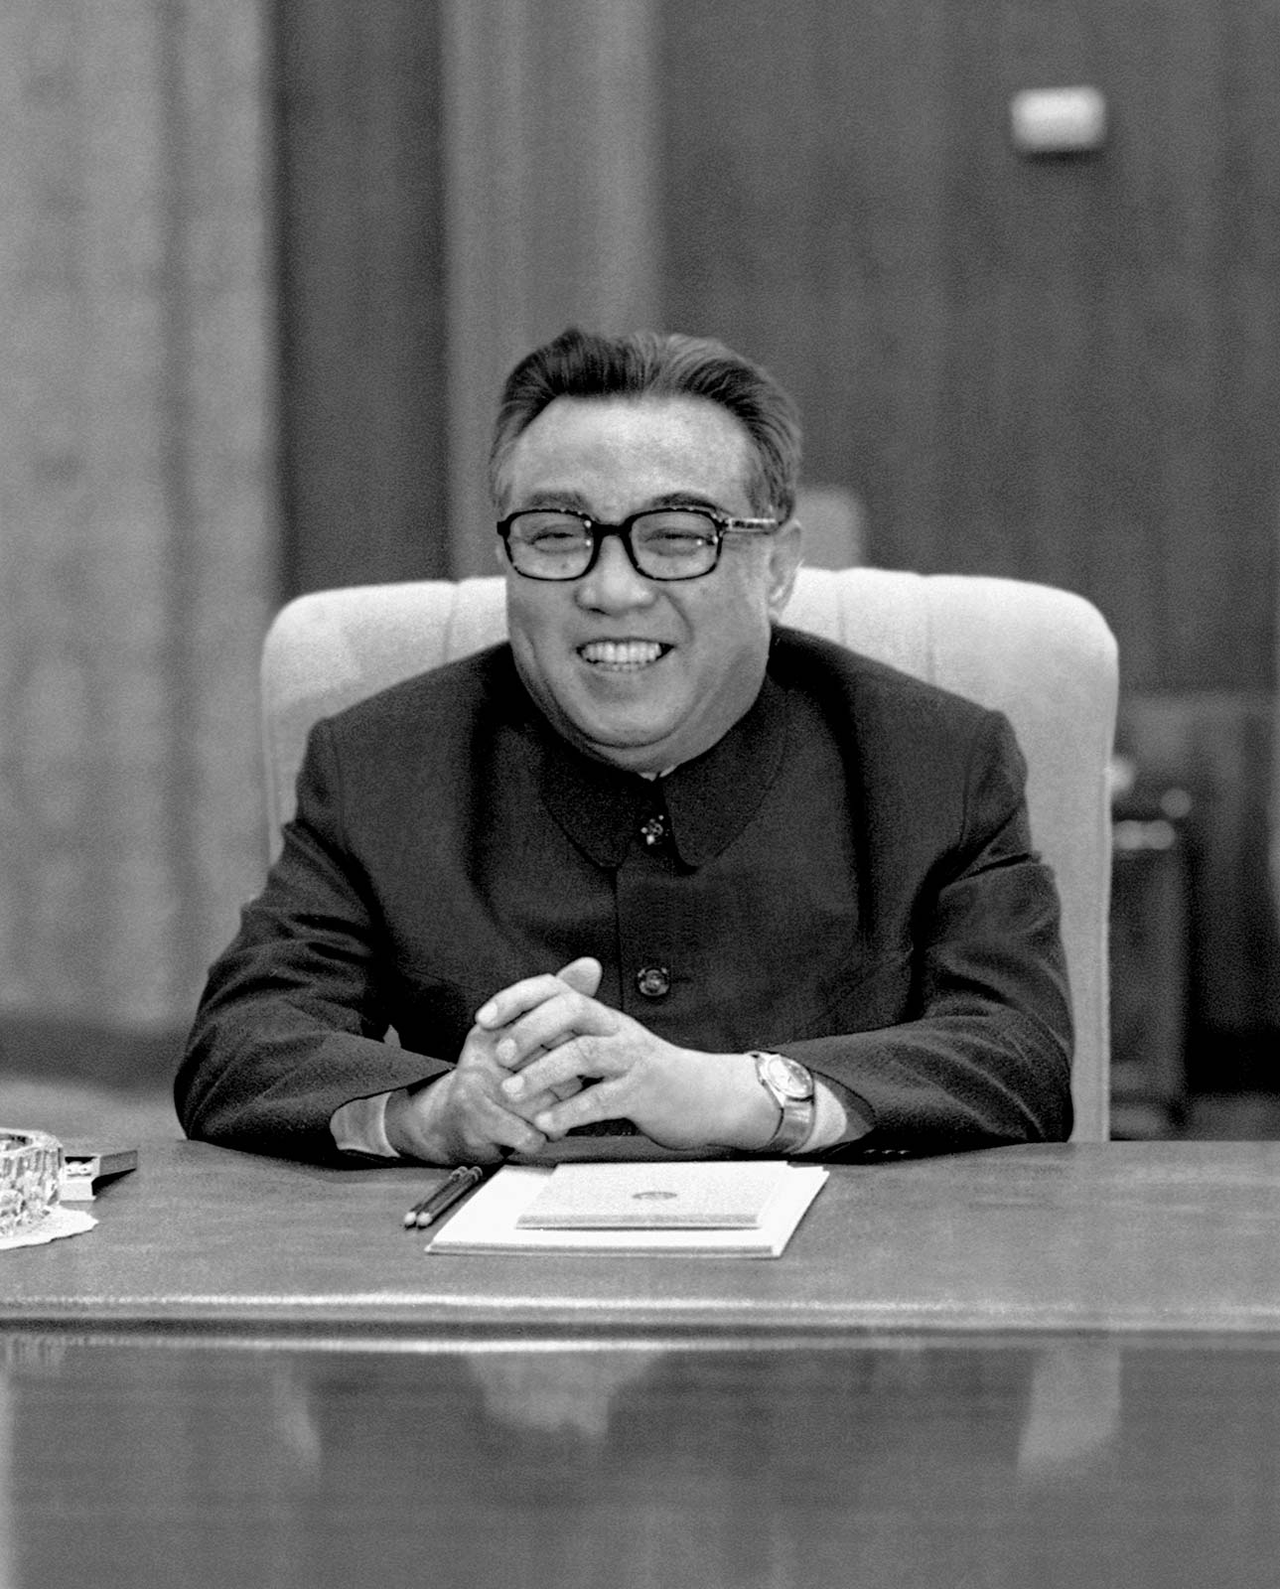
Kim II Sung
The Soviets established a military occupation force but gave the Koreans autonomy.
People’s Committees were established consisting of communists and nationalists.
Of the potential communist leaders, Kim II Sung emerged – he was a strong nationalist who ultimately sought to expel foreign influence.
His other main concern was rebuilding the country, partly through land reform.

Slide 7
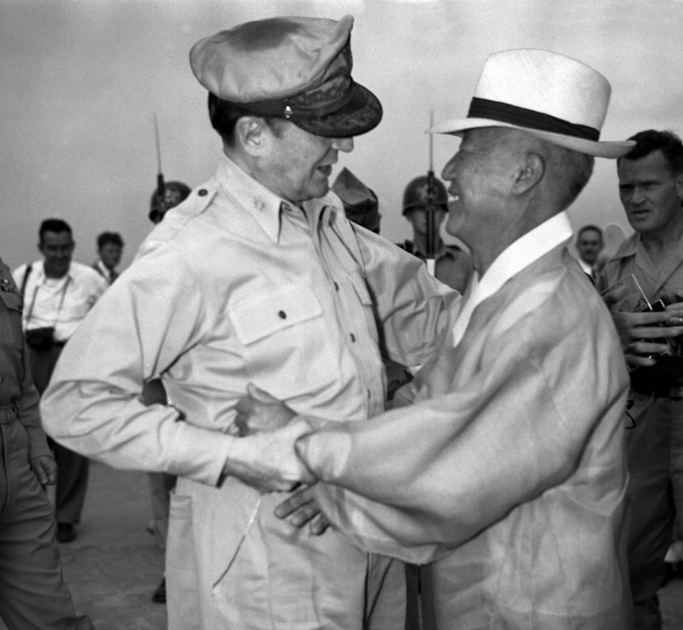
Syngman Rhee
The USA were suspicious of the People’s Committees – they supported Syngman Rhee.
He was American educated and presided over the Korean Government in Exile after 1919.
He proved to be a brutal ruler working in a structure that many Koreans despised.
The USA kept him in power, despite reservations, as he stood firm against Communism.

Slide 8
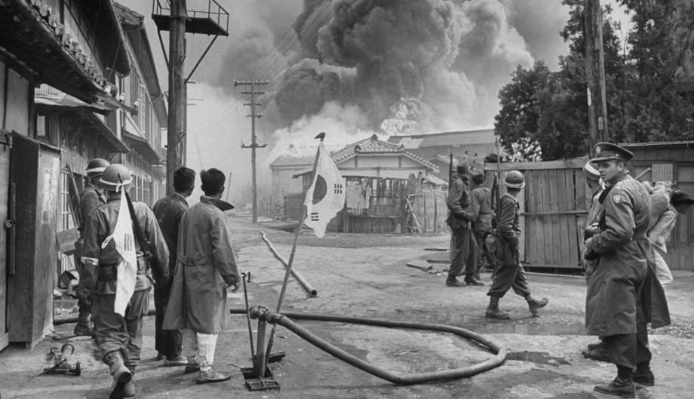
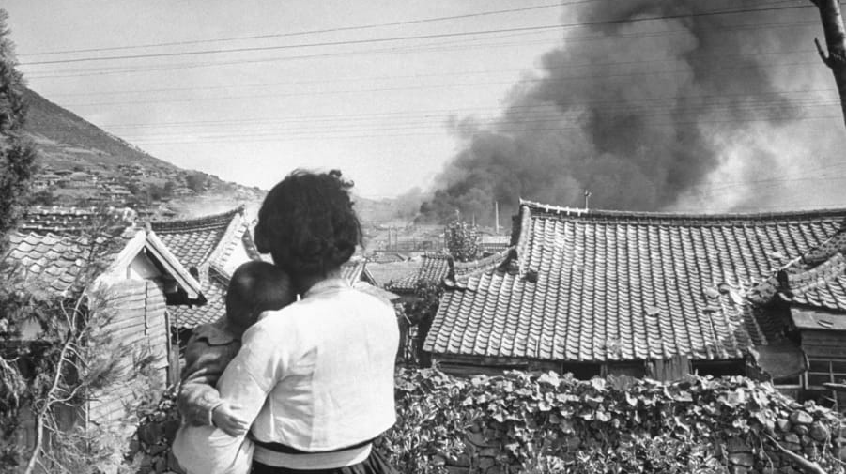
Considering withdrawal
There were uprisings in both zones of occupation.
Both powers considered it beneficial to withdraw their forces as soon as possible.
There was concern there might be civil conflict, so in August 1947 Truman proposed elections.
The Soviets rejected this as the population in the south was approximately 2 and a half times bigger.
Stalin proposed both powers withdrew by 1948 but Truman rejected this.

Slide 9
Further division
A Temporary Commission on Korea, created within the UN (Nov 1947), suggested supervised elections and UN representatives to be admitted to Korea to observe the transition.
The Soviets refused entry to these representatives so the UN decided (Feb 1948) to proceed with the south alone.
In May (1948) UN supervised free elections resulted in Rhee being elected President of the Republic of Korea.
In September 1948, the Democratic People’s Republic of Korea was formed under Kim’s leadership.
Occupation forces (Soviet and American) were withdrawn but links to the powers from the respective republics continued.

Slide 10
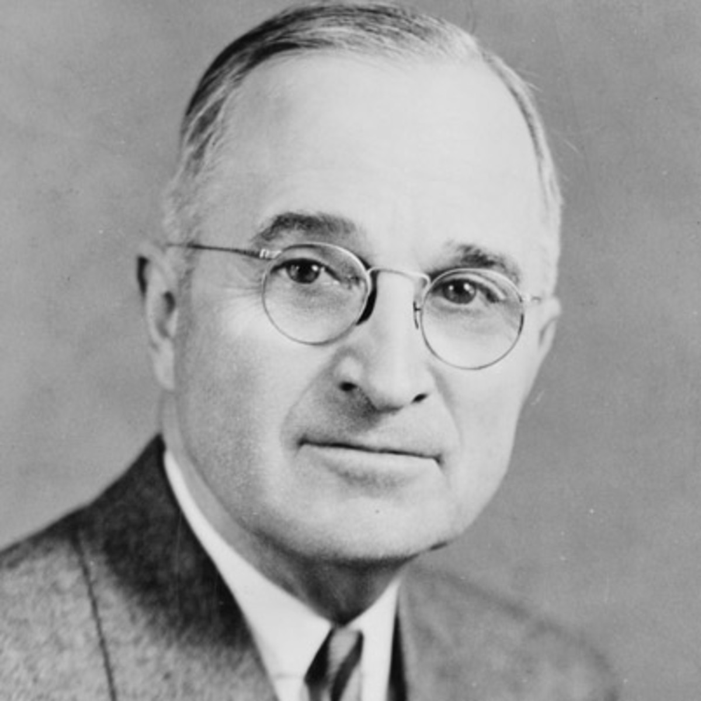
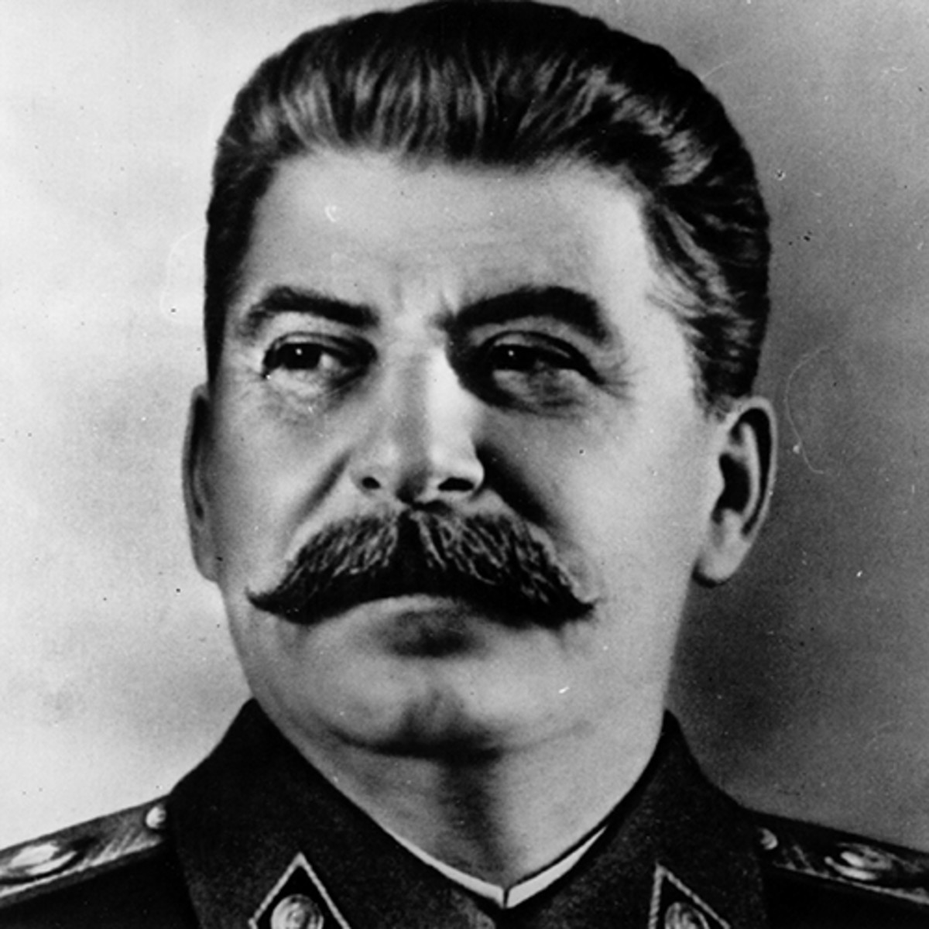
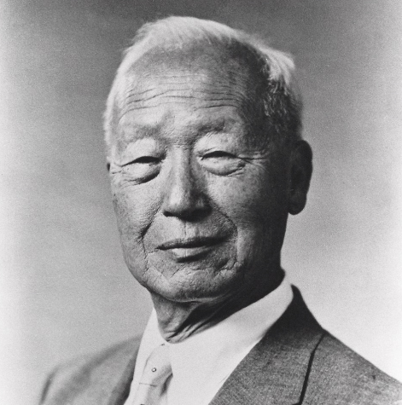
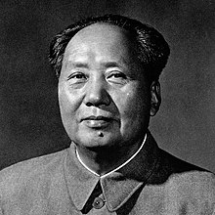
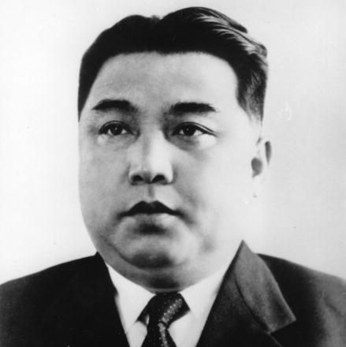
THE PLAYERS
Turn to ‘The Players’ table in your resource packs and be ready to note down the goals of each individual

Slide 11
The position and aims of Kim II Sung
Kim was determined to unify the peninsula but the north weren’t strong enough to act alone.
Kim pressed Stalin to agree to an invasion and spoke separately with Mao.
Although the DPRK outnumbered the ROK (135,000 to 98,000) they lacked weaponry.
He argued the North would win a swift and decisive victory if the acted before the US could mobilise a counter-attack.

Slide 12
The position and aims of Rhee
Rhee had similar aspirations but needed US assistance.
He had wanted the USA to remain in the south but the US did not want to provoke conflict.
He made the argument that defending a border Manchuria was essential.
He was also confident that an assault against the DPRK would be successful.

Slide 13
The position and aims of the US – NSC 68
In April 1950, the USA issued NSC 86 (this was a secret document).
It suggested that the US defence budget be tripled in order to:
Sustain substantial armed forces to prevent Soviet expansion
Have a large stockpile of weapons
Prepare for armed conflict.

Slide 14
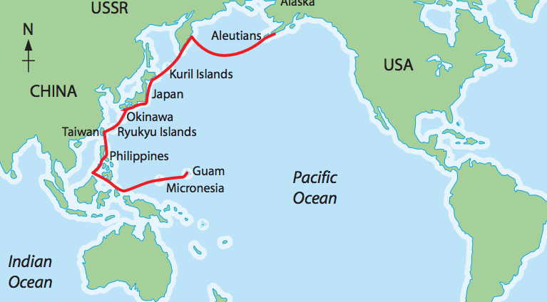

Slide 15
The Defensive Perimeter Strategy
Military, air and naval bases were to be set up on the offshore island chain.
The CIA stressed the need to keep these islands out of hostile hands.
In Jan 1950 US SoS Dean Acheson spoke to the National Press Club, giving the ‘Pacific Perimeter Speech.’
This, plus the US withdrawal of troops from the ROK (June 1949) may have influenced Stalin’s decision to ultimately support Kim.

Slide 16
Adapted from Dean Acheson’s speech to the National Press Club in Washington DC on 12th January 1950:
This defensive perimeter runs along the Aleutians to Japan and then goes to the Ryukyu Islands. These islands are essential parts of the defensive perimeter of the Pacific, and they must and will be held. The defensive perimeter runs from the Ryukyu to the Philippine Islands. So far as the military security of other areas in the Pacific is concerned, it must be clear that no person can guarantee these areas against military attack.

Slide 17
The position and aims of Stalin and Mao
Kim petitioned to both Stalin and Mao.
Stalin came to believe the US would not intervene and authorised Kim’s plans in April 1950. He did not supply men.
He would not have been satisfied with the PRC being the only supporters of the north.
Mao was initially focused on consolidating Chinese territory but was spurred into action by US naval forces being positioned in the Taiwan Strait.

Slide 18
25th June 1950
By the 27th June, the North Korean army controlled most of the peninsula, including the capital Seoul.

Slide 19
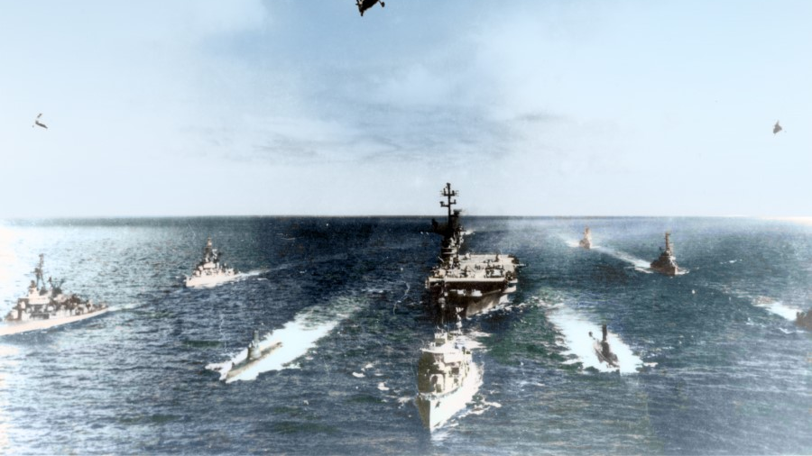
26th June 1950

Slide 20
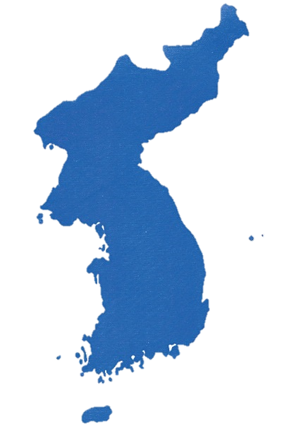
Recap
EXTERNAL
INTERNAL
Formerly occupied by Japan, divided along the 38th parallel by Soviets and Allies
Democratic People’s Republic of Korea (DPRK) founded in response, under Kim Il Sung
Most Koreans wanted unification, whichever side they were on, they had suffered occupation in one way or another since 1910
North Korean communists were emboldened by communist triumph in the Chinese civil war and support by the new People’s Republic
The Republic of Korea (ROK) created by US, Syngman Rhee installed as leader
The North Koreans wished to extend communism throughout the Korean peninsula
North occupied by Soviets, South by US and puppet governments in place
Check you have fully completed the ‘table of factors’ in your resource packs

Slide 21
Tasks
Complete pages 3 to 5 of your resource booklet.
Extension: Consider how you might approach the following question
‘’The main reason why the United States entered the Korean War was in order to defend South Korea.’
Assess the validity of this view

Slide 22
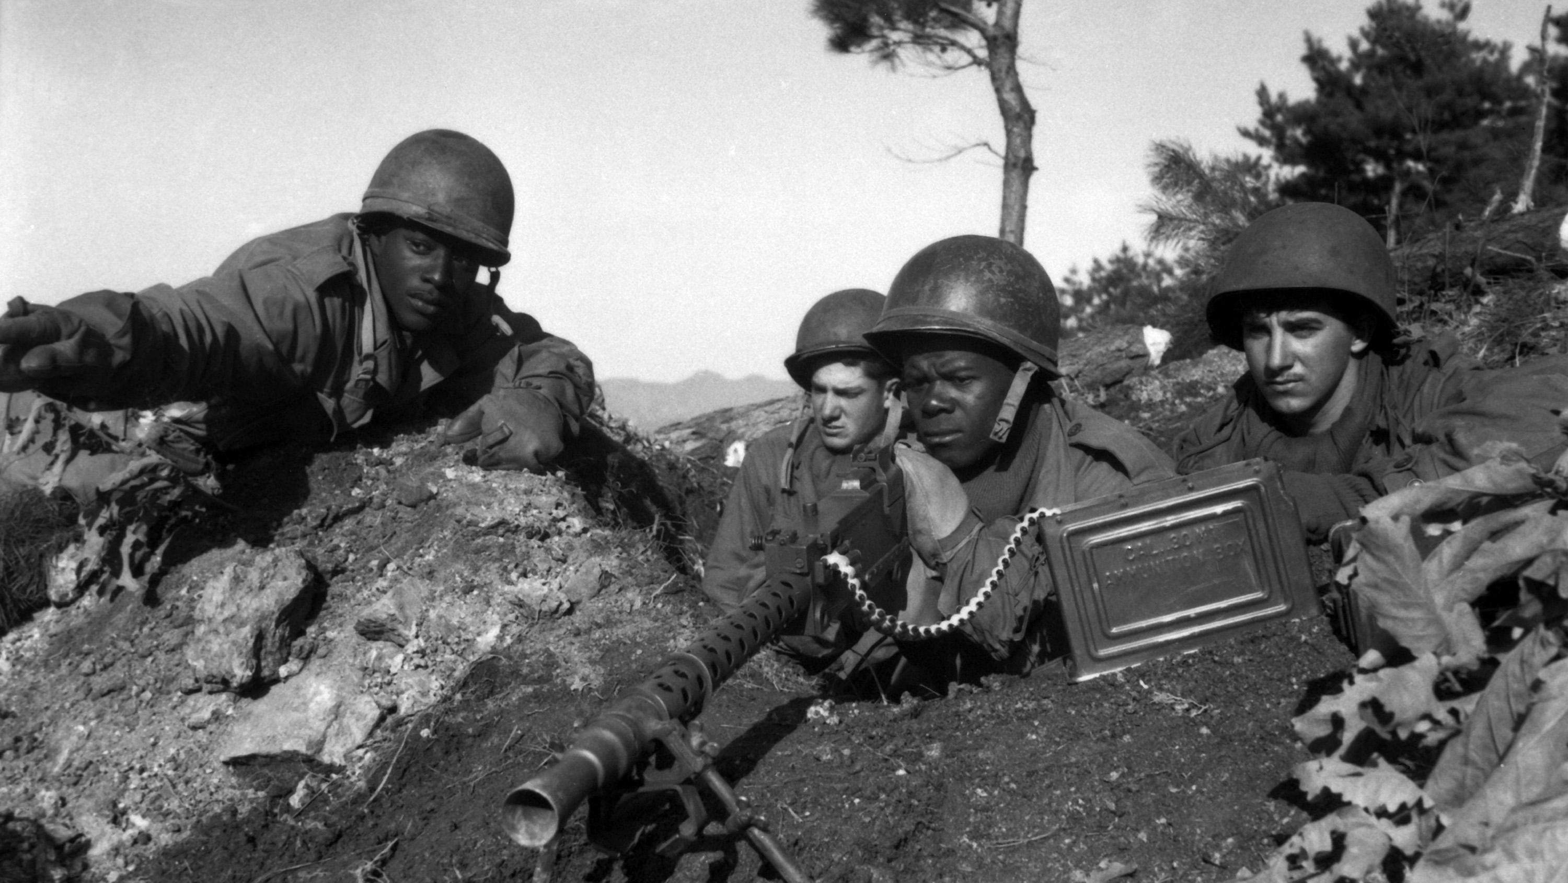
US and Chinese involvement

Slide 23
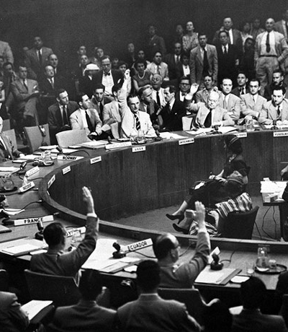
UN involvement
The US immediately referred the matter to the UN.
The UN passed a resolution (UN Security Council Resolution 82) to take military actions against the north Korean forces.
15 countries agreed to send troops (but the majority were American).
What made this resolution possible?

Slide 24
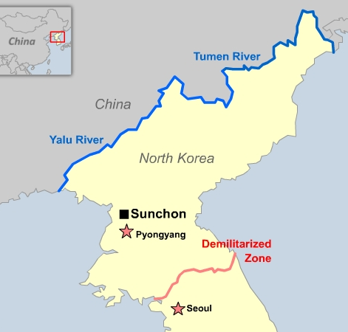
Rollback
The UN forces were led the General Douglass MacArthur.
The UN armies launched an amphibious attack at the Port of Inchon, near Seoul.
No only did north Koreans lose the south, the UN forces pushed them up to the Yalu River by October 1950.

Slide 25
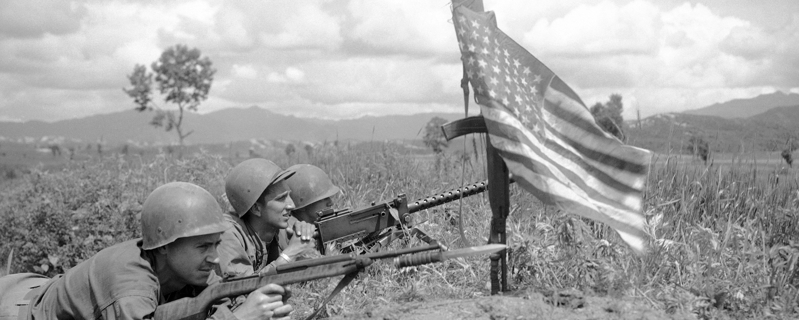
Task
Complete pages 7 to 9 of your resource booklet.

Slide 26
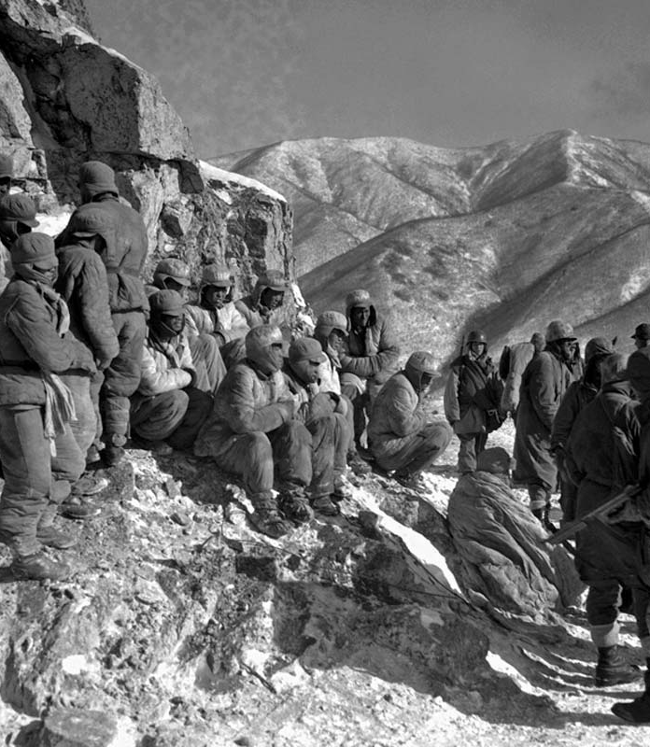
Chinese counter-offensive
In October 1950, Kim wrote to Stalin begging for assistance, but Stalin requested the Chinese send in forces.
Initially reluctant, Mao agreed to assist.
The Communist Volunteer Army Corps was created in October 1950 (300,000 mobilised).
The Chinese ‘volunteers’ crossed the Yalu River and launched their counter offensive.

Slide 27
MacArthur removed
The surprise attack was very effective and drove the UN forces out of DPRK territory.
Mao provided unlimited ‘volunteers’ to defeat the UN forces.
MacArthur went as far as to suggest the use of nuclear weapons against the Chinese.
Due to the public nature of MacArthur’s criticisms of government, he was relieved of command (April 1951) and replaced by Matthew Ridgeway.

Slide 28
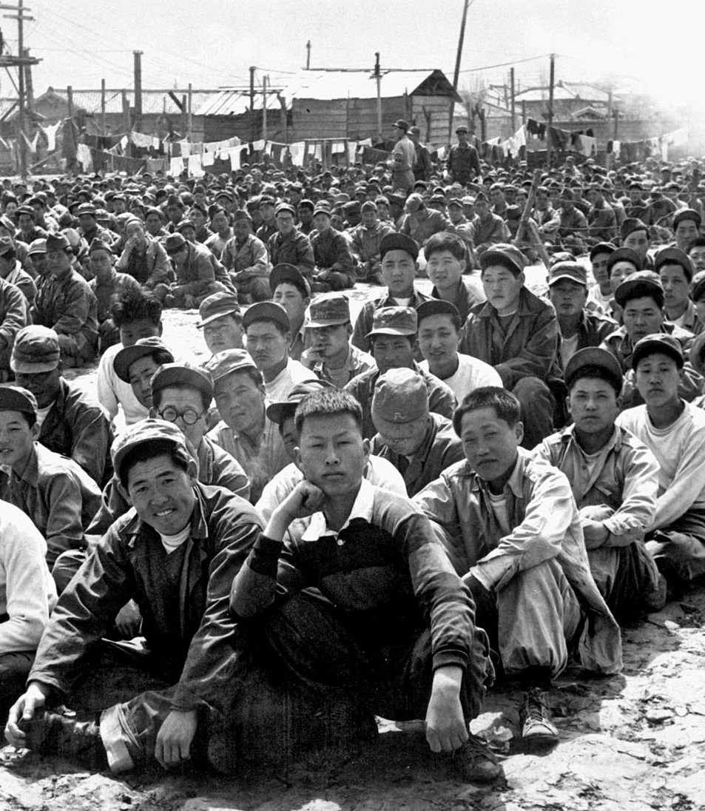
POW issues
Battlelines stabilised near the 38th parallel and a ceasefire was called to discuss terms.
1951-3 there were sporadic battles.
The main sticking point was the repatriation of POW.
The USA and UN wanted voluntary returns, but the majority of North Korean and Chinese forces did not return voluntarily.

Slide 29
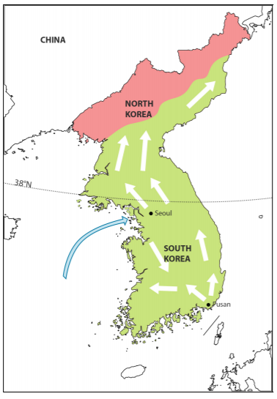
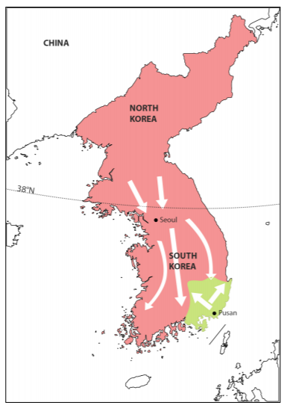
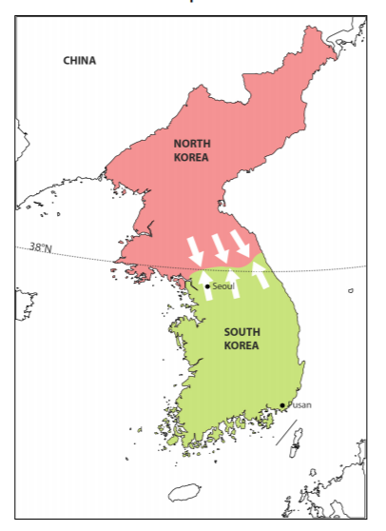
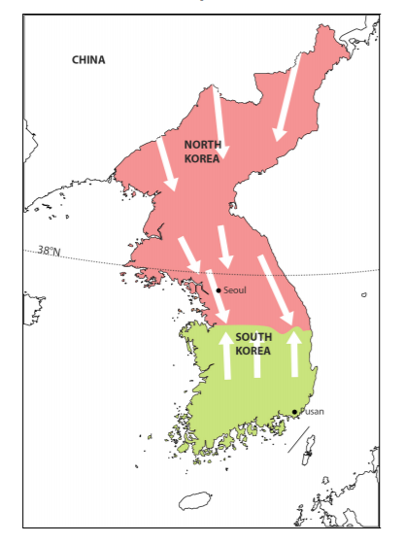
Page 6

Slide 30
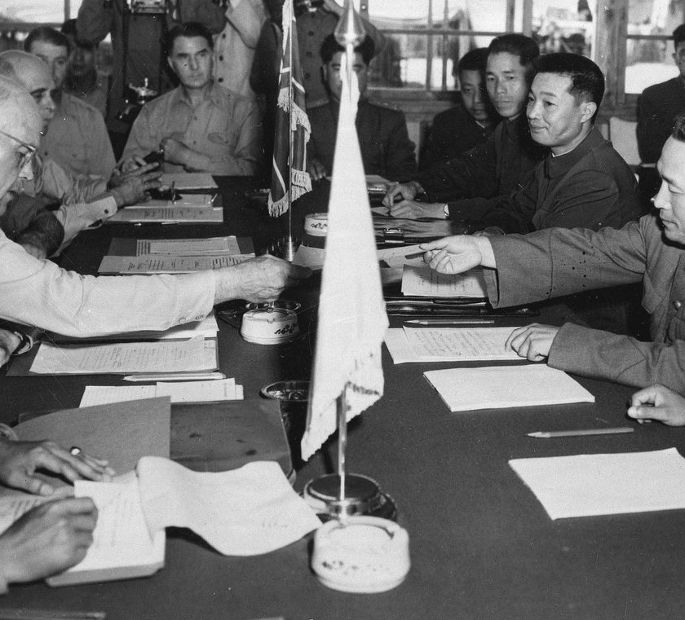
Ceasefire
The official position of the USSR was neutral though they did contribute disguised pilots.
Stalin was unwilling to accept communist defeat, so his death (March 1953) was instrumental to ending the war.
Eisenhower became POTUS in 1953 and based part of his election on withdrawal.
27th July 1953 the UN, North Korea and China signed a ceasefire.

Slide 31
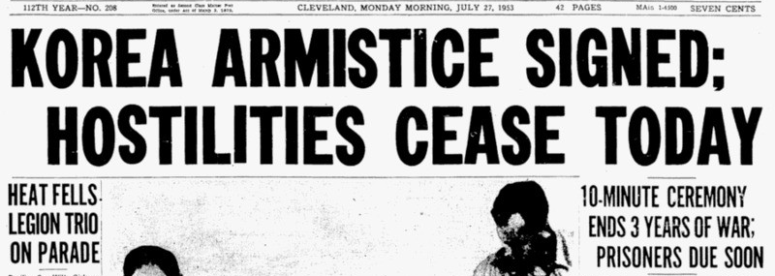
Task
Complete pages 10 and 11 of your resource booklet.

Slide 32
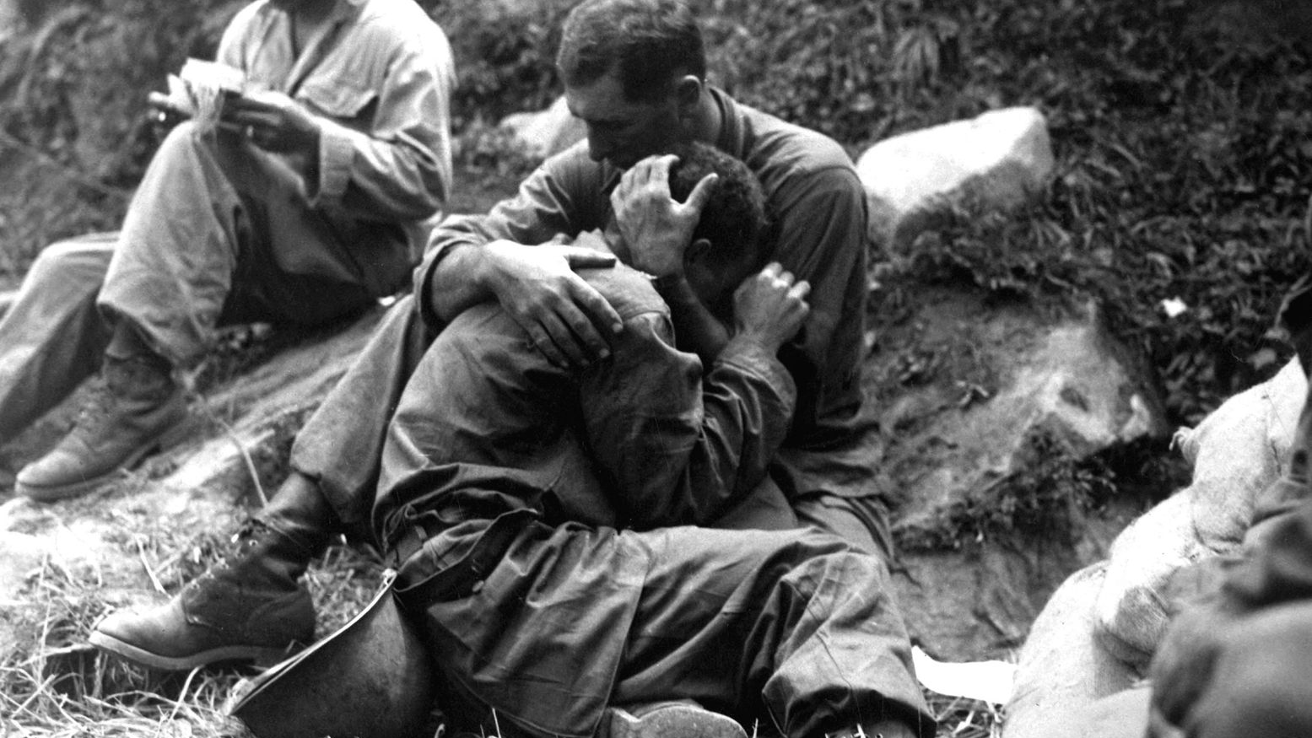
Impact

Slide 33
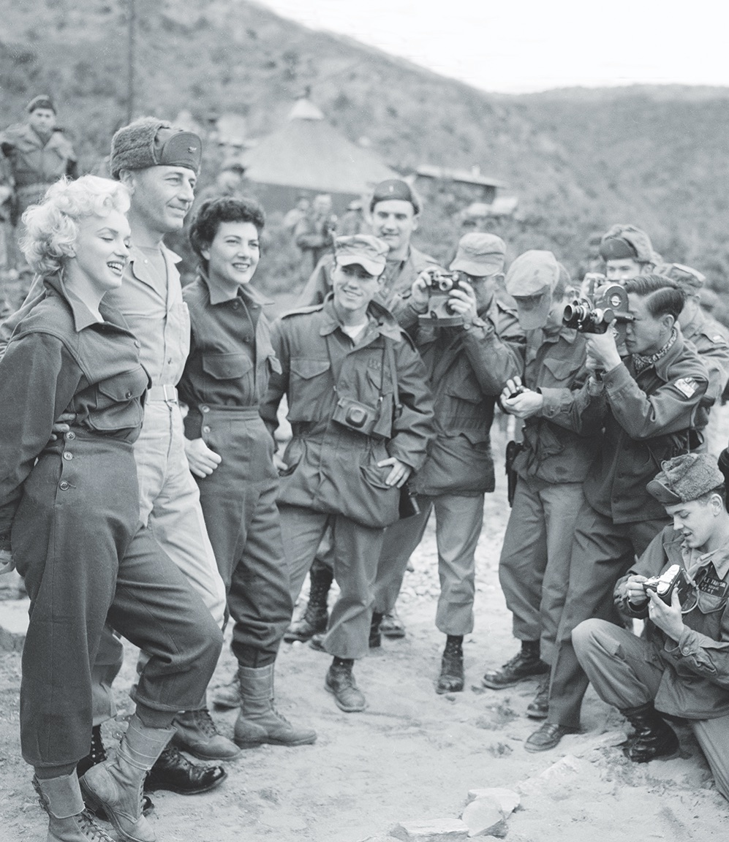
Consequences US ideology
The USSR remained officially neutral
The USA stood by its policy of containment – Eisenhower kept troops in South Korea and expanded Acheson’s defence perimeter.
Rearmament in West Germany began.
The USA intensified espionage and developed the CIA to conduct covert operations.

Slide 34
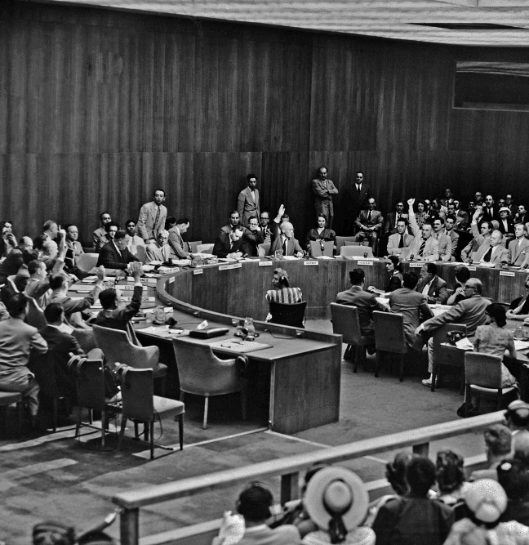
United Nations
A majority of UN member states had agreed to support police action.
Once the Soviets rejoined the Security Council they used their veto to block further action in Korea.
It demonstrated weakness in the UN system.

Slide 35
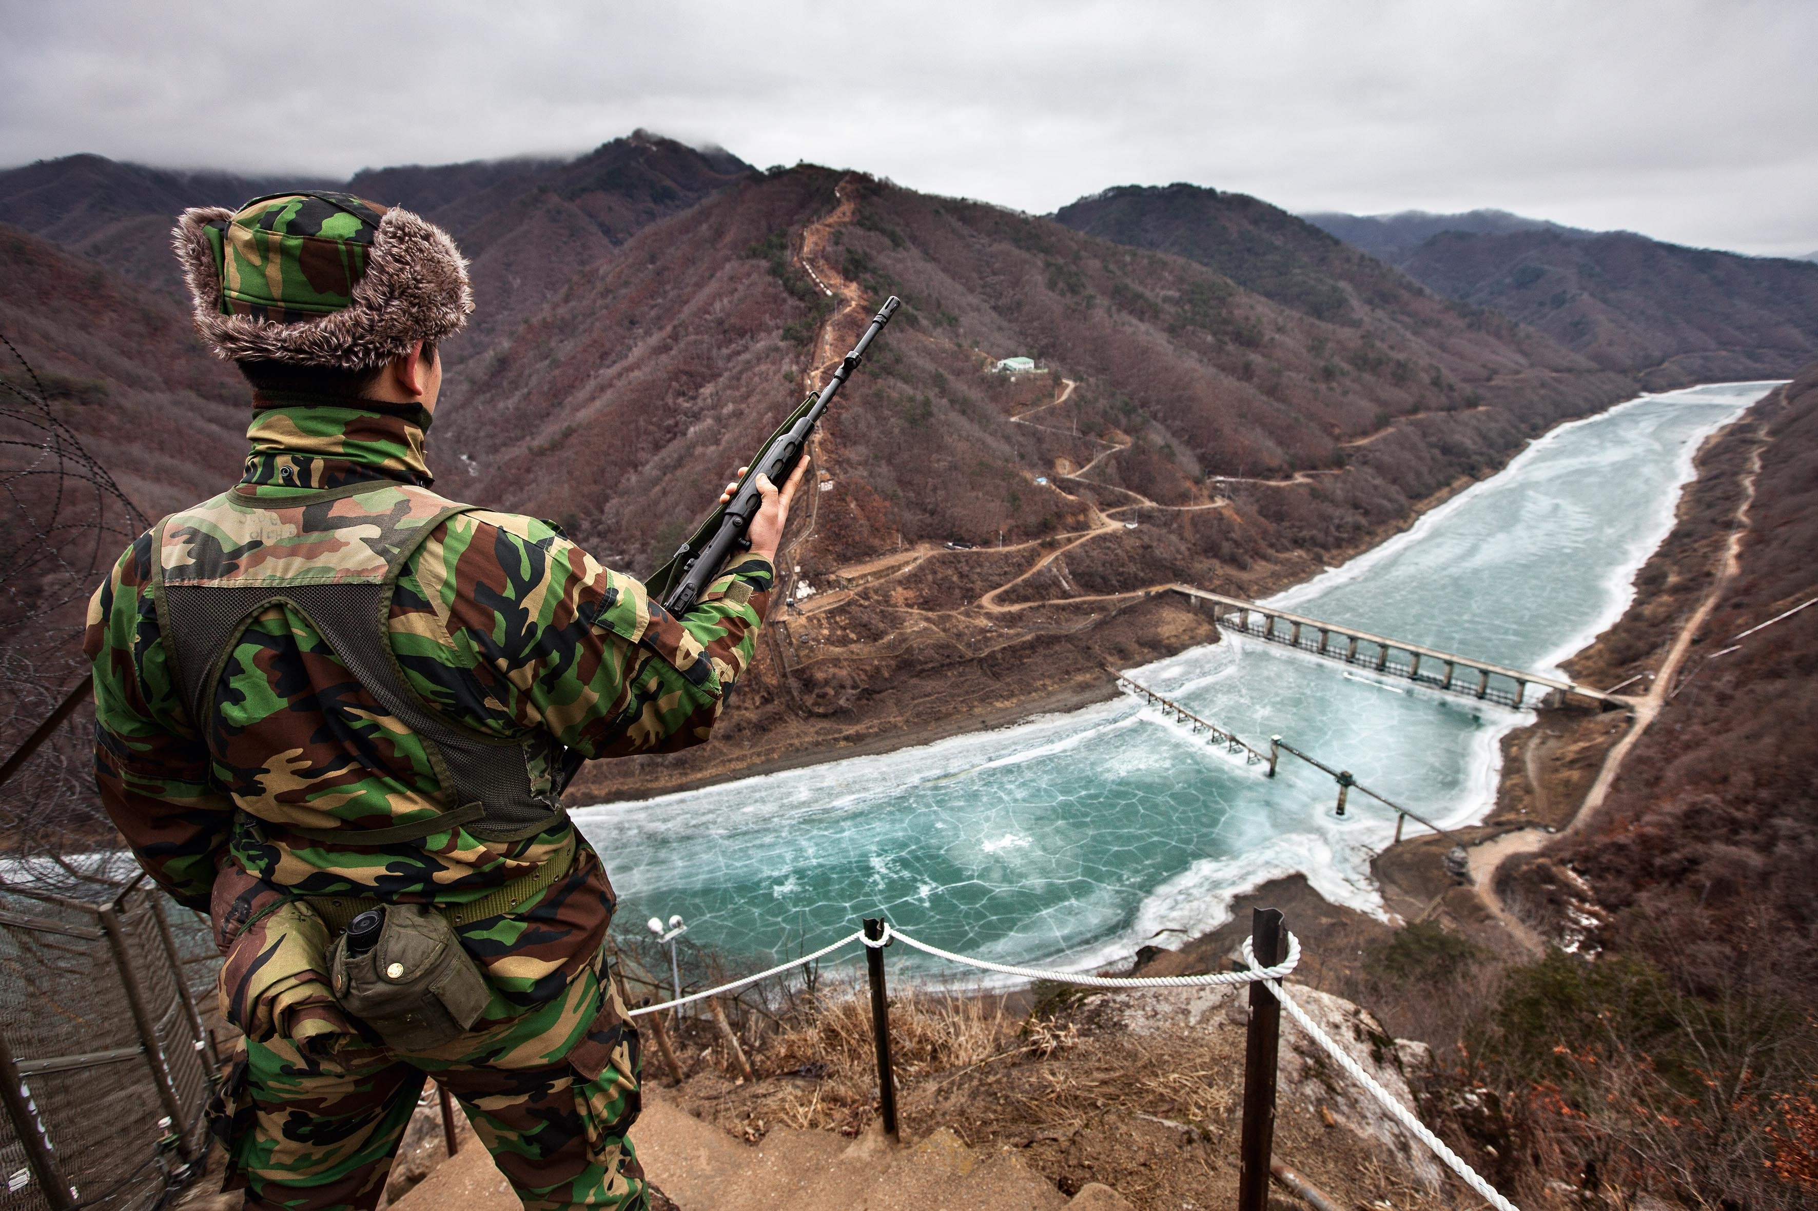
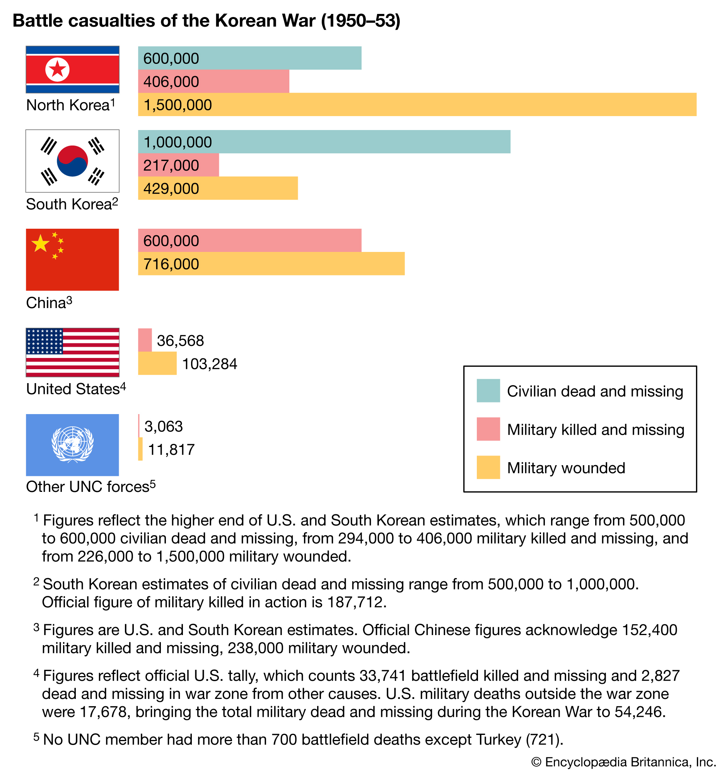

Slide 36
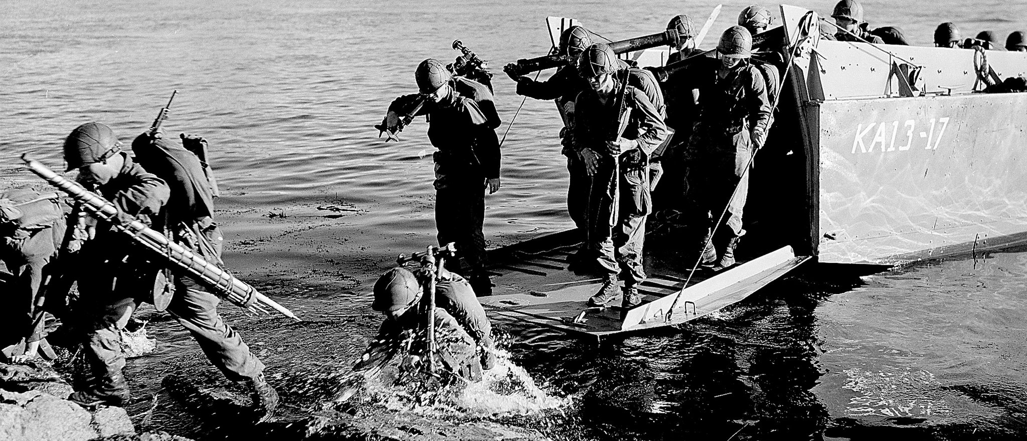
Task
Complete pages 12 to 14 of your resource booklet.

Slide 37
From a speech delivered by president Truman to the US Congress, on 27 June 1950, in which he announced his plans to address the crisis in Korea.
The attack upon Korea makes it plain beyond all doubt that communism has now passed beyond the use of subversion to conquer independent nations, and will now use armed invasion and war. It has defied the orders of the Security Council of the United Nations issued to preserve international peace and security. A return to the rule of force in international affairs would have far-reaching effects. The United States will continue to uphold the rule of law.

Slide 38
From an official statement by Mao, issued on 28 June, 1950, in which he define China’s position regarding North Korea’s invasion of the South.
The US invasion of Asia can only touch off the broad and resolute opposition of the Asian people. On 5 January, Truman said in an announcement that the United States would not intervene in Taiwan. Now this conduct proves what he said was false. The United States thus reveals its imperialist nature in its true colours. The United States is unable to justify in any way its intervention in the internal affairs of Korea.

