Slide 1
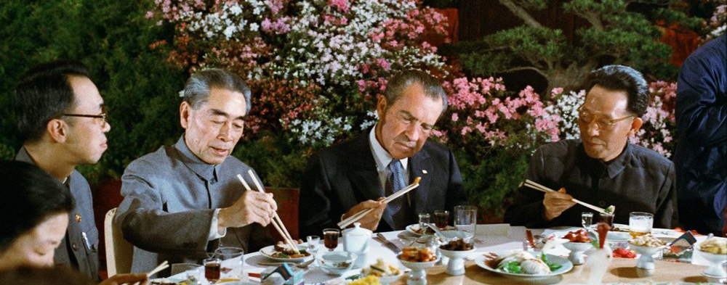
Why were the USA and PRC interested in normalizing relations?

Slide 2
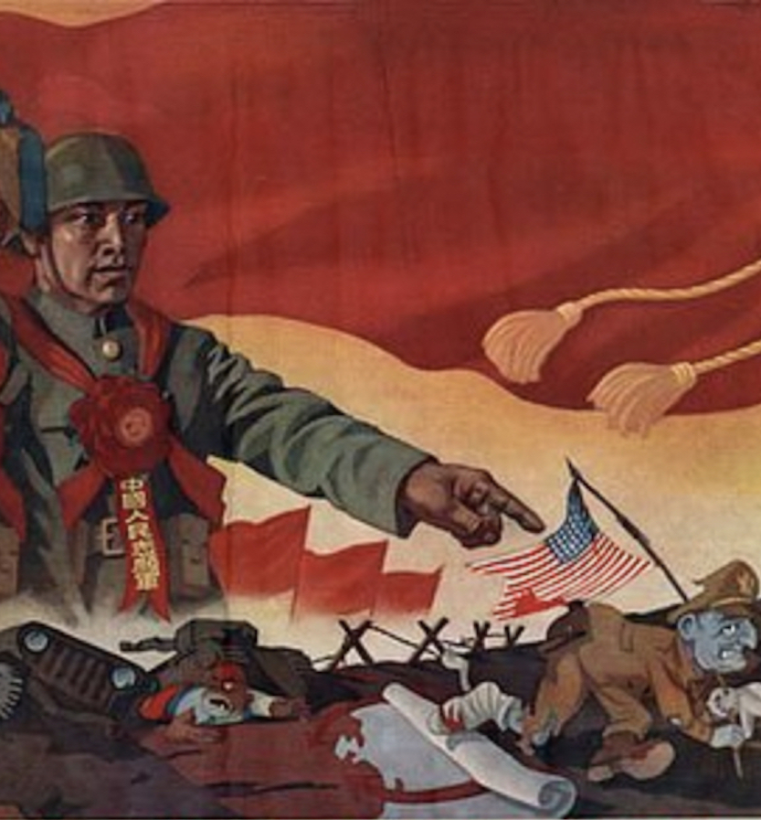
What was the situation in the 1950s?
The US were determined in their support for the ROC but Mao was equally hostile in return.
In 1953 Mao hoped to open relations but the Korean War had pushed the US away.
In the 1960s Mao proclaimed the USA to be China’s number one enemy.
The Sino-Soviet split left China isolated.

Slide 3
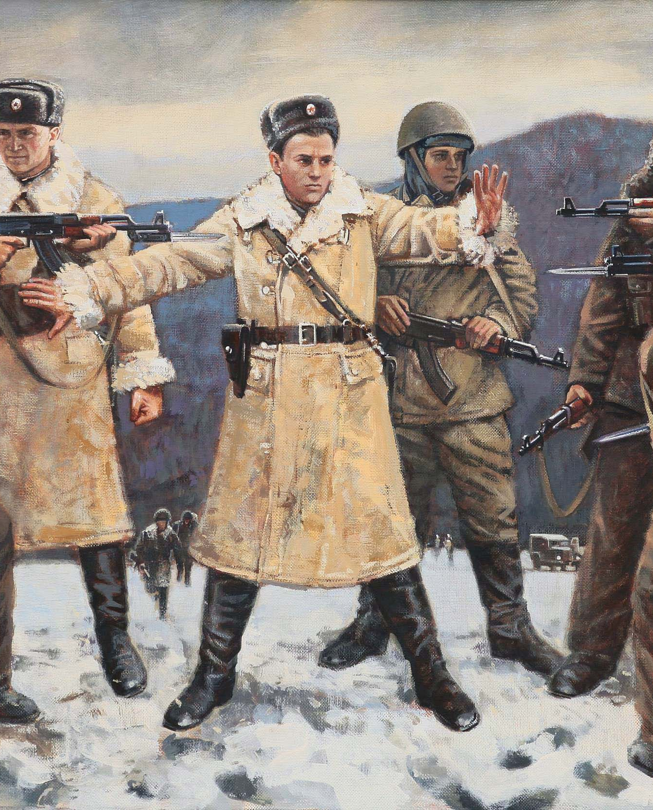
China’s isolation
The USA and PRC communicated through ambassadors in Poland.
However, with the Vietnam War ongoing and over 4000 incidents of exchanged fire between Chinese and Soviet troops 1964-69, rapprochement was slow.

Slide 4
Possibility of talks
The opening signal came in 1966; Americans invited Chinese scientists to visit the USA.
In 1969, the Chinese became more receptive to the possibility of better relations.
A combination of clashes with the USSR, and Chinese engineers and scientists needing access to western technology, led to the Chinese opening to the idea of talks.

Slide 5
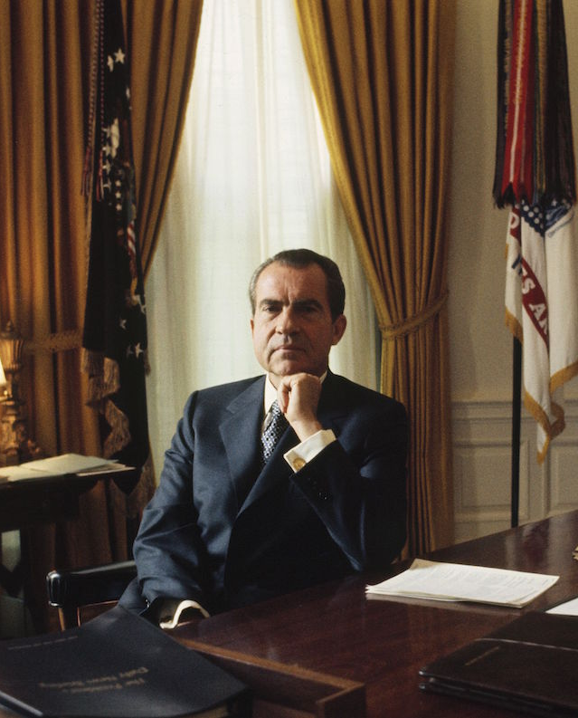
Secret talks
Nixon took office in January 1969 and signalled a desire to change the US position (allowing Americans to travel to China for instance).
Nixon’s interests converged with Mao’s (concern of Brezhnev Doctrine, Vietnam, and a wish to restore order domestically).
Tenuous talks resumed between the US and Chinese in Poland (with a brief break in May 1970 due to the bombing of Cambodia).

Slide 6
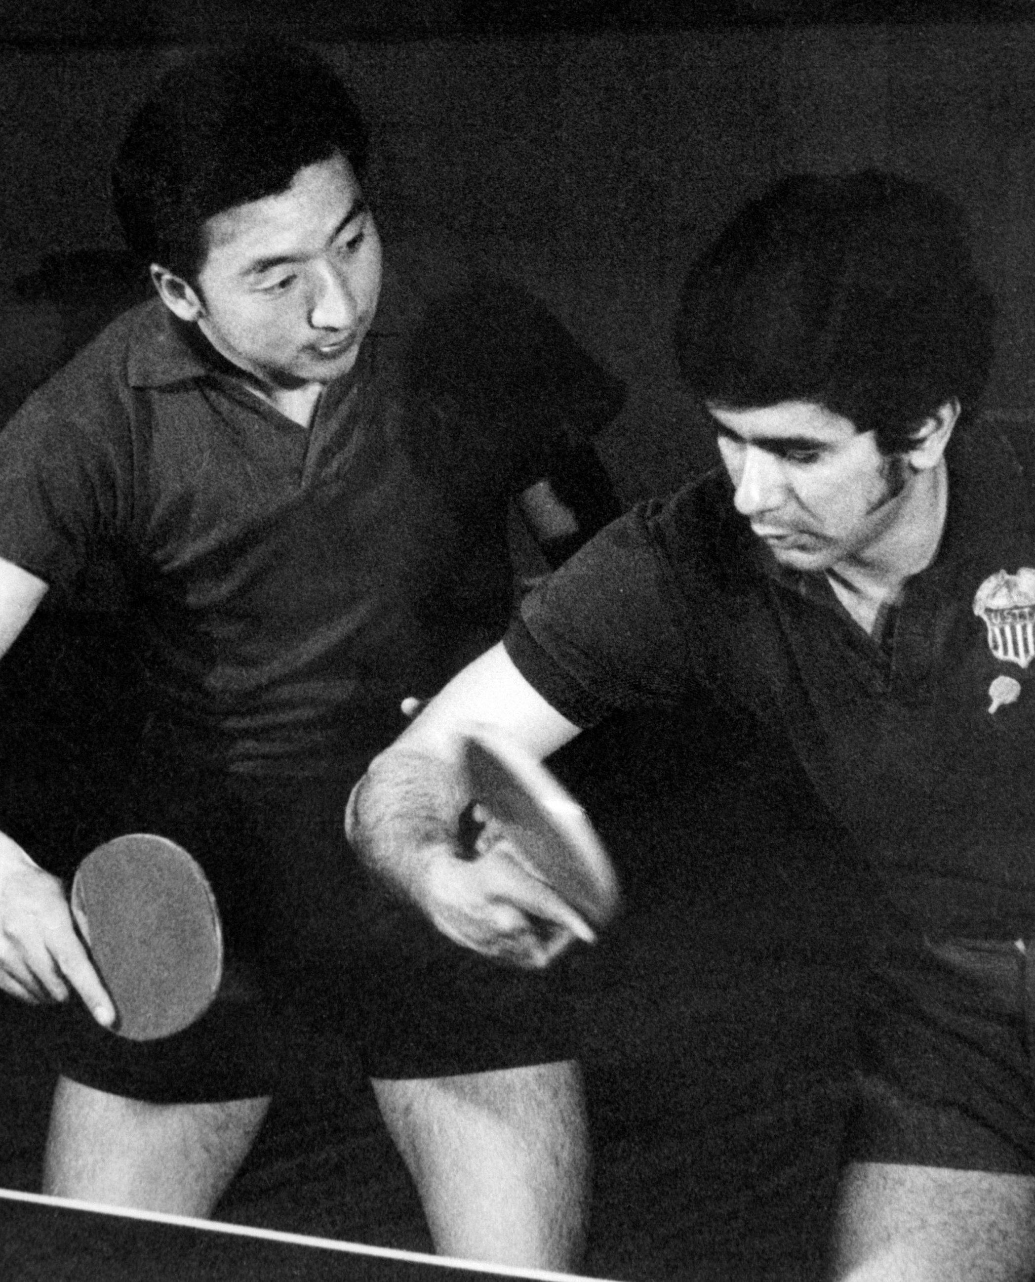
Ping-pong diplomacy
April 1971: world championship table tennis tournament (Japan).
Following a conversation between an American and Chinese player, the US team received an invitation to pay in Beijing (and granted visas).
The trip was a public relations success and Nixon needed it to counter the disaster he was facing.

Slide 7
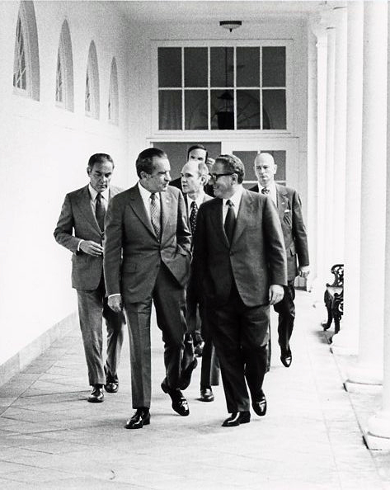
Kissinger visits Beijing
Kissinger took his secret trip to China in July 1971.
He offered a number of enticements – acceptance in the UN and full diplomatic recognition by 1975 (if Nixon were re-elected).
One of the main issues in dispute was the status of Taiwan.
Kissinger made an official known visit to China to prepare for Nixon’s October trip.

Slide 8
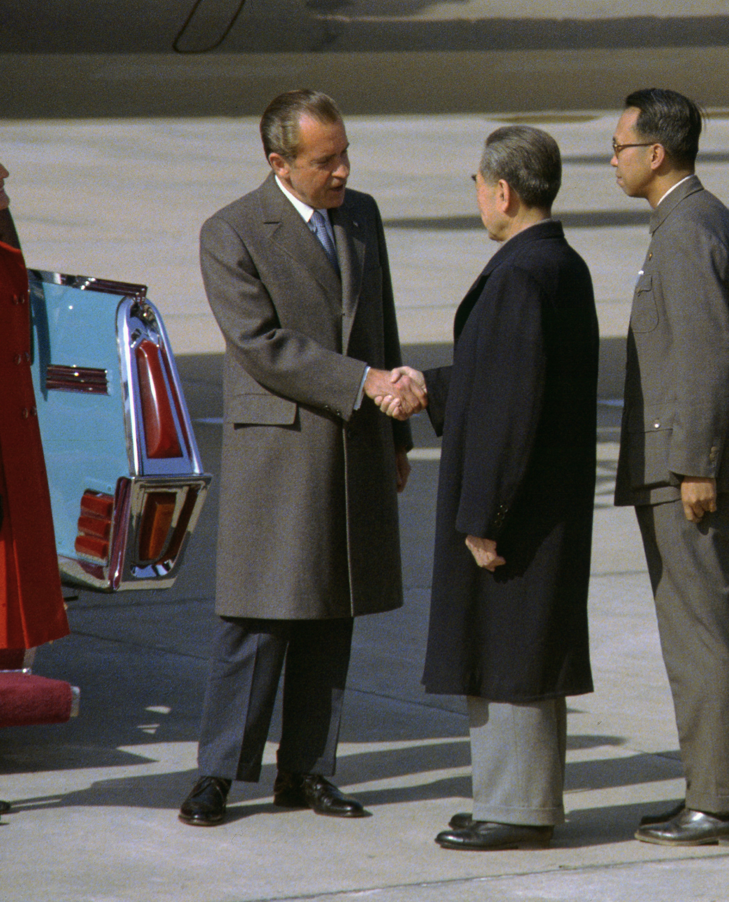
Nixon visits Beijing
In October 1971, a UN General Assembly vote resulted in the PRC taking their seat on the Security Council.
Nixon met with Mao and Zhou Enlai ending 23 years of diplomatic freeze, setting in motion a process of restoring full diplomatic relations.
There were agreements around trading and scientific contacts as well a secret agreements whereby the USA supplied China with intelligence on Soviet forces.

Slide 9
Normalization
In 1972, the USA and PRC issued a joint statement, the Shanghai Communiqué, which pledged both countries would do their best to normalise relations.
The USA stated its acceptance of a one-China policy.
China sent two pandas to the USA and the US responded with a musk oxen.
Discussions stalled owing to Nixon’s resignation and Mao’s death.
Ling-Ling and Hsing-Hsing

Slide 10
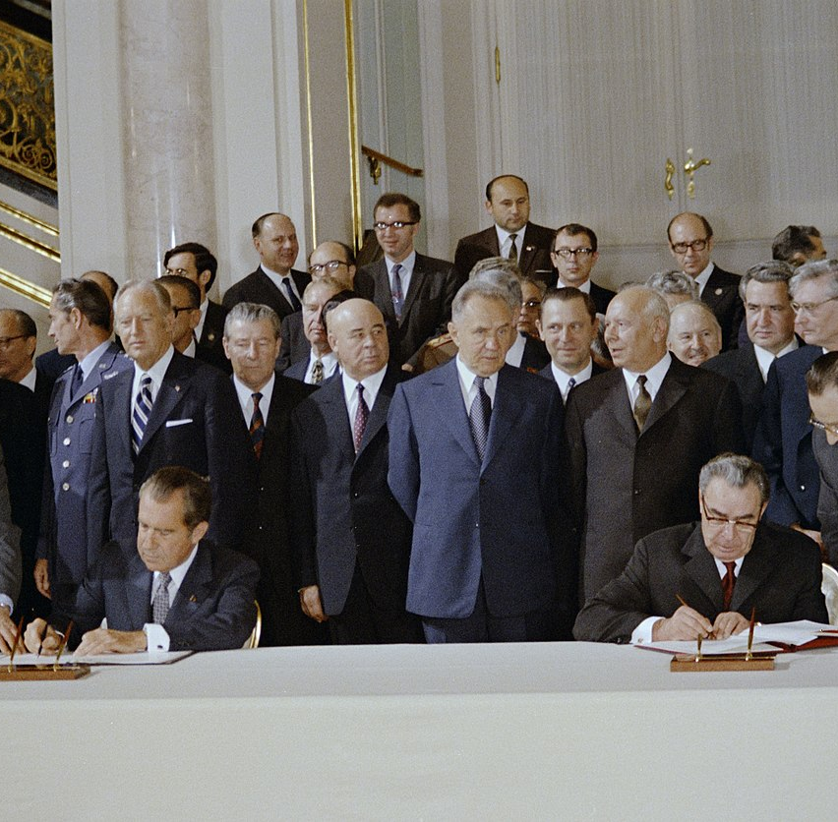
Effects of Sino-US normalization on the Cold War
Soviet specialists argued it would lead to tension with the USSR and jeopardize détente.
Brezhnev was sufficiently alarmed that SALT I was signed (as well as the CSCE).
There was no attempt to re-establish the Treaty of Friendship and Alliance when it lapsed in 1979.

Slide 11
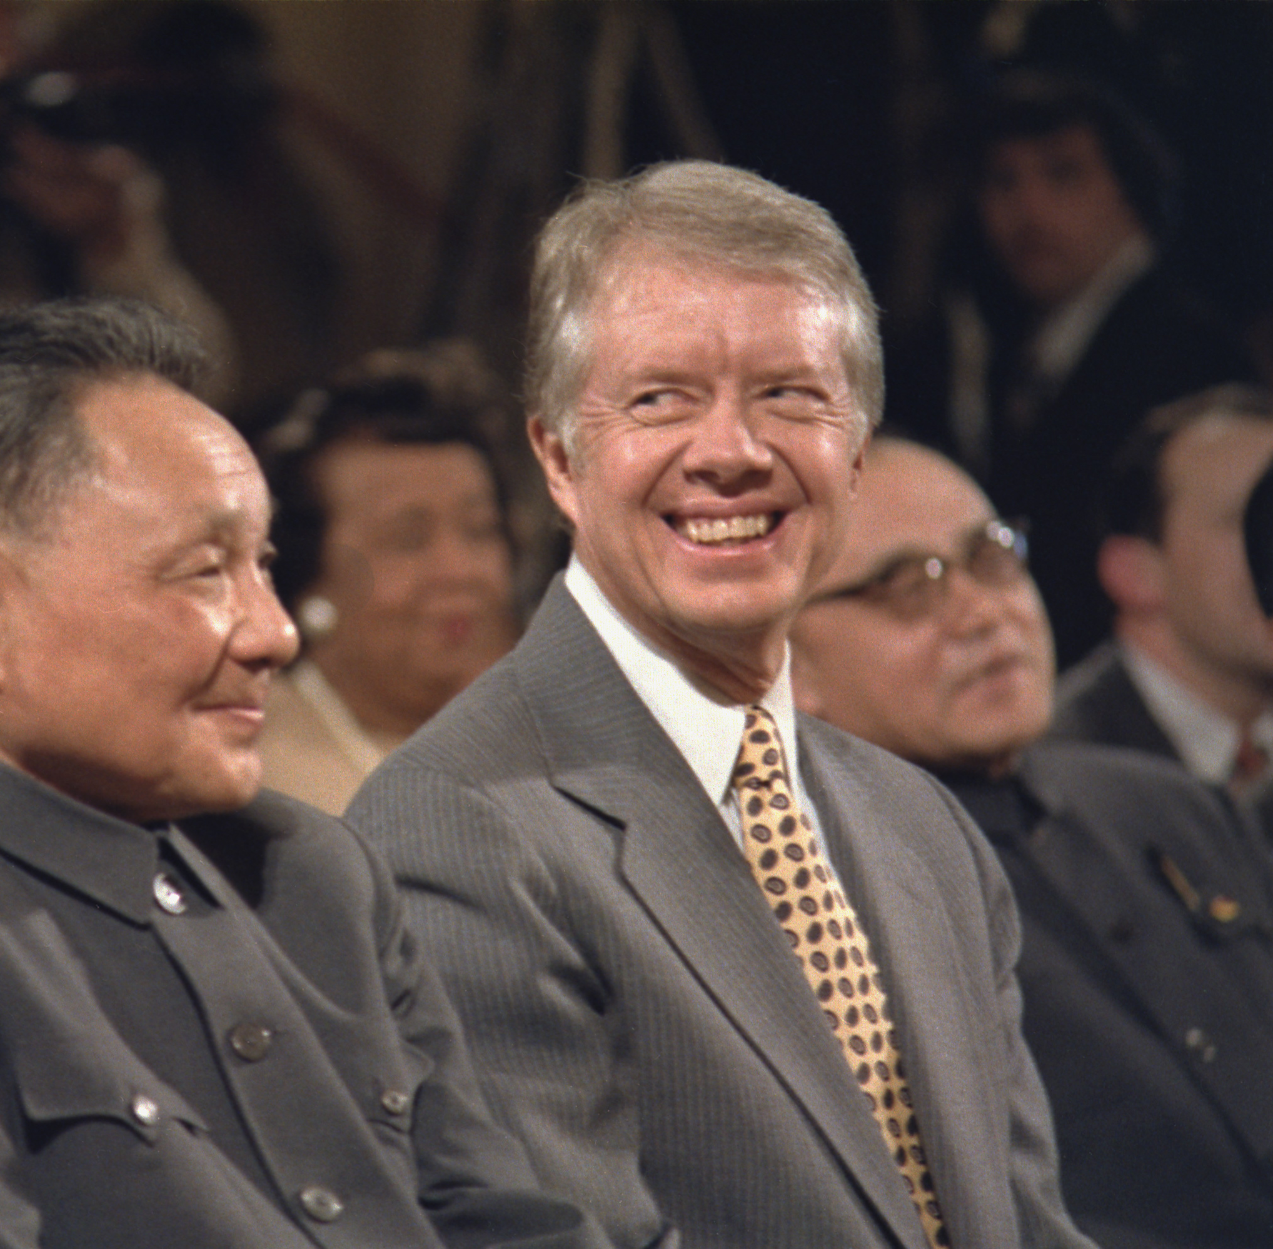
Effects of Sino-US normalization on the Cold War
For Nixon it was the public relations success he hoped for, but withdrawal from Vietnam and Watergate were impossible to overcome.
Nixon did see reproachment with China as his most significant achievement.
On 1 January 1979 the USA formally recognised the PRC as the legitimate government of China (with full diplomatic relations).
In 1979 the US also passed the Taiwan Relations Act.

Slide 12
“Many factors produced the change in U.S. policy toward China and Taiwan in the 1970s, some tactical, some strategic. The timing of the initial step was unquestionably related to the Vietnam War and the Sino-Soviet dispute. The second and third steps were facilitated by and partly a response to the Soviet expansion. But these were transitory considerations. From a longer-term perspective, America’s China policy of the 1950s and 1960s could not be sustained. It was based on American acknowledgment of an absurd claim. Taiwan was not, as it asserted, the government of mainland China. At the same time, China’s position was unrealistic. The People’s Republic was not the government of Taiwan. In fact, the two governments ruled different parts of Chinese territory, each asserting that it was the rightful authority for all of China, each denying the legitimacy of the other.”
Jonathan Spence, The Search for Modern China (New York: W. W. Norton & Company, 1990)

