Slide 1
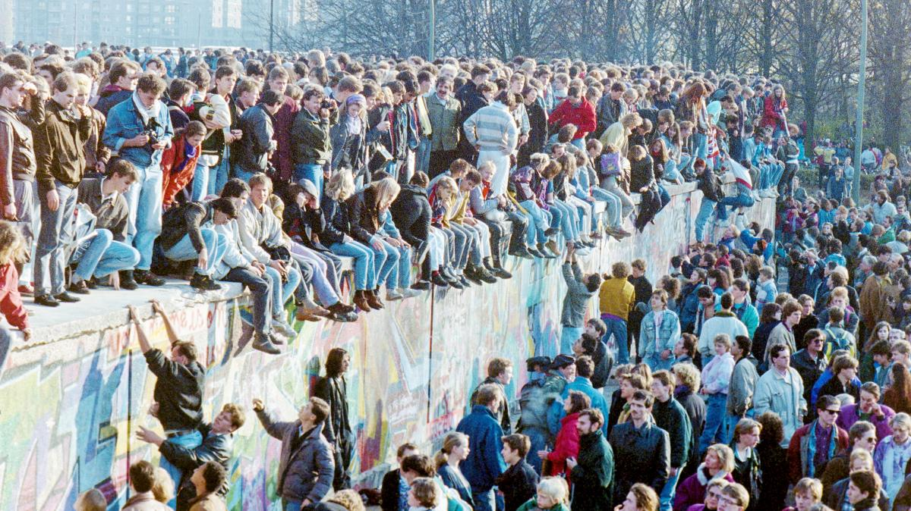
The East European Revolutions of 1989
Notes:
2,3, 5-8, 10-12, 14-17, 20, 27, 30-32, 34-40, 42-44, 46-47

Slide 2
How significant were economic problems in the USSR and its satellite states in explaining the collapse of communism in Eastern Europe in 1989?

Slide 3
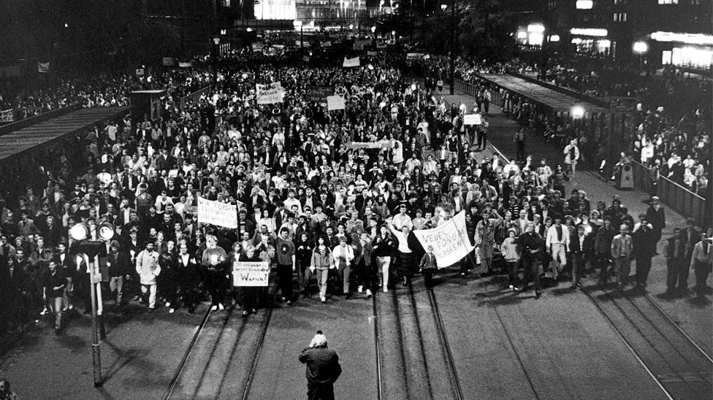
East Germany

Slide 4
The SED shunned reform and defied Perestroika.
In June 1989 Gorbachev visited Bonn (provisional capital of FRG) in June 1989, promoting trust between Gorbachev and Helmut Kohl (Chancellor of Germany FRG).
East Germans continued to seek refuge in FRG’s embassies in Warsaw, Prague and Budapest.
Oct 1989 a sealed train travelled with 8,000 East Germans from Warsaw to Helmstedt, West Germany, via East Germany

Slide 5
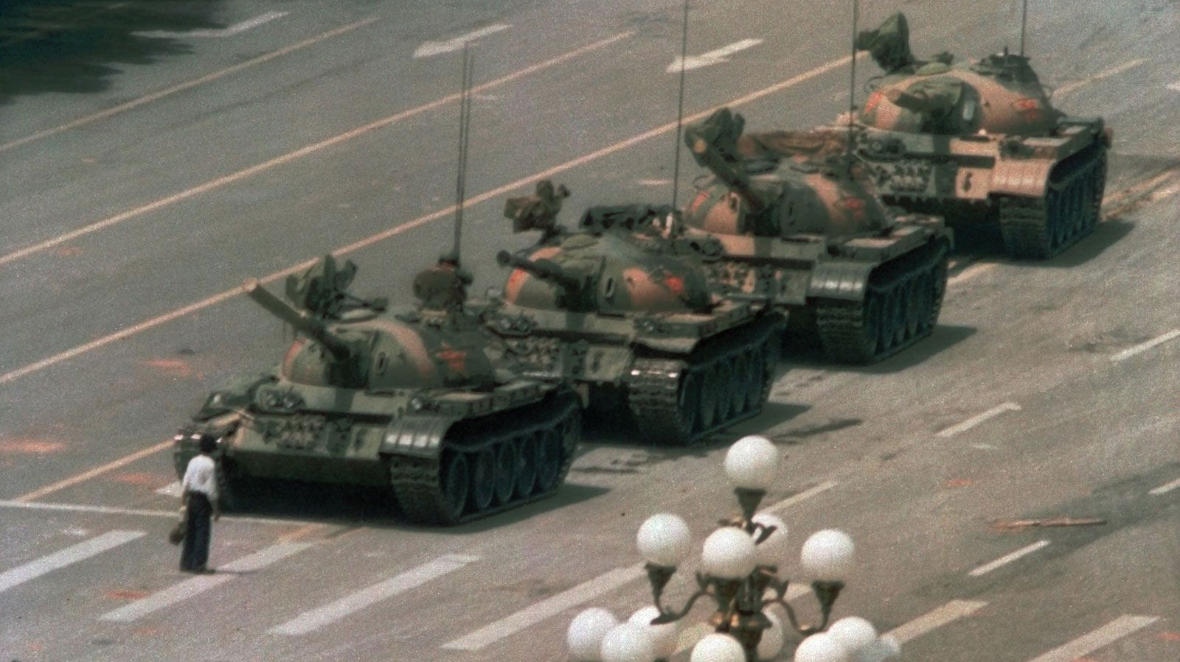
How did the events in China impact feelings in Germany?

Slide 6
Popular upheaval
The Stasi (GDR secret service) actively spied on the discontented, protesters were clubbed by the police and army.
9 October more than 100,000 people took to the streets after a service in Leipzig’s Nikolai Cathedral.
16 October, a large showdown was expected, but against expectations, the authorities did not use force and neither did the Soviet troops.

Slide 7
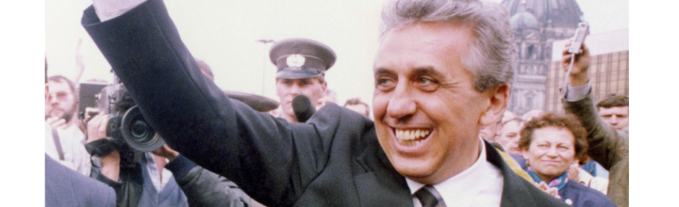
Political changes
The GDR was approaching economic collapse.
A small group, led the Egon Krenz, called to the dismissal of Honecker; on 18 October he agreed to be replaced by Krenz.
Krenz promised “Wende” (turnaround) announcing steps for reform but without a clear political plan.

Slide 8
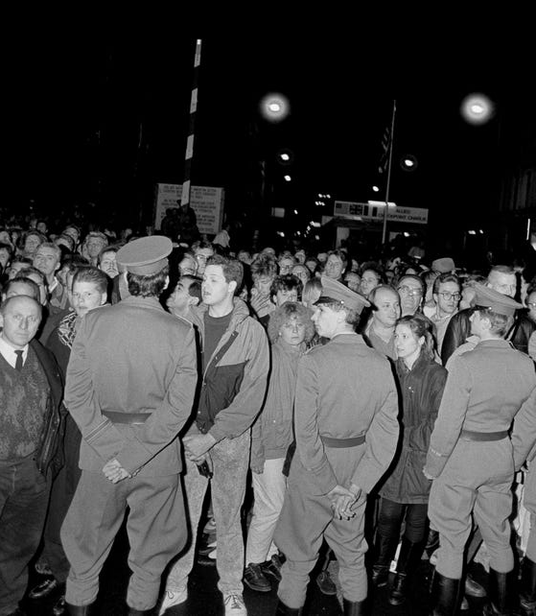
The fall of the Berlin Wall
SED spokesman Schabowski’s incomplete announcement on travel regulations approved by the Politburo on 9 November 1989 forced the wall open.
People rushed to transit points and overwhelmed bewildered guards, who ultimately stood aside to let people through.
Krenz had to reassure the Soviet ambassador that the government was in control.

Slide 9
From a transcript in which East German press officer Gunter Schabowski tried to explain the change in East German travel laws, in press conference on 9 November 1989:
Schabowski: […scratches his head] You see, comrades, I was informed today [puts on his classes as he speaks further], that such an announcement had ben [um] distressed earlier today. You should actually have it already. So, [reading very quickly from the paper] 1: ‘Applications for travel abroad by private individuals can now be made without the previously existing requirement [of demonstrating a need to travel or proving familial relationships]. The travel authorisations will be issued within a short time. Ground for denial will only be applied in particular exceptional cases. The responsible departments of passport and registration control in the People’s Police district offices in the GDR are instructed to issue visas for permanent exit without delays and without presentation of the existing requirements for permanent exit.
…
Question: When does it come into effect?
Schabowski: […looks through his papers] That comes into effect, according to my information, immediately, without delay [looking through his papers further].
Labs: [quietly]…without delay
Beil: [quietly] That has to be decided by the Council of Ministers

Slide 10
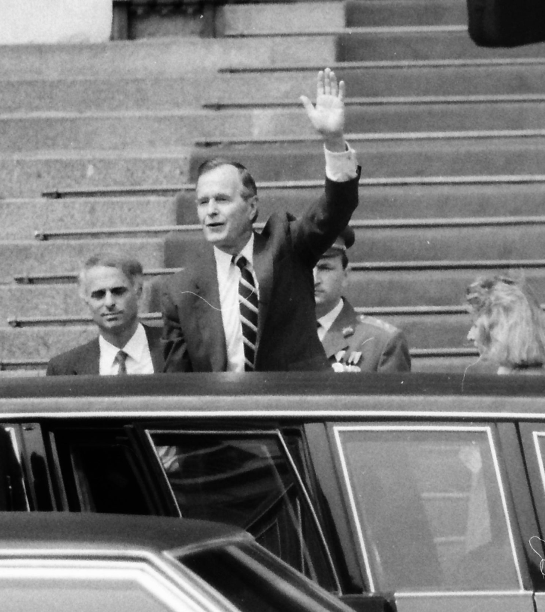
Possibility of unification?
In the weeks following, the East German regime began to crumble.
Kohl (German Chancellor – FRG) now felt confident German unification was possible.
G.H.W. Bush (POTUS) and Kohl insisted a united Germany should be a full member of NATO

Slide 11
Impacts on Hungary
26 November a referendum postponed presidential elections until after parliamentary elections.
May 1990 elections: successor to the HSWP (Hungarian Socialist Party) received 8% of the vote.
25 February 1991 (under PM Antall) the dismantling of all military structures in the WP was unanimously adopted.
The last of the Red Army left in March 1990, the WP dissolved on 1 July 1991.

Slide 12
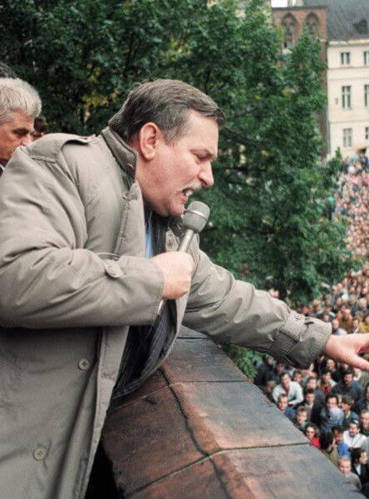
Impacts on Poland
The PUWP, which was against German neutrality, crumbled in the weeks following the 9/10 Nov 1989.
Support for German membership to NATO was confirmed in Feb 1990.
In the summer of 1990 Jaruzelski decided to renounce the presidency; Wałęsa became President of the Republic of Poland on 9 Dec 1990.
By May 1990 Poland had started pulling out of the WP; the last Russian detachment left 17 Sept 1993

Slide 13
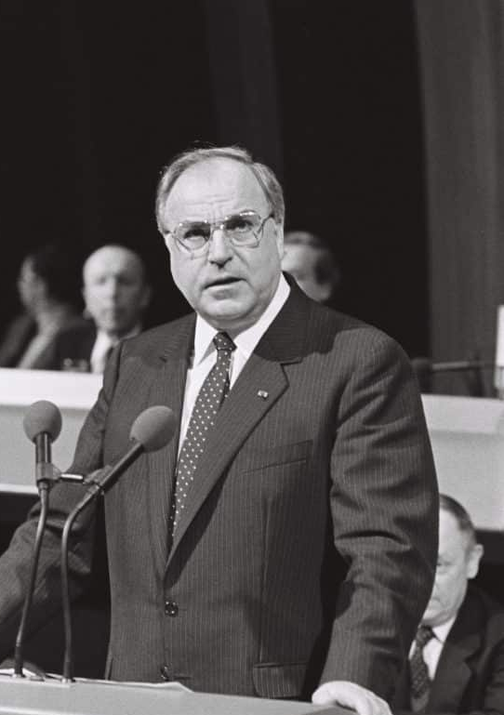
Calls for German reunification
1 Dec 1989 the GDR changed the constitution eliminating the clause giving the SED a dominant role.
3 Dec Krenz resigns, replaced by a provisional coalition government.
Kohl (FRG) announced his “Ten Points” on 28 Nov laying out a path to e an all-German federation.
The US backed this position, but there was initial concern from France, the UK (and Poland).

Slide 14
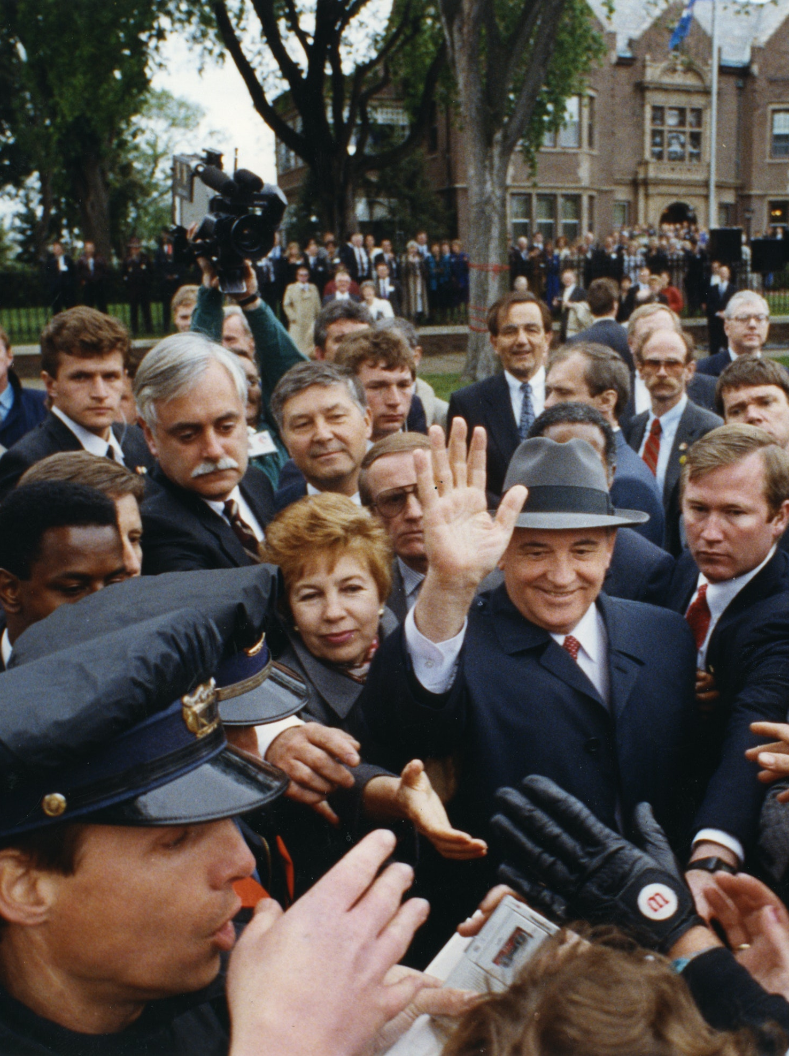
Unification process
Federal Foreign Minister Hans-Dietrich Genscher, responsible for negotiations for the FRG, proposed the “2+4” formula
This was accepted at the "Open Skies“ conference in Ottawa (Feb 1990)
The next step was taken during Gorbachev’s visit to Washington and Camp David (May-June 1990)
The London Declaration (1990) was another milestone where NATO offered dialogue and cooperation with members of the WP.

Slide 15
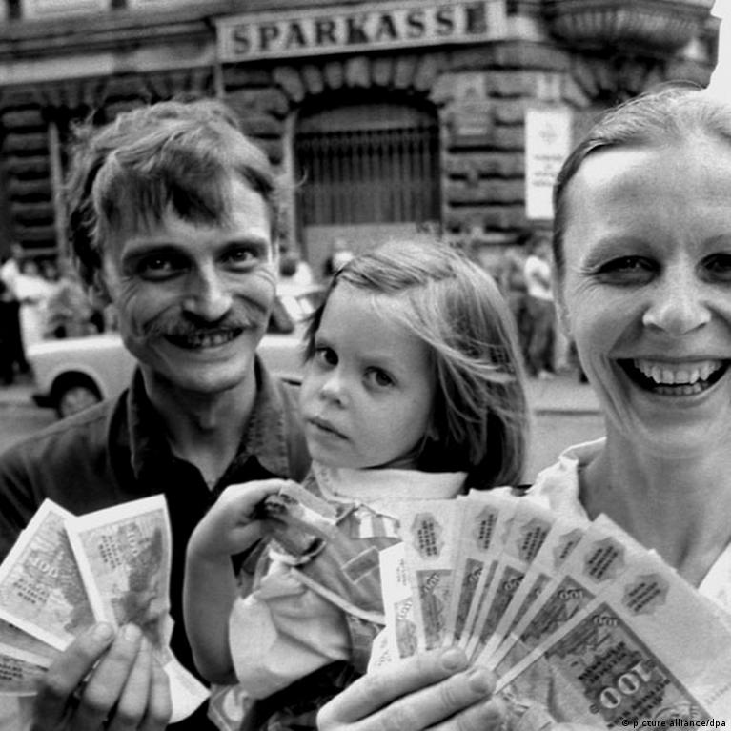
Unification process
The continued movement of people to West Germany (approx. 2,000 per day) brought the GDR economy to the brink.
Bonn ruled out substantial aid, but Kohl suggested a monetary union.
A treaty resulted (took effect 1 July 1990) which made political unification all the more likely.
West German federal law would extend to all of Germany.

Slide 16
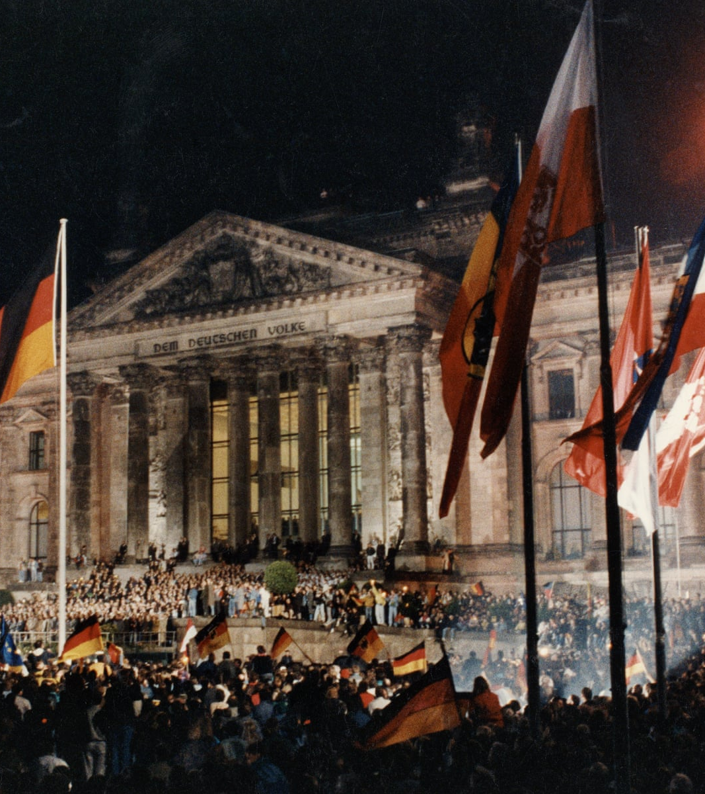
Reunification
In July, residual issues were overcome and satisfactory wording of a final confirmation of German borders was reached.
A formal “peace settlement” ended the division and was signed by the six governments on 12 September (1990) in Moscow.
A new European structure in which German unification was embedded, was created.

Slide 17
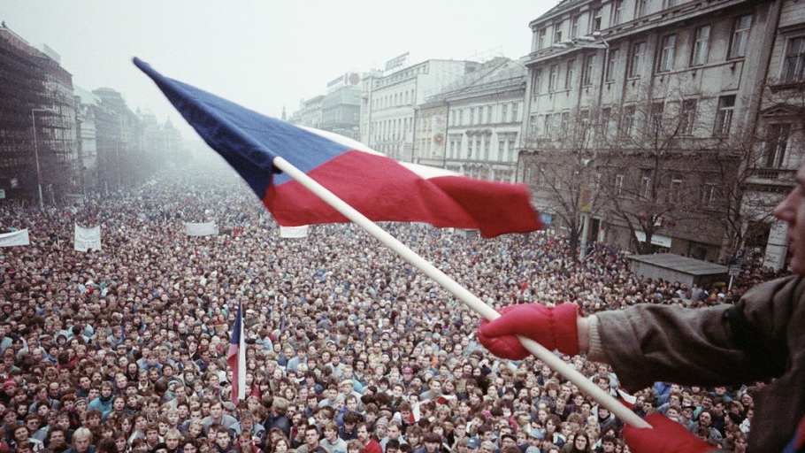
Czechoslovakia (The Velvet Revolution)

Slide 18
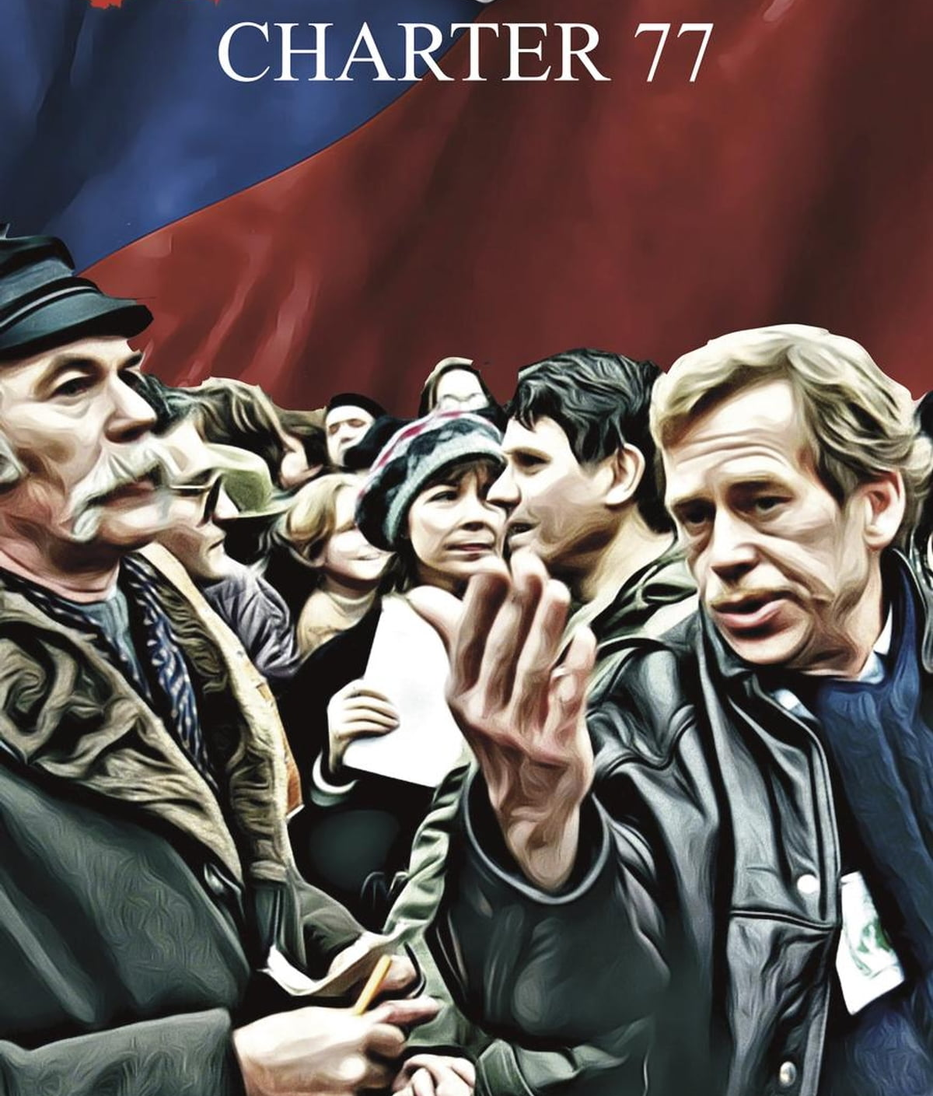
Czechoslovakia at the start of 1989
The Czechoslovak Communist Party (CzCP) was controlled by those who called for suppression of the Prague Spring (1968).
In Jan 1989, there didn’t exist a reformist wing within the party.
Active opposition was limited to smaller groups (e.g. Charter 77 and its prominent member Havel).
Slightly higher standards of living resulted in (comparatively) wider acceptance of the regime.

Slide 19
Opposition gathers
Gorbachev said change would need to come from within the CzCP.
Milouš Jakeš (CzCP First Secretary) pointed to the Prague Spring as turning towards “counterrevolution” whilst considering reforms.
PM and would-be-reformer Ladislav Adamec was a timid proponent of reforms.
Opposition grew; on 21 August nearly 10,000 people took place in demonstrations.

Slide 20
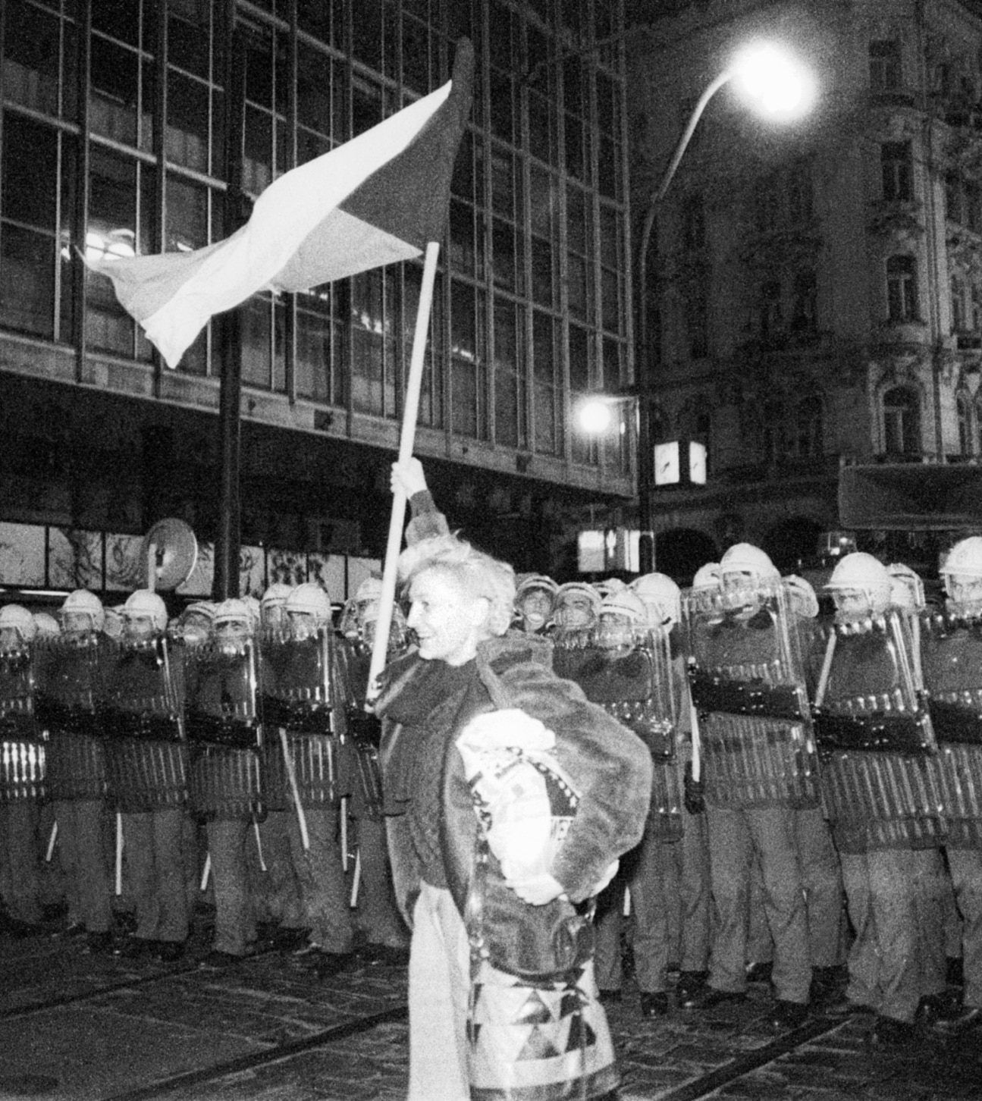
Opposition increases
Following 9/10 Nov, an official student demonstration morphed into an anti-government demonstration with sections of the crowd assaulted by the police.
19 November twelve opposition groups formed a Civil Forum.
Daily demonstrations in Prague grew to massive proportions.
21 November Havel addresses a crowd at Wenceslas Square.

Slide 21
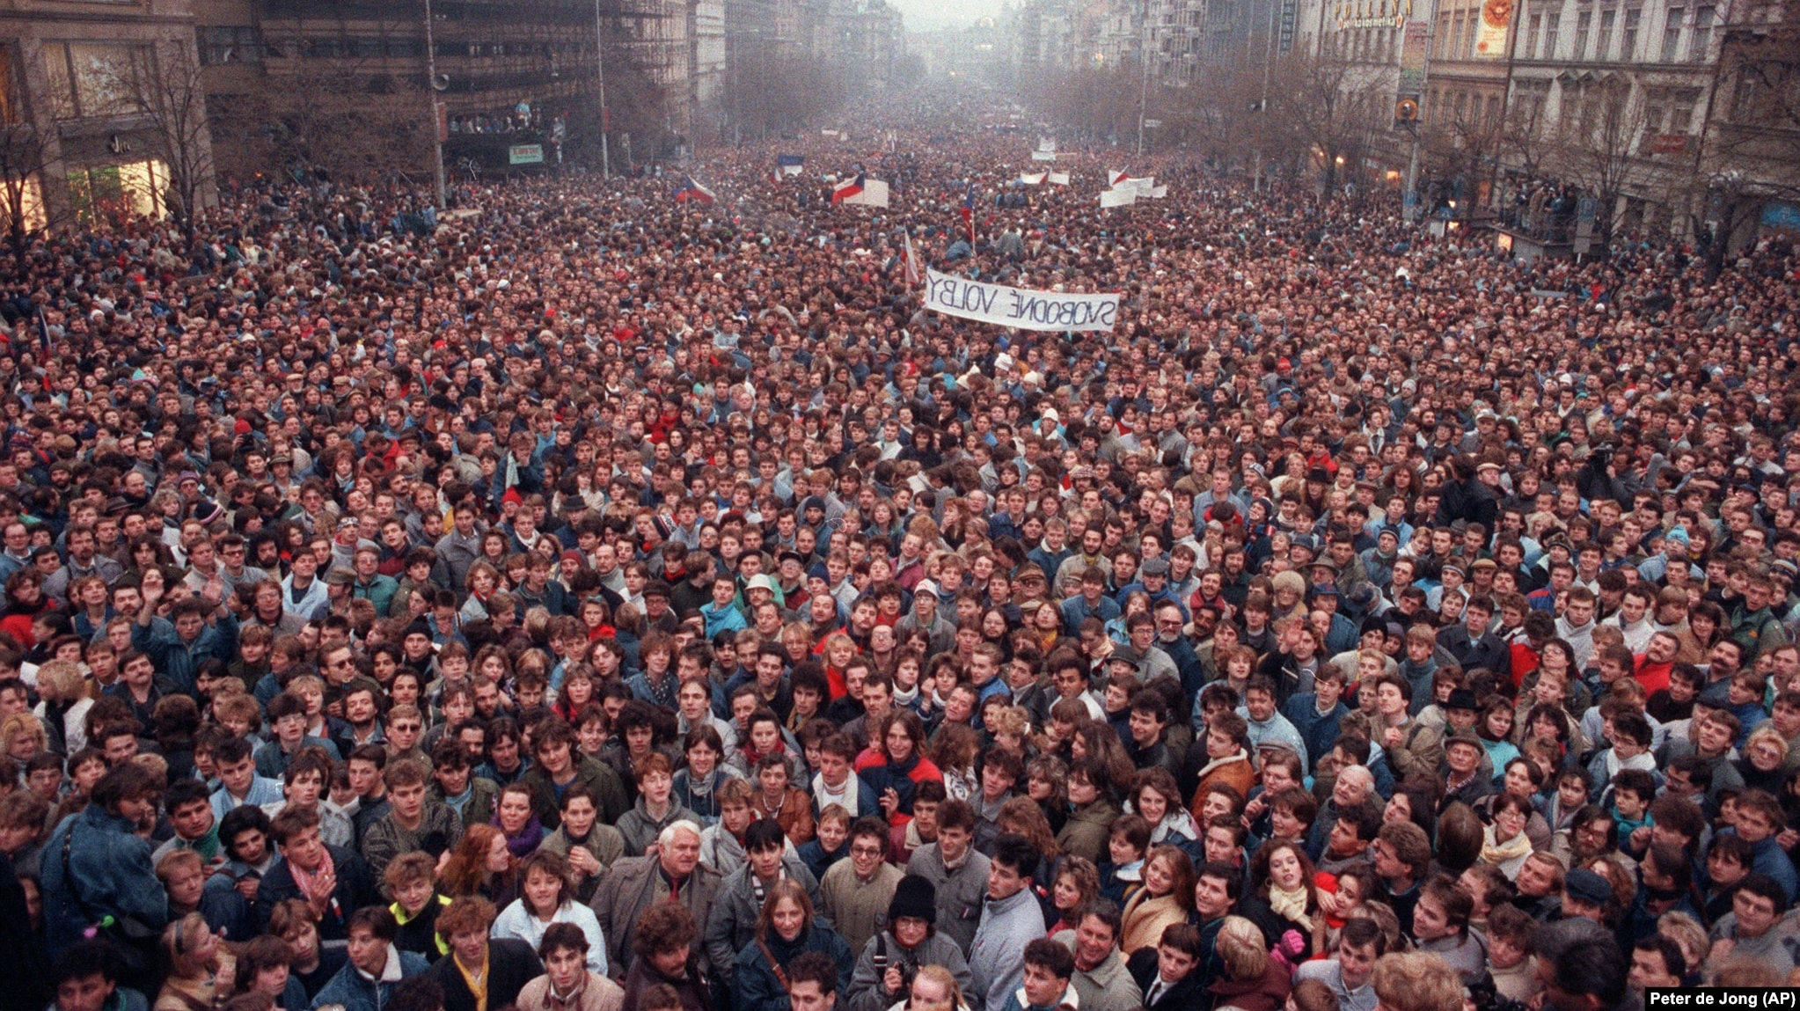

Slide 22
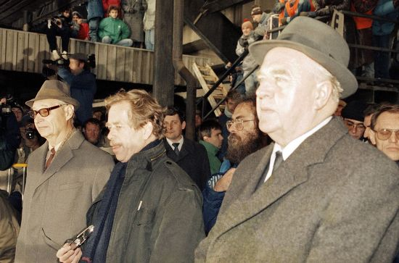
Too little too late?
21 Nov PM Adamec announced he would open the government to non-communists.
3 Dec he proposed non-communists would receive 5/21 seats in the Cabinet (which was rejected)
Adamec left from Moscow and sought Gorbachev’s support, but the Soviet leader declined to get involved.

Slide 23
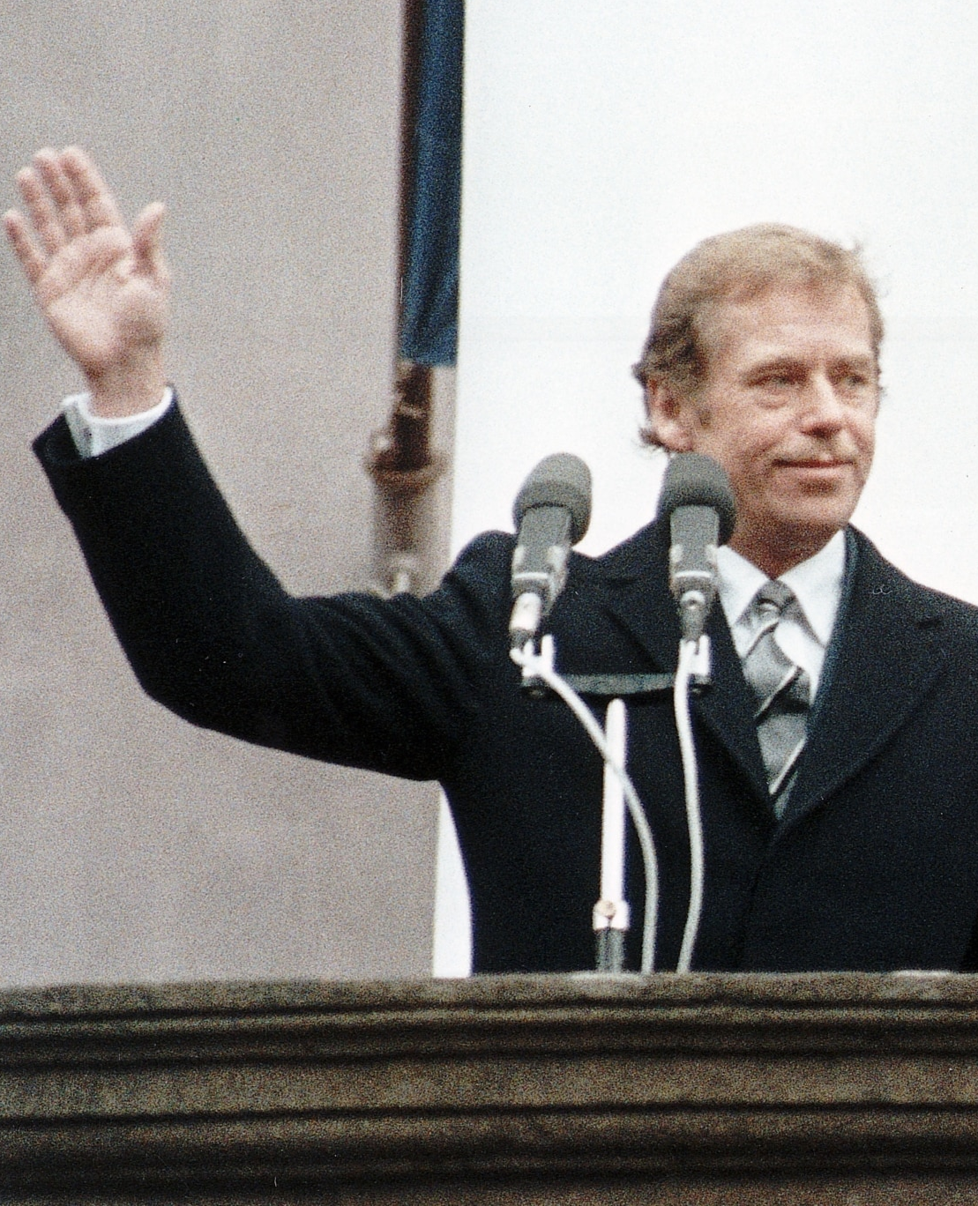
New governance
Adamec resumed negotiations upon return, but ultimately resigned on 7 Dec.
His short-term successor, Marián Čalfa, formed a more inclusive government.
29 Dec Havel was elected President. They gained the withdrawal of Soviet troops (June 1991).
There was consideration of a new pan-European security system, but ultimately they withdrew from the WP following Hungary and Poland.

Slide 24
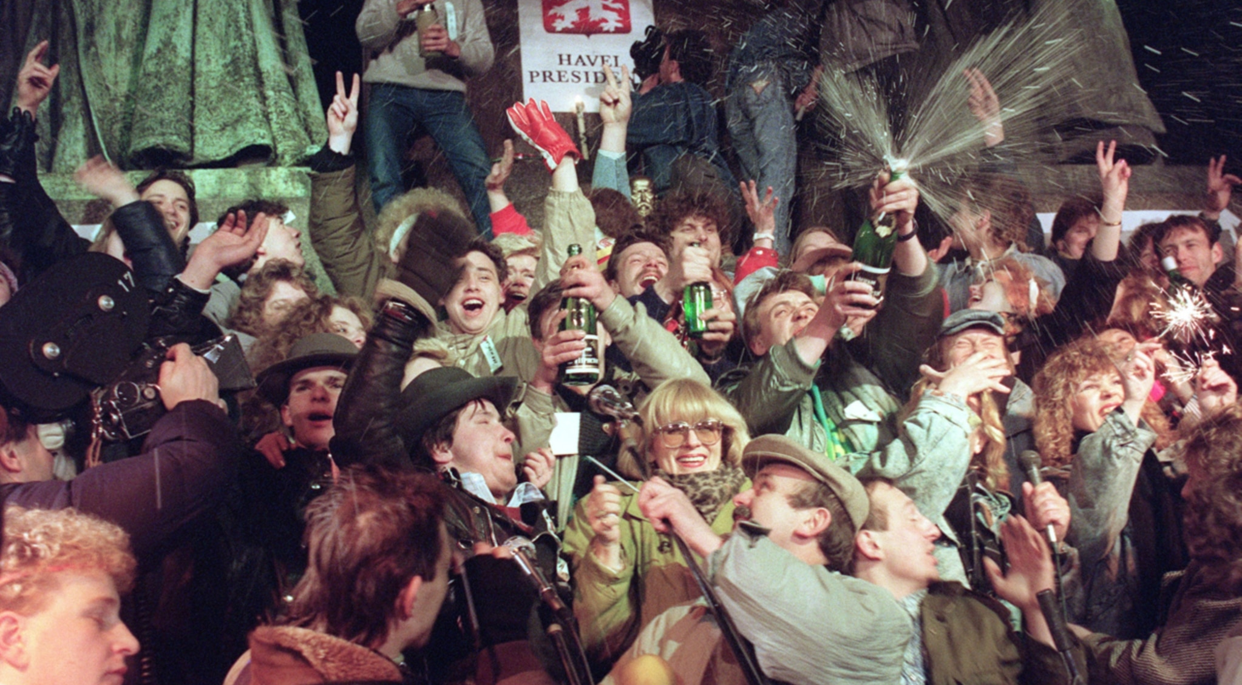

Slide 25
How significant were economic problems in the USSR and its satellite states in explaining the collapse of communism in Eastern Europe in 1989?

